Slide 1
ECEN 460
Power System Operation and Control
Spring 2025
Lecture 15: Power Flow Sensitivities, Transmission Issues
Prof. Tom Overbye
Dept. of Electrical and Computer Engineering
Texas A&M University
overbye@tamu.edu

Slide 2
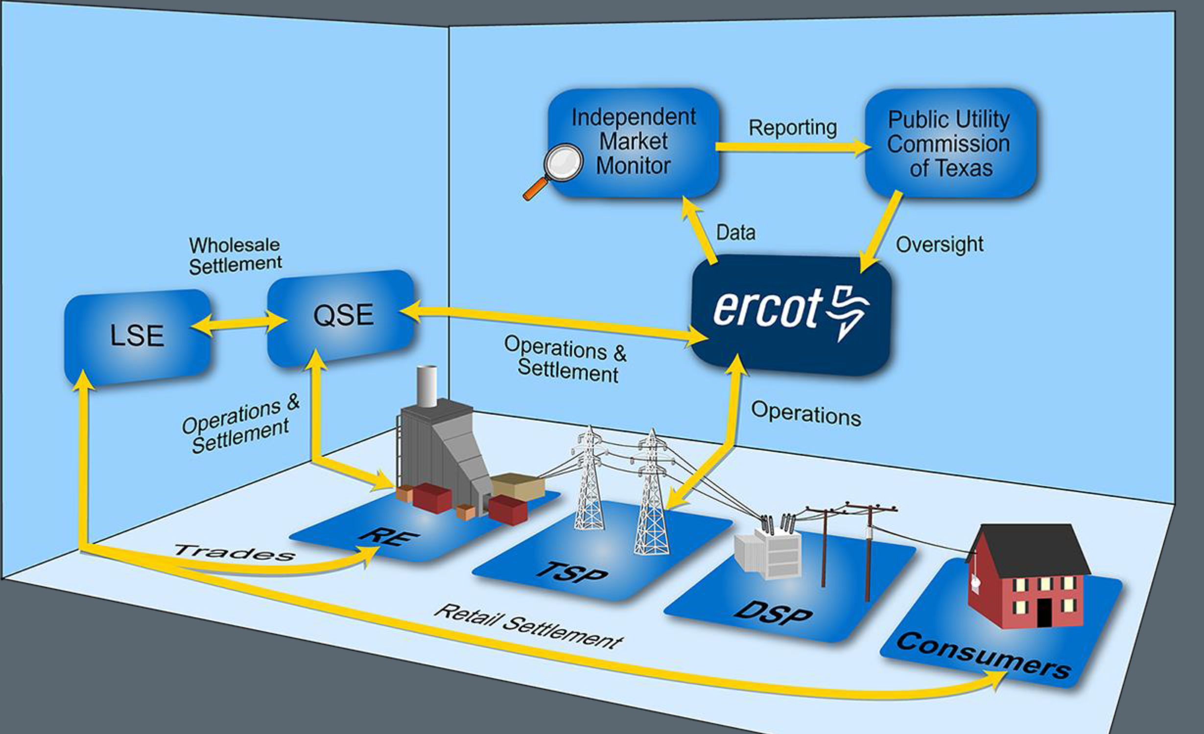
The ERCOT Wholesale Markets
The overall structure of the ERCOT market is given below
  There is a day-ahead time market,
  an adjustment period,
  hour ahead, and then the
  operating hour
  LSE is a Load Serving Entity
  (e.g., a utility; there are > 400 in
  ERCOT)
  RE is a Resource Entity (> 950)
  QSE is a Qualified Scheduling
  Entity (there are > 1200)
  TSP is Transmission Service Provider, DSP is Distribution Service Provider
Material partially from www.ercot.com/files/docs/2023/07/07/2023_07-wholesale-101.pdf
1

Slide 3
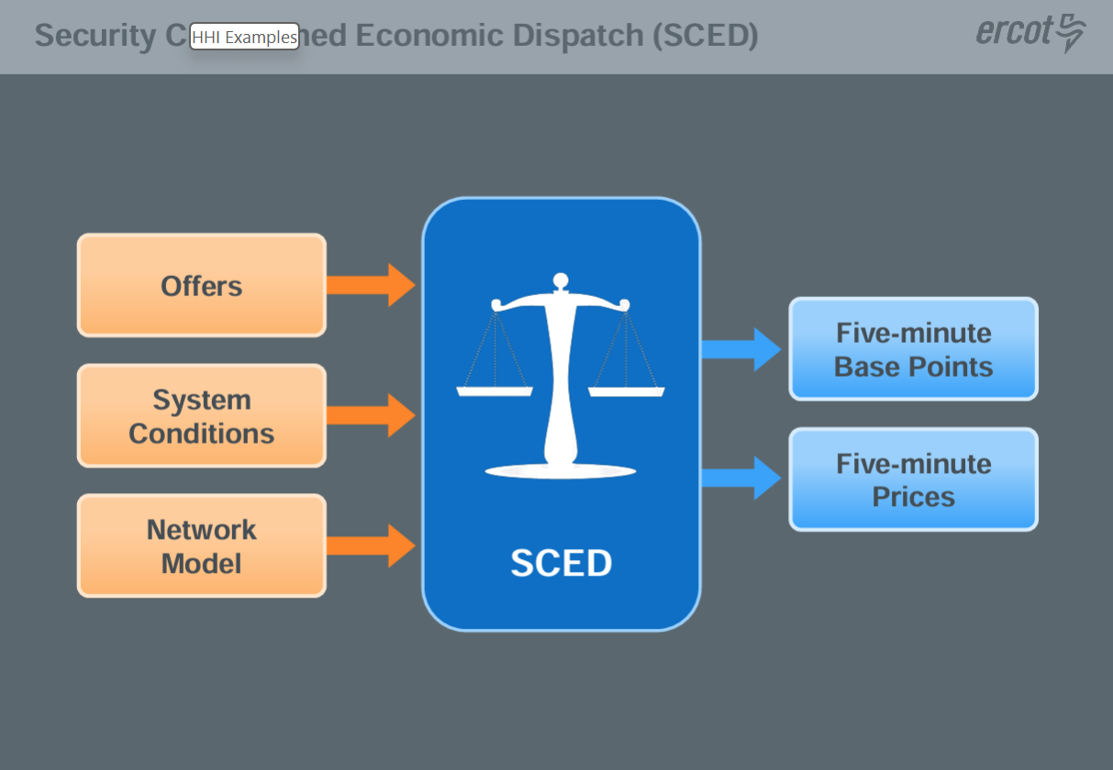
ERCOT Real-Time Dispatch and Pricing
The goal of real-time dispatch is to manage reliability, matching the generation with the load,
ensuring the transmission
flows and voltages stay
within limits, and operate
the system at least cost
Material partially from www.ercot.com/files/docs/2023/07/07/2023_07-wholesale-101.pdf
2

Slide 4
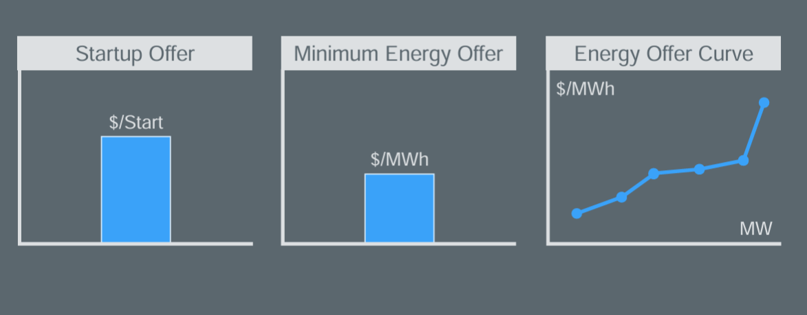
ERCOT Forward Markets
Since the electric load for tomorrow can be well estimated, the goal is to determine next day dispatch as accurately as possible
  Hedging is transacting at a known price now to protect from having to transact at an unknown price later
Forward energy markets in ERCOT include a centralized day-ahead market (DAM) conducted by ERCOT and bilateral trades
An offer to sell energy in
the DAM includes three
parts
Material partially from www.ercot.com/files/docs/2023/07/07/2023_07-wholesale-101.pdf
3

Slide 5
ERCOT Energy Settlements
The energy settlements provides the dollars to the entities that provided electric energy
It consist of three parts: 1) the bilateral trades, 2) the day-ahead market (DAM), and 3) real—time
In the DAM, the settlement is based on the Day-Ahead Settlement Point Price (DASPP) and the amount of power
The real-time energy settlement is based on the difference between what is scheduled in the DAM, and the actual metered generation and load
  The price is based on the Real-Time Settlement Point Price (RTSPP)
We’ll talk about the impact of congestion after the test
Material partially from www.ercot.com/files/docs/2023/07/07/2023_07-wholesale-101.pdf
4

Slide 6
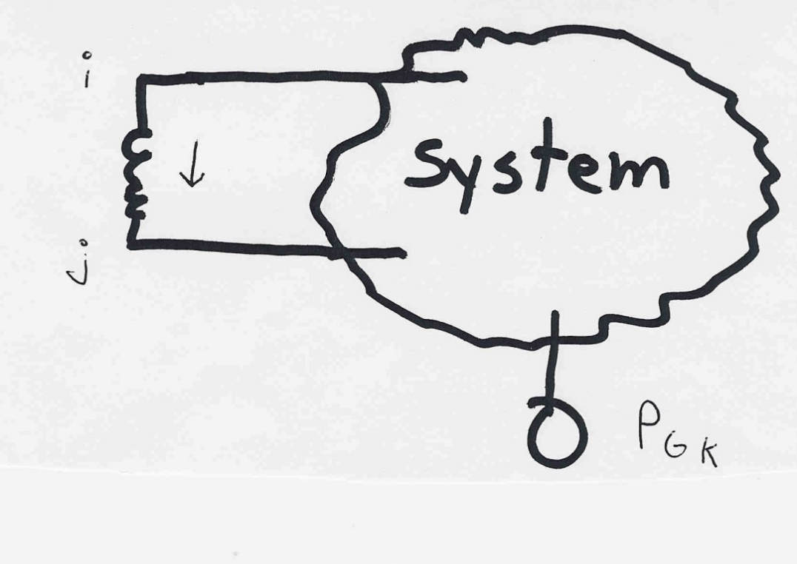
Power System Control and Sensitivities
In order to optimize the grid, the OPF and SCOPF need to have sensitivity information on how a change in control affects a constraint
An example would be to determine is how a change in generation at bus k affects the power flow on a line from bus i to bus j.
The assumption is that the change in generation is absorbed by the slack bus
5

Slide 7
Power Flow Simulation - Before
One way to determine the impact of a generator change is to compare a before/after power flow.
For example below is a three bus case with an overload
6

Slide 8
Power Flow Simulation - After
Increasing the generation at bus 3 by 95 MW (and hence decreasing it at bus 1 by a corresponding amount), results in a 30.3 MW drop in the MW flow on the line from bus 1 to 2, and a 64.7 MW drop
on the flow from 1 to 3.
Expressed as a percent, 30.3/95 =32% and 64.7/95=68%
7

Slide 9
Analytic Calculation of Sensitivities
Calculating control sensitivities by repeat power flow solutions is tedious and would require many power flow solutions. An alternative approach is to analytically calculate these values
8

Slide 10
Analytic Sensitivities
9

Slide 11
Three Bus Sensitivity Example
10

Slide 12
Sensitivity Comments
In ECEN 615 the methods for quickly calculating sensitivities are developed. Here the focus is just on their application
Sensitivities can (relatively) easily be calculated even for large systems, and can be calculated for a variety of different power system controls, such as phase shifting transformers
Sensitivities are dependent upon the operating point
  They also include the impact of marginal losses
11

Slide 13
A Sensitivity Example in Simulator
Open the Lab2_Bus37_Start (from Lab 2). To optimally remove the overloads it is important to know how changing a particular control (say the KYLE69 MW generation) affects the line flows
  A common assumptions is the opposite generation change occurs at the slack bus
These sensitivity values can be approximated by solving a power flow, noting the flows, changing the power flow (e.g., increasing the KYLE69 generation), resolving, and looking at the flow differences
Simulator allows a comparison of two cases using Difference Flows
  Solve the case, then select Tools, Difference Case, Set Present as Base
  Change the case (e.g., increase KYLE69 from 60 to 80 MW), resolve
12

Slide 14
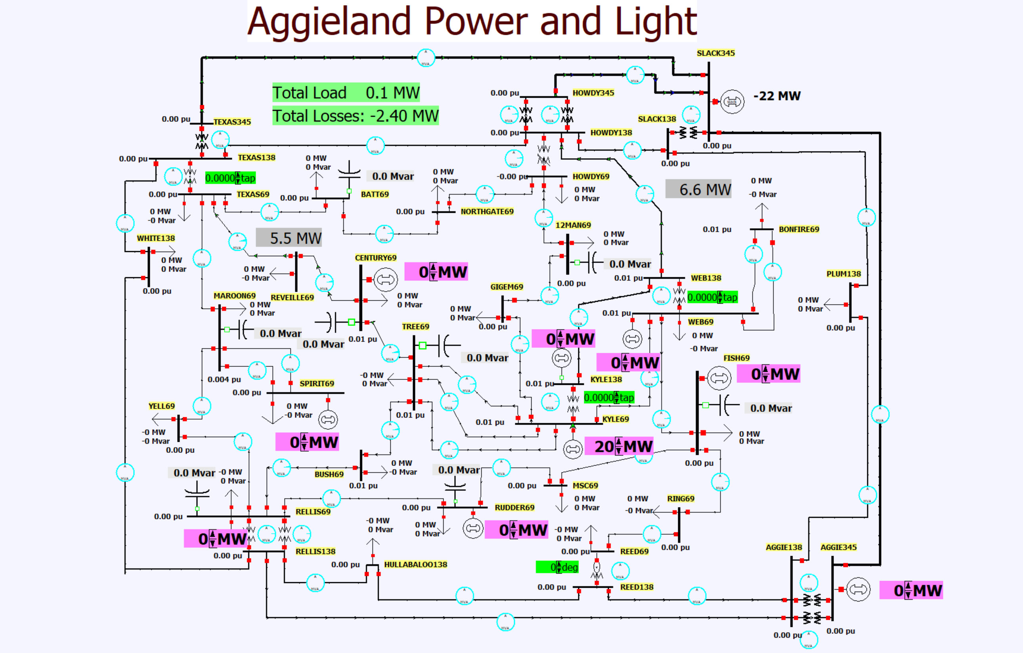
Lab 2 37 Bus Case Difference Flows
The image shows
the difference flows
for the 20 MW
generation change
at KYLE 69; note
the flow on the
line from WEB138
to HOWDY138 has
increased by 6.6 MW
  Its sensitivity to this
  generation change
  it 6.6/20 = 0.33
13

Slide 15
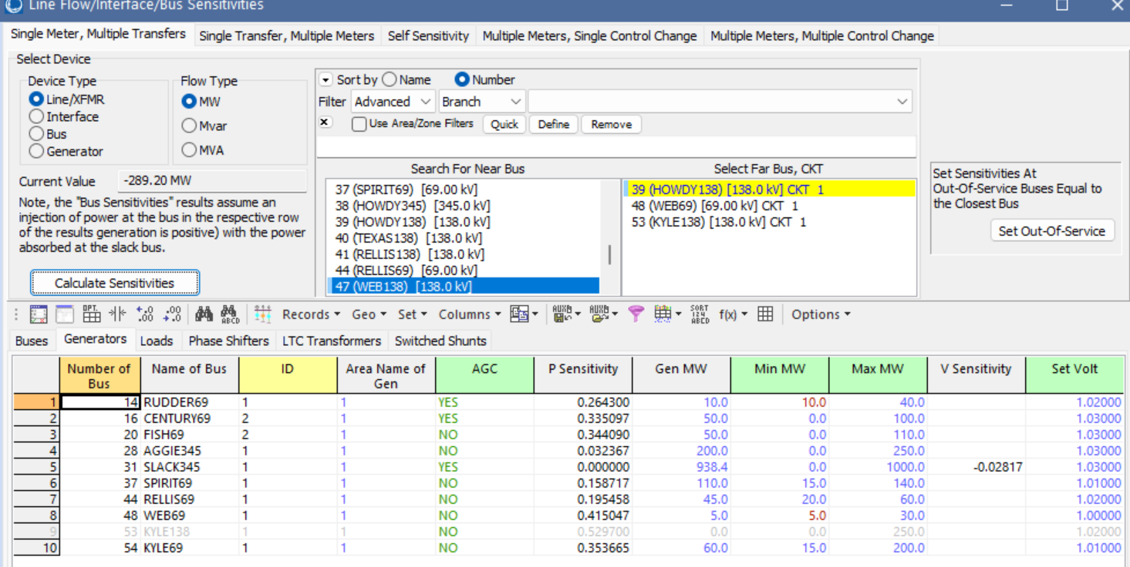
Showing Sensitivities in PowerWorld
PowerWorld has a number of different ways to show sensitivities. One approach is to show all the sensitivities for a single device (e.g., a line) to multiple controls (e.g., generator changes); the other is the sensitivities for many devices to a single control
To see the sensitivity for a line
flow to generation changes select
Tools, Flow and Voltage
Sensitivities, Single Meter,
Multiple Transfers
  Select the WEB138 (bus 47) to
  HOWDY138 (bus 39) line
14

Slide 16
Power Transfer Distribution Factors (PTDFs)
PTDFs are a common sensitivity values that are used to show how a particular power transfer (i.e., from a source to a sink) will affect the grid
NERC defines a PTDF as
  “In the pre-contingency configuration of a system under study, a measure of the responsiveness or change in electrical loadings on transmission system Facilities due to a change in electric power transfer from one area to another, expressed in percent (up to 100%) of the change in power transfer”
In the lossless formulation presented here (and commonly used) it is slack bus independent
15

Slide 17
PTDFs
Note, the PTDF is independent of the amount Δt; which is often expressed as a percent
16

Slide 18
Nine Bus PTDF Example
Display shows the PTDFs
for a transaction
from Bus A to Bus I. Note that 100% of the transaction leaves Bus A
and 100% arrives at Bus I
PowerWorld Case:
B9_PTDF
17

Slide 19
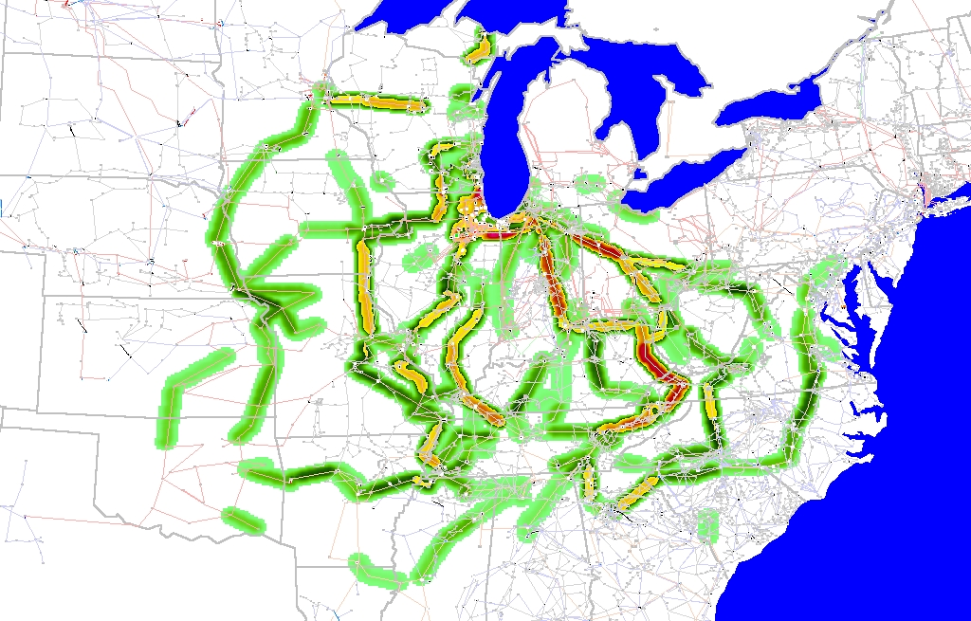
Eastern Interconnect Example: Wisconsin Utility to TVA PTDFs
In this example multiple generators
contribute for both
the seller and the buyer
Contours show lines that would carry at least 2% of a power transfer from Wisconsin to TVA
18

Slide 20
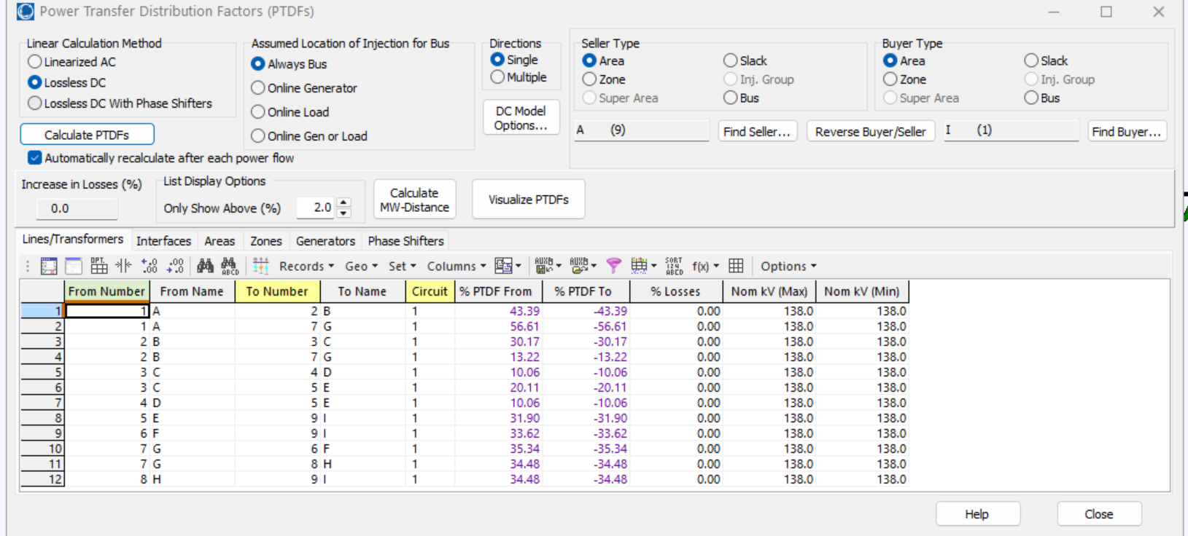
Calculating PTDFs in PowerWorld
PowerWorld provides a number of options for calculating and visualizing PTDFs
  Select Tools, Sensitivities, Power Transfer Distribution Factors (PTDFs)
Results are shown for the nine bus case for the Area A to Area I transaction
19

Slide 21
Transmission Ownership
The vast majority of the US transmission grid is privately owned, mostly by investor owned utilities; almost all is ac, with a small amount of HVDC
  There are some transmission only companies like ATC (mostly in Wisconsin)
Normally property ownership includes several rights including
  The right to use the property
  The right to allow others to use the property, often for a fee
  The right to exclude others from using the property
  The right to transfer the property to others such as by selling it
With ac transmission because of its nature (e.g., loop flow) some of these rights need to be modified; how they are modified can be market specific
20

Slide 22
Historical Transmission Usage and Expansion
When most electric utilities were vertically integrated monopolies the costs and benefits associated with operating and expanding the transmission system did not need to be precisely determined since a single entity controllable all aspects of electricity supply, and could do joint generation, load and transmission planning
There could still be (and were) disputes between adjoining utilities since loop flows still existed
The most common way of providing another utility access to the transmission to transact with more distant utilities was through a notion known as the “contract path”
21

Slide 23
Contract Path Nine Bus Example
If A wished to transact with I, using the contract path approach they just needed to get some of the intermediate areas to agree (say G and H)
This did not account
for the loop flows
This led to the creation of larger ISOs to manage issues
22

Slide 24
Transmission Challenges
The main challenges with transmission are
  Compensating existing transmission line owners
  Ensuring sufficient new transmission is constructed
Different markets use different rules to achieve this
For current transmission there are 1) maintenance costs, 2) operating costs, 3) depreciation expenses, and 4) financing costs; state regulators usually approve these charges
New transmission needs are usually determined by a regional planning organization (e.g., ERCOT) working with existing transmission line owners with the states approving the new transmission lines
23

Slide 25
General Economics: Types of Goods
In economics goods (products or services) are often differentiated based on whether they are excludable and rivalrous
  Excludable is the degree to which a good can be prevented from being used
  Rivalrous is the degree to which consumption by one prevents consumption by others
  Public goods are non-excludable and non-rivalrous; examples are official statistics, national defense, public radio and TV
  Private goods are excludable and rivalrous; most things are in this category
  Common goods are non-excludable and rivalrous; many free public services fall in this category, like roads and electric transmission access; the “tragedy of the commons” refers to common goods.
  Club goods are excludable and non-rivalrous; examples are private parks and satellite TV
24

Slide 26
Paying for the Transmission Grid
Paying for the transmission grid involves a number of different factors, including perceived fairness and simplicity
ERCOT uses a “postage stamp” approach, in which the total transmission costs are paid by each of the load serving entities (LSEs) based on their load usage during the 15 minute period in which ERCOT sets its maximum demand during each of the four summer months (the 4CP approach) (June, July, August, September)
  This is a relatively simple approach, and benefits from just having a single state involved
  A criticism of this approach is it could certainly be possible for larger loads to deliberately reduce their demand during these periods
25

Slide 27
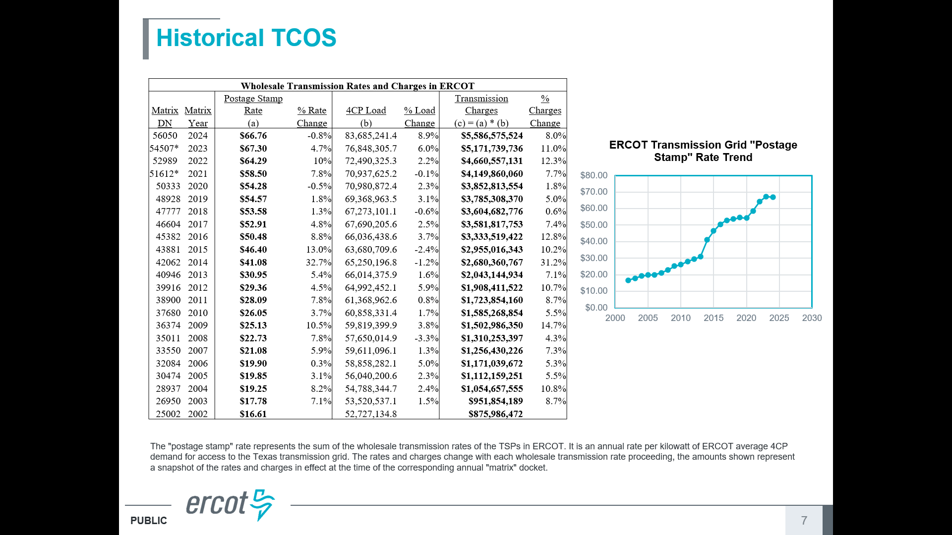
ERCOT Transmission Cost of Service (TCOS)
26

Slide 28
Congestion Revenue Rights (CRRs)
In LMP markets congestion causes price differences. Markets provide financial instruments to hedge against the uncertainty associated with these price differences
  In ERCOT and CAISO (California) they are known as Congestion Revenue Rights (CRRs); in PJM, MISO and ISO-NE they are Financial Transmission Rights (FTRs)
  They are not a right to deliver physical electric energy
  In ERCOT they apply in the day ahead market
In ERCOT there are two types
  Point-to-Point Options
    Owners only get paid based upon the
    price difference
  Point-to-Point Obligations
    Owners might have to pay
27

Slide 29
Congestion Revenue Rights (CRRs), cont.
CRRs can be bought in the CRR auction, traded, or awarded by allocation
  Allocations are given to Non-Opt-In Entities (NOIEs) are municipally owned utilities or electric cooperatives that have chosen not to participate in the competitive retail electricity markets
  There are monthly auctions and auctions for six-month periods; CRRs have different time periods including off-peak, peak weekday and peak weekend
Information on ERCOTs CRRs is available at www.ercot.com/mktinfo/crr
  As of March 1, 2025 there were about 685,000 open CRRs! Many are for just a few MWs
Additional information is available from the ERCOT State of the Market Report; the value of congestion in 2023 for ERCOT is $2.3 billion
Nationwide an estimate of congestion costs is about $12 billion in 2023
28

Slide 30
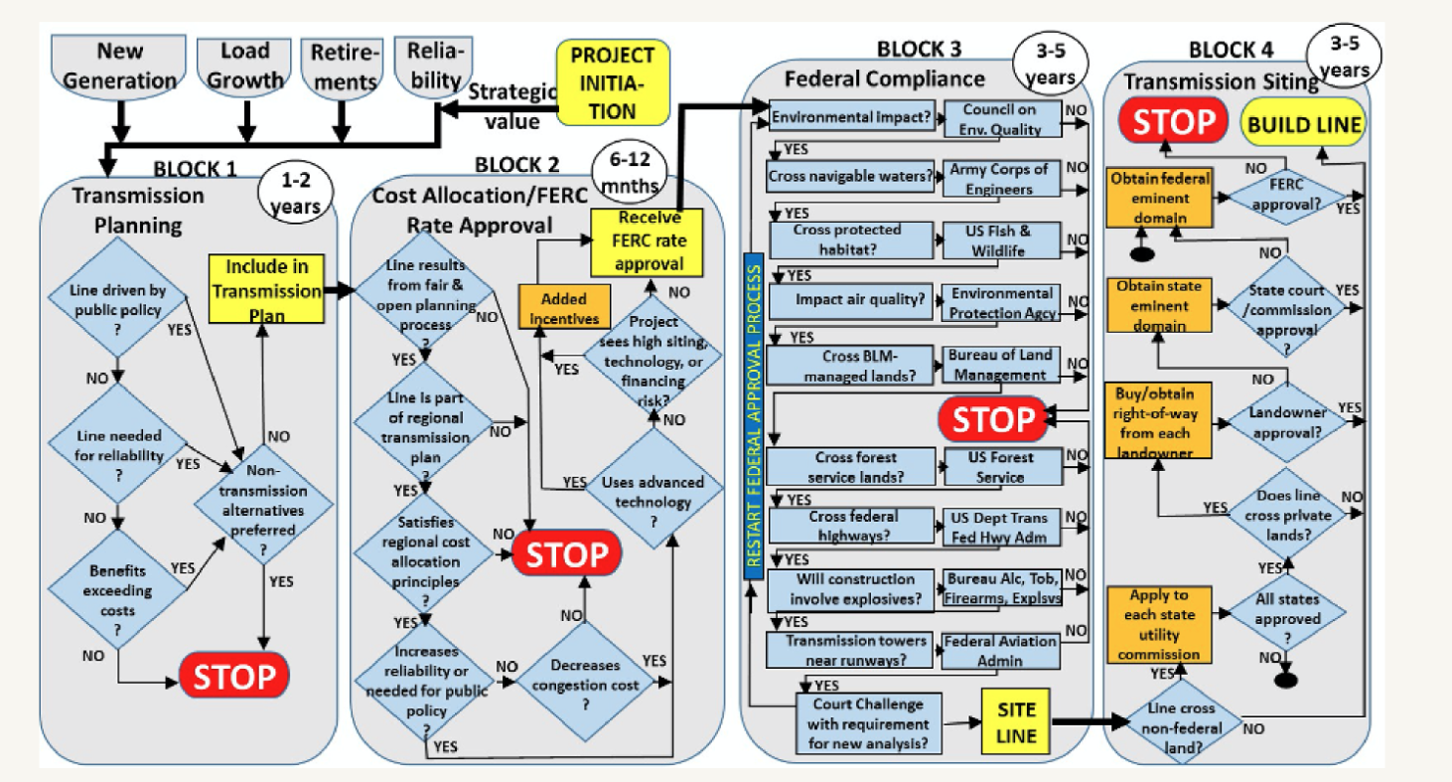
Building New Transmission Lines
In general, getting new transmission build can be a very involved process, particularly if it crosses state lines; the below image summarizes the process
The process is somewhat similar in Texas since just a single state is involved, with the Public Utility Commission of Texas (PUCT) approving new lines by issuing a Certificate of Convenience and Necessity (CCN)
Image source: www.breakthroughenergy.org/newsroom/articles/transmissiondeployment/
29

Slide 31
Who Gets to Build New Transmission
In many locations, including Texas, Right of First Refusal (ROFR) laws give the incumbent utilities the first right to construct and operate new transmission lines
In October 2024 a US district court ruled that this Texas law was invalid because if violated the Dormant Commerce Clause of the US Constitution since the court viewed the Texas law as restricting interstate commerce
  This ruling did not apply to the ERCOT portion of Texas since its electricity is not considered interstate commerce
30

Slide 32
Getting Transmission Line Right-of-Ways
Determining the path for a new transmission line is an involved process, with the PUCT ultimately giving final approval
For new right-of-ways that involve private land, the entity constructing the line (usually a utility) contacts the landowners to obtain easements
  An easement provides rights for the utility to use the land for the transmission line, and restricts what the property owner can do with the land; payment is usually up front, though annual payments are common with wind turbines; the price is negotiable
In an easement agreement cannot be obtained, it can be obtained through eminent domain, which is ultimately a legal process in which the landowner gets a court determined payment
31

Slide 33
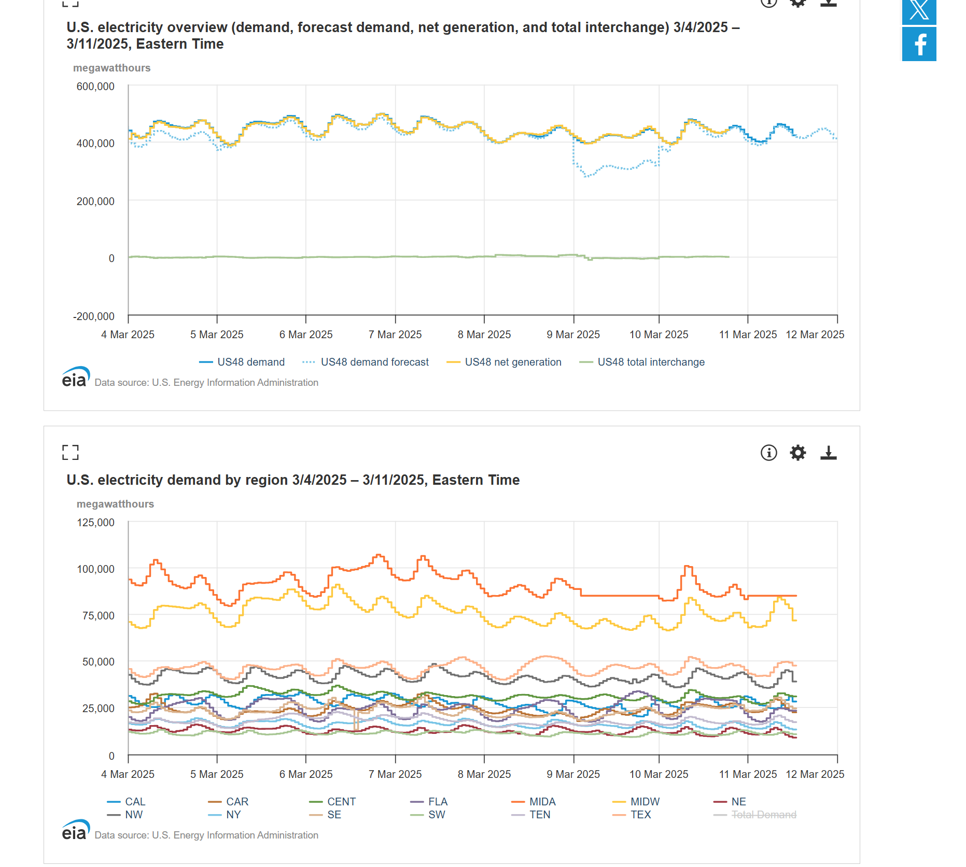
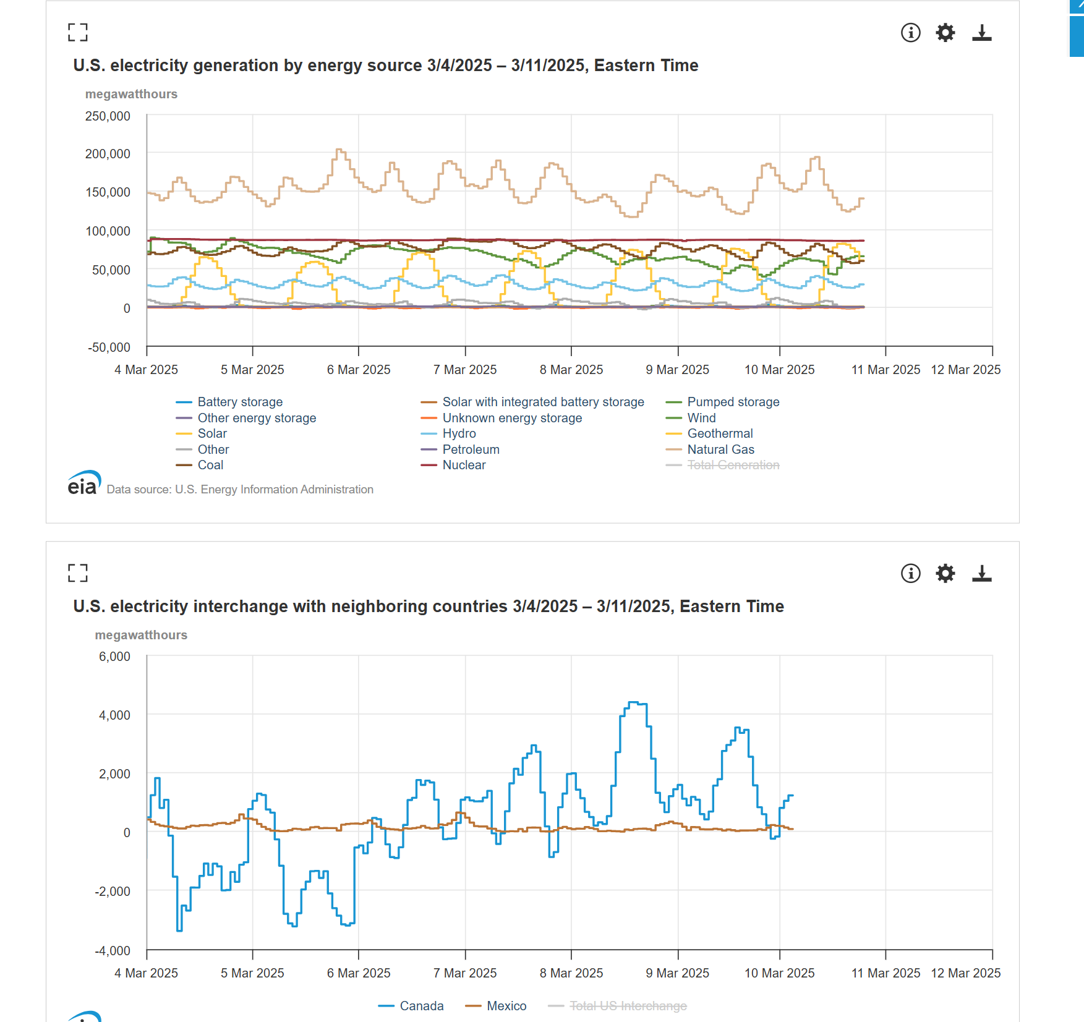
EIA US Real-Time Electric Grid Information
Information about the real-time status of the US electric grid is available at
www.eia.gov/electricity/gridmonitor/dashboard/electric_overview/US48/US48
32

