Slide 1
ECEN 460
Power System Operation and Control
Spring 2025
Lecture 16: Power System Stability
Prof. Tom Overbye
Dept. of Electrical and Computer Engineering
Texas A&M University
overbye@tamu.edu

Slide 2
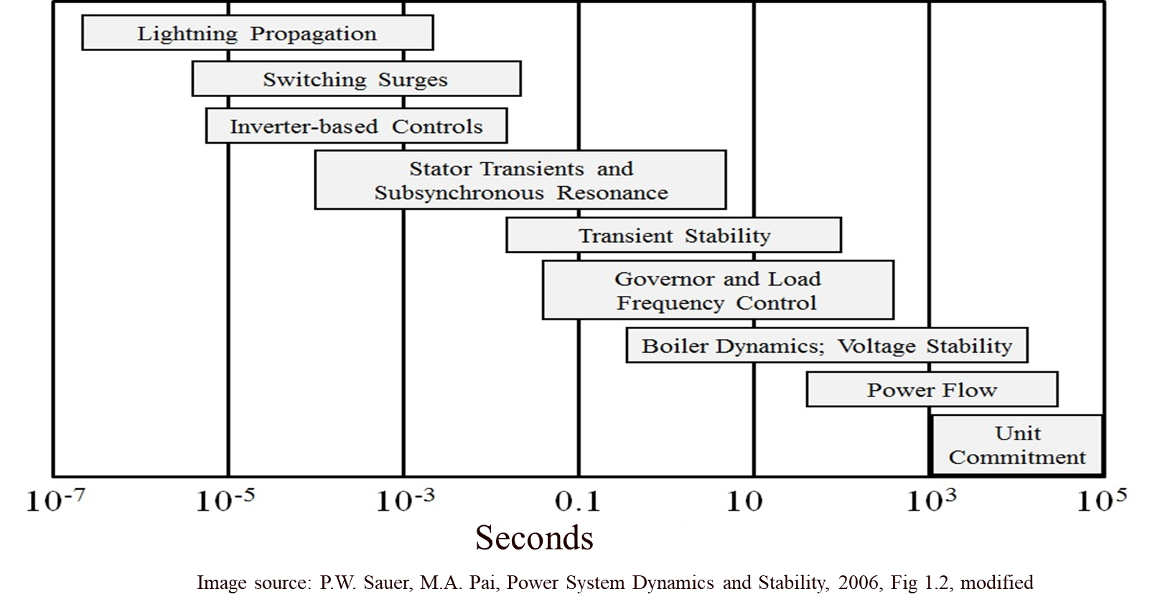
Power System Stability
The focus of the next part of the class is on power system dynamics, with a focus on time frames shorter than steady-state (power flow)
Our focus will mostly be here

Slide 3
A Few Definitions
The words model or modeling have lots of definitions. A germane one is
  "Modeling and simulation (M&S) is the use of a physical or logical representation of a given system to generate data and help determine decisions or make predictions about the system.”
Modeling is crucial for power system dynamics and stability since we can’t (easily) physically build the system being considered
Dynamics also has several definitions, with a common one “the study of how moving objects behave” (here the “moving objects” includes electrical values
Likewise Stability has several definitions, with a germane one here is “the property of a body (or system) that causes it to return to its original condition when disturbed.”

Slide 4
As Before Keeping in Mind the Modeling Cautions!
"All models are wrong, but some are useful," George Box, Empirical Model-Building and Response Surfaces, (1987, p. 424)
  Models are an approximation to reality, not reality, so they always have some degree of approximation
  Box went on to say that the practical question is how wrong to they have to be to not be useful
A good part of engineering is deciding what is the appropriate level of modeling, and knowing under what conditions the model will fail
Always keep in mind what problem you are trying to solve!

Slide 5
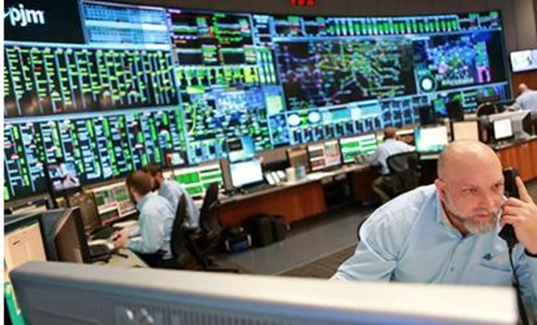
A Few Definitions, cont.
An equilibrium point (ep) of a dynamic systems is a point in which the system doesn’t change with time
Large-scale electric grids are never really at an equilibrium point because something is always changing with time. Here we can talk about a quasi-static ep, which is how the system
would appear on the power flow time
frame
  This is what you would observe if you
  went into a control room and looked at
  the displays; usually things would appear
  to be pretty constant
Image Source: why.org from 3/17/20 of PJM control room

Slide 6
Slow versus Fast Dynamics
Key analysis question in setting up and solving models is to determine the time frame of interest
Values that change slowing (relative to the time frame of interest) can be assumed as constant
  Power flow example is the load real and reactive values are assumed constant (sometimes voltage dependence is included)
Values that change quickly (relative to the time frame of interest) can be assumed to be algebraic
  A generator's terminal voltage in power flow is an algebraic constraint, but not in transient stability
  In power flow and transient stability the network power balance equations are assumed algebraic

Slide 7
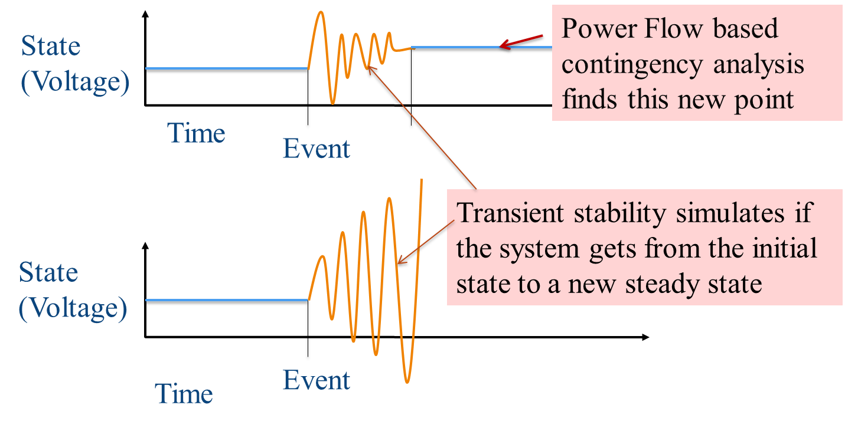
Contingencies (in a Dynamic Sense)
Contingencies (or sometimes known as events) perturb (kick) the system operating point away from its equilibrium point; power system stability analysis looks at whether the system returns to a new equilibrium point
  Best case is a new ep
  exists and the system
  is able to reach this
  new ep.
  However, a new ep may
  exist, but the system
  can’t get there
  Or a new ep doesn’t exist
The electric grid protection system plays a major role in how the system results to different contingencies

Slide 8
Dynamics Example 1: WECC 1996 Blackout
1996: Transient Stability Model Errors Lead to Blackouts
7

Slide 9
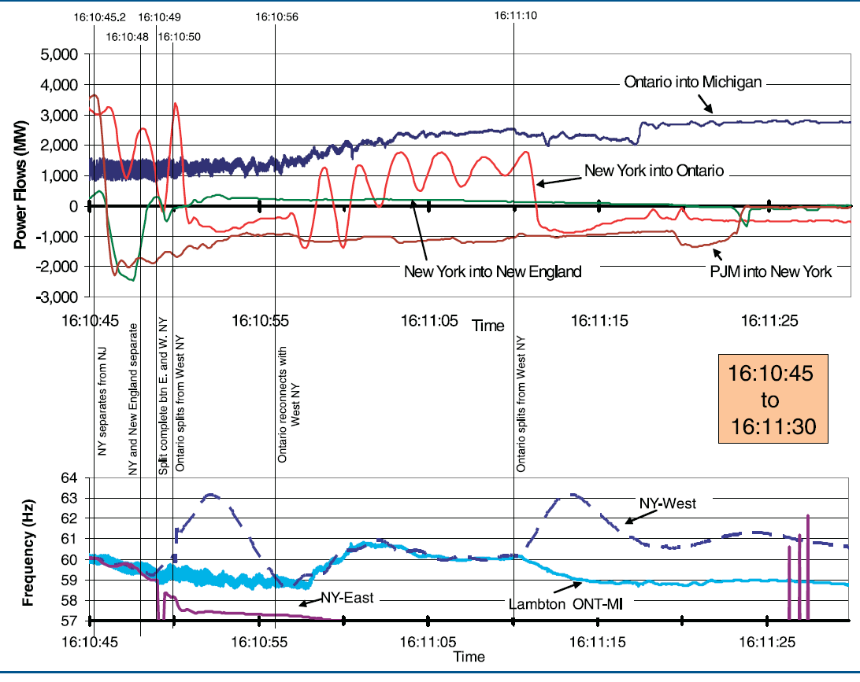
Dynamics Example 2: August 14 Blackout
Image from August 14, 2003 Blackout Final Report, energy.gov, Figure 6.26
8

Slide 10
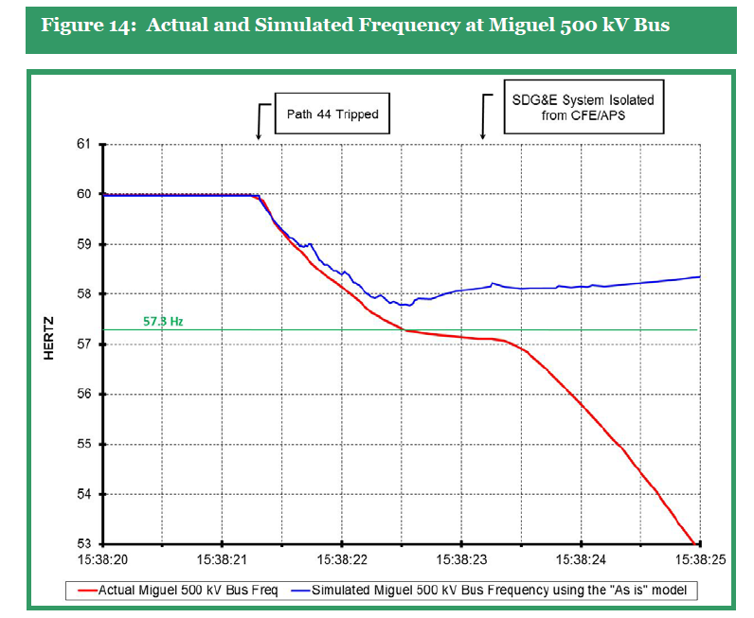
Dynamics Example 3: Arizona-Southern CA 2011
We’ve come a long ways since 1996 towards improved simulations. Still,
a finding from the 2011 Blackout is the simulations
didn’t match the actual system response and need to be improved.
Source: Arizona-Southern California Outages n September 8, 2011 Report, FERC and NERC, April 2012
9

Slide 11
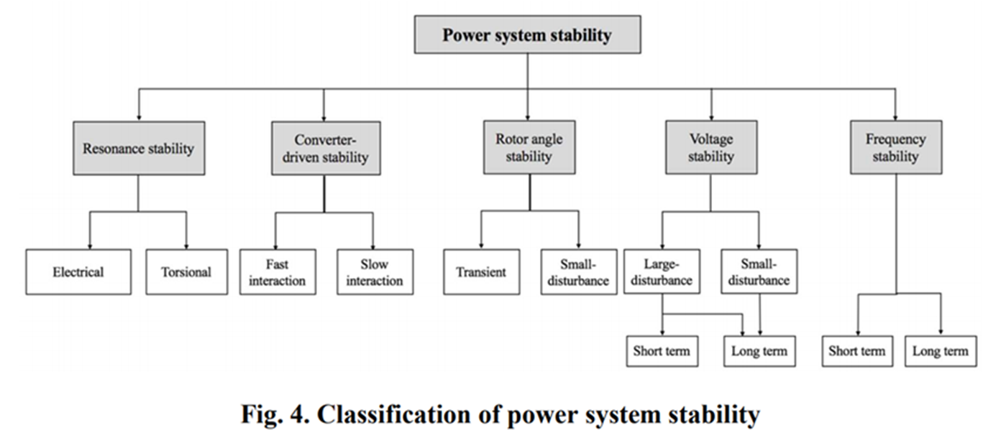
Power System Stability Terms
The terms continue to evolve, but a good reference is [a]; the image shows Figure 4 from this reference
[a] IEEE/PES Power System Dynamic Performance Committee, “Stability definitions and characterization of dynamic behavior in systems with high penetration of power electronic interfaced technologies”, PES-TR77, April 2020

Slide 12
An Example: Lightning Striking a Transmission Line
The sequence of events might be as follows
  Lightning hits a transmission line, setting up an ionized path to ground
    There are at least 30 million lightning strikes per year in the US; a typical stroke might have 25,000 amps with a rise time of 10 μs, dissipated in 200 μs; multiple strokes can occur in a single flash, causing the lightning appear to flick with a total event lasting a second
  After the strike a conduction path is maintained by ionized air after the lightning strike has dissipated, resulting in high fault current (often > 25,000 amps); if this current is not removed it can cause high heating and mechanical stresses
  Within one to three cycles (16-50 ms) relays at both ends of the line detect high currents, signaling circuit breakers to open the line
    Nearby locations see decreased voltages
  The circuit breakers open to de-energize the line in an additional one to two cycles
  Circuit breakers may reclose after several seconds to restore service

Slide 13
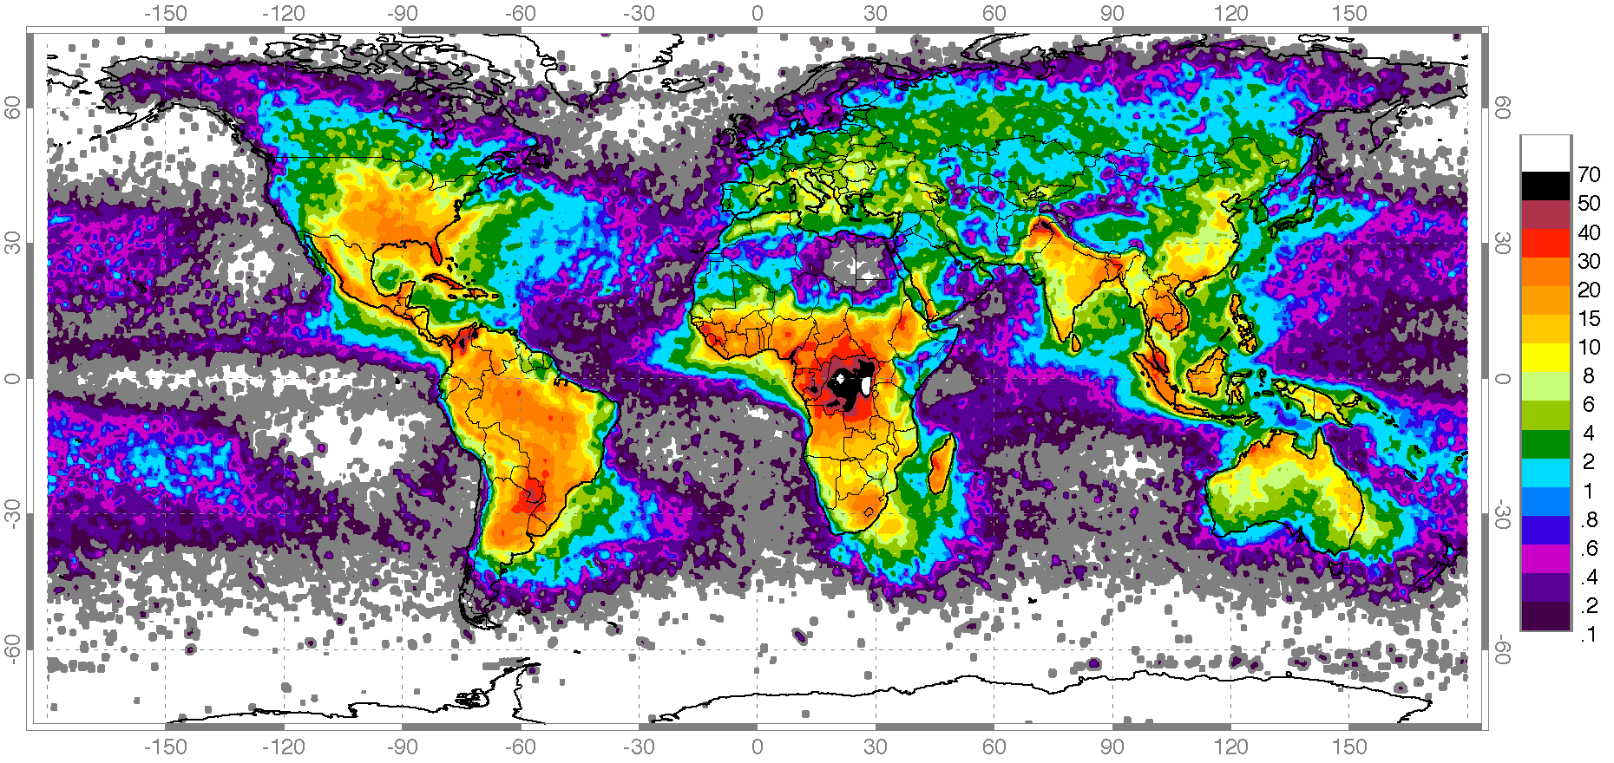
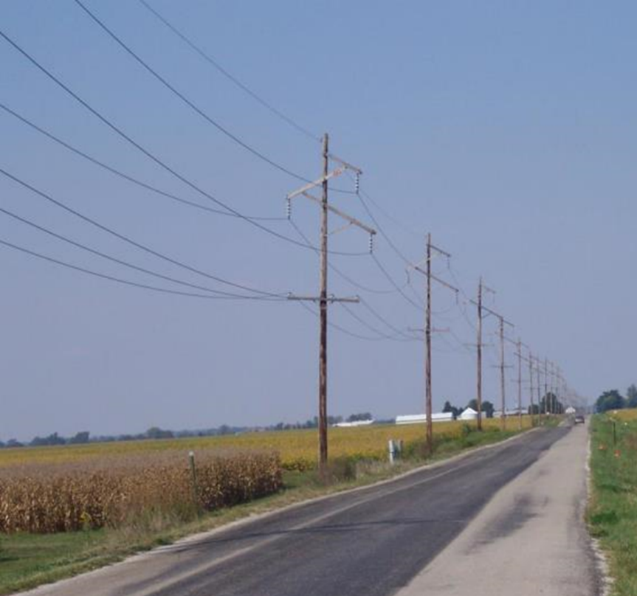
Worldwide Map of Lighting Strikes
Lightning is a major issue in many locations, but not everywhere; where lightning is common transmission lines have ground wires for lightning protection
Image source: en.wikipedia.org/wiki/Distribution_of_lightning

Slide 14
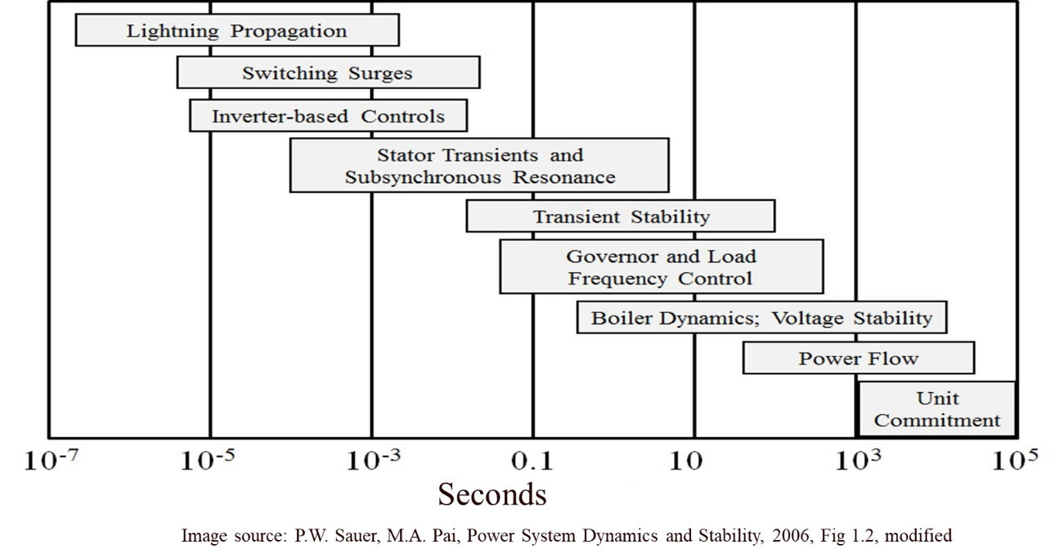
Two Different Types of Simulations for Lightning
Faults caused by lightning are simulated using two different approaches for two different purposes
Simulations using very fast time steps are done for insulation coordination studies; the goal is to design the grid so it can withstand the initial lightning strike; these simulations packages are known electromagnetic transients program (EMTP)
  They can use simulation time steps
  of less than 1 μs, and light only travels 300m in
  a microsecond
  The small timesteps means either they
  solve relatively small systems or use
  lots of computer hardware to do the
  simulations

Slide 15
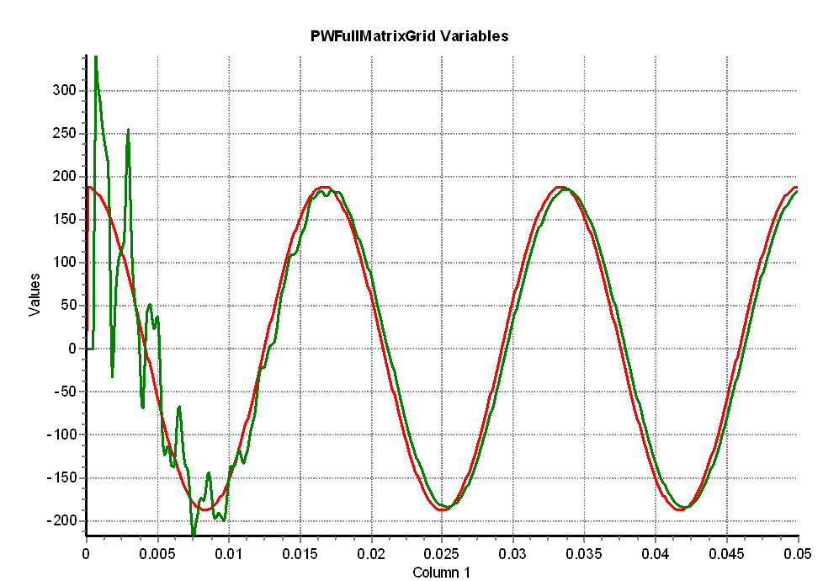
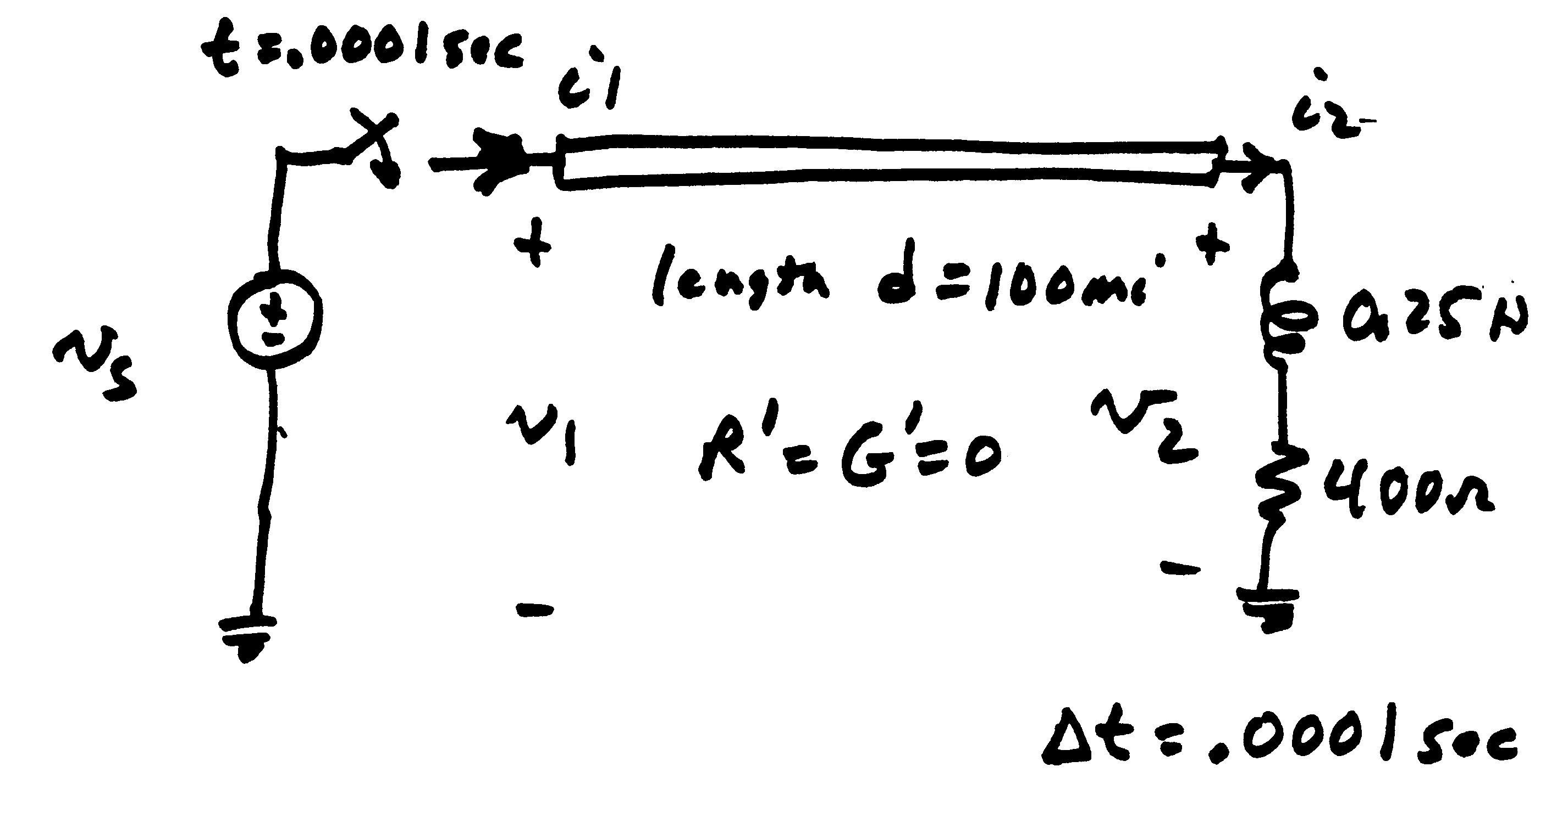
An Example of a Switching Surge
On a very fast time-scale, when a transmission line is closed there is a traveling voltage wave that goes down the line, and reflects off the far end; this high frequency oscillations damp out quickly, but need to be considered in the protection system design
Voltage in kV
Time in seconds

Slide 16
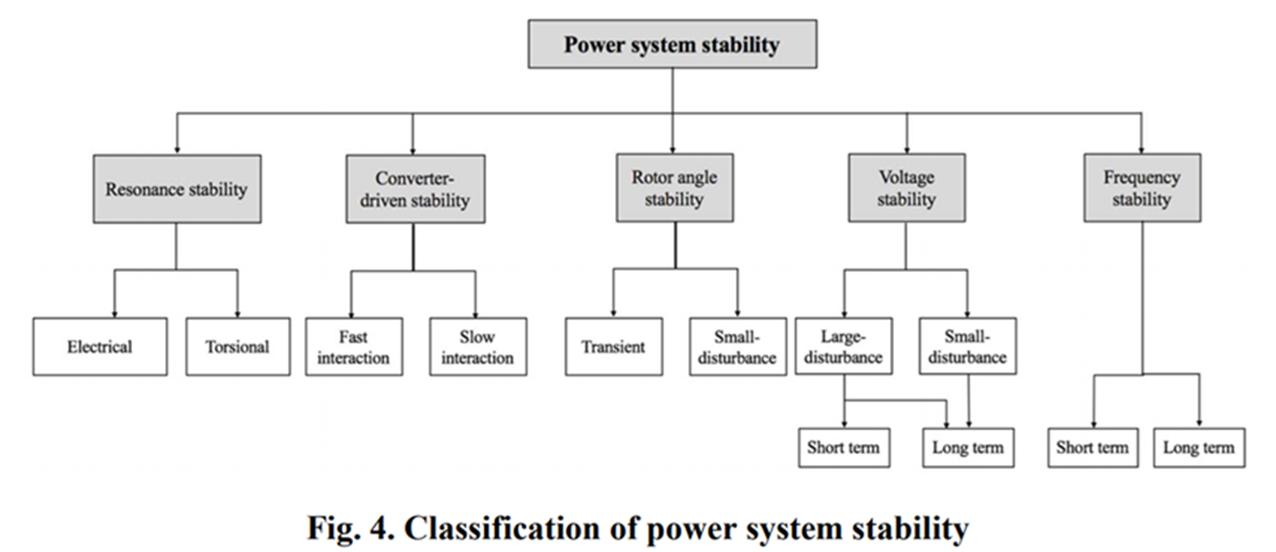
Stability Simulations
The second type of studies are known as stability simulations (or sometimes transient stability) with a focus on determining whether the system will stay together after the fault
  A traditional focus has been on whether the generators will maintain synchronism
  These studies typically use
  time steps on the order
  of about ¼ to ½ electrical
  cycle (so around 0.004
  to 0.008 seconds)
  The larger time step allows
  the study of large systems,
  often up to an entire interconnect

Slide 17
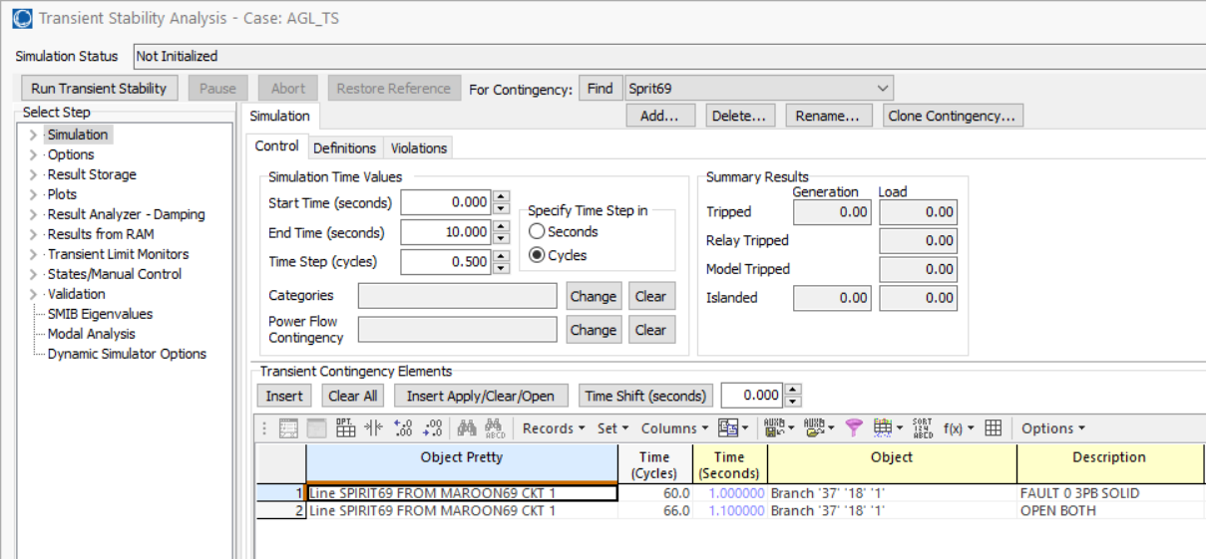
Doing a Stability Simulation
A good way to introduce stability studies is to do one in PowerWorld using a case that is very similar to the previous 37 bus case, augmented to include dynamic models (which we’ll get to in the next few slides)
Open the case AGL_TS, and select Add Ons, Transient Stability
This displays the
Transient Stability Analysis
Form, which is what we’ll
use to do simulations
Key to a simulation is defining
the sequence of events
(contingency elements)

Slide 18
Doing a Stability Simulation
Doing a stability simulation also involves setting a number of other values, such as the start/end time, a time step size, and what to save. Assuming these are set (which
they are here), then
doing the simulation
just involves
pressing the Run
Transient Stability
button
There are many options
for showing the results

Slide 19
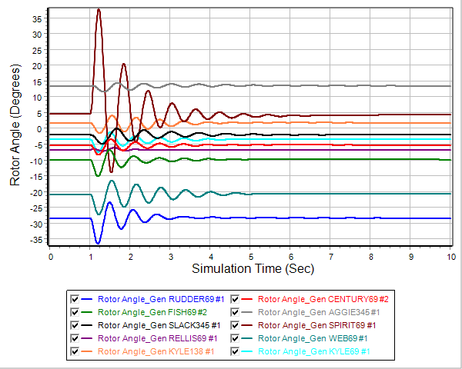
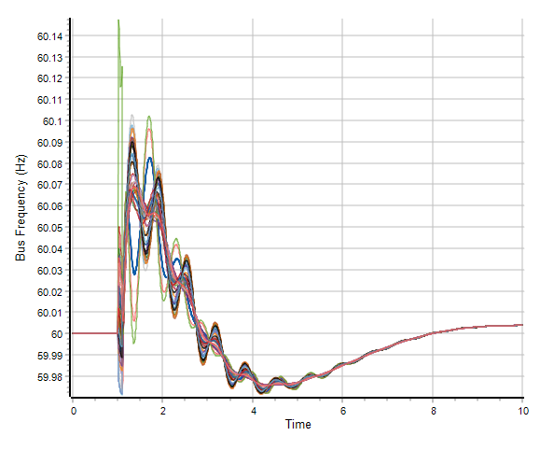
Looking at the Stability Results
A common way to look at the results is using plots of the time-variation of values, with the below graphs showing two examples
  A detailed consideration of the plots is beyond the scope of this class, but these plots do show normal (desired) behavior

Slide 20
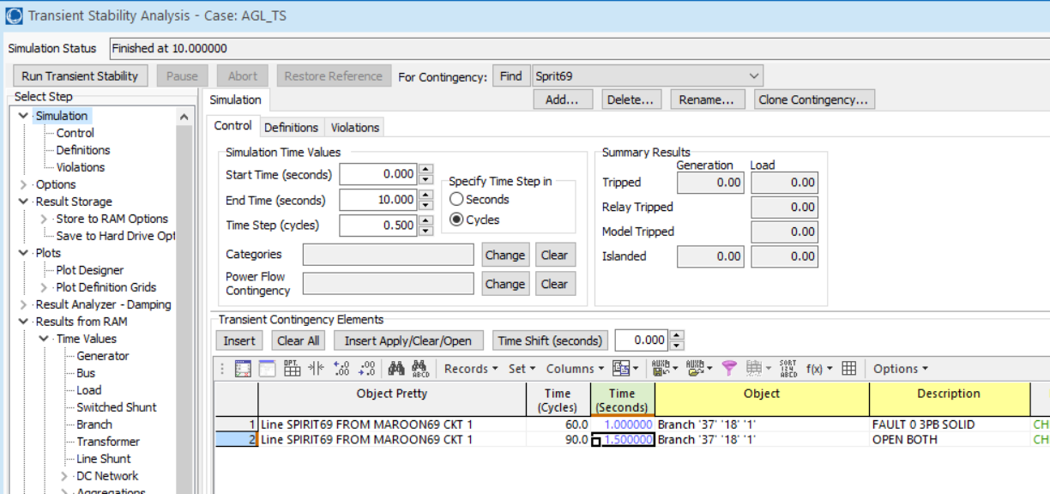
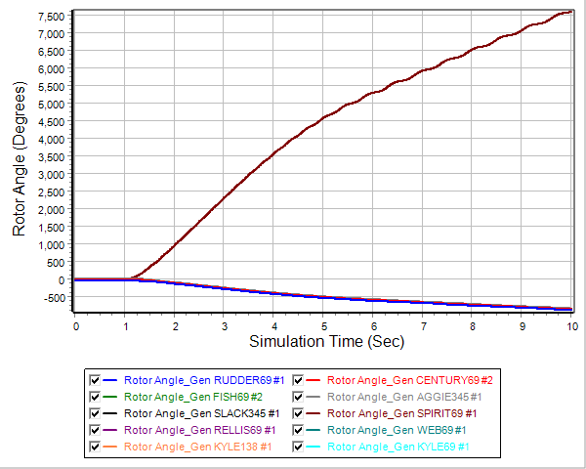
An Unstable Case Example
Change the fault clearing from being at time 1.1 seconds (0.1 seconds after the fault) to being at 1.5 seconds; then re-run; this gives an unstable result

Slide 21
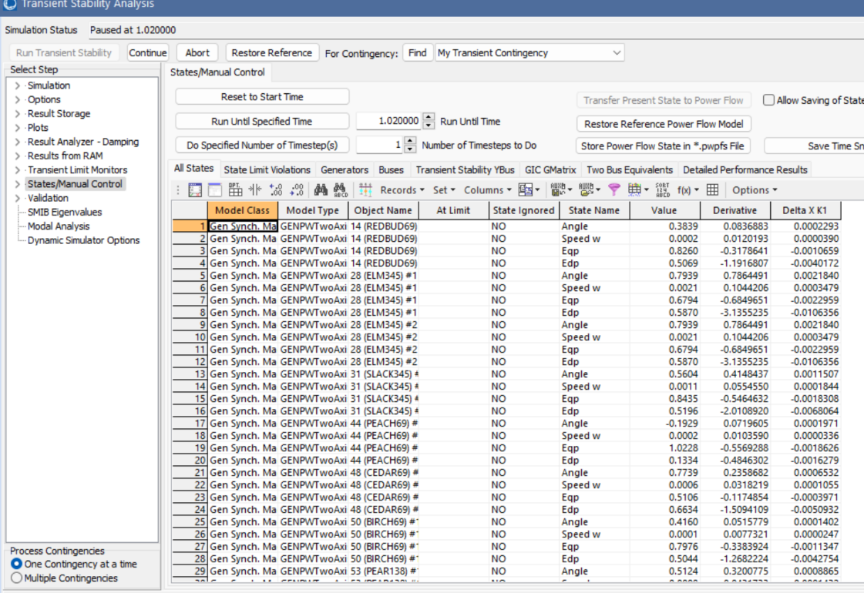
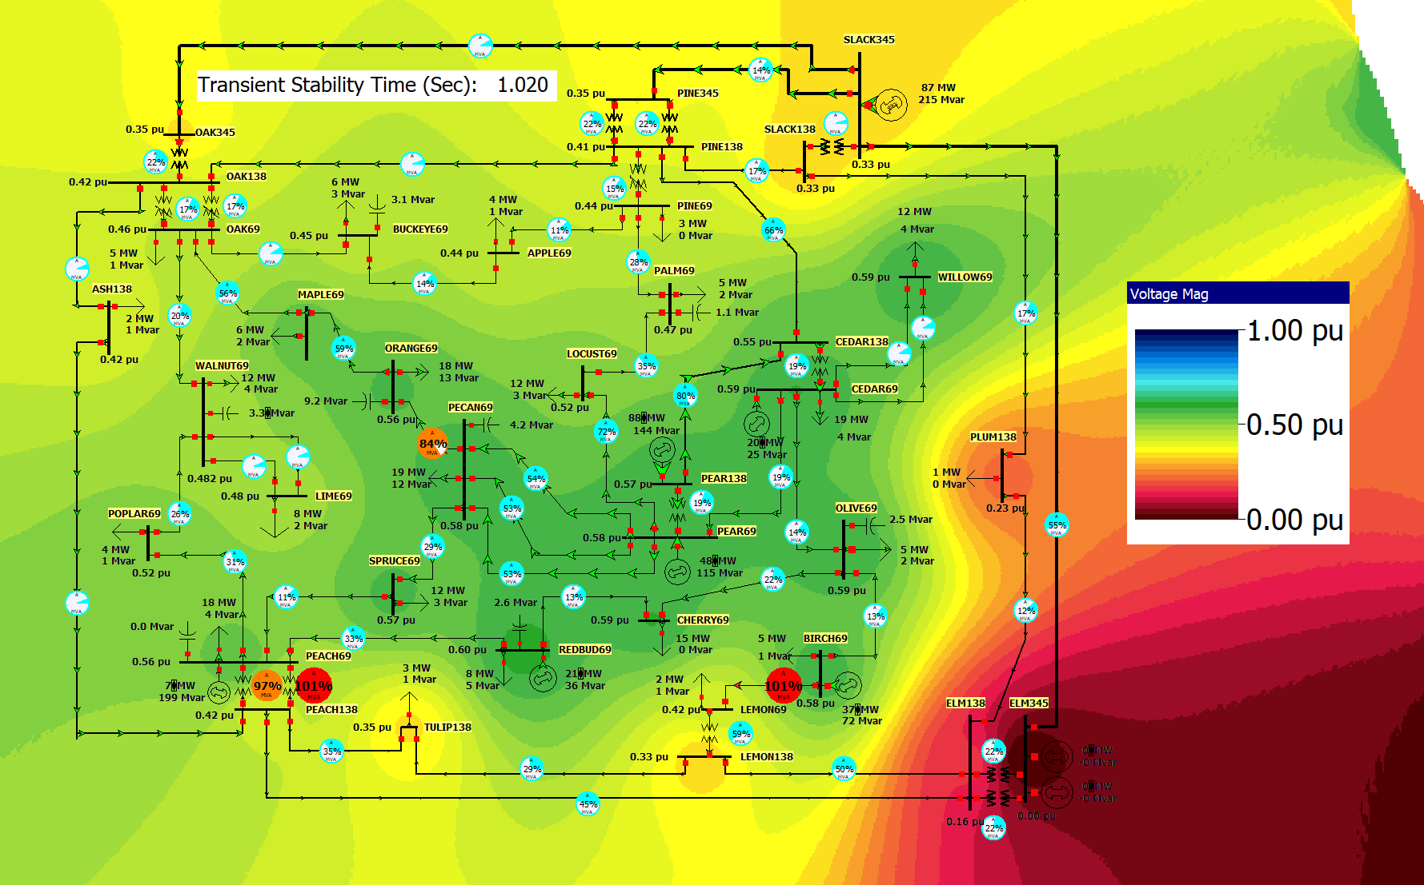
Visualizing Individual Time Points
Do see the simulation results at a particular on the Transient Stability Form select States/Manual Control set the Run Until Specified Time to 1.02 seconds and click on the Run Until Specified Time button
  The contour shows very low voltages across much of the system; this is why lights “blink” during a fault

Slide 22
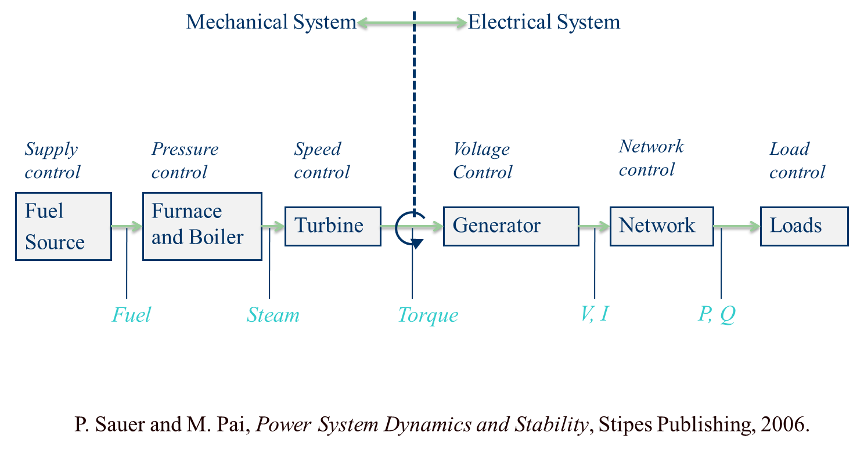
Physical Structure Power System Components
Doing these simulations requires more detailed models than for the power flow; below are of the devices that need models for a synchronous generator

Slide 23
Dynamic Models in the Physical Structure
Mechanical System
Electrical System
Stabilizer
Load
Relay
Line
Relay
Exciter
Supply control
Pressure control
Speed control
Voltage Control
Network control
Load control
Fuel
Source
Furnace and Boiler
Turbine
Generator
Network
Loads
Machine
Load
Char.
Fuel
Steam
Torque
V, I
P, Q
Governor
P. Sauer and M. Pai, Power System Dynamics and Stability, Stipes Publishing, 2006.

Slide 24
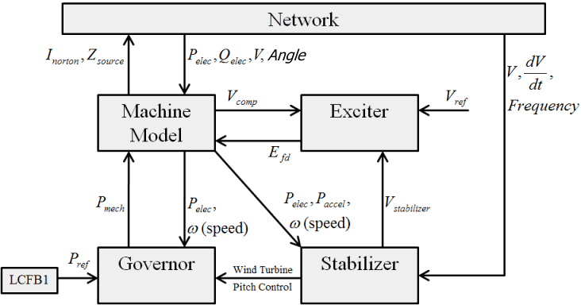
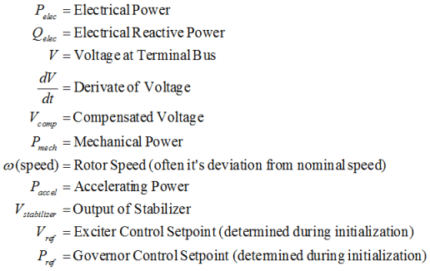
Synchronous Generator Models

Slide 25
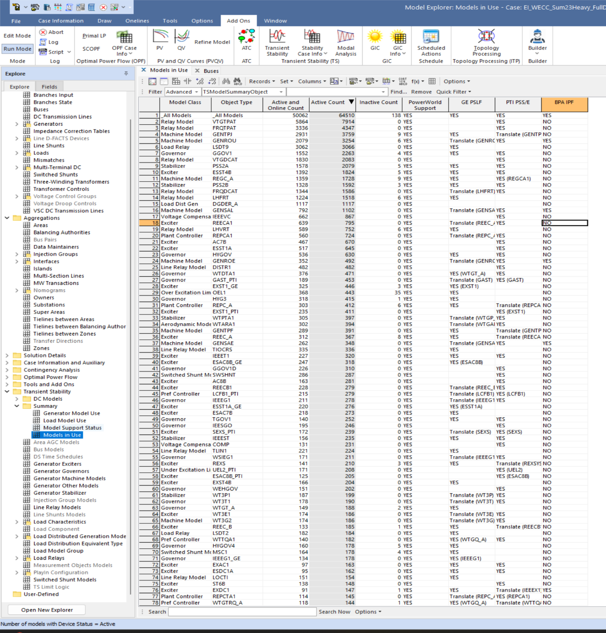
There can be Hundreds of Different Types of Models
In a project we are doing looking at connecting the North American Eastern and Western grids we have a case with 120,000 buses, and 248 different types of dynamic models, and a total of 64,500 different dynamic model instances
  Each instance can have many different parameters

Slide 26
Infinite Bus Modeling
An infinite bus is assumed to have a fixed voltage magnitude and angle; hence its frequency is also fixed at the nominal value.
  Infinite buses obviously do not exist, but at least one (e.g., a slack bus) is needed in every power flow island
  Infinite buses can be a useful concept when learning about transient stability and when “debugging models”
  By default PowerWorld Simulator does NOT treat the slack bus as an infinite bus, but does provide an option.
  Here we will use this option in creating a simple case by selecting Options and the Power System Model tab; set Infinite Bus Modeling to “Model the power flow slack bus(es) as infinite buses”

Slide 27
Quickly Setting Up a Dynamics Case
Open the case Example_12_4_NoModels; this is a four bus power flow case with no dynamic models
To add a model, right-click on the Bus 4 generator, select Generator Information Dialog; go to the Stability page; on the Machine Models tab click Insert and select GENCLS; click OK
  This added a very simple dynamic model for the generator
Select Add Ons, Transient Stability; click Run Transient Stability
  This does the simulation, but nothing occurs because no contingency events have been defined

Slide 28
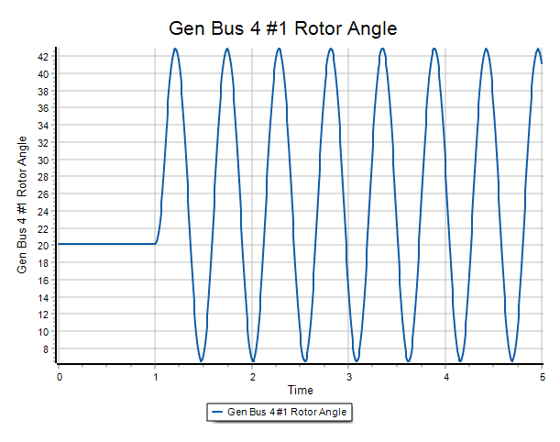
Quickly Setting Up a Dynamics Case, cont.
On the Transient Contingency Elements tab click Insert/Apply/Clear/Open to put in a fault that is subsequently cleared; pick Bus 3 rerun the simulation
Got to the Results from RAM page and view the generator results
  To see a plot of the results, right-click on any result column, and select Plot Column
  The result shows the generator oscillating
  as a result of the fault (the GENCLS
  model does not have implicit damping)
In PowerWorld there are many
ways to further customize and
expand the simulation

Slide 29
Frequency Response for Generation Loss
A common contingency is the response of the grid to the loss of a large generator
In response to a rapid loss of generation, in the initial seconds the system frequency will decrease as energy stored in the rotating masses is transformed into electric energy
  Some generation, such as solar PV has no inertia, and for most new wind turbines the inertia is not seen by the system
Within seconds governors respond, increasing the power output of controllable generation
  Many conventional units are operated so they only respond to over frequency situations
  Solar PV and wind are usually operated in North America at maximum power so they have no reserves to contribute

Slide 30
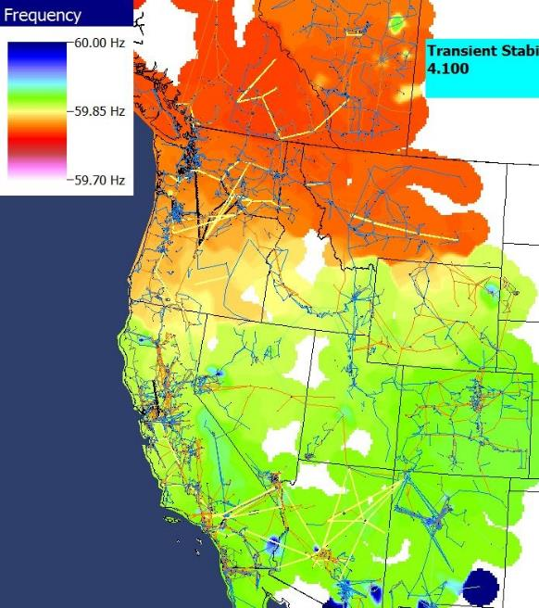
Short Term (20 Seconds) Example
Figures show the frequency change as a result of the sudden loss of a large amount of generation in the Southern WECC
Freq. Hz)
Frequency Contour
Time in Seconds

Slide 31
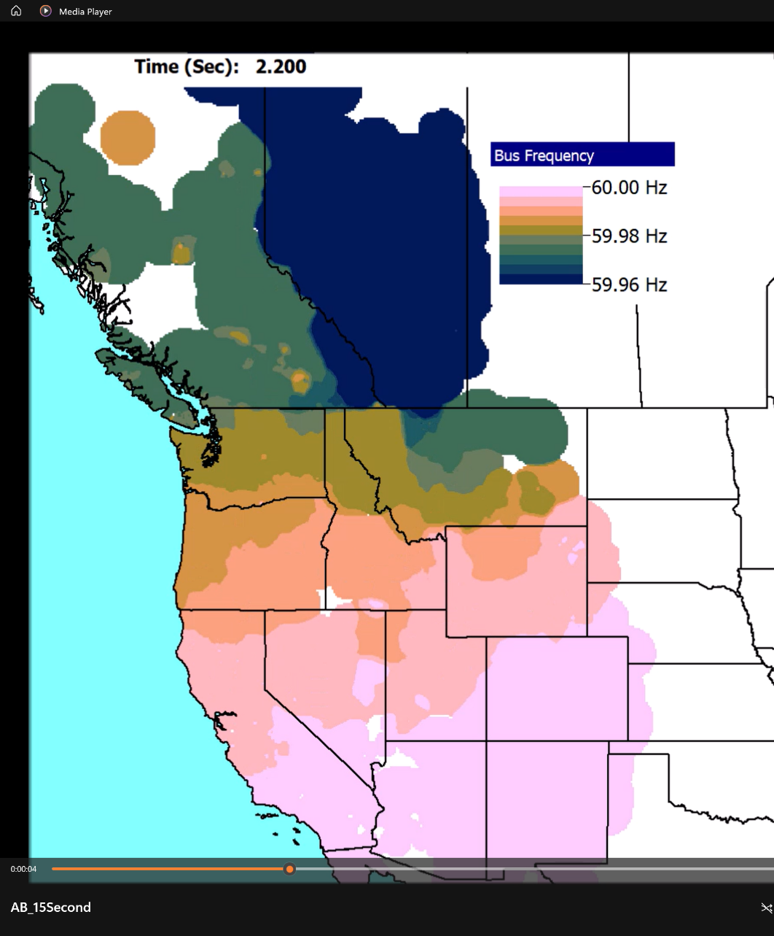
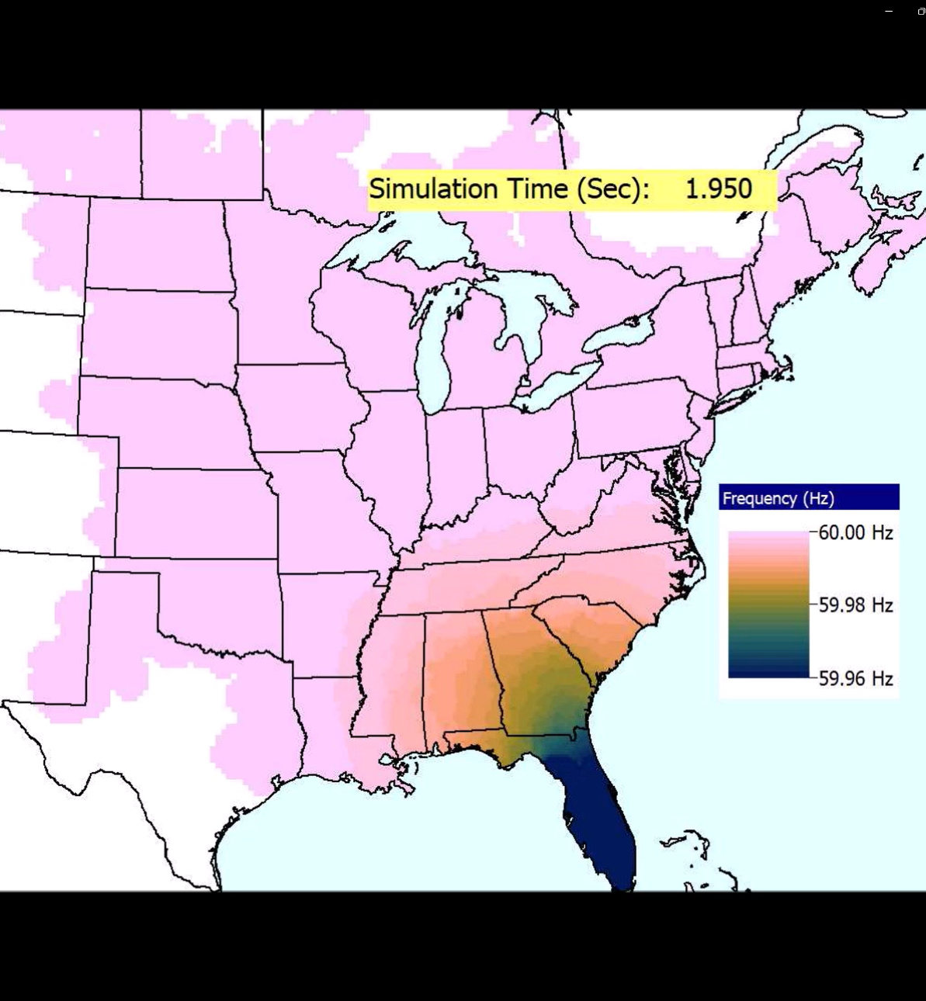
Frequency Contour Videos for the West and East
Video is FreqMovie_WECC
Video is FreqMovie_East

