Slide 1
ECEN 460
Power System Operation and Control
Spring 2025
Lecture 17: Power System Stability
Prof. Tom Overbye
Dept. of Electrical and Computer Engineering
Texas A&M University
overbye@tamu.edu

Slide 2
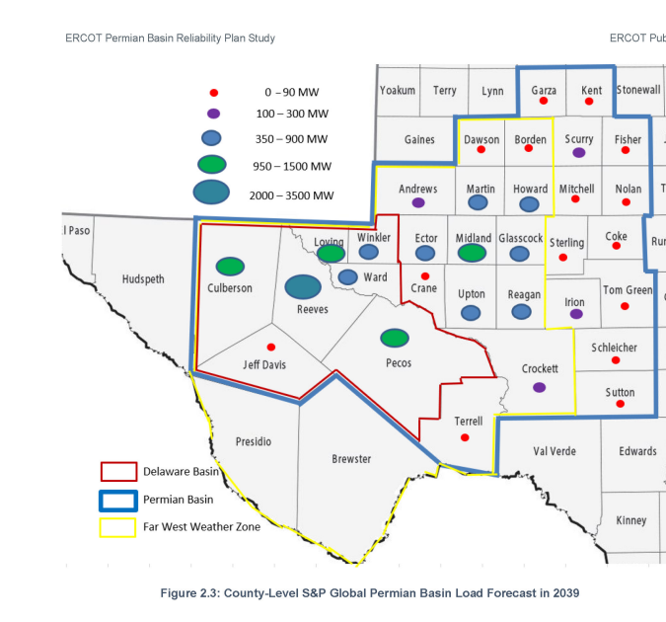
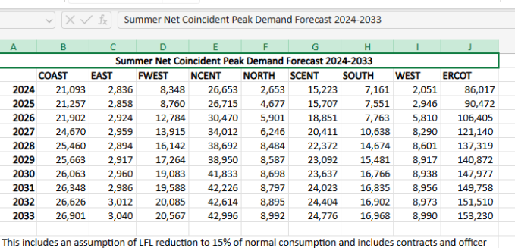
Design Project Overview
The goal of the project is to give experience in planning new transmission for a relatively large-scale electric grid while working as part of a four person engineering design team
Project is motivated by the July 2024
ERCOT report to plan for new
transmission in the Permian Basin to
accommodate large amounts of new load

Slide 3
Design Project Overview, cont.
Since the actual grid models are not publicly available due to them being CEII, you’ll be working with an enhanced version of the 2000 bus grid we’ve been using in 460
  This enhanced grid has much more wind and solar and a higher load; this grid uses at 500/230/161/115 kV transmission grid
Your design goal is to optimally provide reliable electricity to 5 new loads in (or close to) the Permian Basin, with each load requiring 1000 MW at 161 kV
There will be a number of assumptions to simplify the project, including using a DC OPF, only considering three distinct operating points, and ignoring all contingencies except those associated with your new transmission lines and transformers

Slide 4
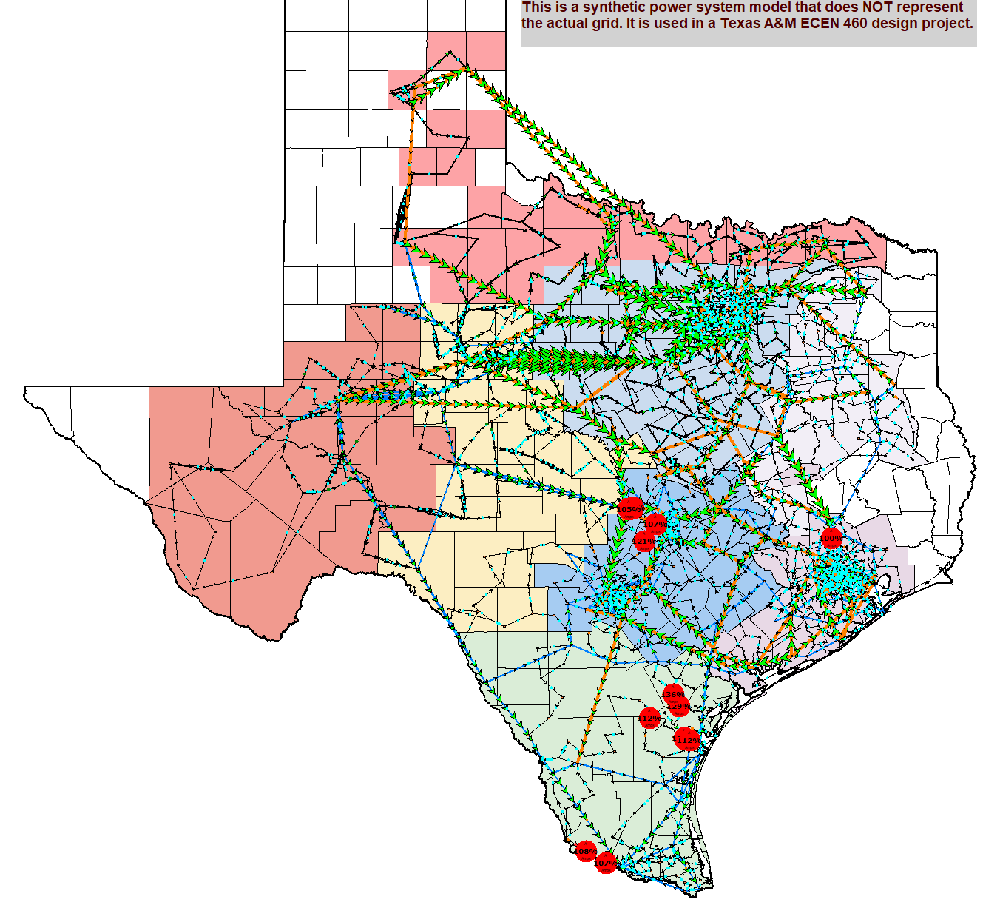
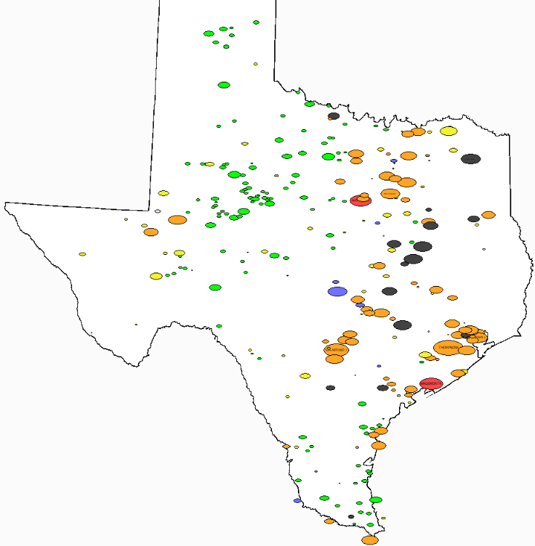
Design Project Overview: Starting Grid Flows and Generation by Fuel Type
Available generation by fuel type (black-coal, orange-natural gas, red-nuclear, green-wind, yellow-solar, blue-hydro)
3

Slide 5
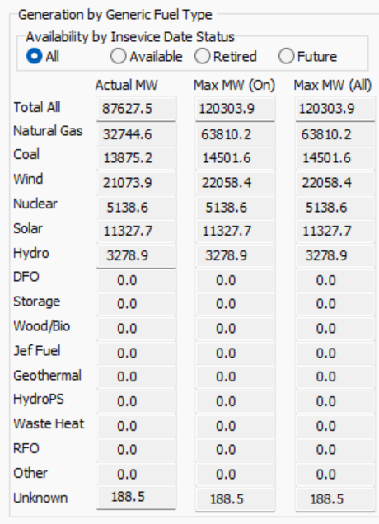
Design Project Overview: Starting Grid Flows and Generation by Fuel Type
Supply Curve

Slide 6
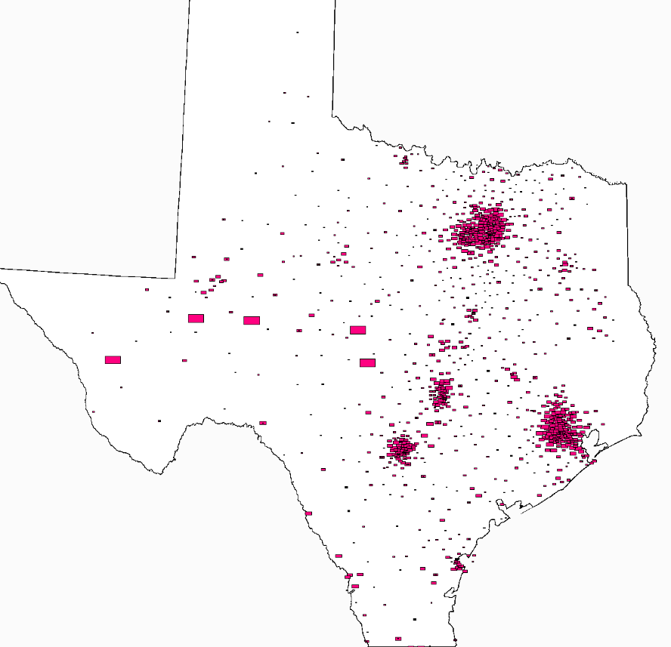
Existing and New Load
This image shows the existing load, with the rectangles proportional to the load
The five large rectangles towards the left represent the new, currently not connected, load

Slide 7
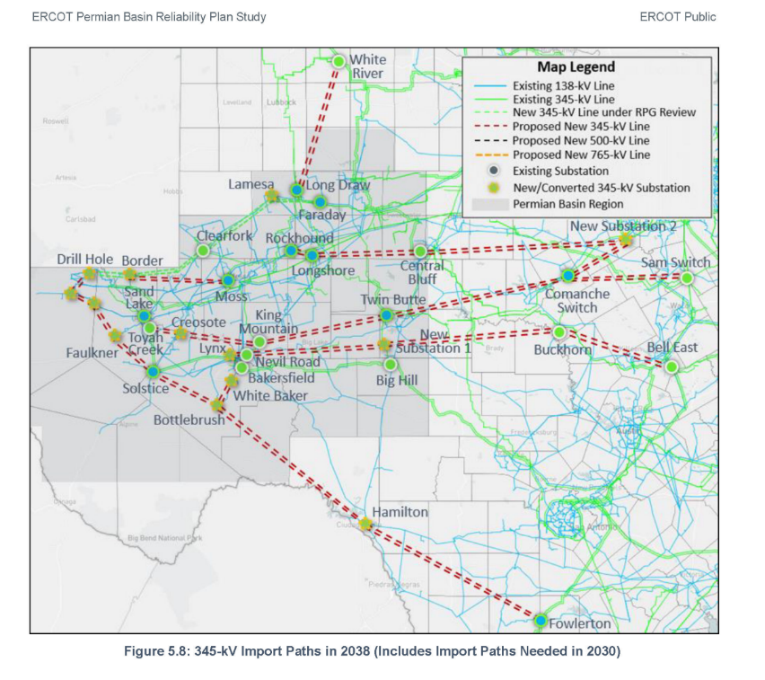
You are Encouraged to Read the ERCOT Report
It will be included with the design project. This image is a solution presented in the report. However,
they are designing for the existing
345/138 kV grid, not your
500/161 kV grid
The ERCOT report is estimating
costs on the order of $ 13 billion

Slide 8
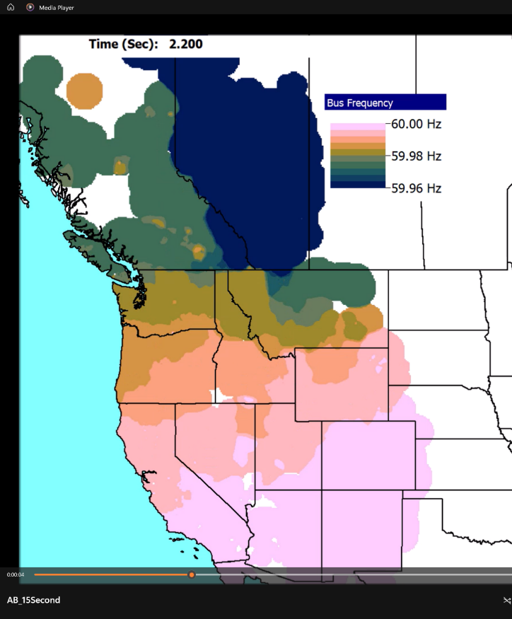
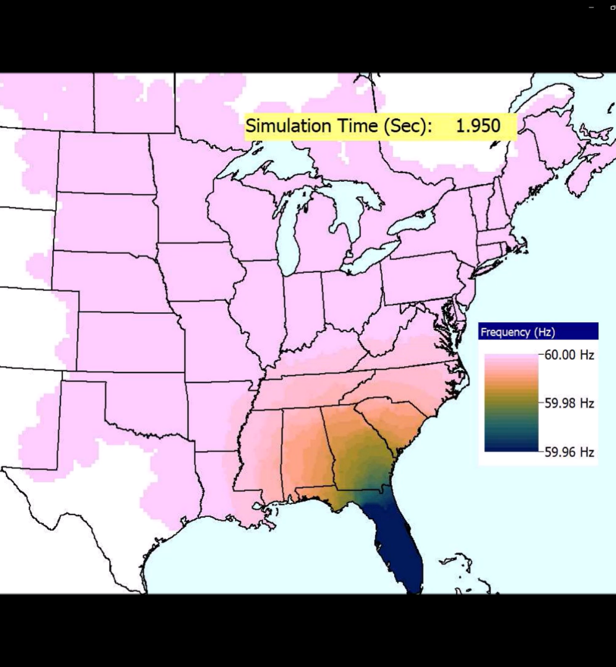
Back to Stability: The Frequency Contour Videos for the West and East from Last Lecture
Video is FreqMovie_WECC
Video is FreqMovie_East

Slide 9
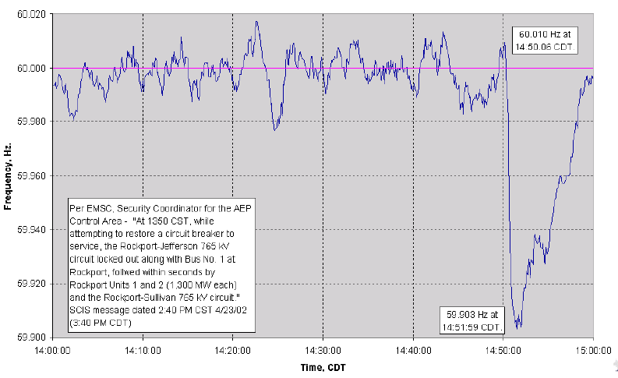
Longer Term Frequency Recovery
Normally the frequency recovers in about ten minutes

Slide 10
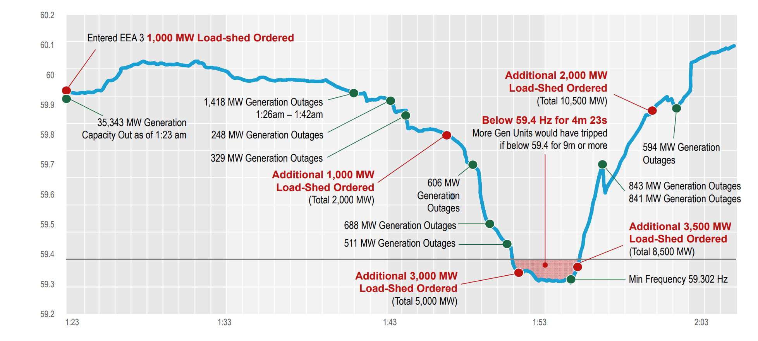
ERCOT Winter Storm Uri Frequency (2/15/21)
Image source: https://www.ercot.com/files/docs/2021/03/03/Texas_Legislature_Hearings_2-25-2021.pdf

Slide 11
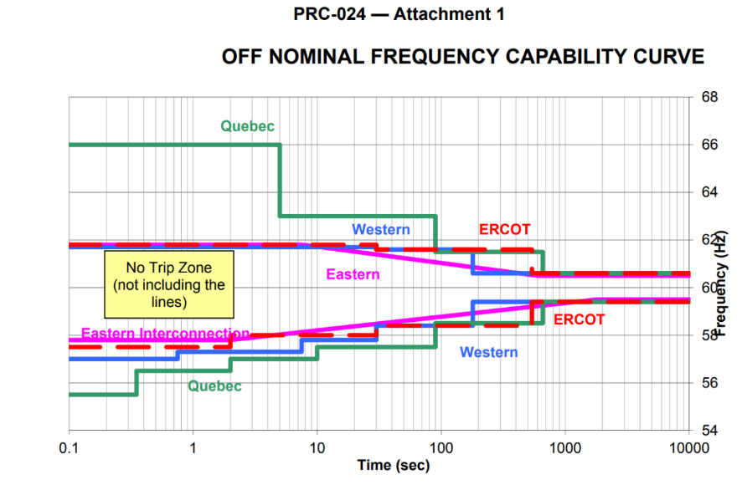
Generator Under and Over Frequency Protection
Generators have automatic protection systems to trip them if the frequency goes out of range for too long (also their voltage)
A typical concern with off-nominal frequency operation is the turbine (i.e., not the synchronous machine) operating at close to one of its natural frequencies, resulting in accelerated aging (metal fatigue); this is often shown using a Campbell diagram; see IEEE C37.106.2022
NERC Standard PRC-024.1

Slide 12
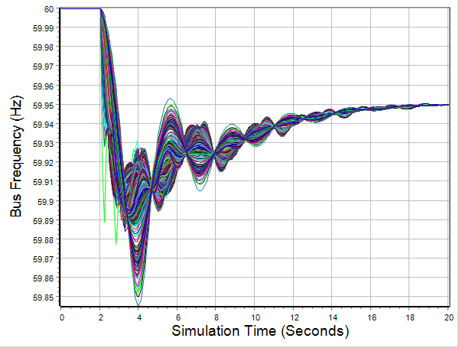
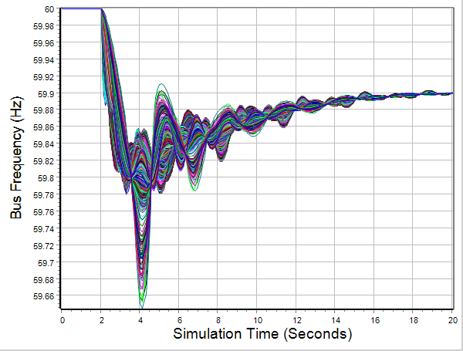
2000 Bus Generator Outage Example
To do an example larger case generator drop stability study, open the case
Texas2000_GenDrop
  Case has 67,000 MW of load; contingency is the loss of a 1350 MW generator
  Go to the Transient Stability form and click Run Transient Stability
  Rerun but drop two generators (one event is initially disabled)
1350 MW loss
2700 MW loss

Slide 13
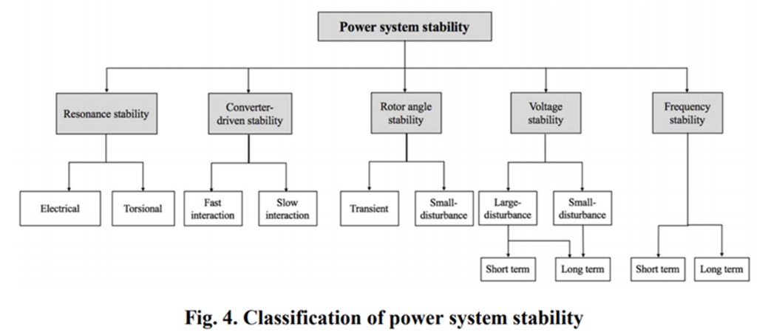
Generator Transient Stability Models
In order to study the transient response of a power system we need to develop models for the generator valid during the transient time frame of several seconds following a system disturbance
We need to develop both electrical and mechanical models for the generators
With the models, we’re starting here

Slide 14
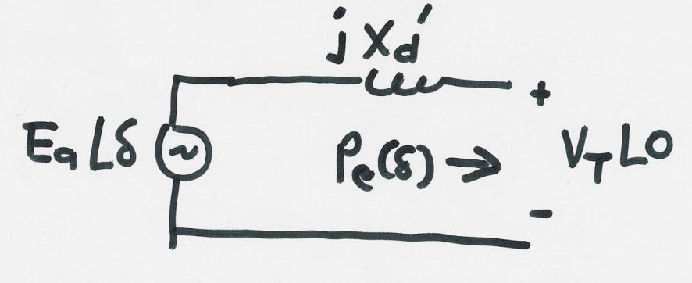
Generator Electrical Model
The simplest generator model, known as the classical model, treats the generator as a voltage source behind the direct-axis transient reactance; the voltage magnitude is fixed, but its angle changes according to the mechanical dynamics
This is an old model that is no longer used in practice, but is a good place to start

Slide 15
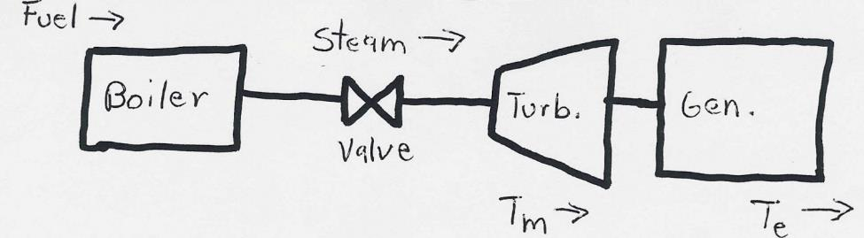
Generator Mechanical Model
Generator Mechanical Block Diagram

Slide 16
Generator Mechanical Model, cont’d
Constant mechanical power is no longer used in studies, but it is a good place to start

Slide 17
Generator Mechanical Model, cont’d

Slide 18
Generator Mechanical Model, cont’d

Slide 19
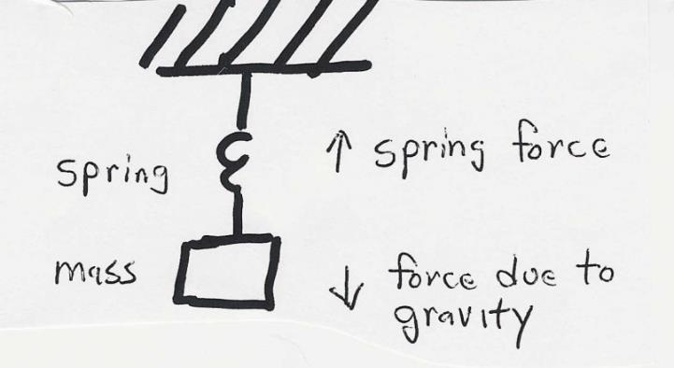
Generator Swing Equation

Slide 20
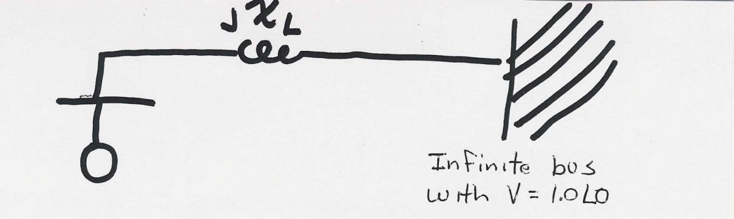
Single Machine Infinite Bus (SMIB)
To understand the transient stability problem we’ll first consider the case of a single machine (generator) connected to a power system bus with a fixed voltage magnitude and angle (known as an infinite bus) through a transmission line with impedance jX_{L}

Slide 21
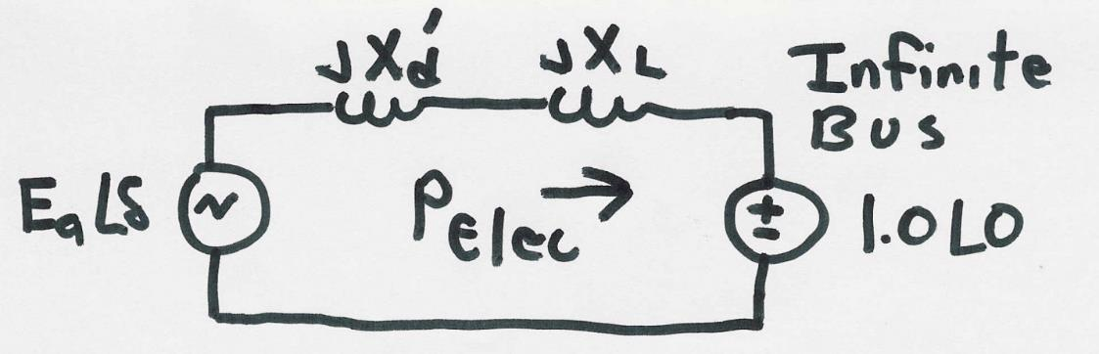
SMIB, cont’d

Slide 22
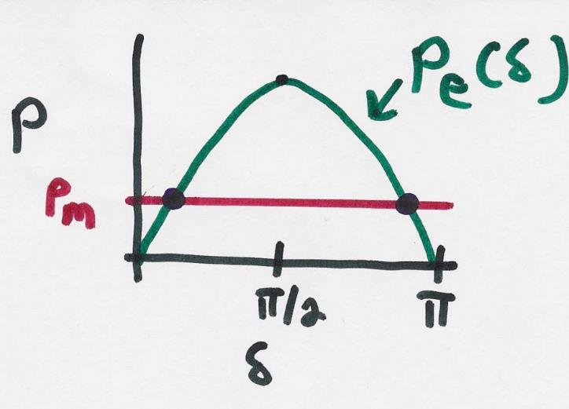
SMIB Equilibrium Points

Slide 23
Transient Stability Analysis
For classical transient stability analysis we need to consider three systems
  Prefault - before the fault occurs the system is assumed to be at an equilibrium point
  Faulted - the fault changes the system equations, moving the system away from its equilibrium point
  Postfault - after fault is cleared the system hopefully returns to a new operating point
Actual stability studies can have multiple events and can be much more involved; however, this is a good place to start

Slide 24
Transient Stability Solution Methods
There are two methods for solving the transient stability problem
  Direct or energy methods; for a two bus system this method is known as the equal area criteria
    mostly used to provide an intuitive insight into the transient stability problem
  Numerical integration
    this is by far the most common technique, particularly for large systems; during the fault and after the fault the power system differential equations are solved using numerical methods
23

Slide 25
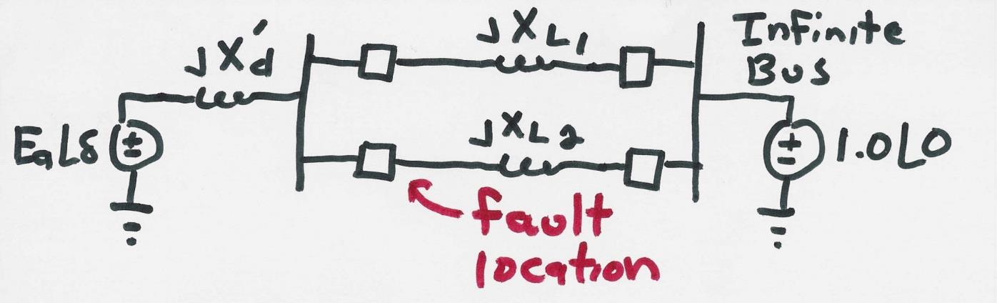
SMIB Direct Method Example
Assume a generator is supplying power to an infinite bus through two parallel transmission lines. Then a balanced three phase fault occurs at the terminal of one of the lines. The fault is cleared by the opening of this line’s circuit breakers.

Slide 26
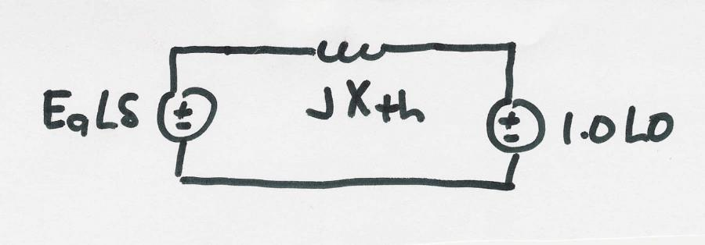
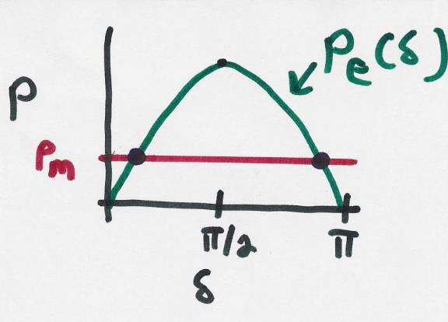
SMIB Example, cont’d
Simplified prefault system

Slide 27
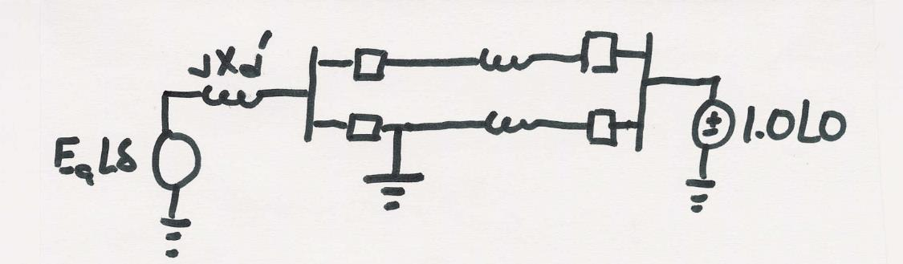
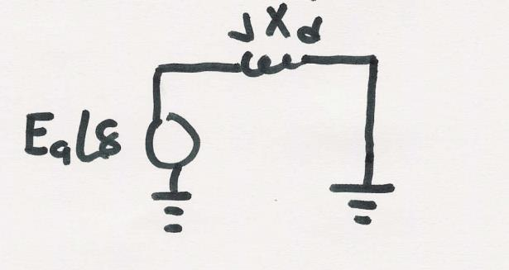
SMIB Example, Faulted System
During the fault the system changes
The equivalent system during the fault is then
During this fault (i.e., a balanced three-phase one) no power can be transferred from the generator to the system
26

Slide 28
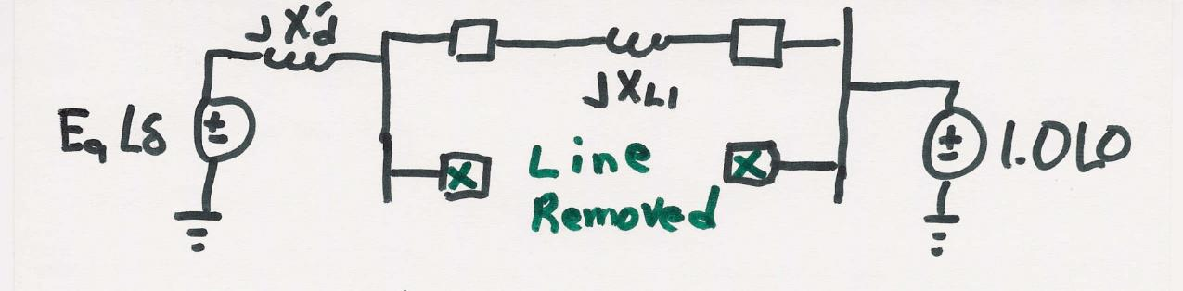
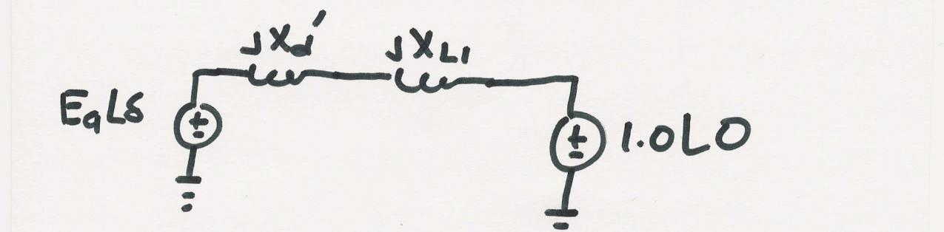
SMIB Example, Post Fault System
After the fault the system again changes
The equivalent system after the fault is then

Slide 29
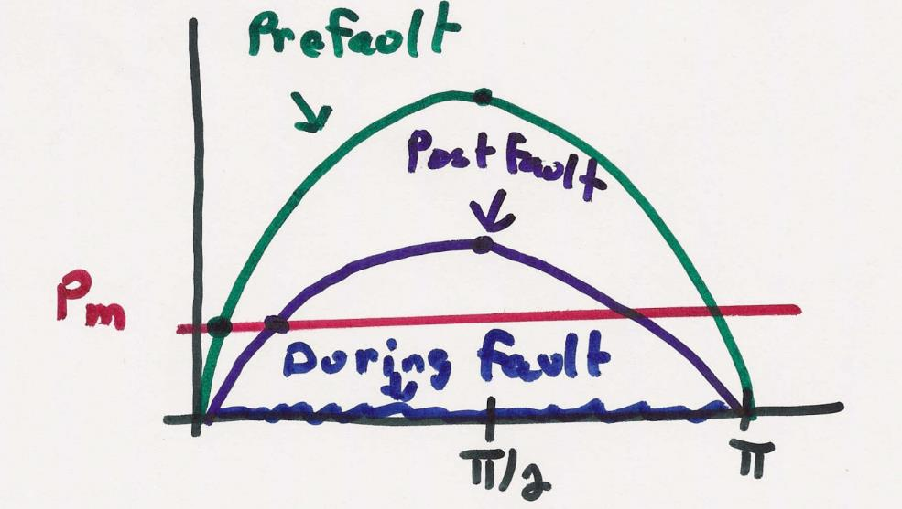
SMIB Example, Dynamics

Slide 30
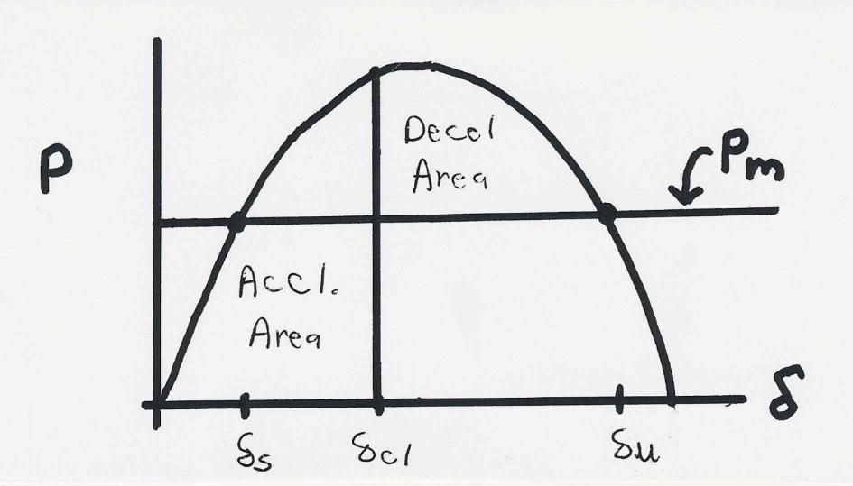
Equal Area Criteria
The goal of the equal area criteria is to try to determine whether a system is stable or not without having to completely integrate the system response.
System will be stable after the fault if the deceleration (Decel) area is greater than the acceleration (Accel.) area
29

Slide 31
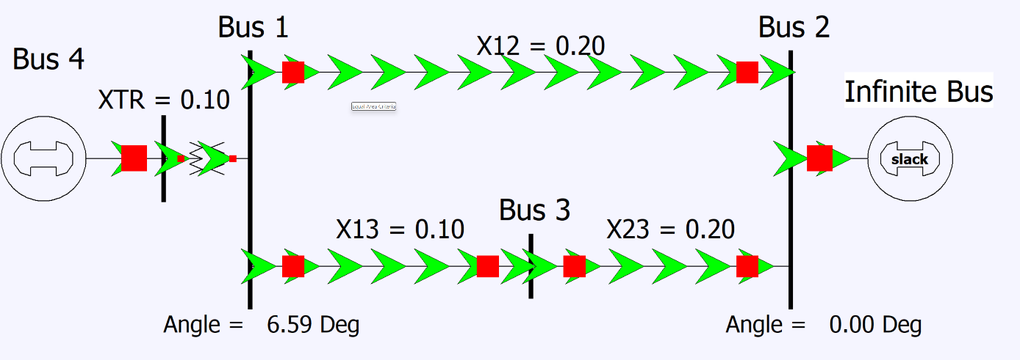
Example 12.4: Undamped
Assume there is a balanced three-phase fault at Bus 1, meaning that during the fault no power can be transferred from the generator to the rest of the system.
30

Slide 32
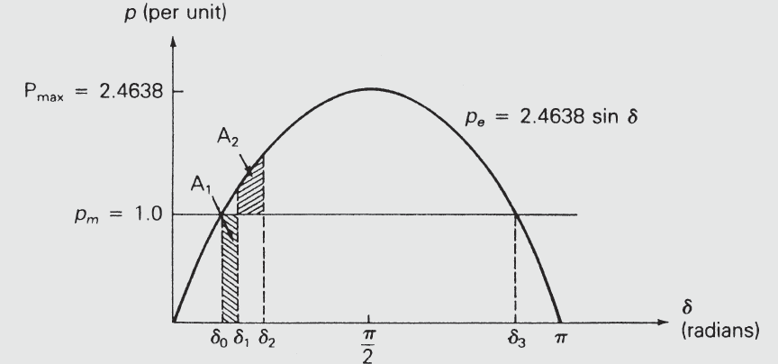
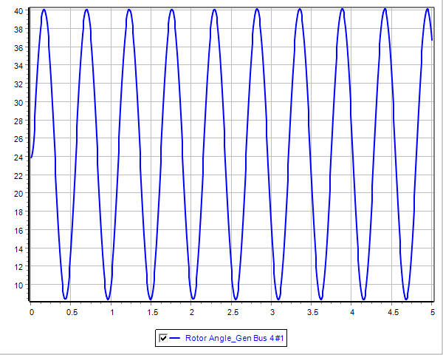
Examples 12.4 and 5: Equal Area
The critical clearing time is slightly less than 0.19 seconds
31

