Slide 1
ECEN 460 Power System Operation and Control Spring 2025
Lecture 18: Design Project, Power System Stability
Prof. Tom Overbye
Dept. of Electrical and Computer Engineering
Texas A&M University
overbye@tamu.edu

Slide 2
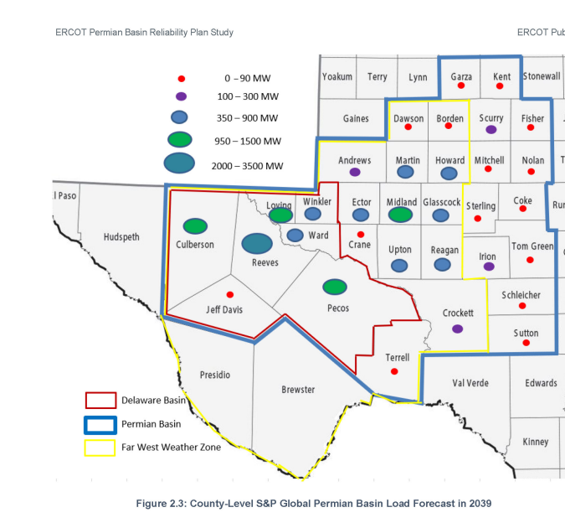
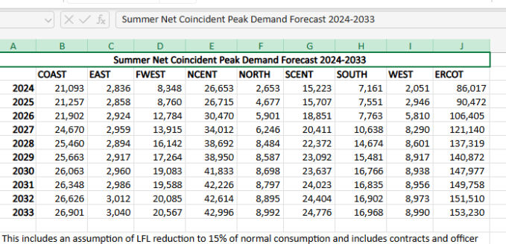
Design Project Overview
The goal of the project is to give experience in planning new transmission for a relatively large-scale electric grid while working as part of a four person engineering design team
Project is motivated by the July 2024 ERCOT report to plan for new transmission in the Permian Basin to accommodate large amounts of new load

Slide 3
Design Project Overview, cont.
Since the actual grid models are not publicly available due to them being CEII, you’ll be working with an enhanced version of the 2000 bus grid we’ve been using in 460
This enhanced grid has much more wind and solar and a higher load; this grid uses at 500/230/161/115 kV transmission grid
Your design goal is to optimally provide reliable electricity to 5 new loads in (or close to) the Permian Basin, with each load requiring 1000 MW at 230 kV
There will be a number of assumptions to simplify the project, including using a DC OPF, only considering four distinct operating points, and ignoring all contingencies except those associated with your new transmission lines and transformers

Slide 4
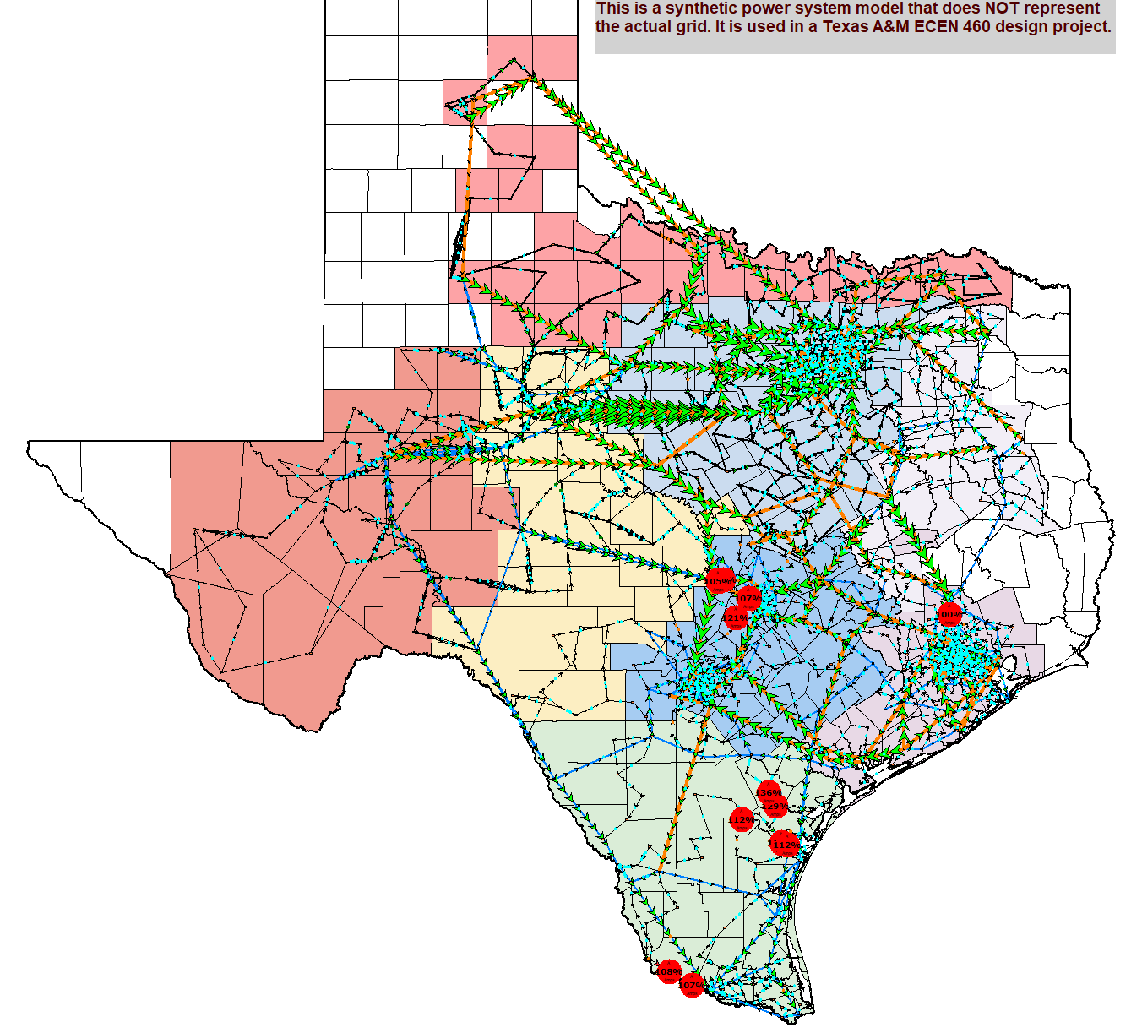
Design Project Overview: Starting Grid Flows and Generation by Fuel Type
Available generation by fuel type
3

Slide 5
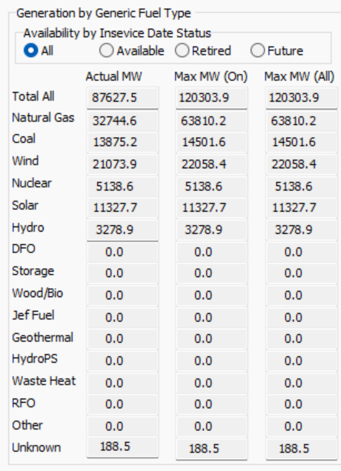
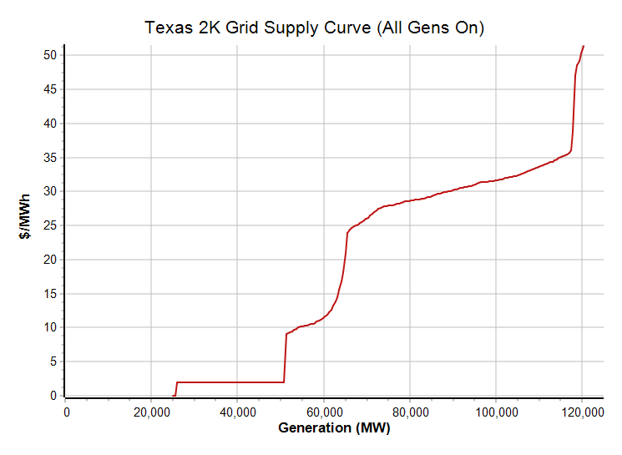
Design Project Overview: Generation by Fuel Type and Total Generation Supply Curve
Supply Curve

Slide 6
Existing and New Load
This image shows the existing loads, with the ovals proportional to the load
A layout algorithm has been used to remove overlap, somewhat expanding the large metro areas
The five large ovals towards the left represent the new, currently not connected, load

Slide 7
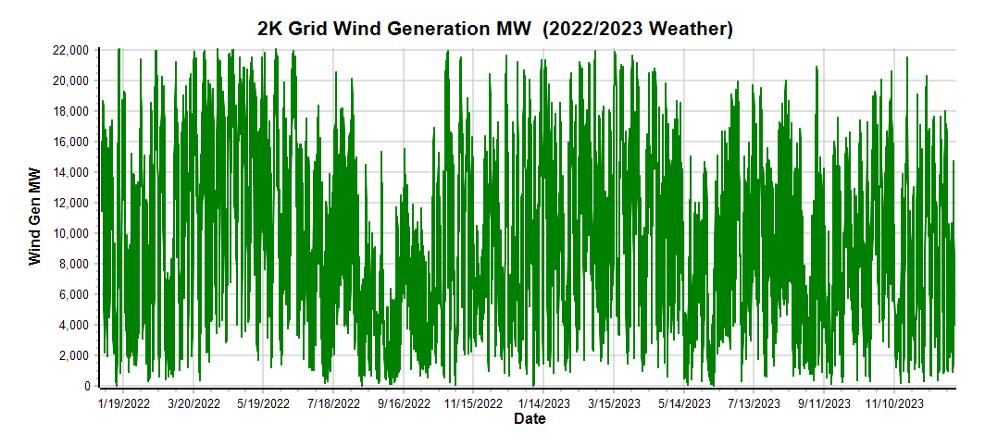
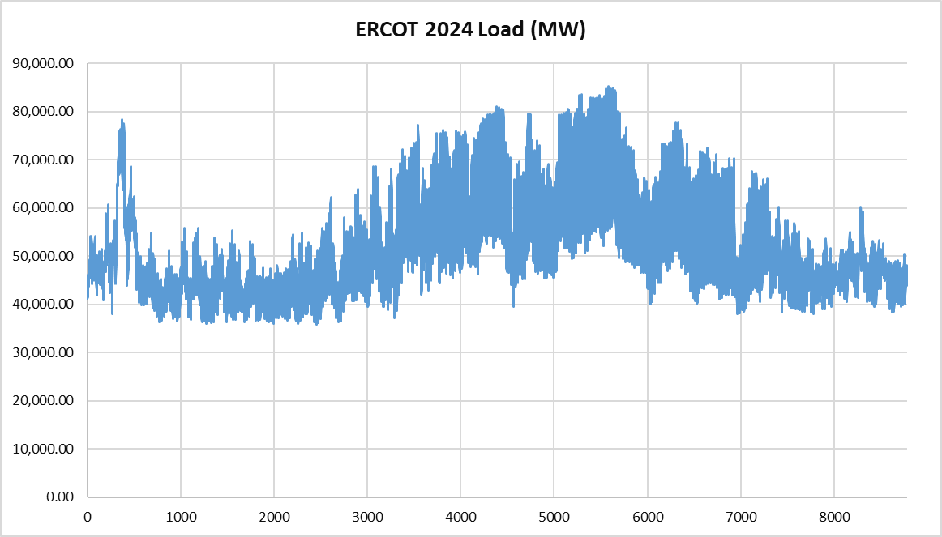
Design Project Scenarios
A transmission system design needs to work well under varying system conditions. In ERCOT key system variations are due to 1) the changing load, and 2) varying amounts of wind and solar generation
6

Slide 8
Design Project Scenarios, Cont.
To simplify the design project, we’ll just be considering four scenarios, with the assumption that the system operates in each scenario for 25% of the time
Maximum load, with maximum wind and solar available (Texas2K_ScenarioA)
80% load with high solar, low wind (August 15, 2023 at 4 pm) (Texas2K_ScenarioB)
70% load with low solar, low wind (August 25, 2022 at 9 am) (Texas2K_ScenarioC)
60% load with medium wind, no solar (May 2, 2023 at 2 am) (Texas2K_ScenarioD)
In all scenarios the five new loads stay fixed at 1000 MW each
Assume transmission right-of-way (ROW) lengths are 120% of the geographic distance between the substations;
there are many online tools to allow you to calculate geographic distance (e.g., www.nhc.noaa.gov/gccalc.shtml)
7

Slide 9
Design Project Lines and Transformers
To serve the new loads you’ll need to modify the grids by adding some combination of
500 kV lines with a fixed cost of $15 million and variable costs of $3 million per mile; X=0.0002 pu per mile, rating of 1600 MVA, max ROW length of 200 miles
230 kV lines with a fixed cost of $8 million and variable costs of $1.3 million per mile, X=0.0012 pu per mile, rating of 400 MVA, max ROW length of 115 miles
500 kV/230 kV transformers with a total cost of $12 million, X=0.015, MVA of 1100
230/115 kV transformers with a total cost of $1.8 million, X=0.05, MVA of 200
Upgrading a 230 kV substation to 500KV is $8 million; a new 500 kV substations costs $11 million plus an extra $2.5 million to also include 230 kV. A new 230 kV substation costs $ 6 million.
Existing lines cannot be modified except you can open them if desired. Do not make any new connections with the existing 161 kV lines
8

Slide 10
Adding New Simulator Objects via Spreadsheet
Simulator has a number of ways to automate the addition of new objects (e.g., lines, transformers, buses and substations) or modifying existing objects
One approach is in the Edit Mode to paste new objects into a Case Information Display from a spreadsheet
Pasting requires 1) the spreadsheet has a description of the data in the first row and column (e.g., Substation, Bus, Branch), 2) Key and Required field headers in the second row, and then 3) data in subsequent rows
Examples are included in the Example_Design_Changes .xls file
9

Slide 11
Example_Design_Changes File
This file is used to create a new 500/230 kV substation, adding two new buses, a transformer between the buses, and two transmission lines connecting it to other buses; first paste in the substation data, then the buses, then the lines
10

Slide 12
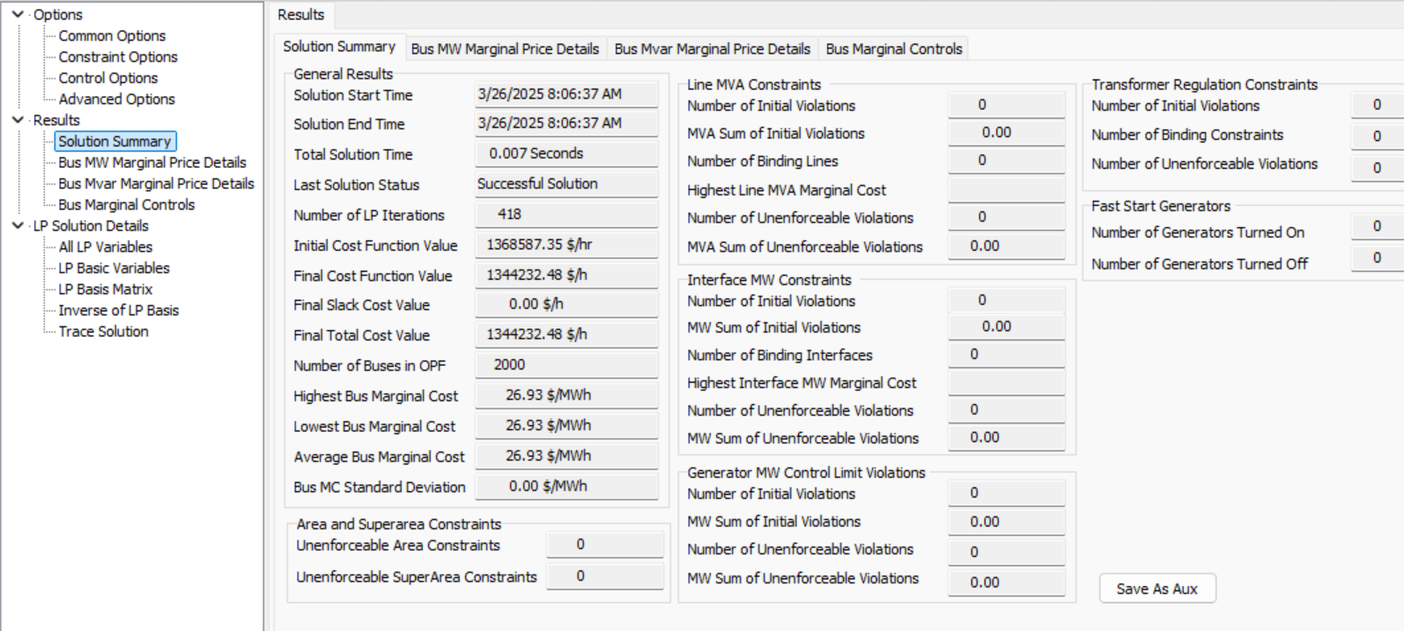
DC OPF Solutions
With the new transmission grid additions, for each scenario you’ll ultimately be solving a DC OPF solution
A key value from the solution is the Final Total Cost Value in $/hr
This is shown on the Add Ons, OPF Case Info, OPF Options and Results dialog, Solution Summary Page
It is OK to have some congestions, but there should be no unenforceable constraints
11

Slide 13
Your Goal
The overall goal is to minimize the sum of the total yearly production cost plus 0.129 times the new transmission costs
The total yearly production cost is calculated assuming the grid operates in each of the four scenarios for 25% of the time over a year (i.e., 2190 hours each). So, to get the total yearly production cost sum the Total Final Cost Values for each of the four scenarios and multiply by 2190.
The 0.129 (12.9%) is based on the value ERCOT uses in their production cost savings test associated with the first-year annual revenue requirement
Example: if the hoursly costs for the scenarios are 1.6, 1.4, 1.2 and 1.0 million dollars per hour, and your total transmission costs are two billion dollars, then the total value in million dollars is 2190*(1.6 + 1.4 + 1.2 + 1.0) + 0.129*2000 = $11.646 billion
12

Slide 14
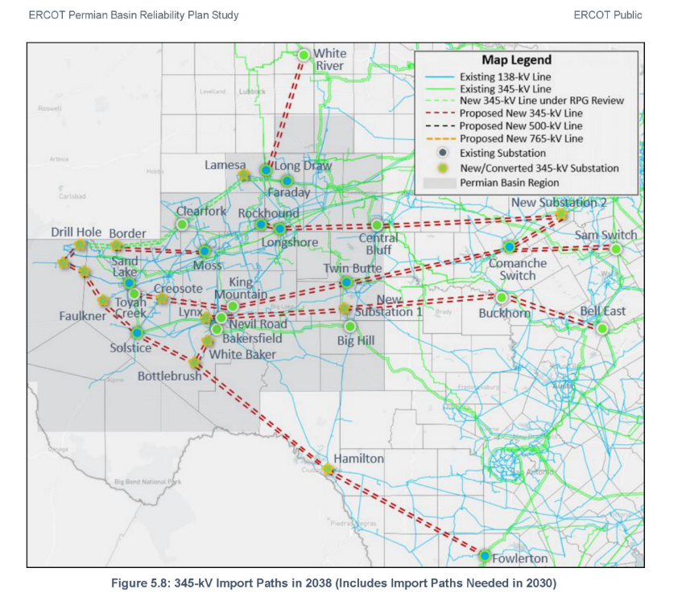
You are Encouraged to Read the ERCOT Report
It will be included with the design project. This image is a solution presented in the report. However, they are designing for the existing 345/138 kV grid, not your 500/161 kV grid
The ERCOT report is estimating costs on the order of $ 13 billion

Slide 15
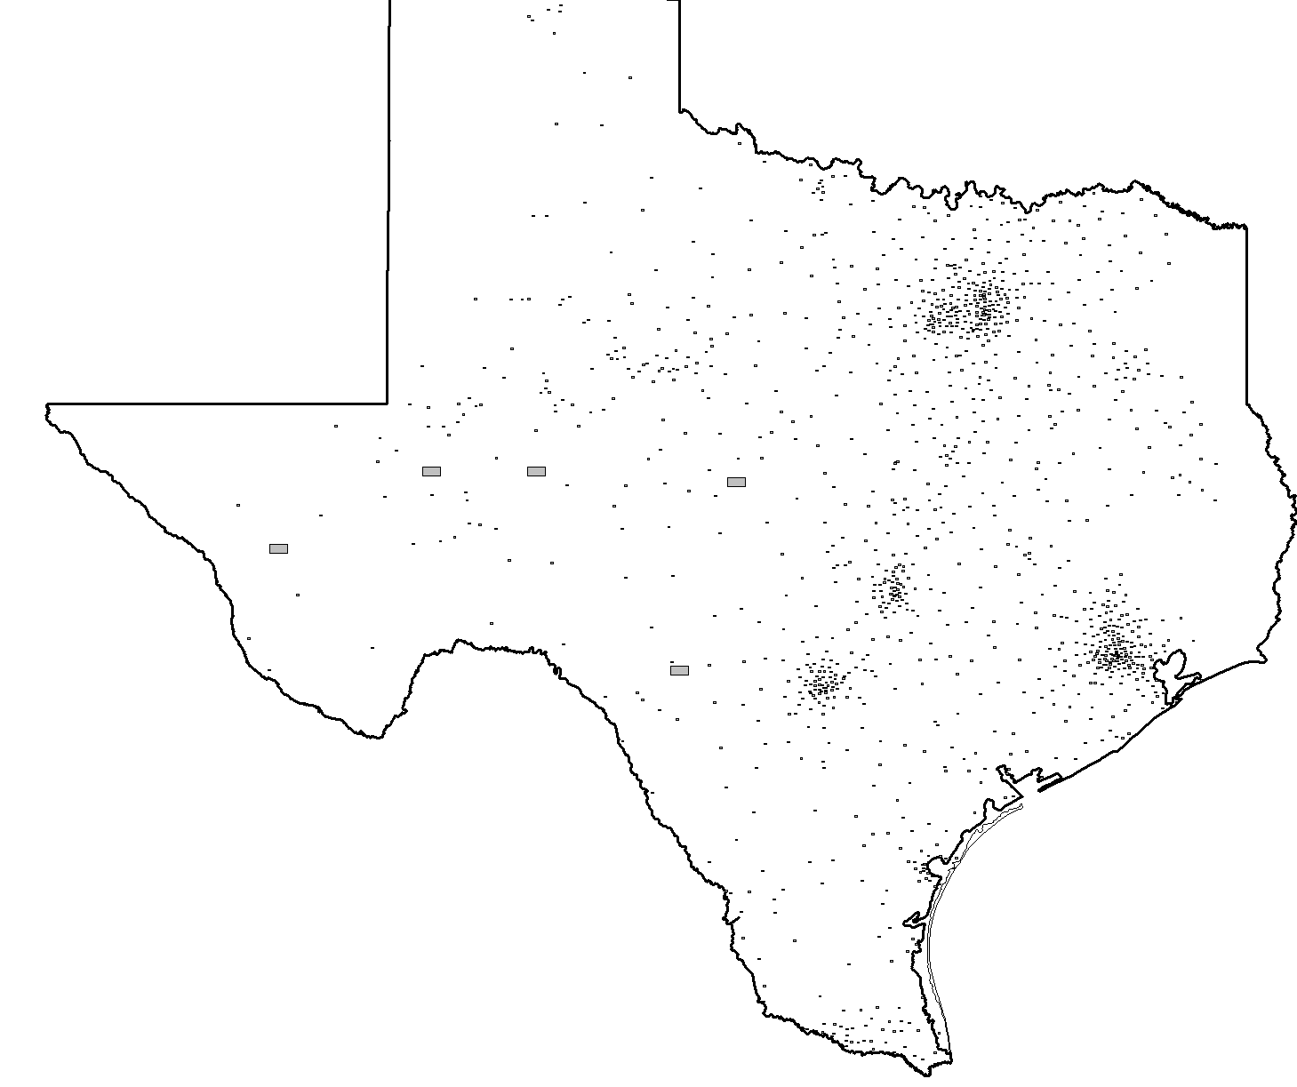
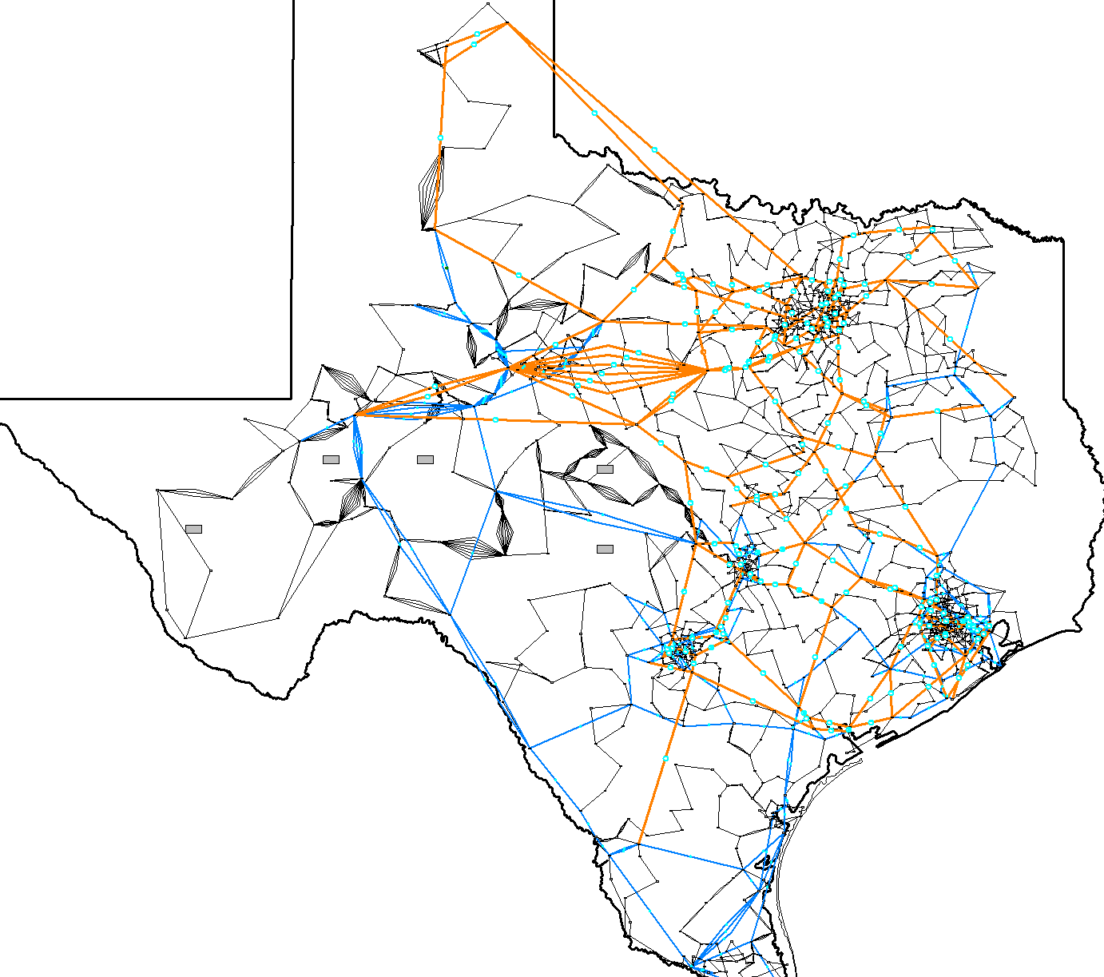
Quickly Auto-Drawing a Transmission Grid
Simulator does make it extremely easy to auto-draw a transmission grid. To do this with one of the design project cases open, open the oneline Texas_2K_SubGDVDesign; then in the Edit Mode select Draw, Auto Insert, Lines (click Default Drawing Values to Customize), click OK
14

Slide 16
Switching Back to Dynamics: Differential Algebraic Equations
Because of the complexity of modern electric grid, stability is determined using numerical techniques. Many problems, including many in the power area, can be formulated as a set of differential, algebraic equations (DAE) of the form
A power example is transient stability, in which f represents (primarily) the generator dynamics, and g (primarily) the bus power balance equations
We'll initially consider the simpler problem of just
15

Slide 17
Ordinary Differential Equations (ODEs)
Assume we have a problem of the form
This is known as an initial value problem, since the initial value of x is given at some time t₀
We need to determine x(t) for future time
Initial value, x₀, must be either be given or determined by solving for an equilibrium point, f(x) = 0
Higher-order systems can be put into this first order form
Except for special cases, such as linear systems, an analytic solution is usually not possible – numerical methods must be used
16

Slide 18
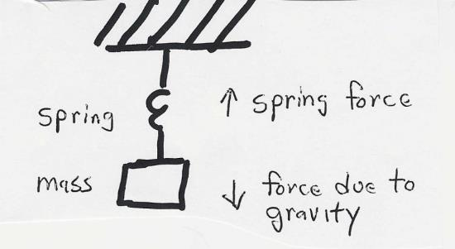
Initial value Problem Examples
Example 2 is similar to the SMIB swing equation
17

Slide 19
Numerical Solution Methods
Numerical solution methods do not generate exact solutions; they practically always introduce some error
Methods assume time advances in discrete increments, called a stepsize (or time step), Δt
Speed accuracy tradeoff: a smaller Δt usually gives a better solution, but it takes longer to compute
Numeric round-off error due to finite computer word size
Key issue is the derivative of x, f(x) depends on x, the value we are trying to determine
A solution exists as long as f(x) is continuously differentiable
18

Slide 20
Numerical Solution Methods
There are a wide variety of different solution approaches, we will only touch on two
One-step methods: require information about solution just at one point, x(t)
Forward Euler
Runge-Kutta
Multi-step methods: make use of information at more than one point, x(t), x(t-Δt), x(t-Δ2t)…
Adams-Bashforth
Predictor-Corrector Methods: implicit
Backward Euler
19

Slide 21
Error Propagation
At each time step the total round-off error is the sum of the local round-off at time and the propagated error from steps 1, 2 , … , k − 1
An algorithm with the desirable property that local round-off error decays with increasing number of steps is said to be numerically stable
Otherwise, the algorithm is numerically unstable
Numerically unstable algorithms can nevertheless give quite good performance if appropriate time steps are used
This is particularly true when coupled with algebraic equations
20

Slide 22
Euler’s Method
The simplest technique for numerically integrating these equations is known as Euler’s method, which dates to about 1768
The key idea is to approximate
Then
In general, the smaller the time step, Δt, the better the approximation
21

Slide 23
Euler’s Method Algorithm
22

Slide 24
Euler’s Method Example 1, cont’d
Consider the exponential decay example with
Since we know the solution, we can compare the accuracy of Euler’s method for different time steps
t | x^{actual}(t) | x(t) Δt=0.1 | x(t) Δt=0.05
0 | 10 | 10 | 10
0.1 | 9.048 | 9 | 9.02
0.2 | 8.187 | 8.10 | 8.15
0.3 | 7.408 | 7.29 | 7.35
… | … | … | …
1.0 | 3.678 | 3.49 | 3.58
… | … | … | …
2.0 | 1.353 | 1.22 | 1.29
23

Slide 25
Euler’s Method Example 2
24

Slide 26
Euler's Method Example 2, cont'd
25

Slide 27
Euler's Method Example 2, cont'd
t | x₁^{actual}(t) | x₁(t) Δt=0.25
0 | 1 | 1
0.25 | 0.9689 | 1
0.50 | 0.8776 | 0.9375
0.75 | 0.7317 | 0.8125
1.00 | 0.5403 | 0.6289
… | … | …
10.0 | -0.8391 | -3.129
100.0 | 0.8623 | -151,983
Since we know from the exact solution that x₁ is bounded between -1 and 1, clearly the method is not working well, and is actually numerically unstable. Below is a comparison of the solution values for x₁(t) at time t = 10 seconds
Δt | x₁(10)
actual | -0.8391
0.25 | -3.129
0.10 | -1.4088
0.01 | -0.8823
0.001 | -0.8423
26

Slide 28
Second Order Runge-Kutta Method
Runge-Kutta methods improve on Euler's method by evaluating f(x) at selected points over the time step
Simplest method is the second order method in which
That is, k₁ is what we get from Euler's; k₂ improves on this by reevaluating at the estimated end of the time step
27

Slide 29
RK2 Oscillating Cart
Consider the same example from before the position of a cart attached to a lossless spring. Again, with initial conditions of x₁(0) =1 and x₂(0) = 0, the analytic solution is x₁(t) = cos(t)
With Δt=0.25 at t = 0
28

Slide 30
Comparison
The below table compares the numeric and exact solutions for x₁(t) using the RK2 algorithm
time | actual x₁(t) | x₁(t) with RK2 Δt=0.25
0 | 1 | 1
0.25 | 0.9689 | 0.969
0.50 | 0.8776 | 0.876
0.75 | 0.7317 | 0.728
1.00 | 0.5403 | 0.533
10.0 | -0.8391 | -0.795
100.0 | 0.8623 | 1.072
The below table compares the x₁(10) values for different values of Δt; recall with Euler's with Δt=0.1 was -1.41 and with 0.01 was -0.8823
Δt | x₁(10)
actual | -0.8391
0.25 | -0.7946
0.10 | -0.8310
0.01 | -0.8390
0.001 | -0.8391
29

Slide 31
RK2 Versus Euler's
RK2 requires twice the function evaluations per iteration, but gives much better results
With RK2 the error tends to vary with the cube of the step size, compared with the square of the step size for Euler's
The smaller error allows for larger step sizes compared to the Euler Method
30

Slide 32
Multistep Methods
Euler's and Runge-Kutta methods are single step approaches, in that they only use information at x(t) to determine its value at the next time step
Multistep methods take advantage of the fact that using we have information about previous time steps x(t-Δt), x(t-2Δt), etc
These methods can be explicit or implicit (dependent on x(t+Δt) values; we'll just consider the explicit Adams-Bashforth approach
31

Slide 33
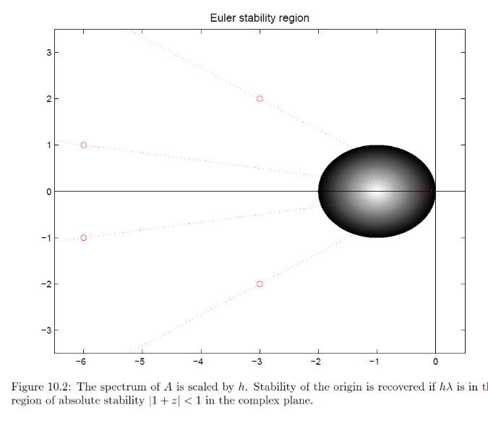
Numerical Instability
All explicit methods can suffer from numerical instability if the time step is not correctly chosen for the problem eigenvalues
Values are scaled by the time step; the shape for RK2 has similar dimensions but is closer to a square. Key point is to make sure the time step is small enough relative to the eigenvalues.
Image source: http://www.staff.science.uu.nl/~frank011/Classes/numwisk/ch10.pdf
32

Slide 34
Implicit
Implicit solution methods have the advantage of being numerically stable over the entire left half plane
Only method considered here is the Backward Euler
We’ll only consider linear equations
33

Slide 35
Backward Euler Cart Example
Returning to the cart example
Results with Δt = 0.25 and 0.05
time | actual x₁(t) | x₁(t) with Δt=0.25 | x₁(t) with Δt=0.05
0 | 1 | 1 | 1
0.25 | 0.9689 | 0.9411 | 0.9629
0.50 | 0.8776 | 0.8304 | 0.8700
0.75 | 0.7317 | 0.6774 | 0.7185
1.00 | 0.5403 | 0.4935 | 0.5277
2.00 | -0.416 | -0.298 | -0.3944
Note: Just because the method is numerically stable doesn't mean it is error free! RK2 is more accurate than backward Euler with a small enough timestep.
34

Slide 36
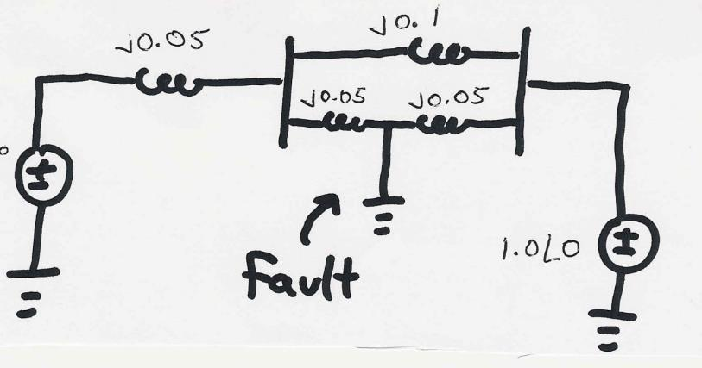
Transient Stability Example
A 60 Hz generator is supplying 550 MW to an infinite bus (with 1.0 per unit voltage) through two parallel transmission lines. Determine initial angle change for a fault midway down one of the lines. H = 20 seconds, D = 0.1. Use Δt = 0.01 second.
E_{a}
35

Slide 37
Transient Stability Example, cont'd
36

Slide 38
Transient Stability Example, cont'd
37

Slide 39
Transient Stability Example, cont'd
38

Slide 40
Two-Axis Synchronous Machine Model
Classical model is appropriate only for the most basic studies; no longer widely used in practice
More realistic models are required to couple in other devices such as exciters and governors
A more realistic synchronous machine model requires that the machine be expressed in a reference frame that rotates at rotor speed
Standard approach is d-q reference frame, in which the major (direct or d-axis) is aligned with the rotor poles and the quadrature (q-axis) leads the direct axis by 90°
39

Slide 41
Synchronous Machine Modeling
Damper windings are added to help damp out oscillations
3φ bal. windings (a,b,c) – stator
Field winding (fd) on rotor
Damper in “d” axis
(1d) on rotor
2 dampers in “q” axis
(1q, 2q) on rotor
40

Slide 42
Two Main Types of Synchronous Machines
Round Rotor
Air-gap is constant, used with higher speed machines
Salient Rotor (often called Salient Pole)
Air-gap varies circumferentially
Used with many pole, slower machines such as hydro
Narrowest part of gap in the d-axis and the widest along the q-axis
Book Chapter 9 Photo
41

Slide 43
D-q Reference Frame
Analyzing synchronous machines is done using Park’s transformation (from 1929) to change the machine differential equations with time-varying components into a set of equations with time invariant components
That is, the machine voltages and currents are “transformed” into what is known as the d-q reference frame using the rotor angle, δ
Terminal voltage in network (power flow) reference frame are V_{T} = V_{r} - V_{i}
42

Slide 44
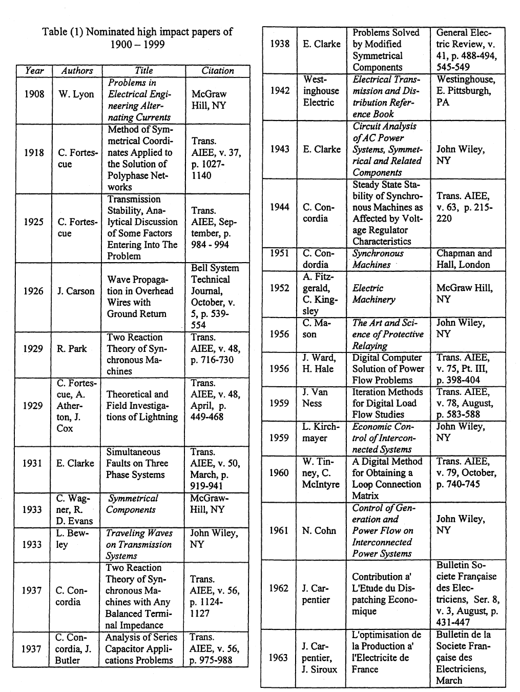
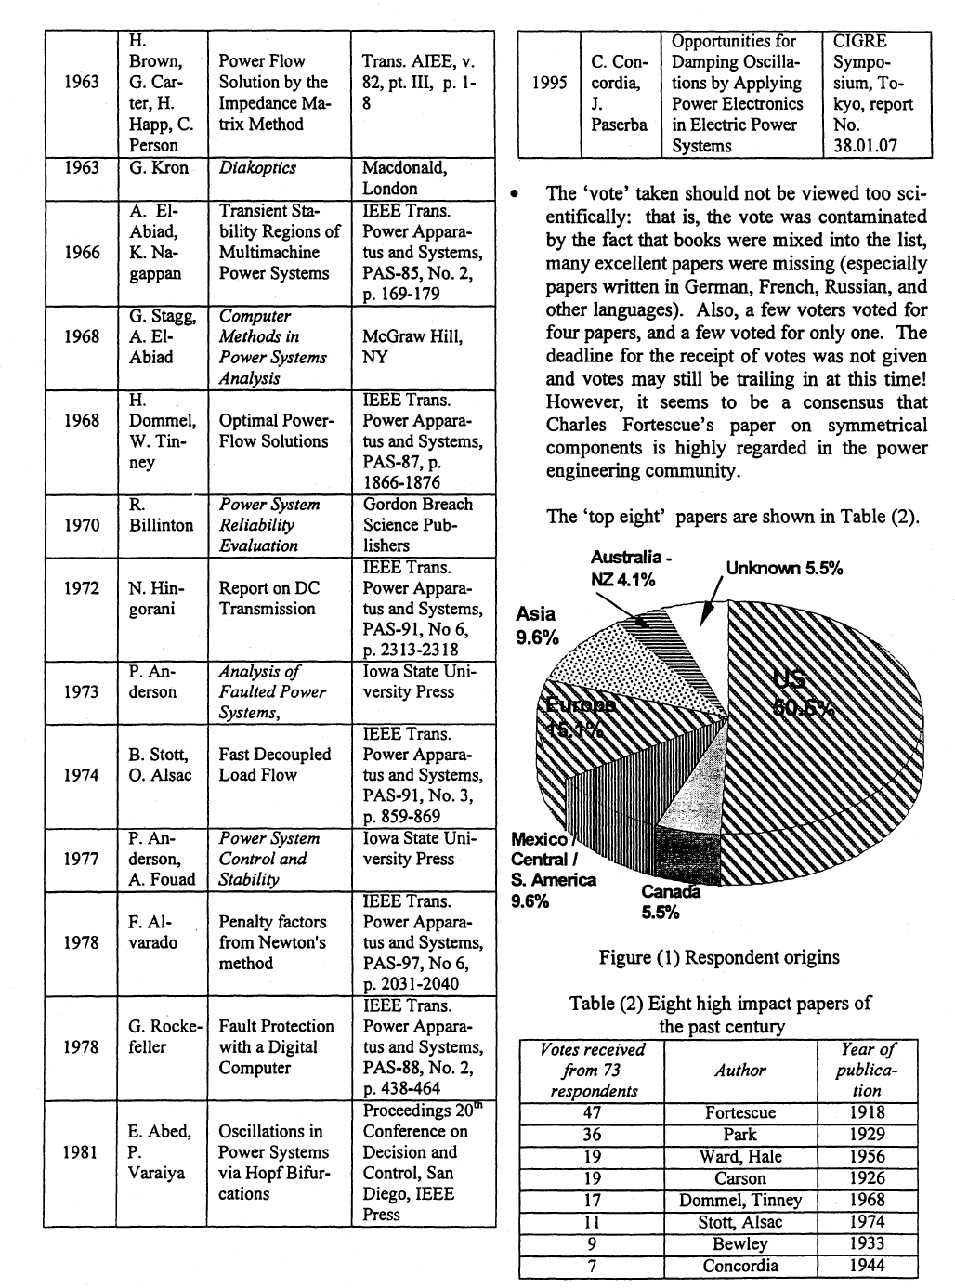
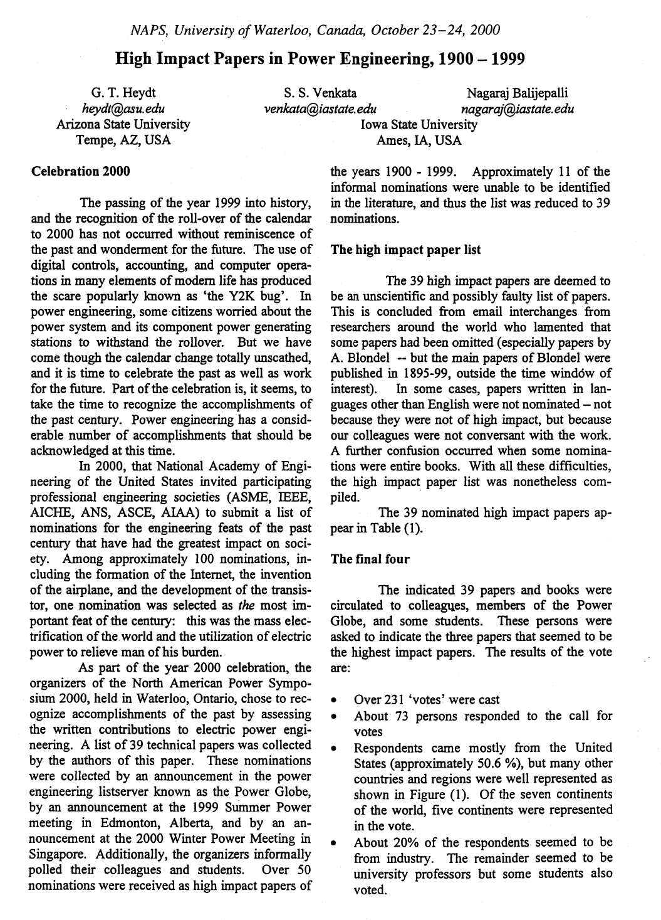
Top Electric Power Papers of the 20th Century
In 2000 Park’s paper was voted the second most important power paper of the 20th Century
43

