Slide 1
Application of Weather and Other Environmental Inputs in PowerWorld Simulator Version 24
Thomas J. Overbye
O’Donnell Foundation Chair III
Texas A&M University overbye@tamu.edu March 13, 2025

Slide 2
Overview
The purpose of this presentation is to show the benefits of having weather information become a standard part of power flow analysis and more broadly electric grid planning, and to show how everyone can easily begin using weather data today (at least for North America)
The results also apply to related applications such as optimal power flow (OPF), contingency analysis, security-constrained OPF
This presentation builds on the one I gave in April 2024, covering some of the many recent developments with a tutorial focus
A few of the more recent PowerWorld developments are covered, including what is in the newly released Version 24 (March 2025)

Slide 3
Aside: Upcoming Short Courses
At Texas A&M in College Station TX in 2025
Full details at epg.engr.tamu.edu/short-courses-main/
Electric Grid Impacts of Geomagnetic Disturbances (March 18-19)
Primer on the Planning and Operation of Large- Scale Electric Grids (Sept 9-11)
Fundamentals of Electric Transmission System Planning (Oct 7-9)
Introduction of Artificial Intelligence in Power Systems (Nov 4-6)

Slide 4
Using Weather with PowerWorld Simulator
Over the last three years PowerWorld has gained a lot of weather modeling related capability, and is continuing to gain more
Currently
Past, present and future weather data can be loaded into Simulator
This can be done using *.pww, *.aux, or *.csv files
Hourly past data is available from 1940 to five days behind real time; present data is available from measurements; future is hourly up to 16 days
The weather impacts the power system models using PFW (Power Flow Weather or Power Flow Whatever) models; PFW models can be thought of like the stability models: they are applied to power system objects (e.g., a generator or line) and different classes of models can be defined
PFW models can be applied automatically in the Time Step Simulation, and applied (currently) on demand in the other applications like power flow

Slide 5
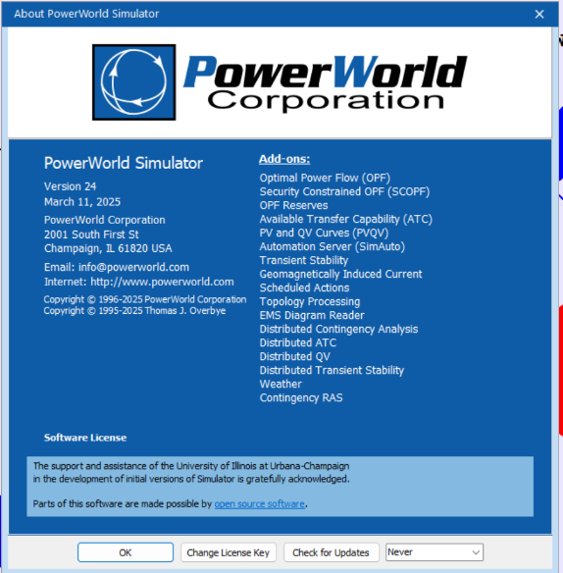
PowerWorld Simulator Version and Build Date
The weather functionality started being available in Version 23, particularly ones with later build dates, with much more now in 24 Currently available as an add-on included in the base package
Much of the weather does not require cases with geographic values, but more can be done when available
Since new Version 24 patches are frequently released, what is available depends on the build date; the Simulator version and build date are available by selecting Window, About
We desire your suggestions on what should be included moving forward

Slide 6
The Power Flow and Weather
Human activity depends on the weather, and this has always been reflected in the electric load
Traditionally some power flow parameters have depended on the weather (e.g., line ratings, turbine max MW, line resistance)
Over the last several decades this dependence has grown substantially with the increase in wind and solar generation
They now (all of 2024) provide about 17% of US electric energy; there are times when most of the electricity in regions is supplied by these sources
They are extremely dependent on the weather
Major power system input parameters are now heavily weather dependent (e.g., wind and solar generator Max MW)

Slide 7
Planning, Weather and Other Resiliency Events
As defined by NERC, planning assessment for large-scale grids is, “Documented evaluation of future transmission system performance and corrective action plans to remedy identified deficiencies”
Planning is forward looking, leveraging historical information
Planning can consider timeframes from near real-time to decades
Weather and other resiliency considerations can include
Inputs to set weather dependent power flow values such as wind, solar (irradiation), temperature for transmission line and transfer limits
Extreme weather including hurricanes, ice storms, derechos, tornados
Other events such as earthquakes, wildfires, geomagnetic disturbances (GMDs), volcanic events, eclipses
This are collectively referred to here as Environmental Inputs (ENIs)

Slide 8
Using Weather and Related Data in the Power Flow
To use weather data and other ENIs in the power flow requires
The availability of geographic information mapping buses to substations, and then geocoordinates for the substations
This is now mostly available for North American grids; PowerWorld has long stored it mostly with the substation records (sometimes the buses)
Large-scale synthetic grids with geographic information are also available
Convenient access to available ENIs (e.g., weather information) over the footprint of interest
For planning often the footprint is large, beyond a single utility
The availability of models that represent the impact of weather and other ENIs on electric grid components

Slide 9
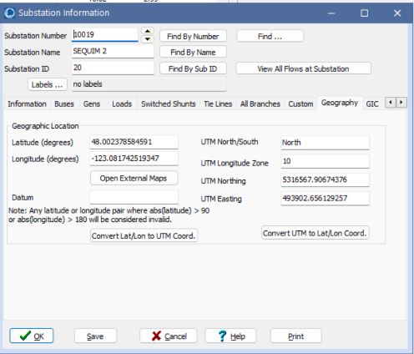
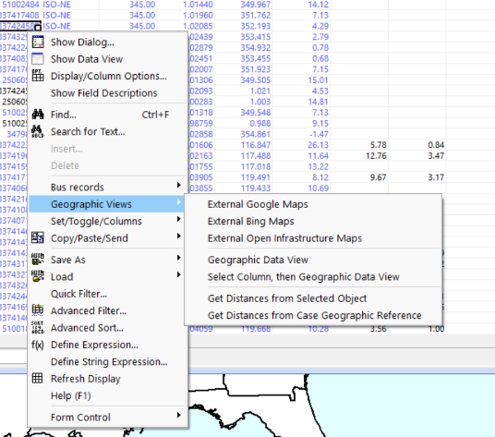
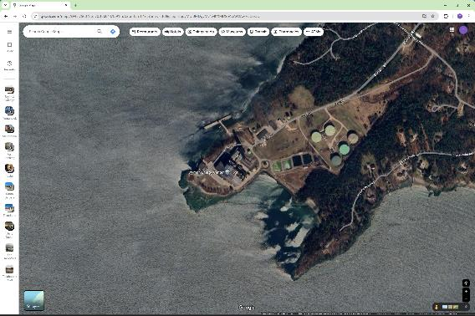
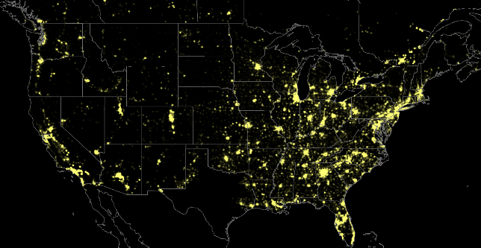
Example Simulator Geographic Displays
Starting with version 24, external maps can easily be displayed using the right-click menu
Geography page from the substation objects
Power flow load density contour created leveraging geographic information

Slide 10
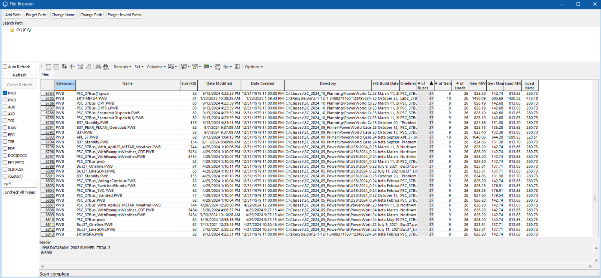
Aside: Rapidly Finding Files Using Simulator
To quickly find stored files, select File, General File Browser
Extra information is shown for *.pwb files, and the right-click menu can used to open the file
This display can be used to find and open files of any time (e.g., *.ppt, *.xls, etc.)

Slide 11
Availability of Weather Information
We started this effort three years back by using historical weather station measurements (mostly identified by their ICAOs [International Civil Aviation Organization], e.g. KLIT, KCLL)
We had lots of data, but much of it had missing values; we also only had surface wind values and no direct solar measurements
Such measurements at specific locations can still be very useful (e.g., at electrical substations)
There are many other sources of free weather information, with good coverage provided by Weather DataSet Needs for Planning and Analyzing Modern Power Systems, Energy Systems Integration Group (ESIG), October 2023
www.esig.energy/wp-content/uploads/2023/10/ESIG-Weather-Datasets-summary-report-2023.pdf

Slide 12
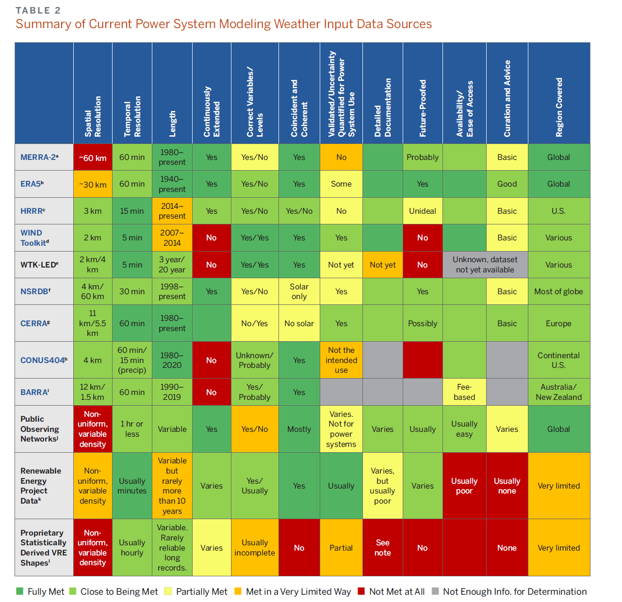
ESIG Report (10/2023)
“These widespread changes lead to the increasing weather-dependence of supply and demand, making power system planning dramatically more complex and requiring much more comprehensive weather data for robust system planning.”
“The work required to achieve a long-term solution to weather data needs is not trivial, but it is manageable and is much less costly than blindly building trillions of dollars of infrastructure without the basic tools to cost effectively optimize it and assess its reliability.”
PowerWorld had started working in planning weather integration about a year before the ESIG report appeared, but much progress has been made in the last 18 months

Slide 13
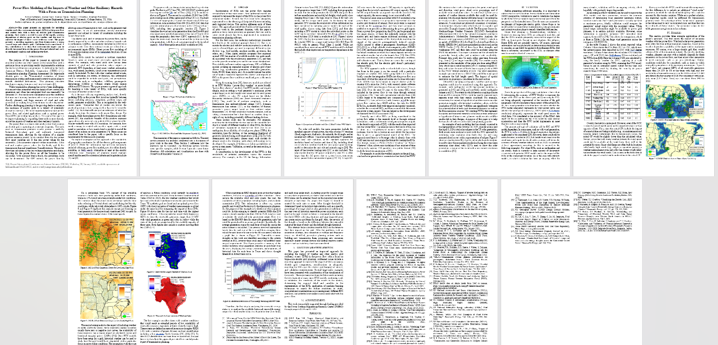
HICSS 2025 Paper on Power Flow Weather Modeling
I have a paper in the 59th Hawaii International Conference on System Sciences (HICSS) titled, “Power Flow Modeling of the Impacts of Weather and Other Resiliency Hazards With a Focus on Transmission Planning,”; available at overbye.engr.tamu.edu/publications

Slide 14
Simulator Weather Data Access
With respect to weather, PowerWorld’s goal is to make it easy to use a wide variety of weather information in all power system planning timeframes, ranging from near real-time to long duration
We’re working on a variety of ways to make weather information available
The Power Weather (*.pww) files use a binary format to store weather information and potentially other environmental inputs for a set of time points and a set of locations (e.g., weather stations); the format is relatively general
The timepoints can be either uniformly spaced (e.g., hourly) or individually specified (as is the case with forecasts)
The weather stations do not need to be on a uniform grid

Slide 15
ERA5
One of the datasets we use is ERA5, which is state-of-the art (fifth generation) reanalysis of global climate and weather since 1940
It is available hourly on a 0.25 degree grid and includes 10m and 100m wind, and solar global horizontal irradiance and direct horizontal irradiance
ERA5 comes from European Centre for Medium-Range Weather Forecasts (ECMWF), (ERA = ECMWF Re-Analysis) with more details on ERA5 available at rmets.onlinelibrary.wiley.com/doi/10.1002/qj.3803; available in GRIB and GRIB2
The ESIG comment on ERA5 is,
“However, while ERA5 is unquestionably the best global reanalysis dataset currently available, it is not a panacea. Average validation statistics are very good, but the horizontal grid spacing of 30 km is insufficient to produce detailed meteorological fields present in complex topography, fields that are crucial to resolve for estimating renewable generation in these areas.”

Slide 16
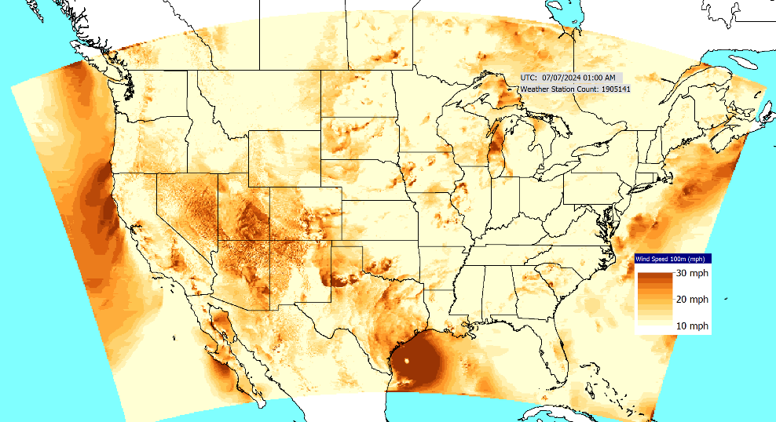
HRRR
A second dataset is the HRRR (High-Resolution Rapid Refresh), which is provided by the US National Oceanic and Atmospheric Administration (NOAA)
HRRR is a 3-km resolution, hourly-updated assimilation/ modeling system provided by the NOAA National Center for Environmental Prediction (NCEP)
Data is provided on a grid with a total of 1.9 million elements
Simulator Contour of HRRR 100m Wind Data (converted from 80m data)
Ref: rapidrefresh.noaa.gov/hrrr/
HRRR uses a Lambert Conformal projection (a conic projection)

Slide 17
Simulator Weather Data Access, cont.
Coming soon to a Version 24 patch, Simulator will be able to directly load power system planning related weather information from GRIB or GRIB2 format files
GRIB (Gridded Binary or General-Regularly-distributed Information in Binary form) is a very common format for the storage and exchange of historical and forecast weather data
It is standardized by the World Meteorological Organization (WMO), with GRIB released in 1994 and GRIB2 initially 2003
Both GRIB and GRIB2 are widely used, including for the ERA5 and HRRR datasets
References: en.wikipedia.org/wiki/GRIB, climatedataguide.ucar.edu/climate-tools/common-climate-data-formats-overview

Slide 18
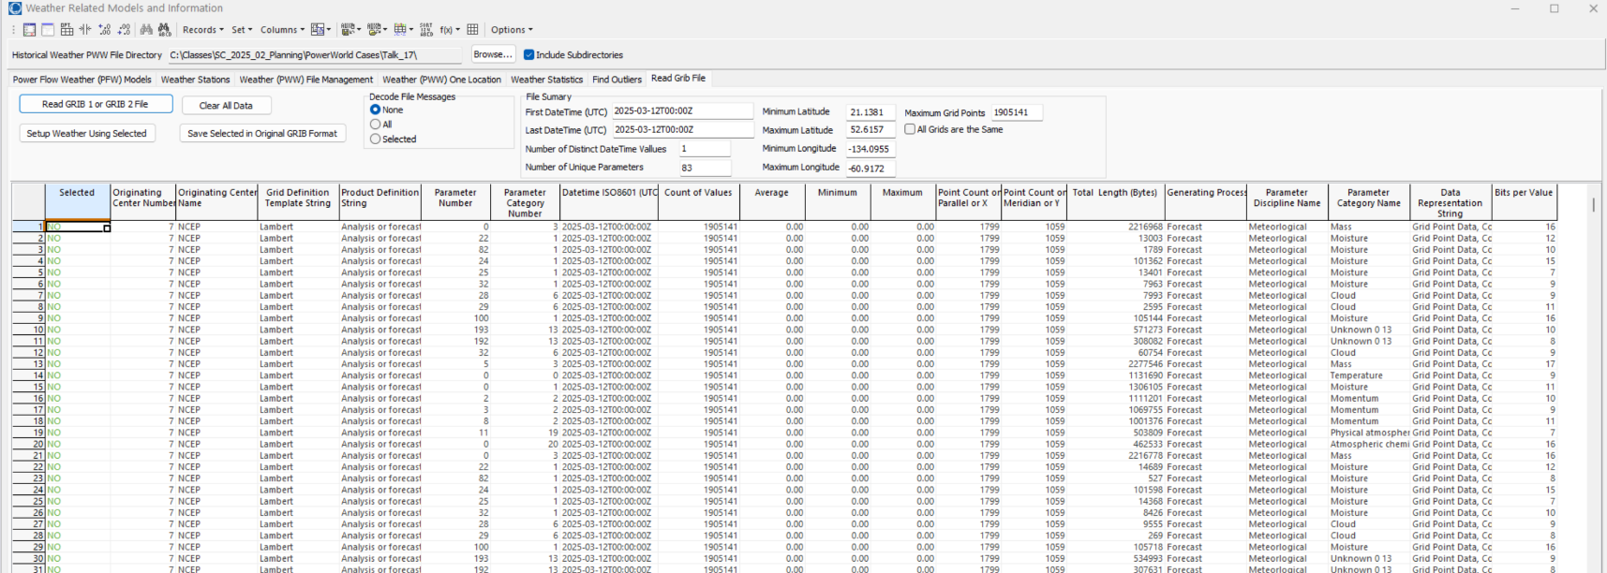
Simulator Weather Data Access, cont.
Image shows soon to be released functionality to directly load GRIB and GRIB2 data
Current HRRR data is available at www.nco.ncep.noaa.gov/pmb/products/hrrr/

Slide 19
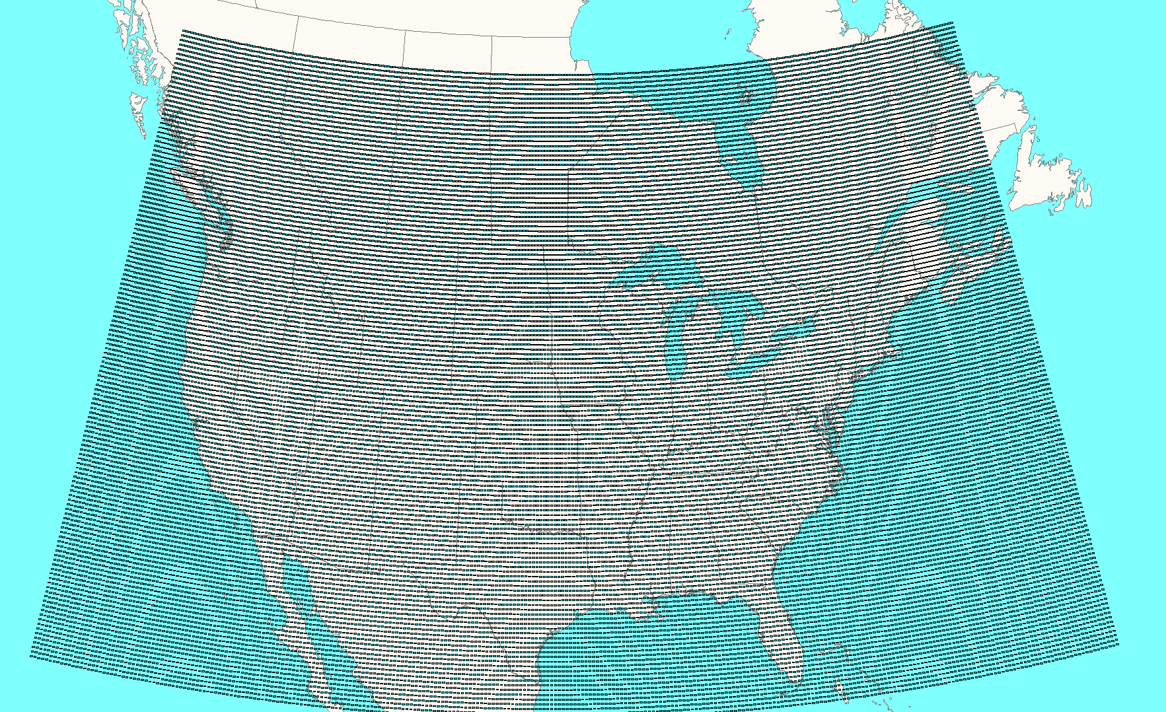
Easy Power Flow Access to ERA5
ERA5 is available worldwide about five days behind real-time
We convert it to pww format files, and place it at electricgrids.engr.tamu.edu/weather-data/
Currently we provided data for most of North America and then smaller files for just Texas
For each hour the pww files store eight weather values (temperature, dew point, cloud cover percent, wind speed (10m), wind direction (10m), wind speed (100m), global horizontal irradiance, direct horizontal irradiance, wind gusts
The North America pww files have 38,497 data points; with 9 values per hour, this is about 247 MB per month, or about 250 GB for the total set
This data is public so it can be freely used and shared

Slide 20
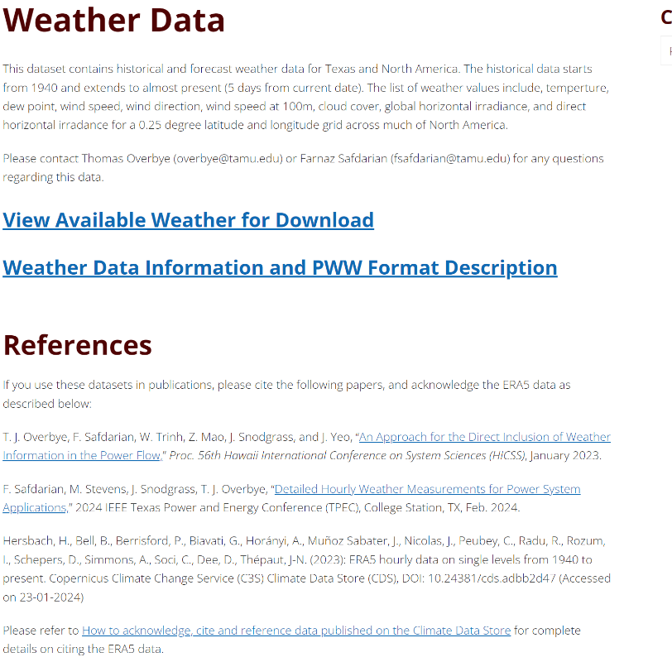
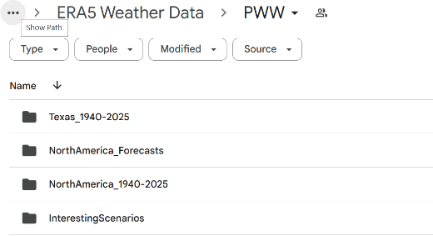
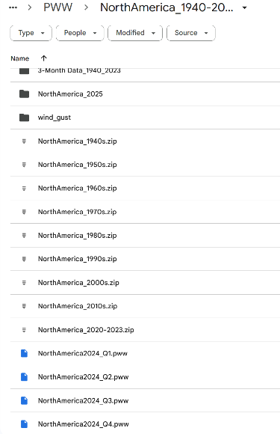
Electricgrids.engr.tamu.edu/weather-data/
Only get the 3-month data if your download speed is slow
Data for current year, updated daily
Historical data; that is, a onetime download; getting a decade took me about 4 minutes

Slide 21
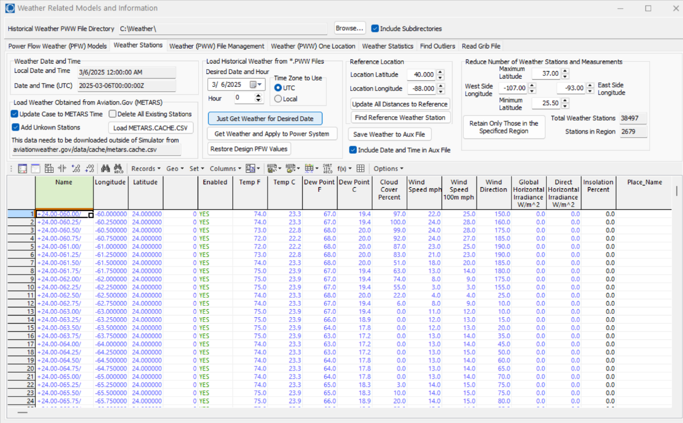
Viewing Weather for an Hour
Goto Tools, Weather, Weather Models and Information, Weather Stations Page to view the weather for any valid time
Directory for pww files
Enter the day and hour; in either Coordinated Universal Time (UTC) or local time
Click Just Get Weather for Desired Date to get the weather; it takes about a second
Right-click to see weather station dialog

Slide 22
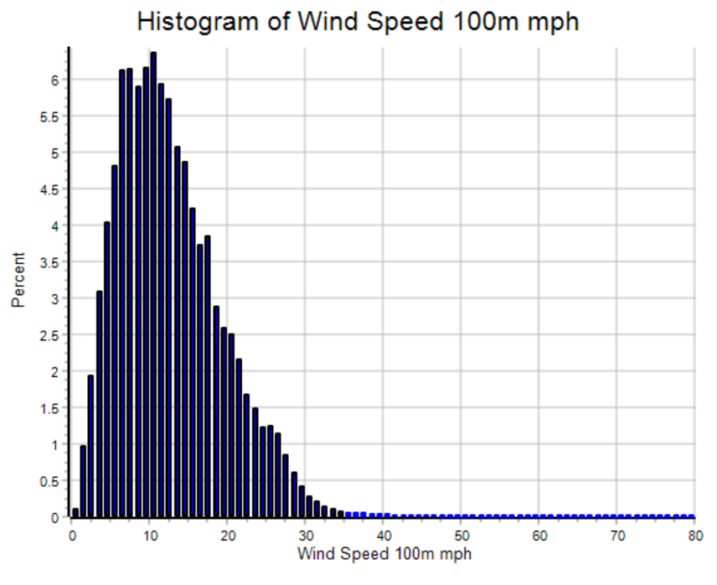
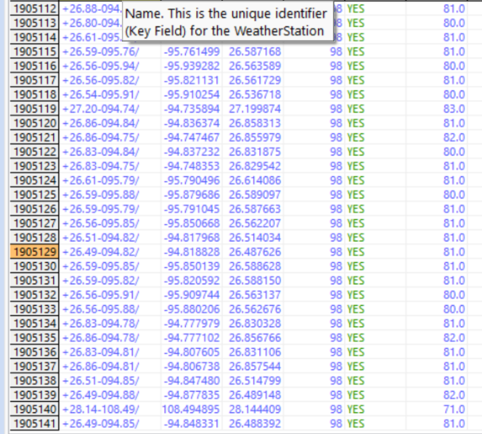
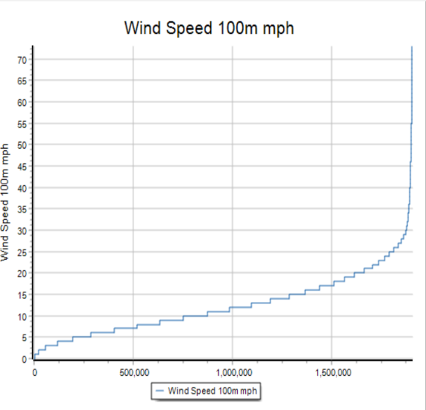
Viewing Weather for an Hour, HRRR
Even the full HRRR data can be viewed this way (1.9 million weather stations!); it can also be sorted or plotted
In contrast Excel 2024 maxes out at about 1 million rows and 16,000 columns

Slide 23
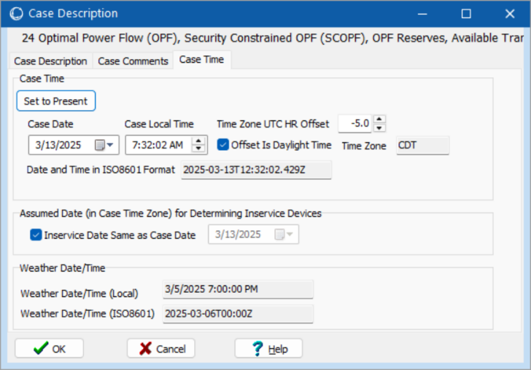
Date and Times in Simulator
In general power flow cases do not need to have an associated date and time, however sometimes these values are useful
When including weather almost always a date/time is needed, but it may be different from the case date/time
Values can be seen with Case Information, Case Description
Case date/time
Assumed time zone
Weather date/time
Weather date in ISO8601 format

Slide 24
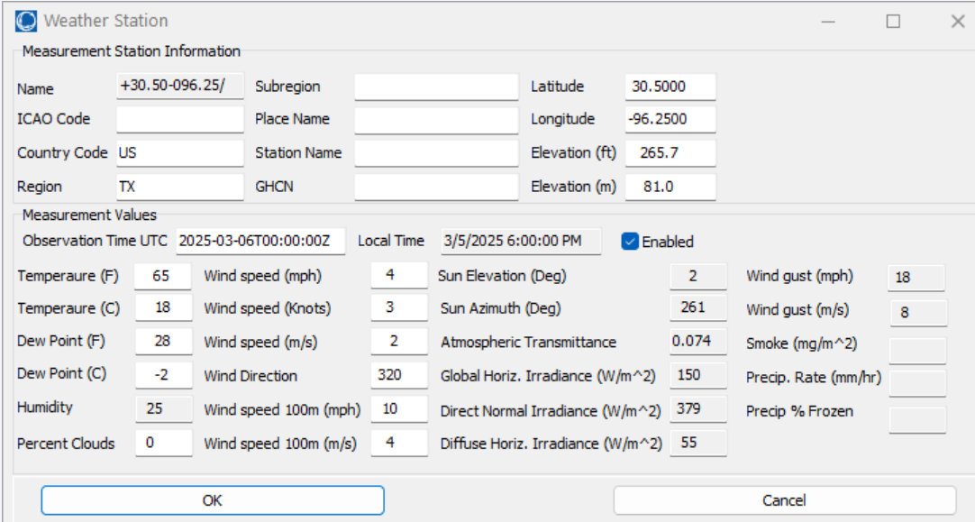
Simulator Weather Stations
Simulator uses weather station objects to store the weather data
A weather station object must have a latitude and longitude; they usually have an elevation, and can have other identifiers
A weather station may be an actual weather measuring location, but it could also just be a point in a weather model (e.g., ERA5 and HRRR)

Slide 25
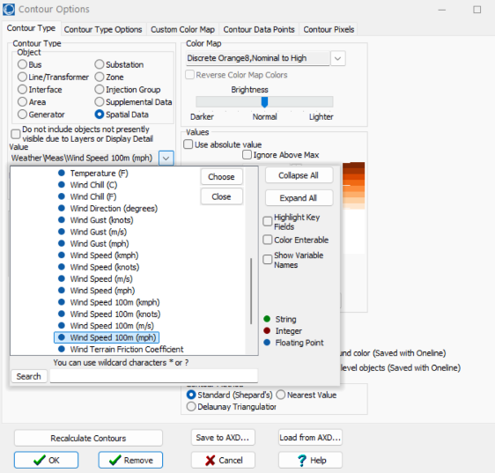
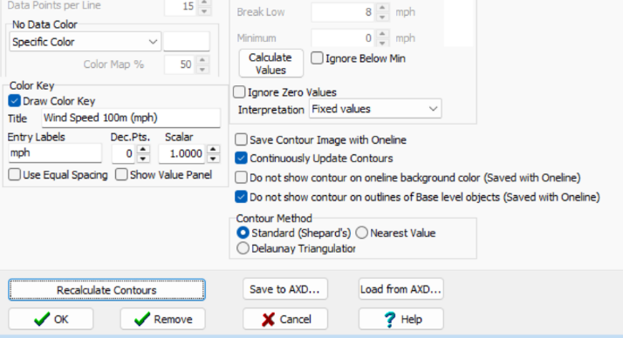
Visualizing the Weather
Weather information can be contoured on a geographic oneline by right-clicking on the oneline background and selecting Contouring…
The weather values can be contoured using the Spatial Data object, which does not require objects to actually be on the oneline
Use to select whether the contour is shown on the background, which is often ocean

Slide 26
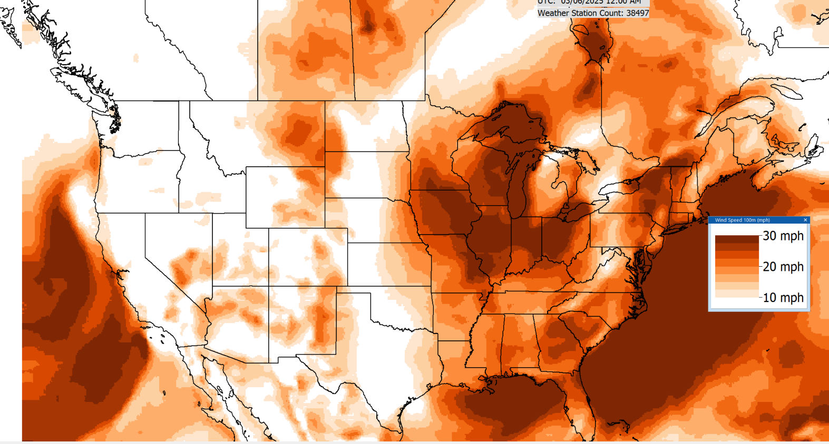
Example Contour

Slide 27
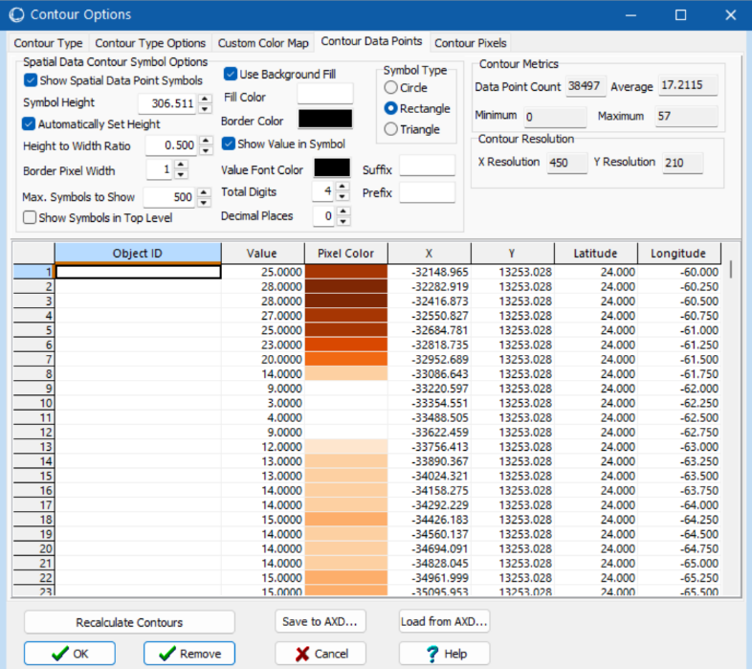
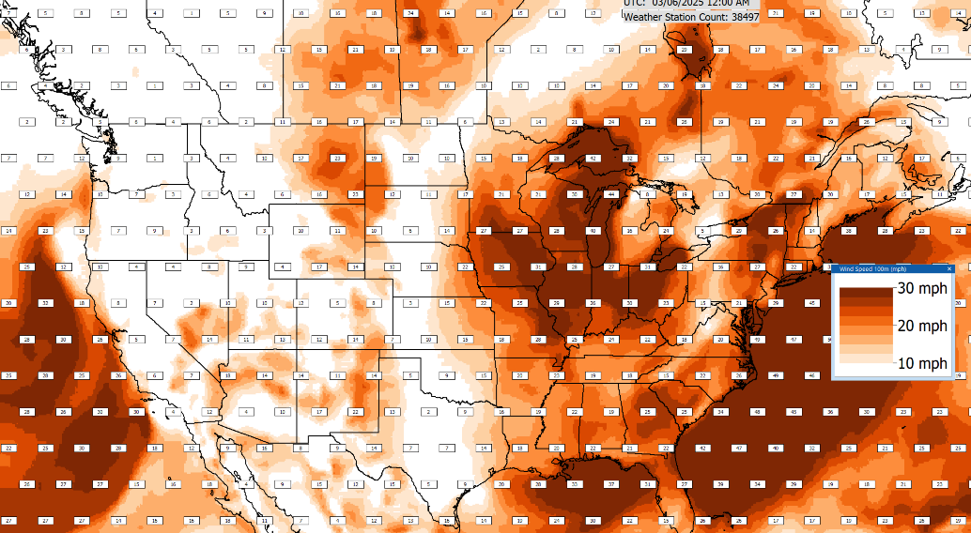
Showing Contour Data Symbols
Data symbols can be easily added to the contour, and then also easily modified later by just right-clicking on one of them
In Version 24 they can be used with any contour type, not just spatial data ones

Slide 28
Available ERA5 Fields in Simulator
The ERA5 dataset has hundreds of different values; currently we are using nine of them
Surface temperature, surface dew point
Wind speed at 10m, wind direction at 10m
Wind speed at 100m
Wind gusts
Total cloud cover (which takes into account all the layers)
Total sky direct short-wave (solar) radiation at surface (fdir); used to get the direct horizontal irradiance and the Direct Normal Irradiance (DNI)
Surface short-wave (solar) radiation downwards (ssrd); this is used with the direct horizontal irradiance to get the Diffuse Horizontal Irradiance
Derived values, like humidity and wind chill, are also available

Slide 29
Available HRRR Fields in Simulator
Likewise, HRRR has many values; currently we are using 11 of them
Surface temperature, surface dew point
Wind speed at 10m, wind direction at 10m
Wind speed at 80m (converted to 100m when stored)
Total cloud cover (which takes into account all the layers)
Total sky direct short-wave (solar) radiation at surface (fdir); used to get the direct horizontal irradiance and the Direct Normal Irradiance (DNI)
Wind gusts
Hourly precipitation (mm/hr)
Percent frozen precipitation
Vertically-integrated total smoke (mg/m^2)
Derived values like humidity are also available

Slide 30
Models of Grid Weather Impacts
Key focus here isn’t weather per se, but modeling the impacts of weather on electric grid components (e.g., generators, lines)
Certainly, a number of models already exist, and undoubtedly more will be created given that weather data is now conveniently available
The approach used here for handling a growing list of models is to mimic what has been done with power system stability – start small and expand
Early (1960) stability codes just had a handful of models, whereas current codes support many hundreds of different model types
PowerWorld implements this using PFW Models
PFW = Power Flow Weather or Power Flow Whatever models

Slide 31
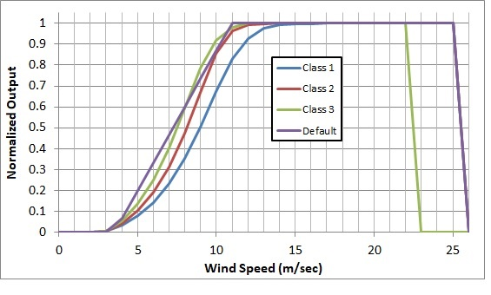
Example: Gen MaxMW Wind and Solar
An example is modeling the impact of wind speed on wind turbine output, or solar irradiation on PV output
The image on the right shows several of the generic wind turbine models are based on the turbine classes using data from [a]
A simple solar PV model uses either provided solar irradiation or the standard equations for insolation based on location and time of day including cloud cover; this is combined with whether the solar has tracking and, if needed, its tilt and azimuth
[a] C. Draxl, A. Clifton, B. Hodge, J. McCaa, “The Wind Integration National Dataset (WIND) Toolkit,” Applied Energy, vol. 151, pp. 355-366, 2015.

Slide 32
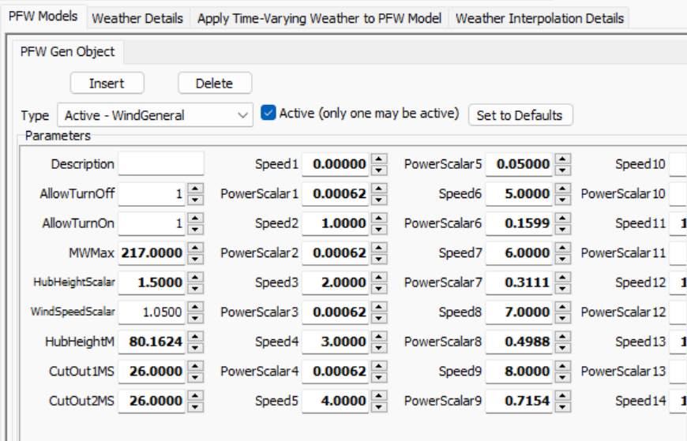
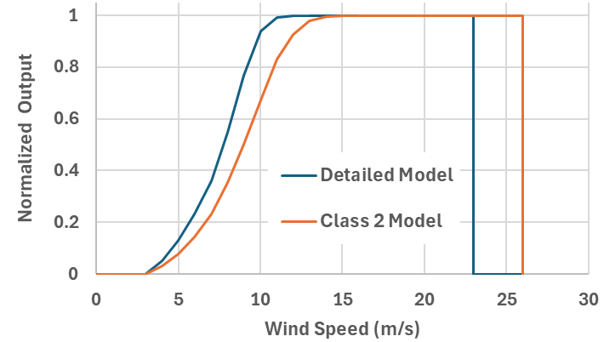
Example: Customized Wind Power Curve Model
Customized wind power curve models can also be defined; this only needs to be done once per wind generator

Slide 33
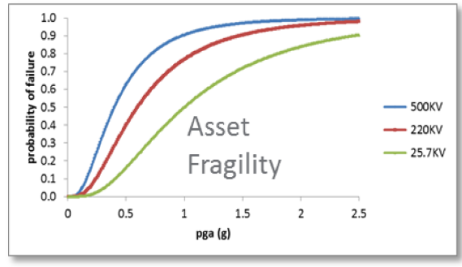
Additional PFWs, Including Stochastic Models
Many different PFW models are possible, and they could certainly be stochastic
Examples include ambient-adjusted line ratings, dynamic line ratings, thermal generator output variation with temperature, line outage due to wind gusts, asset failure during earthquakes (see figure with pga=Peak Ground Acceleration), incremental impacts of temperature on load, etc.
Many such models exist in the literature, with others needing to be developed;
Image source: Figure 2.1 of A. Veeramany, G.A. Coles, S.D. Unwin, T.B. Nguyen, J.E Dagle, “Trial Implementation of the High Impact, Low-Frequency Power Grid Event Risk Framework to Support Informed Decision-Making,” PNNL-25667, October 2016.

Slide 34
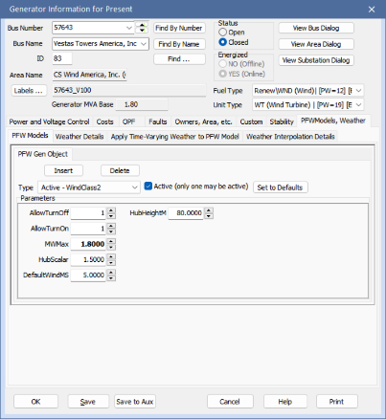
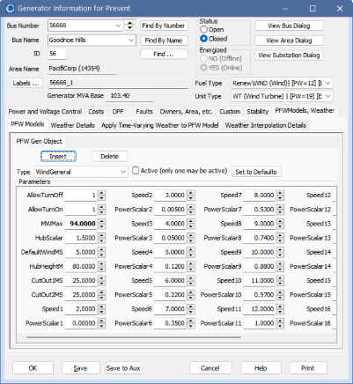
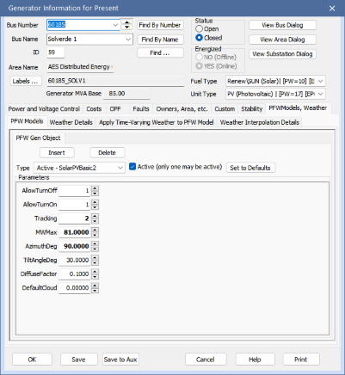
Example: Gen MaxMW PFW Model
Individual generator PFW models can be entered or viewed using the generator dialog

Slide 35
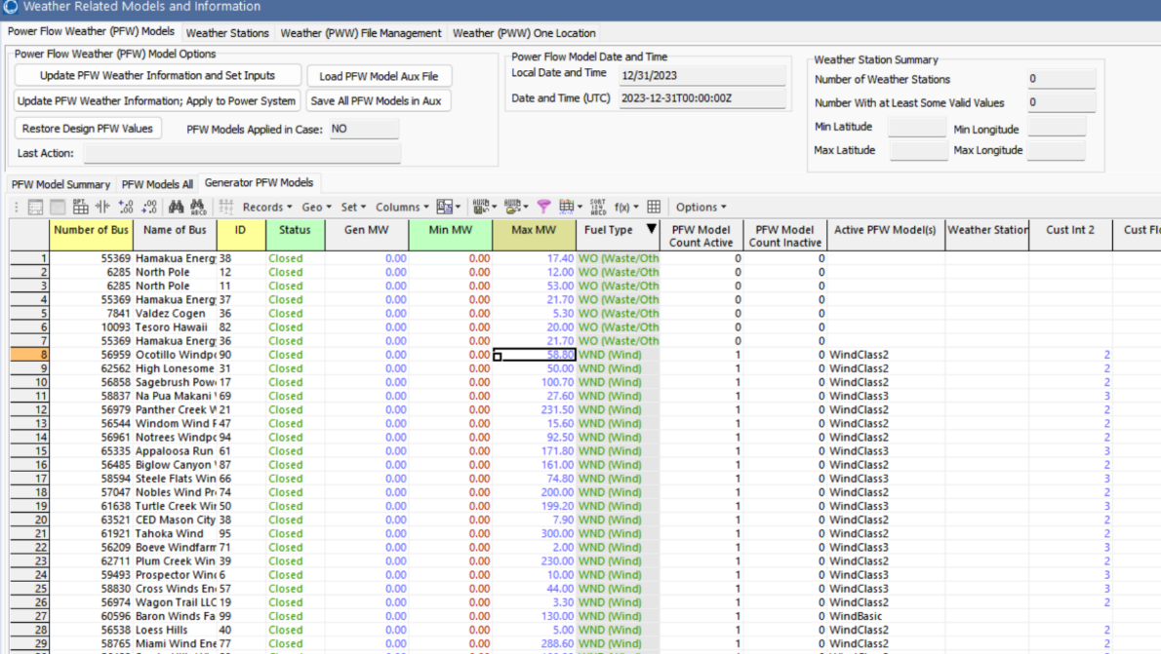
Entering Large Number of PFW Models
A large number of PFW models can be entered by going to the Weather, Weather Models and Information, PFW Models page
The Generator PFW Models list shows all the generators in the case
Select the desired ones, right-click and select Insert New PFW Models
They can also be added with aux files or by pasting them in

Slide 36
Making it Easy to Get Started: Using EIA-860 Data
To make it easy to get started we’ve setup copper plate (i.e., no transmission) power flow cases with PFW models based the data provided by the US Energy Information Administration (EIA) in their Form EIA-860 datasets
EIA-860 provides data on every generator in the US with 1 MW or more capacity
Available at www.eia.gov/electricity/data/eia860/; it is released yearly with monthly updates available
We take this data and convert it into a copper plate power flow model, with the resultant cases publicly available at
electricgrids.engr.tamu.edu/eia-860-generator-data-cases/
Details on this process are in a 2024 TPEC paper (available as a 2024 paper at overbye.engr.tamu.edu/publications/)

Slide 37
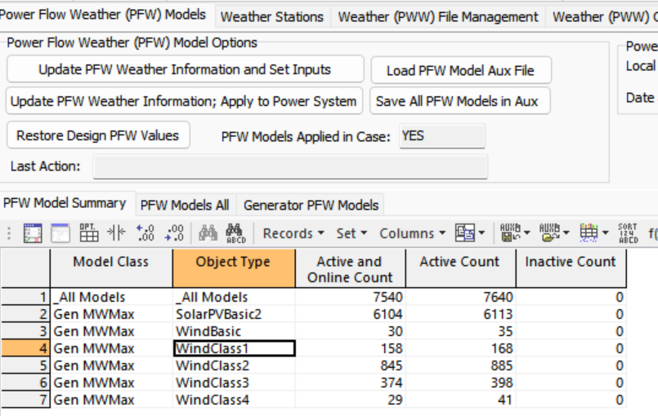
Example EIA-860 Wind Generator Data
Right image shows the PFW models to map weather (wind speed) to MW Max
From the Weather, Weather Models and Information display
Bottom image shows some EIA-860 wind generators with turbine information
For the CEII grids we have bus mapping for more than 95% of the generator capacity

Slide 38
Convenient Access to Wind Turbine Power Curves
Reference [a], from PNNL, provides good access to power curves for all the wind turbines in CONUS as of end of 2020
The data they provide can be directly pasted into Simulator
[a] C. Bracken, S. Underwood, A. Campbell, T.B. Thurber, N. Voisin, Hourly wind and solar generation profiles for every EIA 2020 plant in the CONUS, 2023, dx.doi.org/10.5281/zenodo.7901615

Slide 39
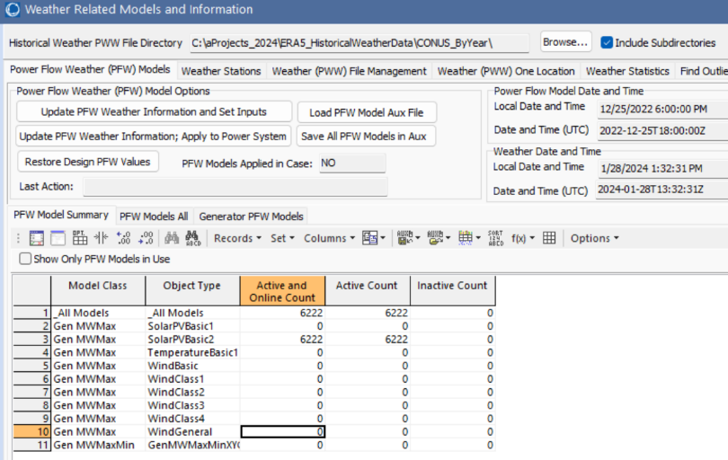
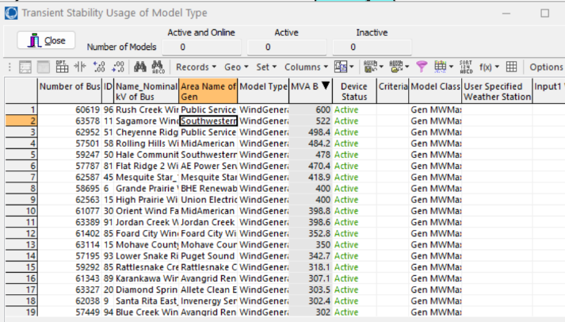
Pasting in the Wind Power Curves
Select all the data on the previous slide data in Excel, and copy it
In Simulator open Tools, Weather, Weather Models and Information; select the PFW Model Summary page, and right-click on the WindGeneral object type

Slide 40
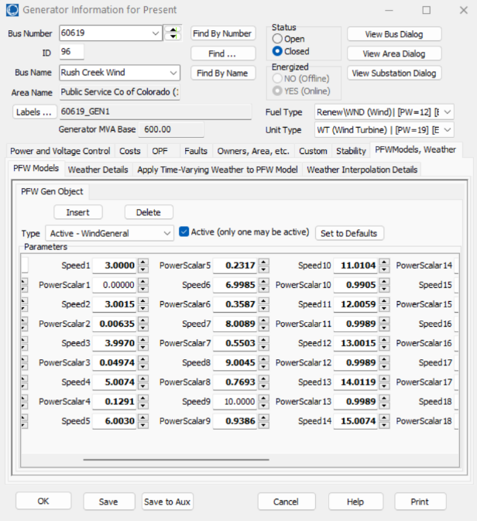
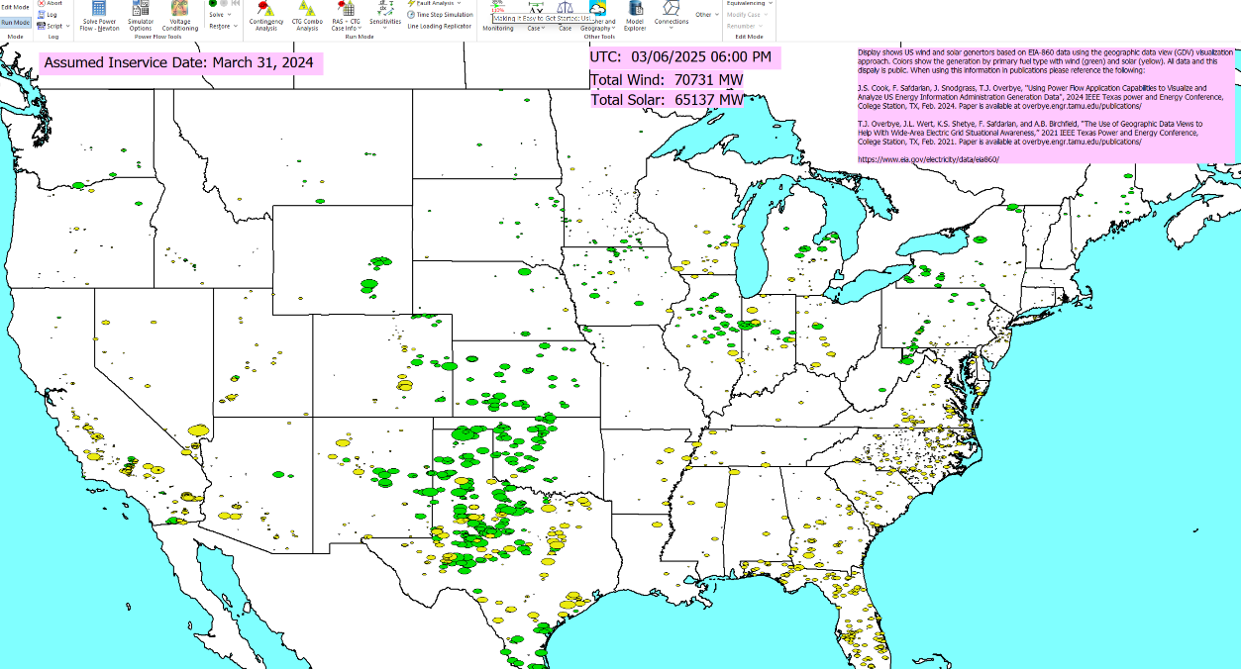
One Wind Turbine Example, Full CONUS Wind/Solar
The below display shows the wind (green) and solar (yellow) installed capacity; applying the weather modifies these

Slide 41
Aside: Geographic Regions in Simulator Version 24
New with version 24, Simulator can directly model geographic regions, including showing a summary and details on the buses in regions; results can also be visualized
The functionality is available by selecting Tools, Weather and Geography, Regions
Regions can be either stored in aux files, imported using shape files, or setup manually
Shows the wind generation by county

Slide 42
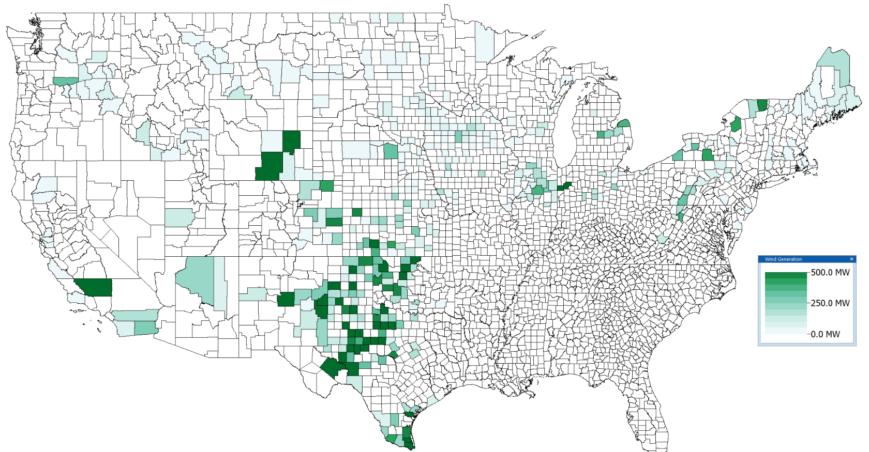
Aside: Geographic Regions Showing Wind Generation by County

Slide 43
Mapping Weather to the Electric Grid Components
While the newer weather datasets have lots of points, there is still usually at least some distance between power grid components and the nearest weather measurement, requiring interpolation
There is no single best algorithm for doing the needed 2D scattered data interpolation, but there are a number of good and fast algorithms (grid-based, closest neighbor, Delaunay Triangulation, Shepherd’s)
Since the weather values have an associated elevation, if the power grid component’s elevation (or profile for a line) is known this could be considered
If high resolution is needed, then HRRR data can be quite useful

Slide 44
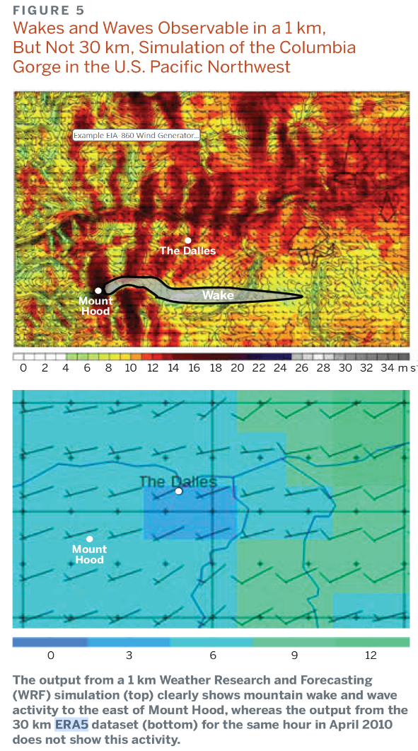
Dealing with Local Terrain
In some situations, particularly wind, the local terrain variation can be significant, meaning that by themselves datasets like ERA5 may not be sufficient
High resolution datasets like HRRR can certainly help in these situations
It is important to keep in mind the ultimate goal of using weather in planning; often quite acceptable results can be obtained including compensation terms in the PFW models that only need to be set once

Slide 45
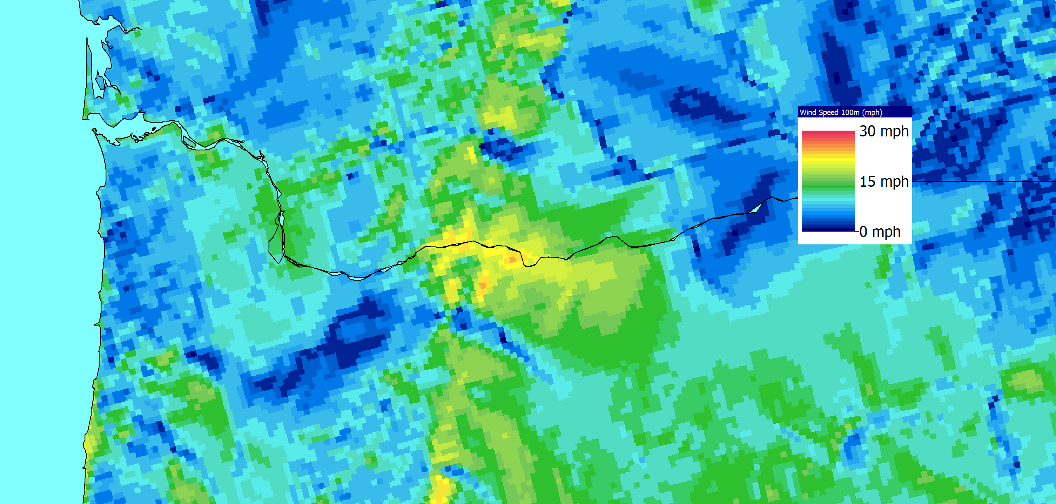
Simulator HRRR 100m Wind Contour Columbia River
This was created using the nearest neighbor contour algorithm

Slide 46
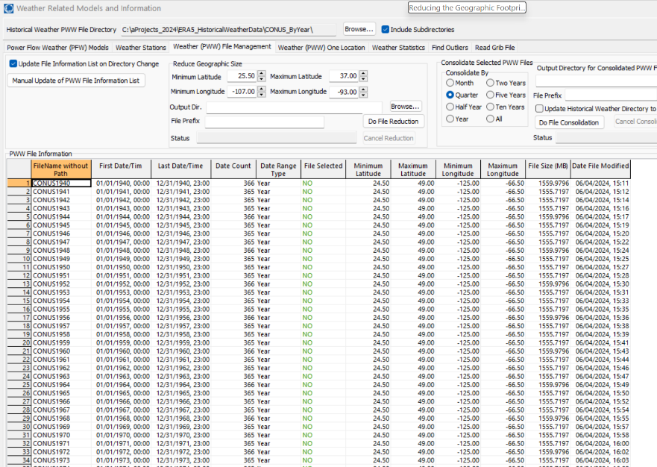
Reducing the Geographic Footprint
Using data for all of North America is not usually recommended
Smaller footprints use less memory, down quicker and require less computation
We are supplying data more most of North America to make sure all data is available for subsequent reduction
PowerWorld has a tool to make it easy to reduce the footprint by specifying a new geographic rectangle
At Tools, Weather, Weather Models and Information on the Weather PWW File Management page

Slide 47
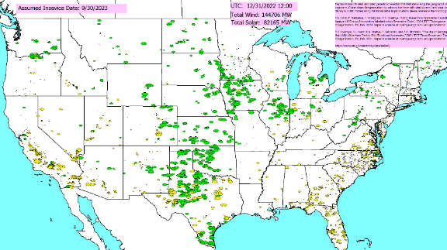
Applying the Weather
Weather can be applied to a power flow case using the pww files in multiple ways
At a specified point in time
As a summary of a large amount of weather at a single location (e.g., a generator) or at a few locations (a transmission line)
As a time series, sequentially solving lots of different time points
The next few slides give an overview of these, showing the changes in the wind and solar outputs

Slide 48
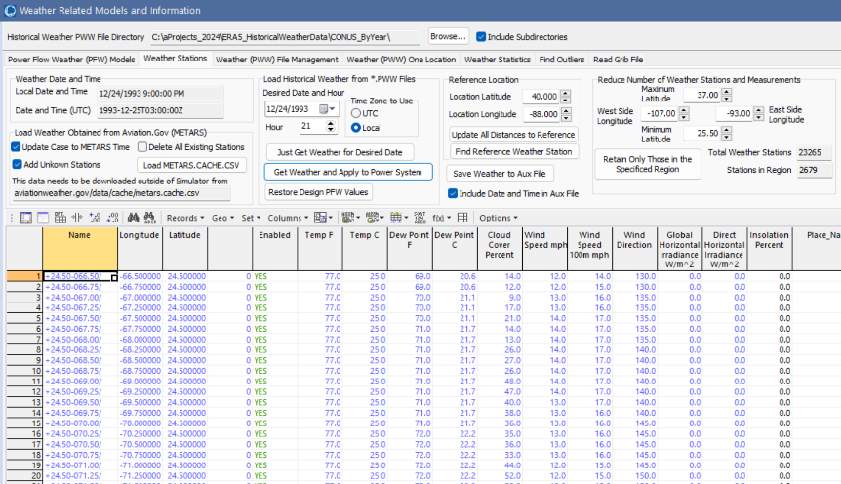
Applying Weather for a Single Time Point
With the provided pww files, any time going back to 1940 can be simulated. The pww files are designed for quick searching, and for providing direct access to all the data for a particular time.
Getting the access to the weather for all of North America with ERA5 takes about a second; optionally the weather can also be applied to the power flow
Once applied the power flow (and other applications) can be solved as normal
Restore values at the end

Slide 49
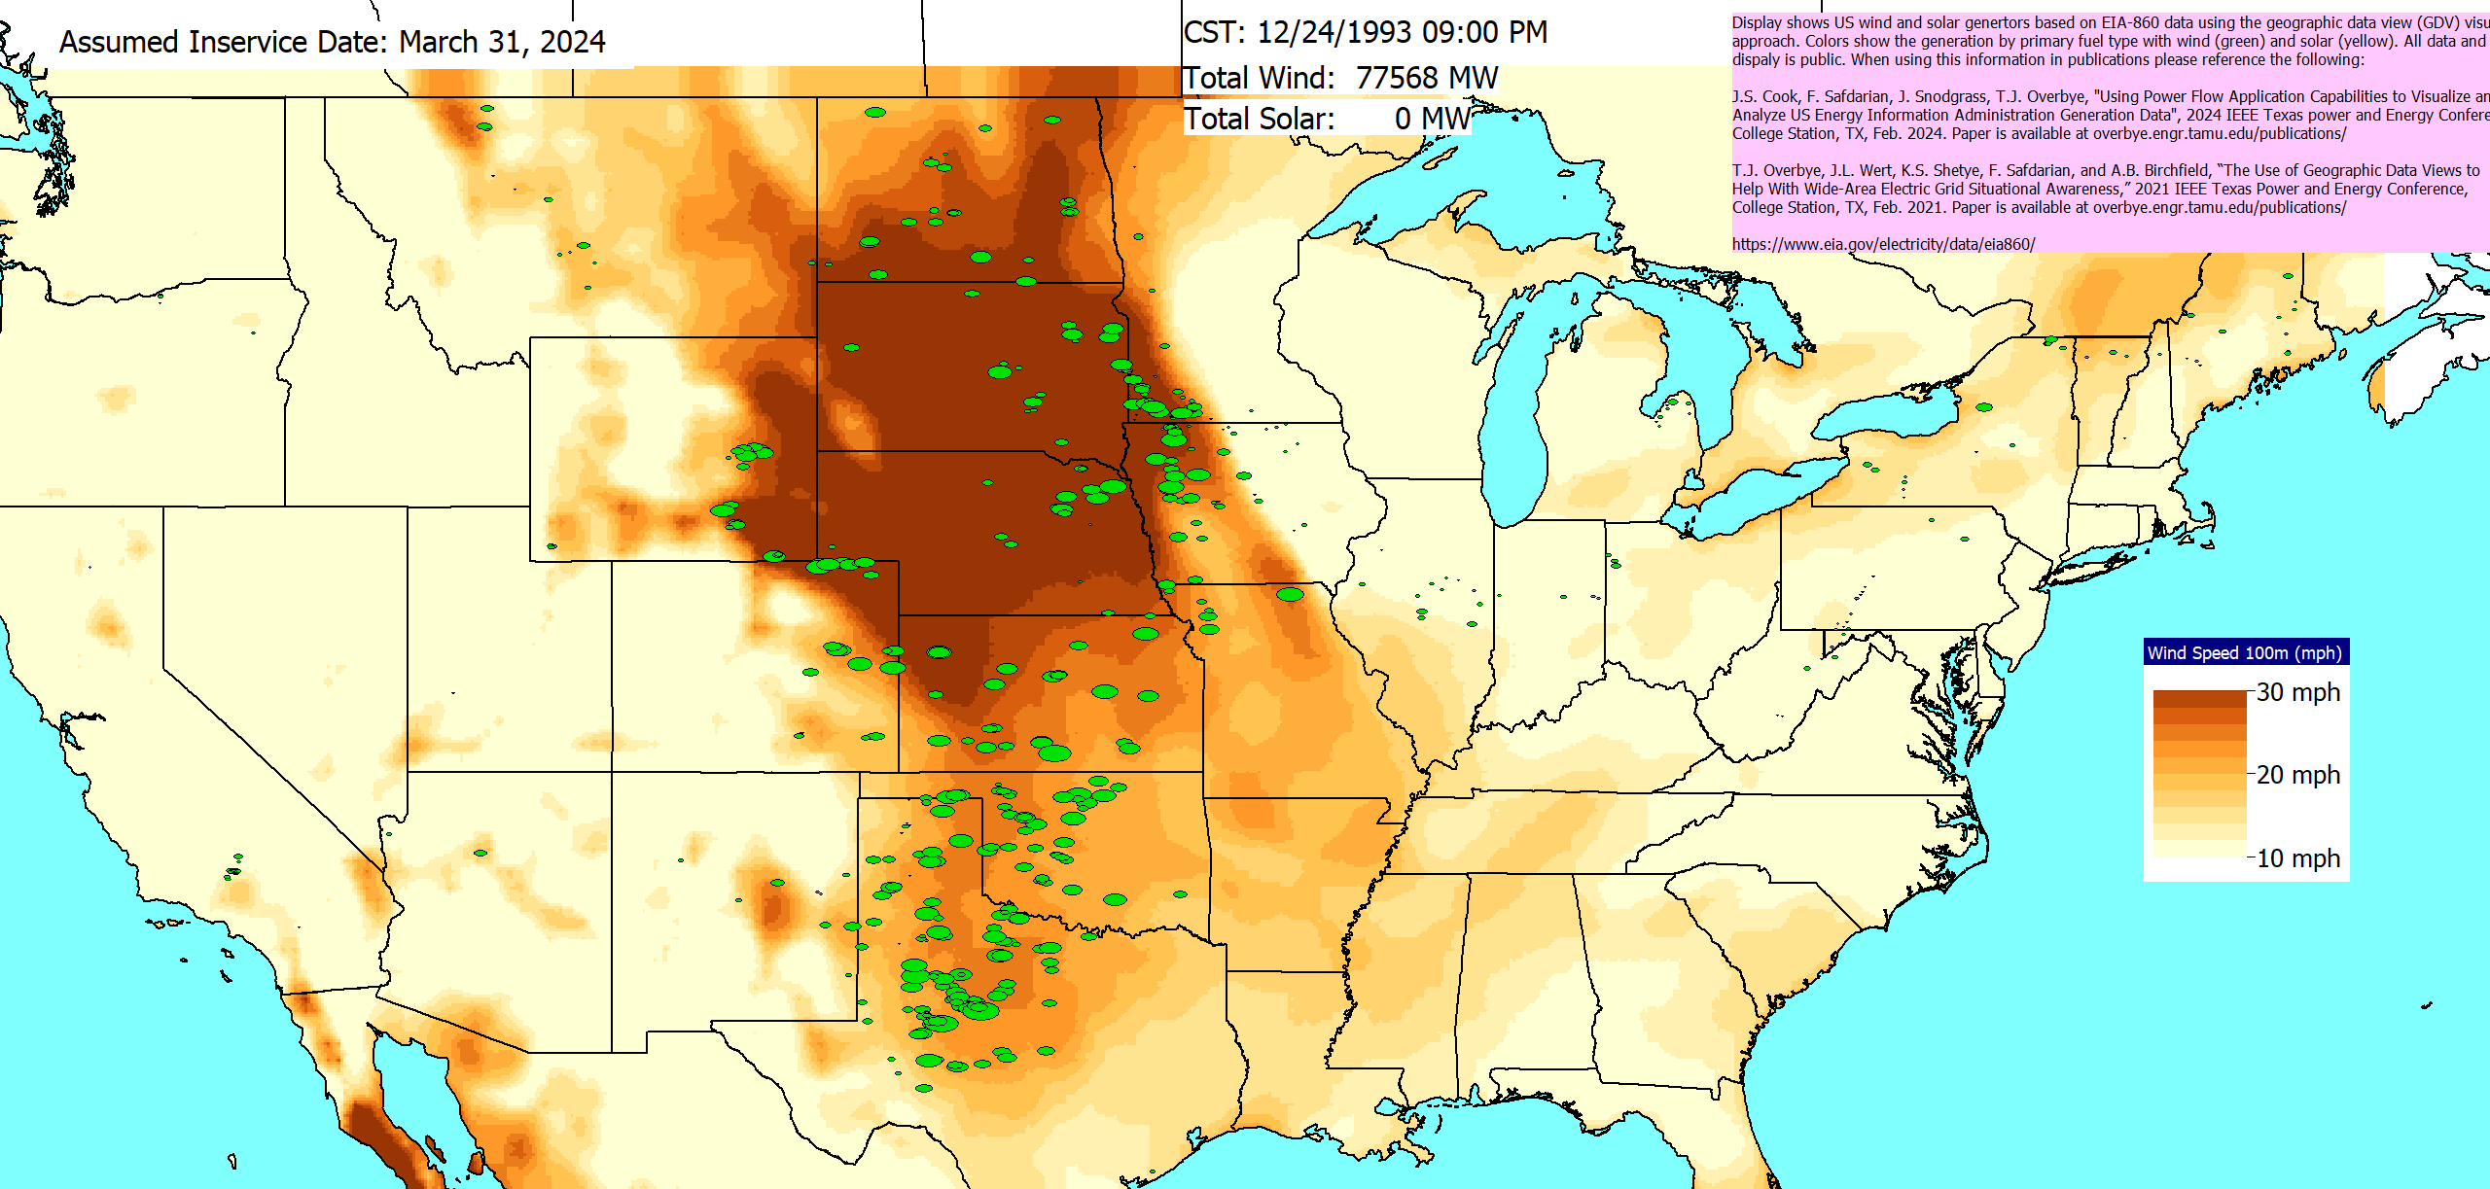
Visualization of Weather from 12/24/1993
Historical weather is being applied to 2024 wind and solar generation

Slide 50
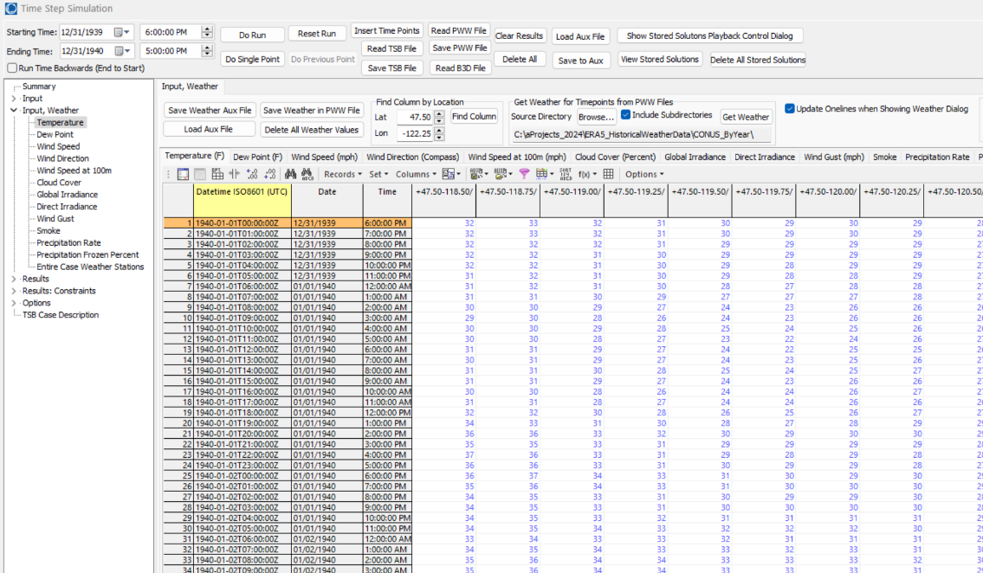
Simulating Large Amounts of Weather Information
To easily view and simulate many time values, the pww files can be loaded into the Time Step simulation (Tools, Time Step Simulation)
Select Read PWW File to load the desired file
Allows a weather location to be easily located (Seattle here)
Like any Simulator case information grid, the data can be easily plotted and exported

Slide 51
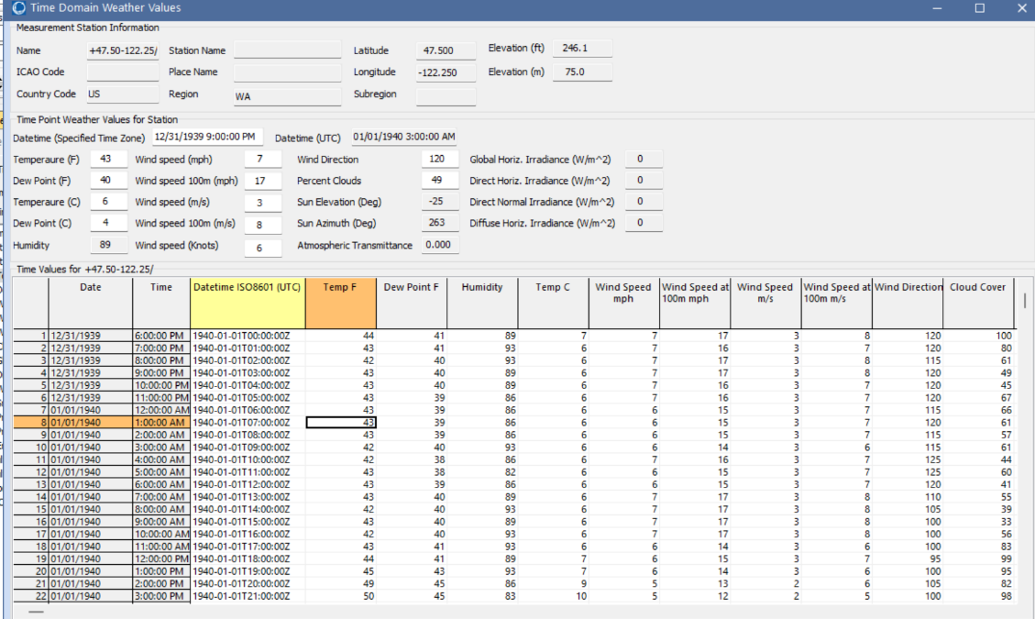
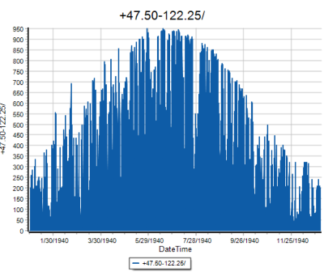
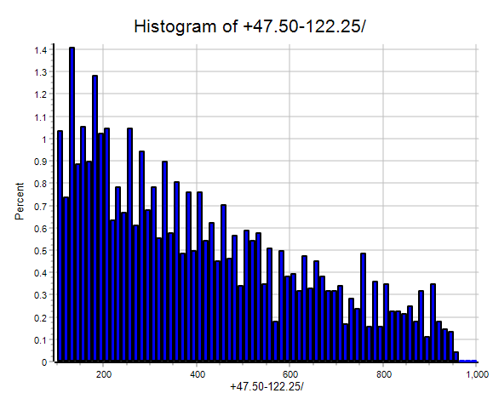
Seeing All Weather Data for a Location
To see all the weather data for a location, just right-click on the column and select Show Dialog with All Times for Location
Global irradiance values (histogram neglects 0)

Slide 52
Availability of Forecasted Weather Information
Forecasted weather information is also available from a variety of sources; here we use the free forecasts provided by US National Oceanic and Atmospheric Administration (NOAA) National Centers for Environmental Prediction (NCEP) NCEP Central Operations
nco.ncep.noaa.gov/pmb/products/gfs/
Specifically we’re using the 0.25 degree resolution GFS results, which provide four global forecasts per day going out for 16 days (hourly for the first five days, then every three hours)
Forecasts are also pww files, so all of the existing tools can be used, though the forecasts to not have the solar irradiance values
We hope to soon get access to longer-term forecasts

Slide 53
Some Potential Additional Models
With weather information a part of the power flow a wide variety of additional power flow model enhancements become possible. Some examples are given below, recognizing that many are already done using external analysis
Transmission line limits that depend on temperature, wind and insolation along the right-of-way; working with industry we already have some quite sophisticated models
Transformer limits
Load models (recognizing that the load depends on many factors, initial models could be linearizations about a specified value)
Line resistance (though this would be more complex since it is operating point dependent
Etc.

Slide 54
Future Directions
There are many future directions to pursue
A number of models that relate weather to electric grid values already exist, but many more certainly need to be developed
Integration of weather into tools such as contingency analysis; better tools for dealing with stochastic models
Support for more weather types, greater integration of reading primary sources such as GRIB and GRIB2 files
Determining the required level of weather details; higher resolution datasets are available; also other potentially severe resiliency events
More validation!!
Increased automation of the updating process; maybe more footprints
Machine learning applications given lots of potential operating points

Slide 55
Thank You! Questions?
Recent papers are at overbye.engr.tamu.edu/publications/ For questions afterwards email at overbye@tamu.edu or overbye@powerworld.com

