Slide 1
ECEN 460
Power System Operation and Control
Spring 2025
Lecture 19: Power System Stability
Prof. Tom Overbye
Dept. of Electrical and Computer Engineering
Texas A&M University
overbye@tamu.edu

Slide 2
Announcements
Please read Chapter 13
By March 31 do problems 12.1, 12.7, 12.10, 12.13, 12.18, 12.19, 12.21
By April 9 do Problem Set A
Schedule for the rest of the semester is
  Lab 9 this week
  Lab 10 week of April 7
  Lab 3 week of April 14 (optional, ungraded machine lab)
  Lab 11 (project presentations) by the individual teams to their TA before the end of classes (on or before April 29)
  Exam 2 on Wednesday April 23 during class
  Design project due at 9:30 am on May 1 (i.e., at the end of our final slot; no final)
1

Slide 3
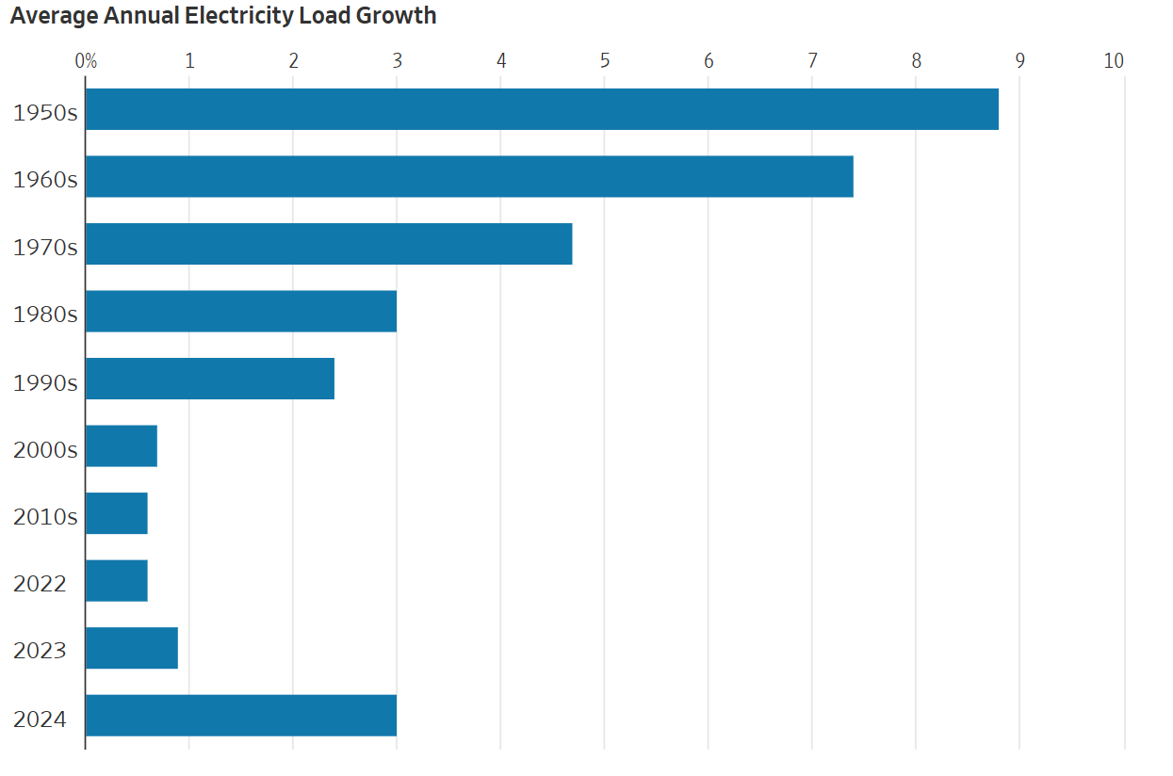
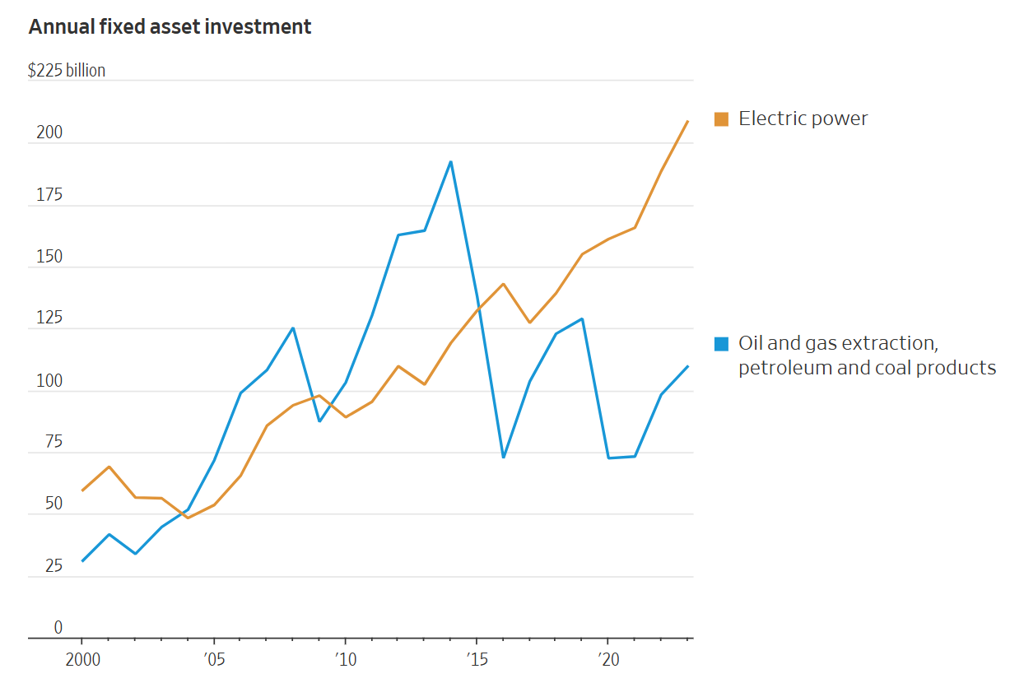
In the News: WSJ Article Titled, “Economic Growth Now Depends on Electricity Not Oil”
The beginning of the article is,
“Americans have long equated energy security with oil. The country wanted as much as possible because of the havoc an interruption to supply—from wars, disasters and political convulsions—can cause. In coming years, though, energy security will mean electricity.”
Electricity growth is back to values from the 1980’s
From a security perspective
a key advantage of electricity
is its sources are almost 100%
domestic
The article notes that with
this growth electricity has
become deeply politicized
Source: www.wsj.com/business/energy-oil/economic-growth-now-depends-on-electricity-not-oil-40250941?mod=hp_lead_pos5
2

Slide 4
2007 CWLP Dallman Accident
In 2007 there was an explosion at the CWLP 86 MW Dallman 1 generator. The explosion was eventually determined to be caused by a sticky valve that prevented the cutoff of steam into the turbine when the generator went off line. So the generator turbine continued to accelerate up to over 6000 rpm (3600 normal).
  High speed caused parts of the generator to shoot out
  Hydrogen escaped from the cooling system, and eventually escaped causing the explosion
  Repairs took about 18 months, costing more than $52 million
https://www.dailyregister.com/20080508/news/dallman-explosion-blamed-on-valve-failures/
3

Slide 5
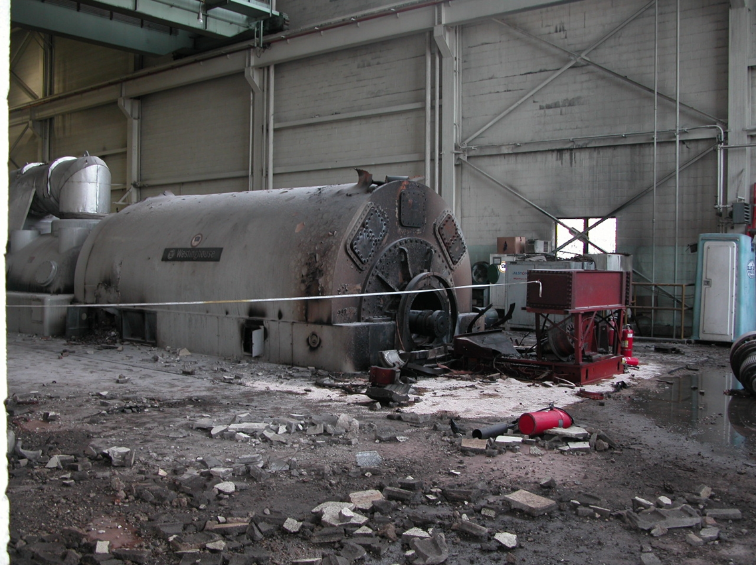
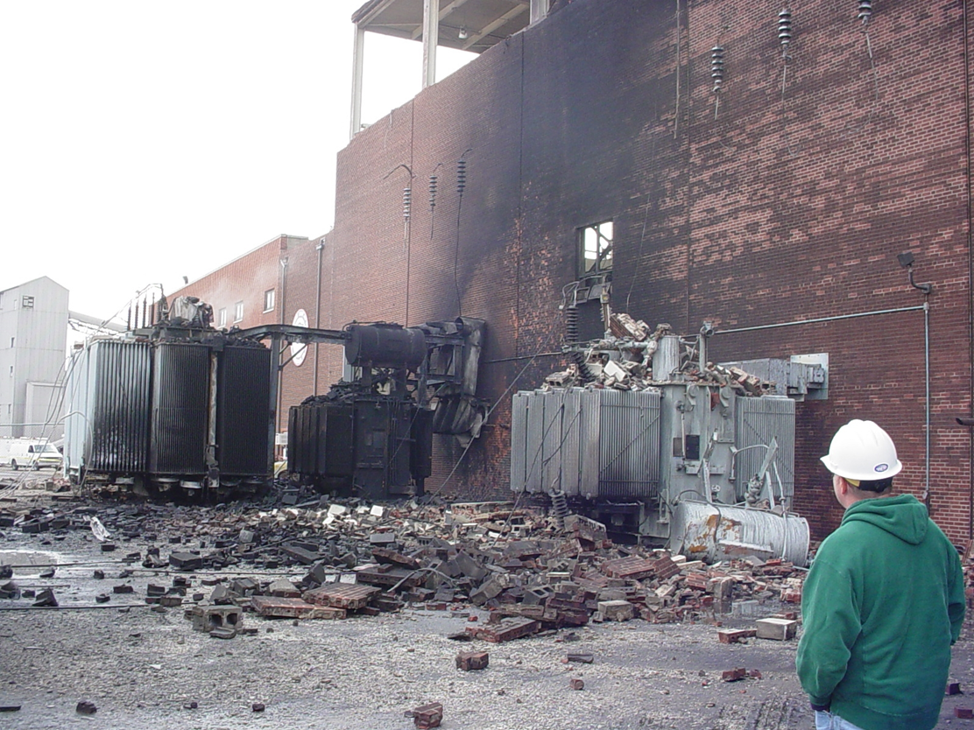
2007 CWLP Dallman Accident
4

Slide 6
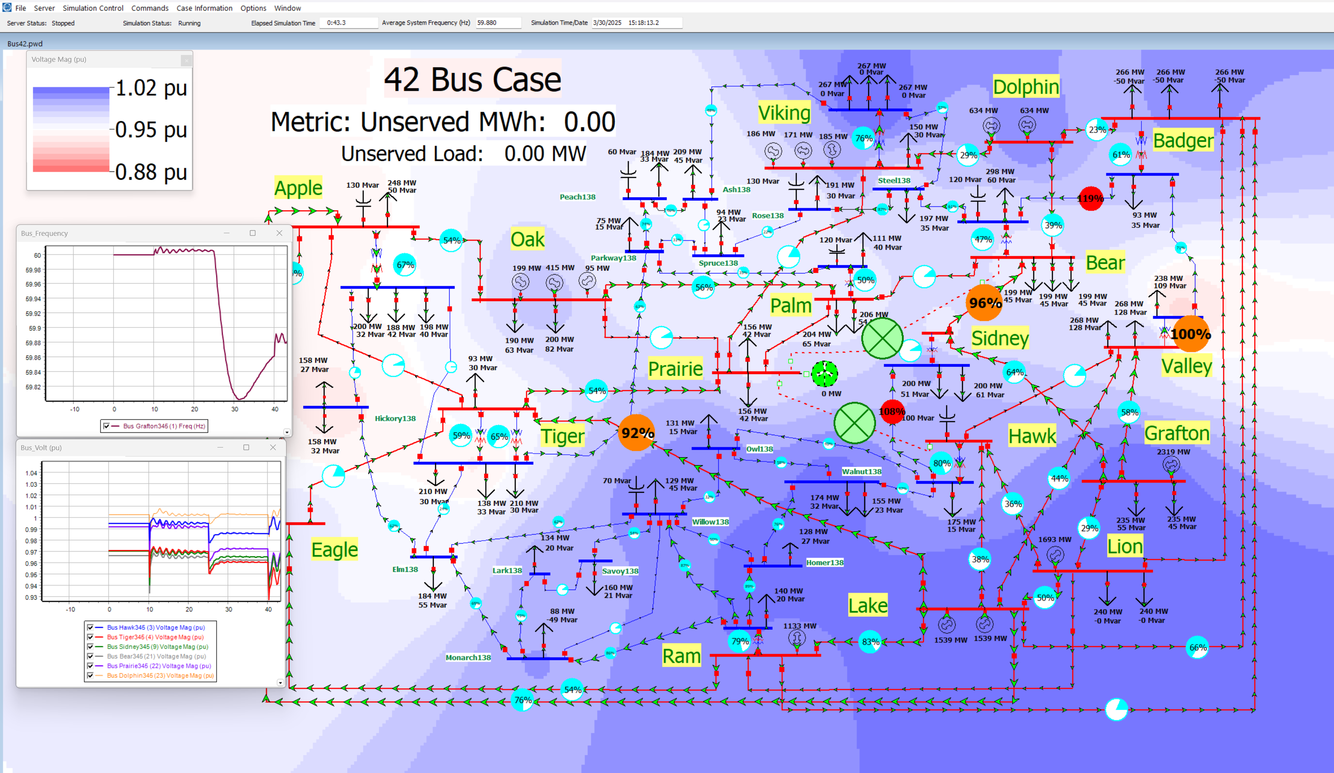
Lab 9 Overview: Stability and PowerWorld DS
5

Slide 7
Two-Axis Synchronous Machine Model
Classical model is appropriate only for the most basic studies; no longer widely used in practice
More realistic models are required to couple in other devices such as exciters and governors
A more realistic synchronous machine model requires that the machine be expressed in a reference frame that rotates at rotor speed
Standard approach is d-q reference frame, in which the major (direct or d-axis) is aligned with the rotor poles and the quadrature (q-axis) leads the direct axis by 90°
6

Slide 8
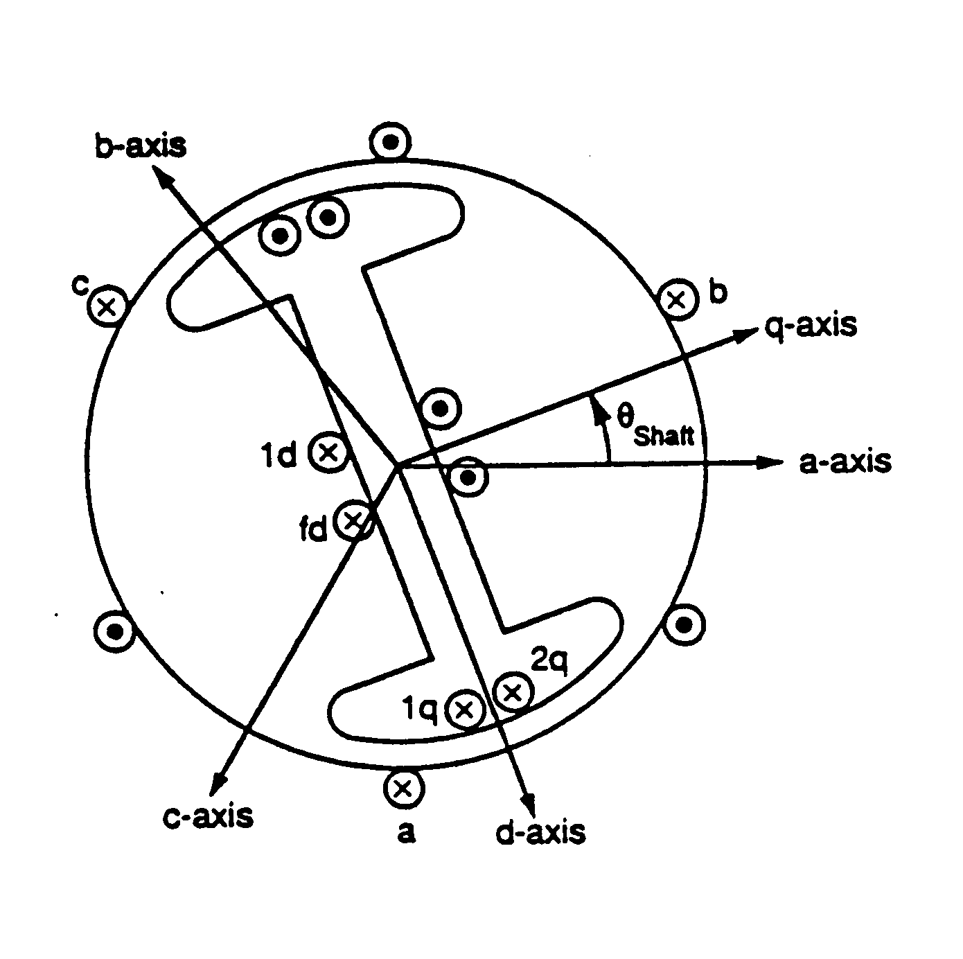
Synchronous Machine Modeling
3φ bal. windings (a,b,c) – stator
Damper windings are added to help damp out oscillations
Field winding (fd) on rotor
Damper in “d” axis
(1d) on rotor
2 dampers in “q” axis
(1q, 2q) on rotor
7

Slide 9
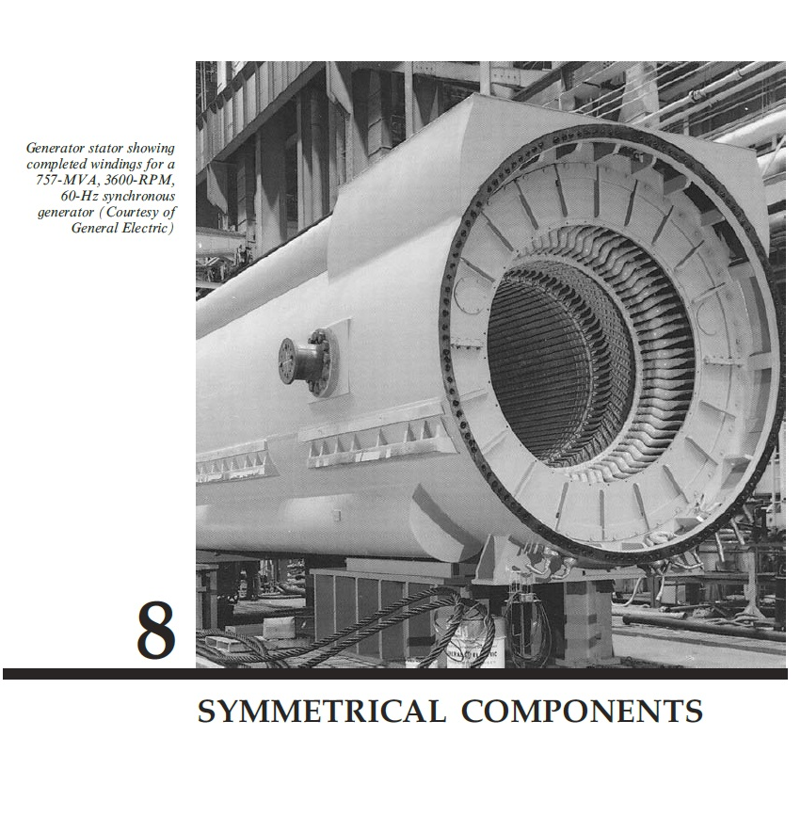
Two Main Types of Synchronous Machines
Round Rotor
  Air-gap is constant, used with higher
  speed machines
Salient Rotor (often called Salient Pole)
  Air-gap varies circumferentially
  Used with many pole, slower machines
  such as hydro
  Narrowest part of gap in the d-axis and
  the widest along the q-axis
Book Chapter 9 Photo
8

Slide 10
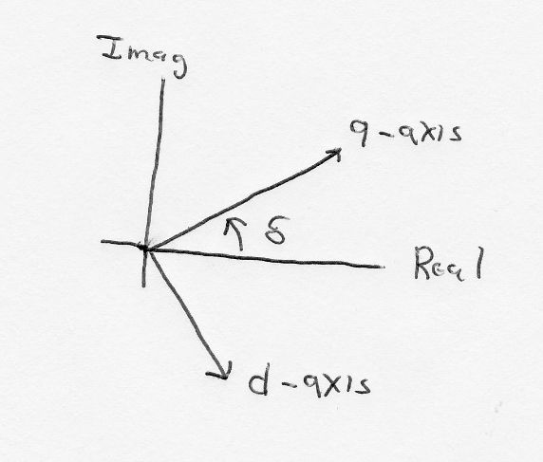
D-q Reference Frame
Analyzing synchronous machines is done using Park’s transformation (from 1929) to change the machine differential equations with time-varying components into a set of equations with time invariant components
That is, the machine voltages and currents are “transformed” into what is known as the d-q reference frame using the rotor angle, δ
  Terminal voltage in network (power flow) reference frame are V_{T} = V_{r} - V_{i}
9

Slide 11
Two-Axis Model Equations
Numerous models exist for synchronous machines. The following is a relatively simple model that represents the field winding and one damper winding; it also includes the generator swing eq.
10

Slide 12
Generator Torque and Initial Conditions
The generator electrical torque is given by
Recall p_{e} = T_{e}ω_{p.u} (sometimes ω_{p.u is} assumed=1.0)
Solving the differential equations requires determining δ; it is determined by noting that in steady-state
Then δ is the angle of E
11

Slide 13
Example 12.10
Determine the initial conditions for the Example 12.3 case with the classical generator replaced by a two-axis model with H = 3.0 per unit-seconds, D = 0, = 2.1, = 2.0, = 0.3, = 0.5, all per unit using the 100 MVA system base
First determine the current out of the generator from the initial conditions, then the terminal voltage
12

Slide 14
Example 12.10, cont.
We can then get the initial angle, and initial
d and q values
13

Slide 15
Example 12.10, cont.
The initial state variable are determined by solving with the differential equations equal to zero.
The transient stability solution is then solved by numerically integrating the differential equations, coupled with solving the algebraic equations
14

Slide 16
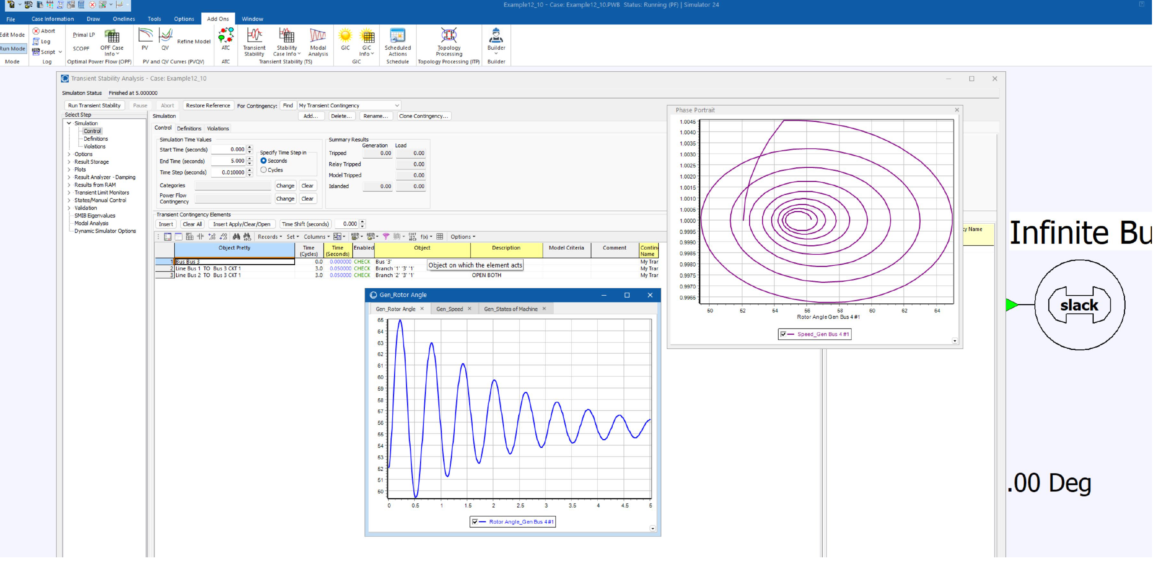
PowerWorld Solution of 12.10
15

Slide 17
Dynamic Models in the Physical Structure: Exciters
Mechanical System
Electrical System
Stabilizer
Load
Relay
Line
Relay
Exciter
Supply control
Pressure control
Speed control
Voltage Control
Network control
Load control
Fuel
Source
Furnace and Boiler
Turbine
Generator
Network
Loads
Machine
Load
Char.
Fuel
Steam
Torque
V, I
P, Q
Governor
P. Sauer and M. Pai, Power System Dynamics and Stability, Stipes Publishing, 2006.
16

Slide 18
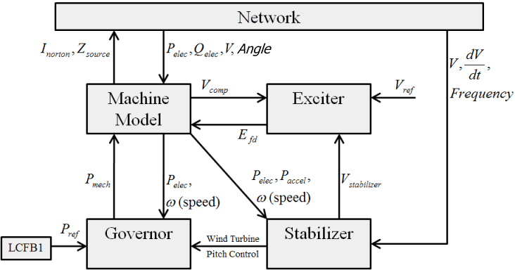
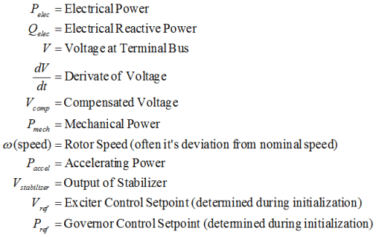
Exciter Models
17

Slide 19
Exciters, Including AVR
Exciters are used to control the synchronous machine field voltage and current
  Usually modeled with automatic voltage regulator included
A useful reference is IEEE Std 421.5-2016
  Updated from the 2005 edition
  Covers the major types of exciters used in transient stability
  Continuation of standard designs started with "Computer Representation of Excitation Systems," IEEE Trans. Power App. and Syst., vol. pas-87, pp. 1460-1464, June 1968
Another reference is P. Kundur, Power System Stability and Control, EPRI, McGraw-Hill, 1994
  Exciters are covered in Chapter 8 as are block diagram basics
18

Slide 20
Potential Types of Exciters
None, which would be the case for a permanent magnet generator
  primarily used with wind turbines with ac-dc-ac converters
DC: Utilize a dc generator as the source of the field voltage through slip rings
AC: Use an ac generator on the generator shaft, with output rectified to produce the dc field voltage; brushless with a rotating rectifier system
Static: Exciter is static, with field current supplied through slip rings
19

Slide 21
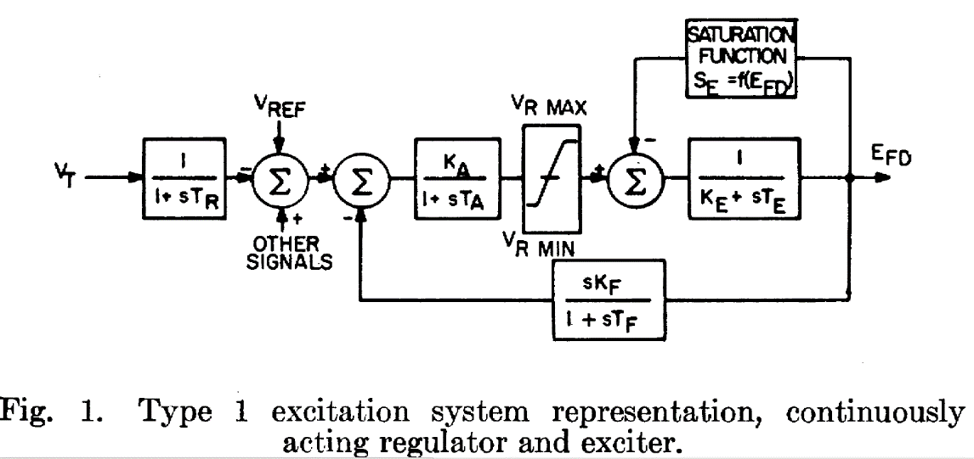
IEEET1 Exciter
We’ll start with a common exciter model, the IEEET1 based on a dc generator and briefly cover its structure
  This model was standardized in a 1968 IEEE Committee Paper with Fig 1. from the paper shown below
20

Slide 22
Block Diagram Basics
The following slides will make use of block diagrams to explain some of the models used in power system dynamic analysis. The next few slides cover some of the block diagram basics.
To simulate a model represented as a block diagram, the equations need to be represented as a set of first order differential equations
Also, the initial state variable and reference values need to be determined
21

Slide 23
Integrator Block
Equation for an integrator with u as an input and y as an output is
In steady-state with an initial output of y₀, the initial state is y₀ and the initial input is zero
u
y
22

Slide 24
First Order Lag Block
Equation with u as an input and y as an output is
In steady-state with an initial output of y₀, the initial state is y₀ and the initial input is y₀/K
Commonly used for measurement delay (e.g., T_{R} block with IEEE T1)
Input
u
y
Output of Lag Block
23

Slide 25
Derivative Block
Block takes the derivative of the input, with scaling K_{D} and a first order lag with T_{D}
  Physically we can't take the derivative without some lag
  An example is the feedback block in the IEEET1 model
In steady-state the output of the block is zero
State equations require a more general approach
u
y
24

Slide 26
State Equations for More Complicated Functions
There is not a unique way of obtaining state equations for more complicated functions with a general form
To be physically realizable we need n >= m
25

Slide 27
Lead-Lag Block
In exciters such as the EXDC1 the lead-lag block is used to model time constants inherent in the exciter; the values are often zero (or equivalently equal)
In steady-state the input is equal to the output
To get equations write
in form with β₀=1/T_{B}, β₁=T_{A}/T_{B},
α₀=1/T_{B}
input
The steady-state requirement that u = y is readily apparent
u
y
Output of Lead/Lag
26

Slide 28
Limits: Windup versus Nonwindup
When there is integration, how limits are enforced can have a major impact on simulation results
Two major flavors: windup and non-windup
Windup limit for an integrator block
The value of v is NOT limited, so its value can "windup" beyond the limits, delaying backing off of the limit
L_{max}
v
u
y
L_{min}
If L_{min} ≤ v ≤ L_{max} then y = v
else If v < L_{min} then y = L_{min},
else if v > L_{max} then y = L_{max}
27

Slide 29
Limits on First Order Lag
Windup and non-windup limits are handled in a similar manner for a first order lag
L_{max}
v
u
y
If L_{min} ≤ v ≤ L_{max} then y = v
else If v < L_{min} then y = L_{min},
else if v > L_{max} then y = L_{max}
L_{min}
Again the value of v is NOT limited, so its value can "windup" beyond the limits, delaying backing off of the limit
28

Slide 30
Non-Windup Limit First Order Lag
With a non-windup limit, the value of y is prevented from exceeding its limit
L_{max}
u
y
L_{min}
29

Slide 31
Ignored States
When integrating block diagrams often states are ignored, such as a measurement delay with T_{R}=0
In this case the differential equations just become algebraic constraints
Example: For block at right,
as T→0, v=Ku
With lead-lag it is quite common for T_{A}=T_{B}, resulting in the block being ignored
L_{max}
v
u
y
L_{min}
30

Slide 32
Saturation
A number of different functions can be used to represent the saturation
The quadratic approach is now quite common
Exponential function could also be used
This is the same
function used with
the machine models
31

Slide 33
Voltage Regulator Model
Amplifier
Modeled as a first
order differential equation
In steady state
As K_{A} is increased
There is often a droop in regulation
32

Slide 34
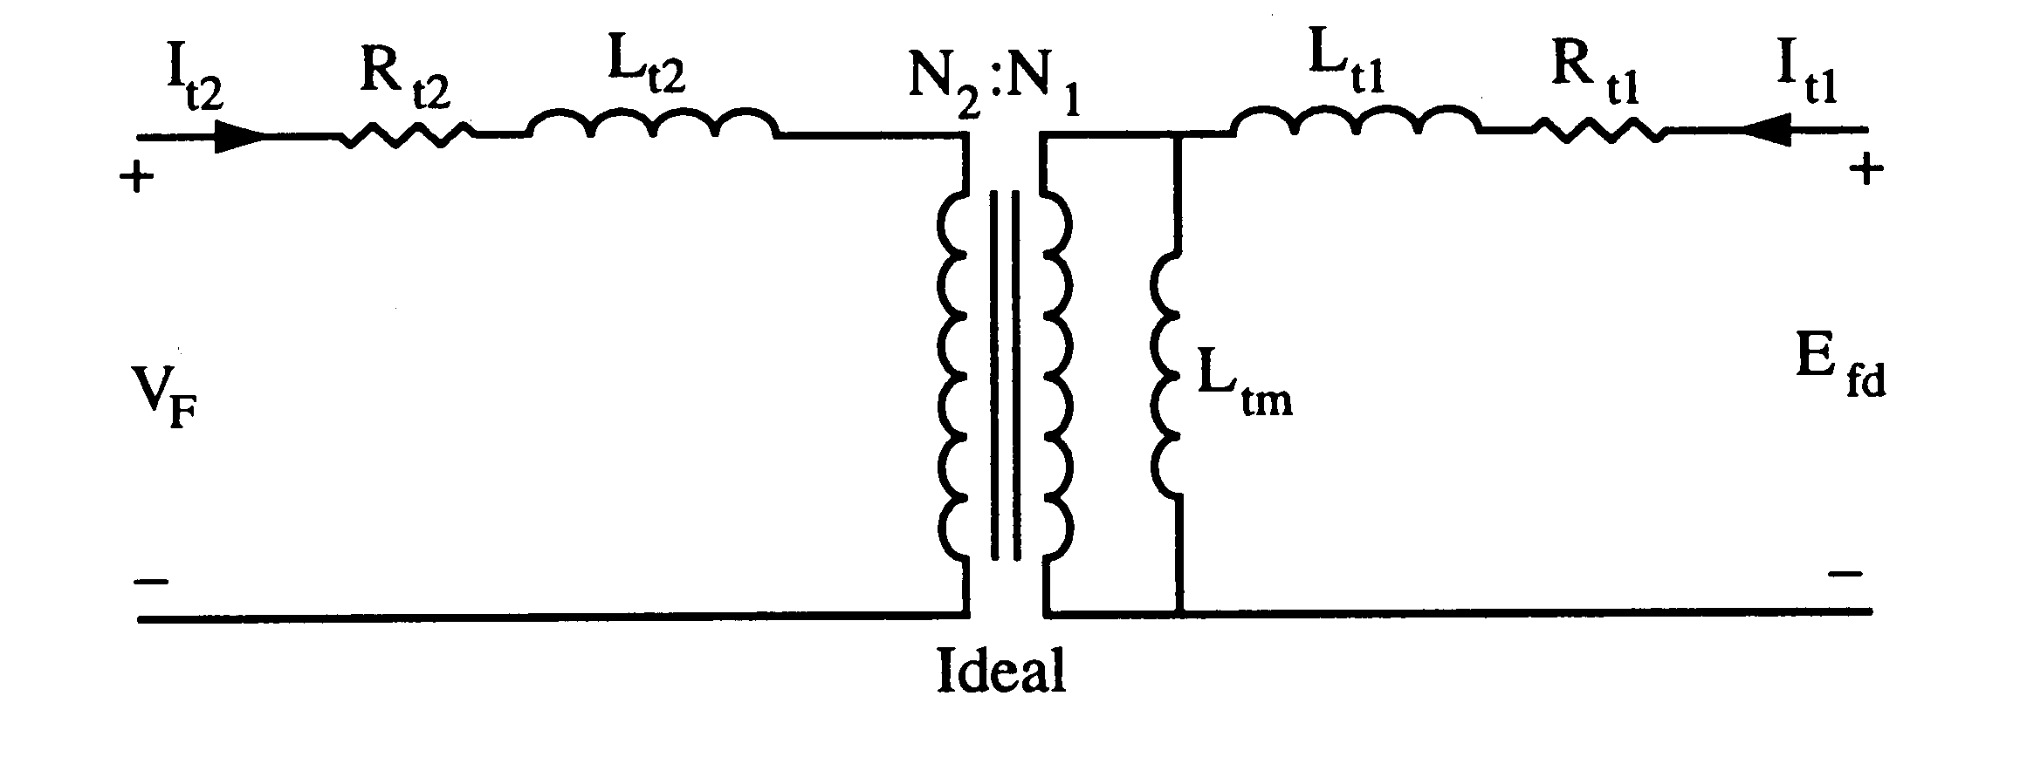
Feedback
This control system can often exhibit instabilities, so some type of feedback is used
One approach is a stabilizing transformer
Designed with a large L_{t2} so I_{t2} ≈ 0
33

Slide 35
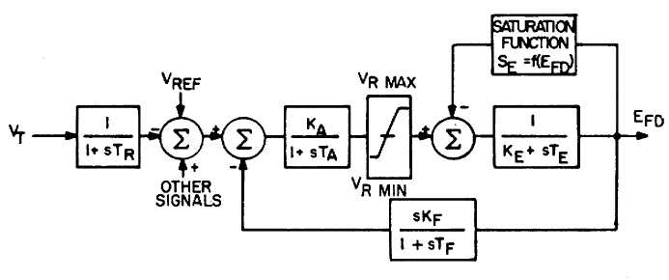
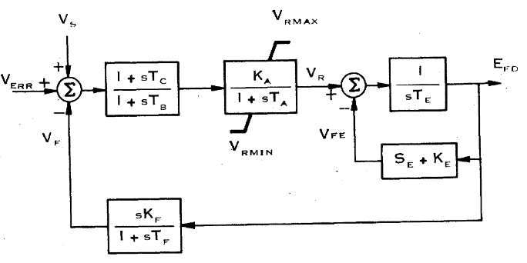
IEEET1 Model Evolution
The original IEEET1, from 1968, evolved into the EXDC1 in 1981
1968
1981
Note, K_{E} in the feedback is the same in both models
Image Source: Fig 3 of "Excitation System Models for Power Stability Studies," IEEE Trans. Power App. and Syst., vol. PAS-100, pp. 494-509, February 1981
34

Slide 36
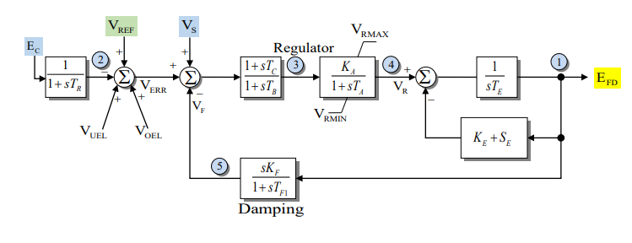
IEEEX1
This is from 1979, and is the EXDC1 with the potential for a measurement delay and inputs for under or over excitation limiters
35

Slide 37
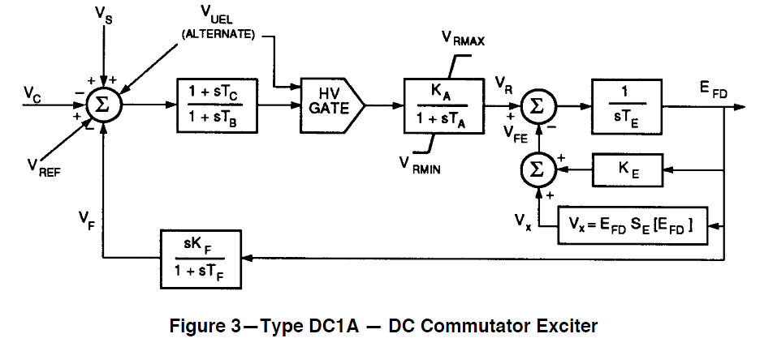
IEEET1 Evolution
In 1992 IEEE Std 421.5-1992 slightly modified the EXDC1, calling it the DC1A (modeled as ESDC1A)
V_{UEL} is a signal
from an under-
excitation limiter,
which we’ll briefly cover later
Same model is in 421.5-2005
Image Source: Fig 3 of IEEE Std 421.5-1992
36

Slide 38
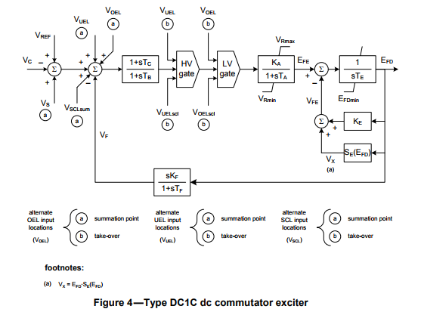
IEEET1 Evolution
Slightly modified in Std 421.5-2016
Note the minimum
limit on E_{FD}
There is also the addition to the input of voltages from a stator current limiters (V_{SCL}) or over excitation limiters (V_{OEL})
37

Slide 39
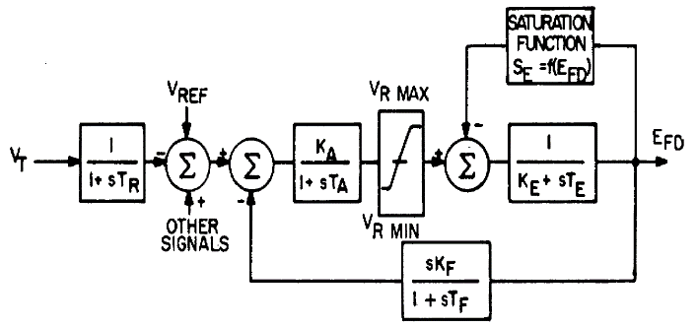
IEEET1 Example
Assume previous GENROU case with saturation. Then add a IEEE T1 exciter with K_{A}=50, T_{A}=0.04, K_{E}=-0.06, T_{E}=0.6, V_{R,max}=1.0, V_{R,min}= -1.0 For saturation assume S_{E}(2.8) = 0.04, S_{E}(3.73)=0.33
Saturation function is 0.1621(E_{FD}-2.303)² (for E_{FD} > 2.303); otherwise zero
E_{FD} is initially 3.22
S_{E}(3.22)*E_{FD}=0.437
(V_{R}-S_{E}*E_{FD})/K_{E}=E_{FD}
V_{R} =0.244
V_{REF} = 0.244/Ka +V_{T} =0.0488 +1.0946=1.09948
Case B4_GENROU_Sat_IEEET1
38

Slide 40
IEEE T1 Example
For 0.1 second fault (from before), plot of E_{FD} and the terminal voltage is given below
Initial V₄=1.0946, final V₄=1.0973
  Steady-state error depends on the value of K_{A}
39

Slide 41
IEEET1 Example
Same case, except with K_{A}=500 to decrease steady-state error, no V_{R} limits; this case is actually unstable
40

Slide 42
IEEET1 Example
With K_{A}=500 and rate feedback, K_{F}=0.05, T_{F}=0.5
Initial V₄=1.0946, final V₄=1.0957
41

Slide 43
AC Exciters
Almost all new exciters use an ac source with an associated rectifier (either from a machine or static)
AC exciters use an ac generator and either stationary or rotating rectifiers to produce the field current
  In stationary systems the field current is provided through slip rings
  In rotating systems since the rectifier is rotating there is no need for slip rings to provide the field current
  Brushless systems avoid the anticipated problem of supplying high field current through brushes, but these problems have not really developed
42

Slide 44
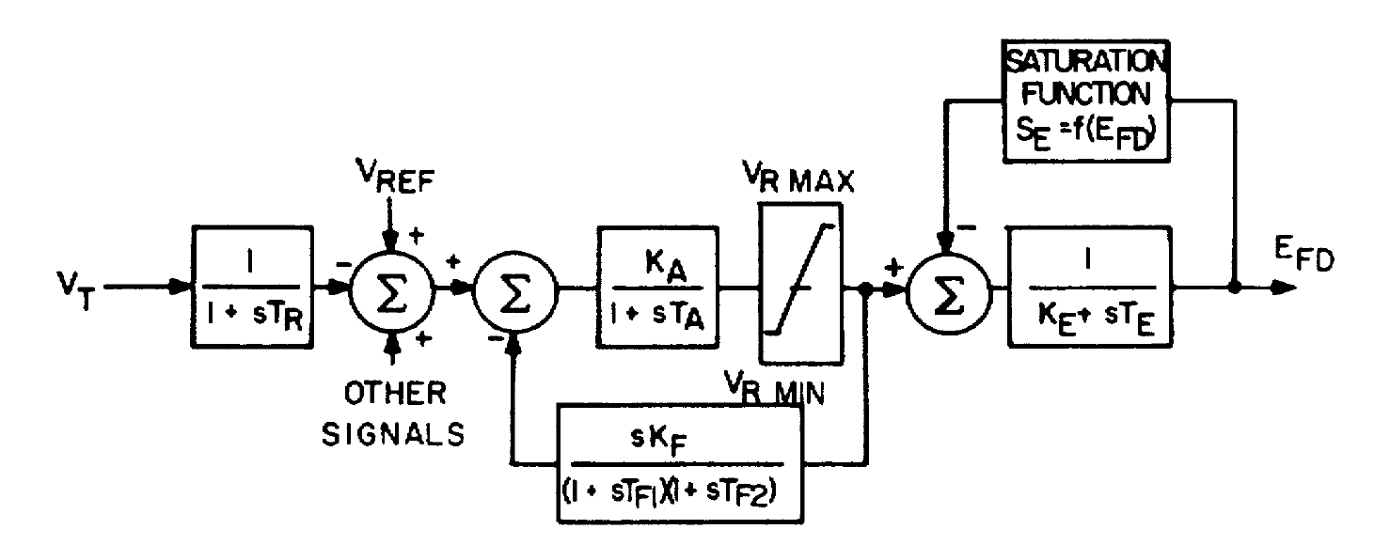
AC Exciter Modeling
  Originally represented by IEEE T2 shown below
Exciter model is quite
similar to IEEE T1; in the EI/WECC case there are 105 IEEE T2 exciters (about 1%)
Image Source: Fig 2 of "Computer Representation of Excitation Systems," IEEE Trans. Power App. and Syst., vol. PAS-87, pp. 1460-1464, June 1968
43

Slide 45
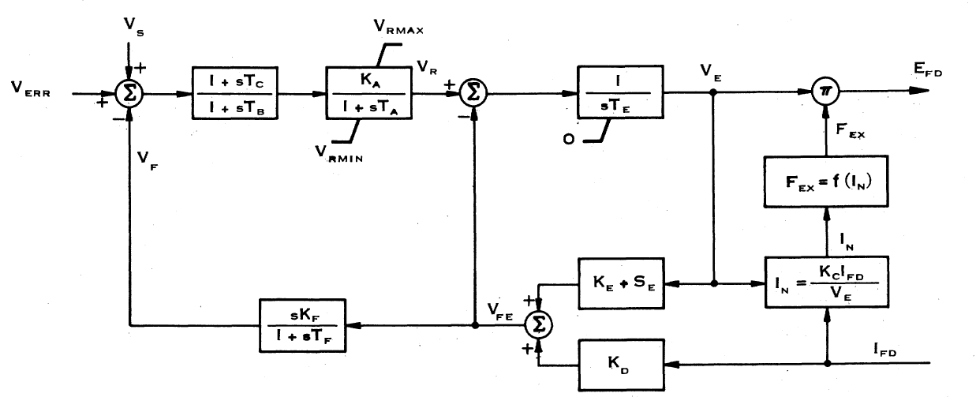
EXAC1 Exciter
The F_{EX} function represent the rectifier regulation, which results in a decrease in output voltage as the field current is increased
About 1% of the EI/WECC exciters
are EXAC1
K_{D} models the exciter machine reactance
Image Source: Fig 6 of "Excitation System Models for Power Stability Studies," IEEE Trans. Power App. and Syst., vol. PAS-100, pp. 494-509, February 1981
44

Slide 46
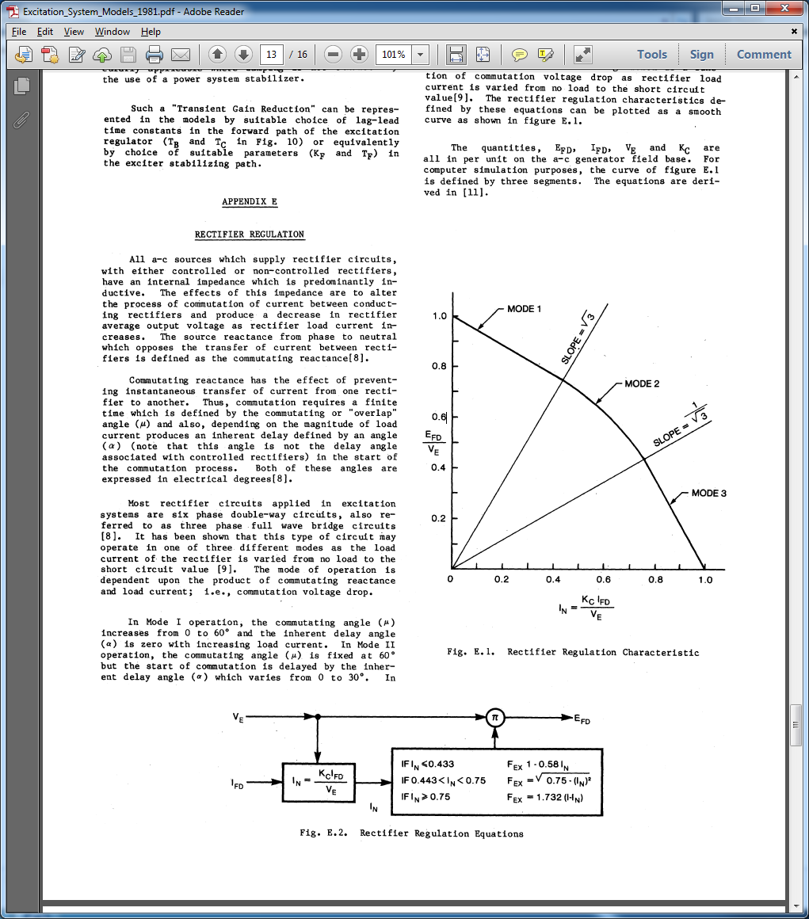
EXAC1 Rectifier Regulation
Kc represents the
commuting reactance
There are about 6 or 7 main types of ac exciter models
Image Source: Figures E.1 and E.2 of "Excitation System Models for Power Stability Studies," IEEE Trans. Power App. and Syst., vol. PAS-100, pp. 494-509, February 1981
45

Slide 47
Static Exciters
In static exciters the field current is supplied from a three phase source that is rectified (i.e., there is no separate machine)
Rectifier can be either controlled or uncontrolled
Current is supplied through slip rings
Response can be quite rapid
46

Slide 48
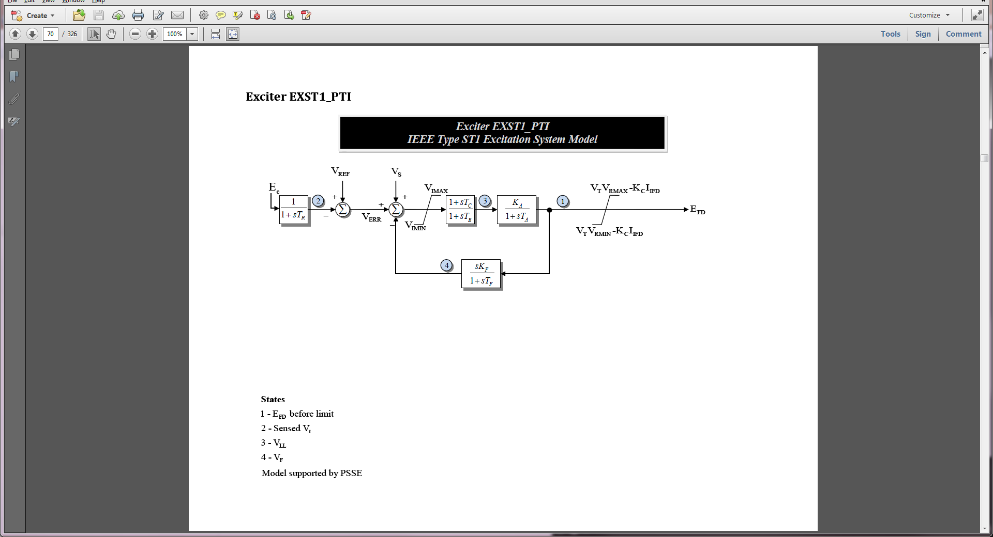
EXST1 Block Diagram
The EXST1 is intended to model rectifier in which the power is supplied by the generator's terminals via a transformer
  Potential-source controlled-rectifier excitation system
The exciter time constants are assumed to be so small they are not represented
This (and the related ESST1A) is a very common exciter (about 14% of EI/WECC total)
Kc represents the commuting reactance
47

Slide 49
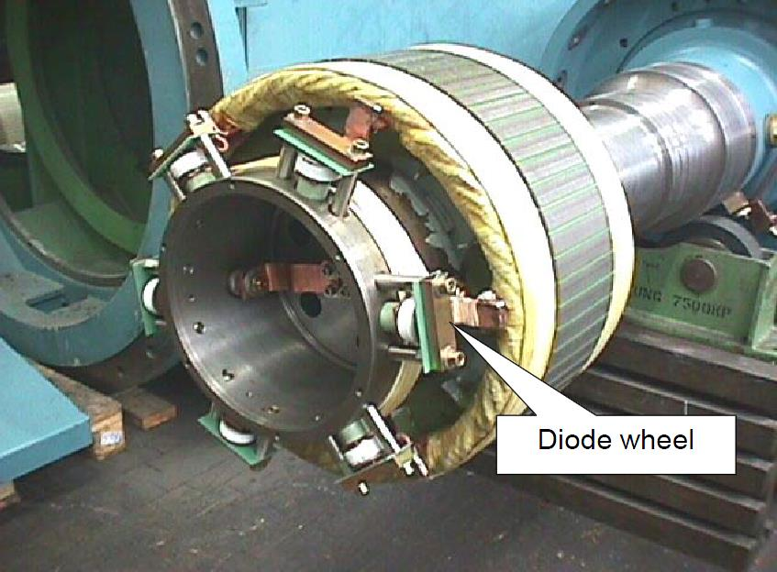
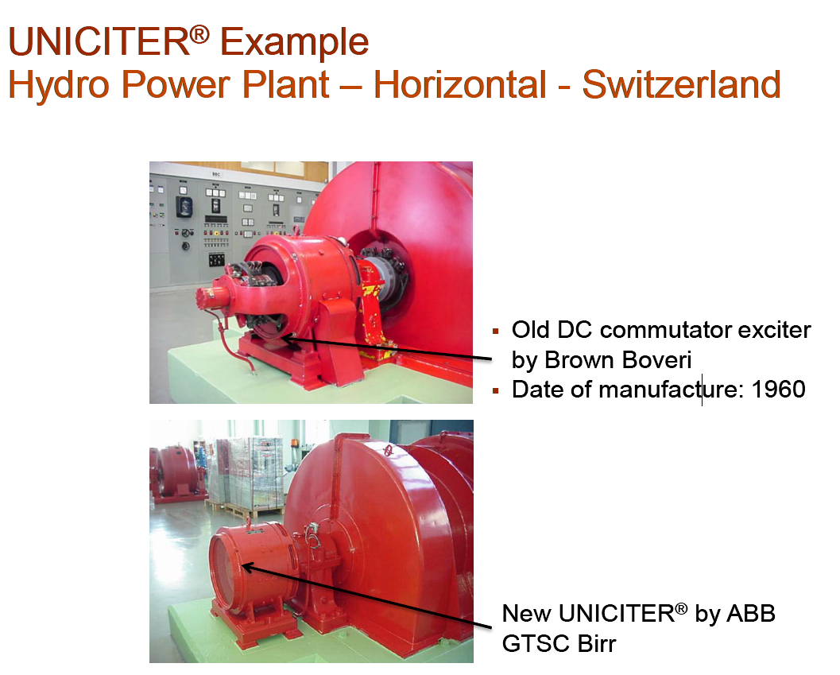
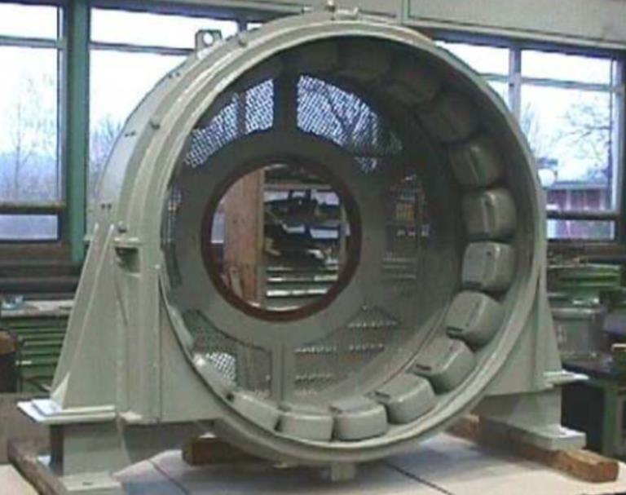
Exciter Upgrade Example: ABB UNICITER
Image Source: qdoc.tips/brushlessexcitationsystemsupgrade-pdf-free.html
Exciter Stator Field
48

Slide 50
Compensation
Often times it is useful to use a compensated voltage magnitude value as the input to the exciter
  Compensated voltage depends on generator current; usually Rc is zero
PSLF and PowerWorld model compensation with the machine model using a minus sign (negative convention)
  Specified on the machine base
PSSE requires a separate model with their COMP model also using a negative sign
Sign convention is from IEEE 421.5
49

Slide 51
Compensation
  Using the negative sign convention
  if X_{c} is negative then the compensated voltage is within the machine; this is known as droop compensation, which is used reactive power sharing among multiple generators at a bus
  If X_{c} is positive then the compensated voltage is partially through the step-up transformer, allowing better voltage stability
  A nice reference is C.W. Taylor, "Line drop compensation, high side voltage control, secondary voltage control – why not control a generator like a static var compensator," IEEE PES 2000 Summer Meeting
50

Slide 52
Initial Limit Violations
Since many models have limits and the initial state variables are dependent on power flow values, there is certainly no guarantee that there will not be initial limit violations
If limits are not changed, this does not result in an equilibrium point solution
PowerWorld has several options for dealing with this, with the default value to just modify the limits to match the initial operating point
  If the steady-state power flow case is correct, then the limit must be different than what is modeled
51

