Slide 1
ECEN 460
Power System Operation and Control
Spring 2025
Lecture 20: Power System Stability
Prof. Tom Overbye
Dept. of Electrical and Computer Engineering
Texas A&M University
overbye@tamu.edu

Slide 2
Announcements
Please read Chapter 13
By April 9 do Problem Set A
Schedule for the rest of the semester is
  Lab 9 this week
  Lab 10 week of April 7, which will include time for the design groups to meet
  Lab 3 week of April 14 (optional, ungraded machine lab)
  Lab 11 (project presentations) by the individual teams to their TA before the end of classes (on or before April 29)
  Exam 2 on Wednesday April 23 during class
  Design project due at 9:30 am on May 1 (i.e., at the end of our final slot; no final)
1

Slide 3
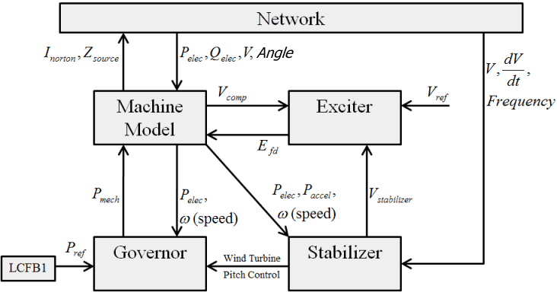
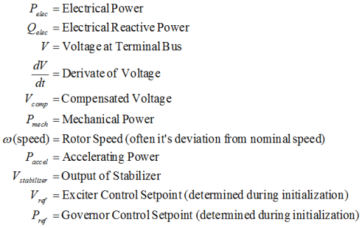
Governor Models
2

Slide 4
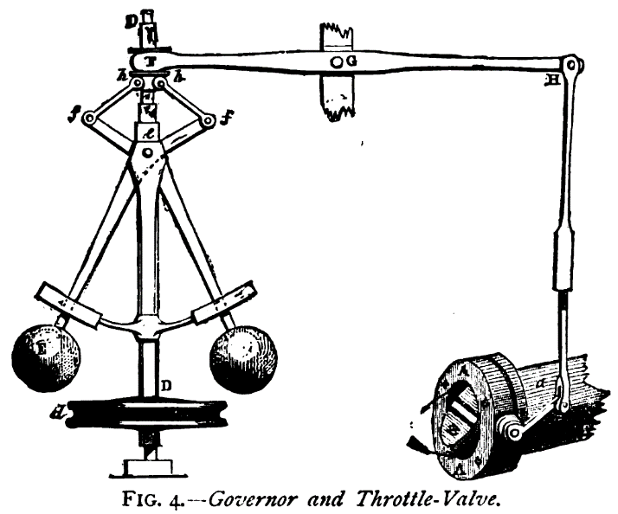
Prime Movers and Governors
Synchronous generator is used to convert mechanical energy from a rotating shaft into electrical energy
The "prime mover" is what converts the original energy source into the mechanical energy in the rotating shaft
Possible sources: 1) steam (nuclear, coal, combined cycle, solar thermal), 2) gas turbines, 3) water wheel (hydro turbines), 4) diesel/
gasoline, 5) wind
(which we'll cover separately)
The governor is used
to control the speed
Image source: http://upload.wikimedia.org/wikipedia/commons/1/1e/Centrifugal_governor.png
3

Slide 5
Prime Movers and Governors
In transient stability collectively the prime mover and the governor are called the "governor"
As has been previously discussed, models need to be appropriate for the application
In transient stability the response of the system for seconds to perhaps minutes is considered
Long-term dynamics, such as those of the boiler and automatic generation control (AGC), are usually not considered
These dynamics would need to be considered in longer simulations (e.g. dispatcher training simulator (DTS)
4

Slide 6
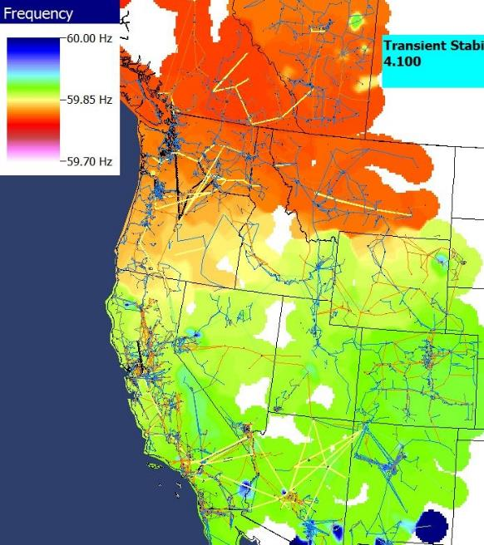
Power Grid Disturbance Example
Figures show the frequency change as a result of the sudden loss of a large amount of generation in the Southern WECC
Freq. Hz)
Time in Seconds
Frequency Contour
5

Slide 7
Frequency Response for Generation Loss
In response to a rapid loss of generation, in the initial seconds the system frequency will decrease as energy stored in the rotating masses is transformed into electric energy
  Some generation, such as solar PV has no inertia, and for most new wind turbines the inertia is not seen by the system
Within seconds governors respond, increasing the power output of controllable generation
  Many conventional units are operated so they only respond to over frequency situations
  Solar PV and wind are usually operated in North America at maximum power so they have no reserves to contribute
6

Slide 8
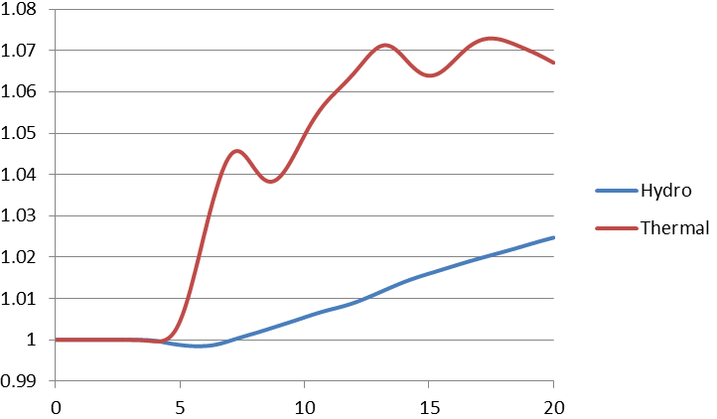
Governor Response:
Thermal Versus Hydro
Thermal units respond quickly, hydro ramps slowly (and goes down initially), wind and solar usually do not respond. And many units are set to not respond!
Normalized
output
Time in Seconds
7

Slide 9
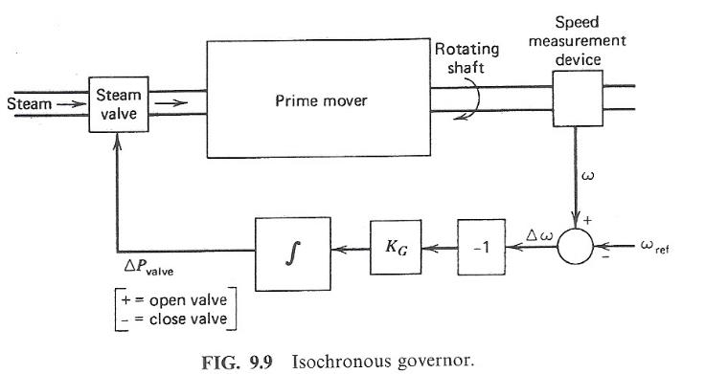
Control of Generation Overview
Goal is to maintain constant frequency with changing load
If there is just a single generator, such with an emergency generator or isolated system, then an isochronous governor is used
  Integrates frequency error to insure frequency goes back to
  the desired value
  Cannot be used with
  interconnected systems
  because of "hunting"
Image source: Wood/Wollenberg, 2nd edition
8

Slide 10
Generator “Hunting”
Control system “hunting” is oscillation around an equilibrium point
Trying to interconnect multiple isochronous generators will cause hunting because the frequency setpoints of the multiple generators are never exactly equal.
  If there are two then one will be accumulating a frequency error trying to speed up the system, whereas the other will be trying to slow it down
  The generators will NOT share the power load proportionally
9

Slide 11
Isochronous Gen Example
WSCC 9 bus from before, gen 3 dropping (85 MW)
  No infinite bus, gen 1 is modeled with an isochronous generator (PW ISOGov1 model)
Case is wscc_9bus_IsoGov
10

Slide 12
Isochronous Gen Example
Graph shows the change in the mechanical output
All the change in MWs due to the loss of gen 3 is ultimately being picked
up by gen 1
11

Slide 13
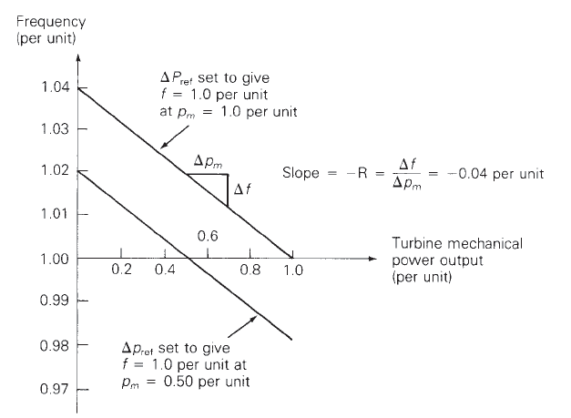
Droop Control
To allow power sharing between generators the solution is to use what is known as droop control, in which the desired set point frequency is dependent upon the generator’s output
R is known as the regulation constant or droop; a typical
value is 4 or 5%. At 60 Hz and a 5% droop, each 0.1 Hz change would change the output by 0.1/(60*0.05) = 3.33%
12

Slide 14
WSCC 9 Bus Droop Example
Assume the previous gen 3 drop contingency (85 MW), and that gens 1 and 2 have ratings of 500 and 250 MVA respectively and governors with a 5% droop. What is the final frequency (assuming no change in load)?
13

Slide 15
WSCC 9 Bus Droop Example
The below graphs compare the mechanical power and generator speed; note the steady-state values match the calculated 59.66 Hz value
Case is wscc_9bus_TGOV1
14

Slide 16
Quick Interconnect Calculation
When studying a system with many generators, each with the same (or close to same) droop, then the final frequency deviation is
The online generator summation should only include generators that actually have governors that can respond, and does not take into account generators hitting their limits
The online generator group obviously does not
include the contingency generator(s) that are opened
15

Slide 17
Larger System Example
As an example, consider the 37 bus, nine generator example from earlier; assume one generator with 42 MW is opened. The total MVA of the remaining generators is 1132. With R=0.05
Case is Bus37_TGOV1
16

Slide 18
Frequency Response Definition
FERC defines in RM13-11: “Frequency response is a measure of an Interconnection’s ability to stabilize frequency immediately following the sudden loss of generation or load, and is a critical component of the reliable operation of the Bulk-Power System, particularly during disturbances and recoveries.”
Design Event for WECC is N-2 (Palo Verde Outage) not to result in UFLS (59.5 Hz in WECC)
Source: wecc.biz/Reliability/Frequency%20Response%20Analysis%20-%20Dmitry%20Kosterev.pdf
17

Slide 19
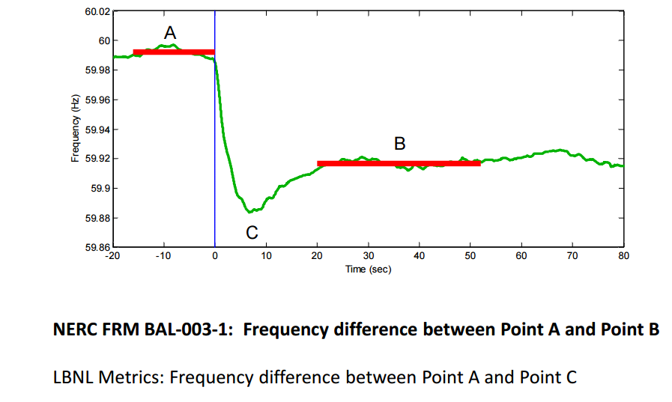
Frequency Response Measure
Source: wecc.biz/Reliability/Frequency%20Response%20Analysis%20-%20Dmitry%20Kosterev.pdf
18

Slide 20
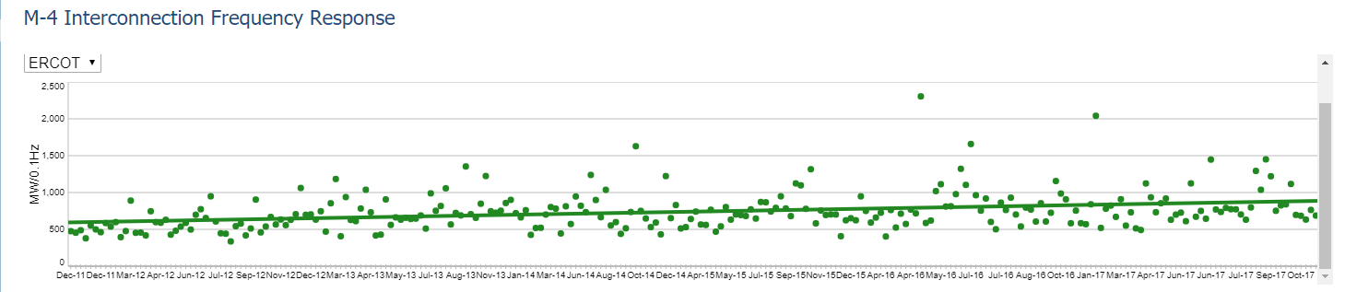
ERCOT Interconnect Frequency Response
The ERCOT values are usually lower
Source: www.nerc.com/pa/RAPA/ri/Pages/InterconnectionFrequencyResponse.aspx
19

Slide 21
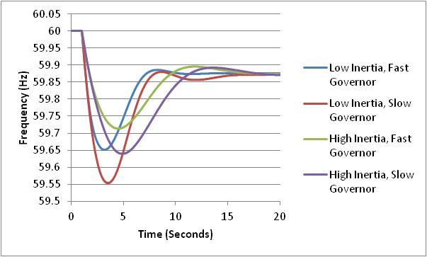
Impact of Inertia (H)
Final frequency is determined by the droop of the responding governors
How quickly the frequency drops depends upon the generator inertia values
The least frequency deviation occurs with high inertia and fast
governors
20

Slide 22
Restoring Frequency to 60 (or 50) Hz
In an interconnected power system the governors to not automatically restore the frequency to 60 Hz
Rather this done via the ACE (area control error) calculation. Previously we defined ACE as the difference between the actual real power exports from an area and the scheduled exports. But it has an additional term
ACE = P_{actual} - P_{sched} – 10β(freq_{act} - freq_{sched})
β is the balancing authority frequency bias in MW/0.1 Hz with a negative sign. It is about 0.8% of peak load/generation
This slower ACE response is usually not modeled in most stability simulations
21

Slide 23
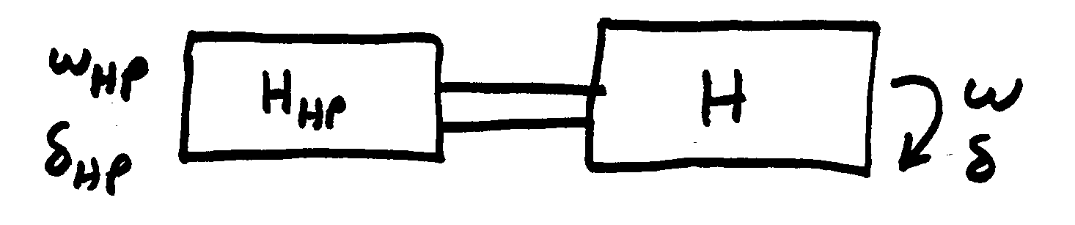
Turbine Models
model shaft “squishiness” as a spring
Usually shaft dynamics
are neglected
High-pressure turbine shaft dynamics
22

Slide 24
Steam Governor Model
Steam valve
limits
R = .05 (5% droop)
23

Slide 25
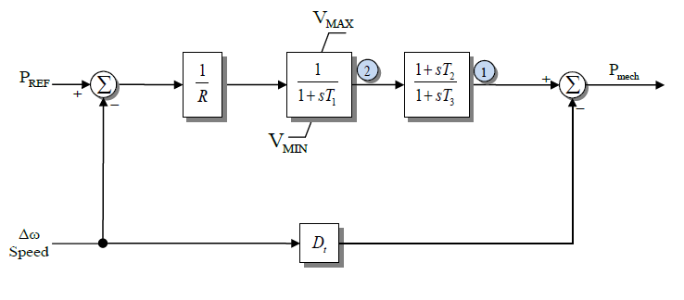
TGOV1 Model
The standard model that is close to this is the TGOV1
About 3% of governors in the 2022 EI/WECC model are TGOV1; R is about 0.05, T₁ is less than 0.5 (except for one 999!), T₃ has an average of 6, average T₂/T₃ is 0.34; D_{t} is used to model turbine damping and is often zero (about 90% of the time)
24

Slide 26
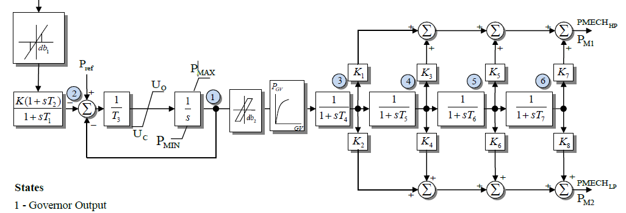
IEEEG1 Model
A common stream turbine model, is the IEEEG1, originally introduced in the below 1973 paper
It can be used to represent
cross-compound units, with
high and low pressure steam
U_{o} and U_{c} are rate limits
In this model K=1/R
IEEE Committee Report, “Dynamic Models for Steam and Hydro Turbines in Power System Studies,” Transactions in Power Apparatus & Systems, volume 92, No. 6, Nov./Dec. 1973, pp 1904-15
25

Slide 27
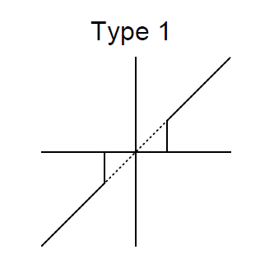
Deadbands
Before going further, it is useful to briefly consider deadbands, with two types shown with IEEEG1 and described in the 2013 IEEE PES Governor Report
The type 1 is an intentional deadband, implemented to prevent excessive response
  Until the deadband activates there is no response, then normal response after that; this can cause a potentially
  large jump in the response
  Also, once activated there is normal
  response coming back into range
  Used on input to IEEEG1
26

Slide 28
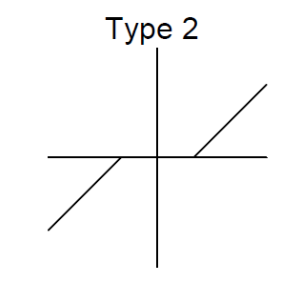
Deadbands
The type 2 is also an intentional deadband, implemented to prevent excessive response
  Difference is response does not jump, but rather only starts once outside of the range
Another type of deadband is the
unintentional, such as will occur
with loose gears
  Until deadband "engages"
  there is no response
  Once engaged there is
  a hysteresis in the
  response
When starting simulations
the deadbands usually start at their origin
27

Slide 29
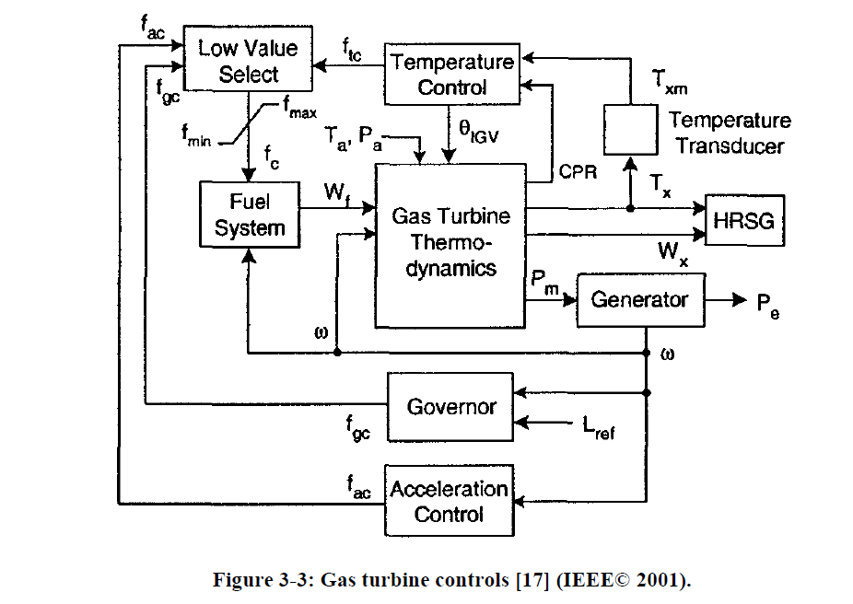
Gas Turbines
A gas turbine (usually using natural gas) has a compressor, a combustion chamber and then a turbine
The below figure gives an overview of the modeling
HRSG is the heat
recovery steam
generator (if it is a
combined cycle unit)
Image from IEEE PES, "Dynamic Models for Turbine-Governors in Power System Studies," Jan 2013
28

Slide 30
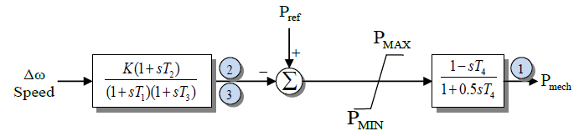
Hydro Units
Hydro units tend to respond slower than steam and gas units; since early transient stability studies focused on just a few seconds (first or second swing instability), detailed hydro units were not used
  The original IEEEG2 and IEEEG3 models just gave the linear response; now considered obsolete
Below is the IEEEG2; left side is the governor, right side is the turbine and water column
For sudden changes there is actually an inverse change in
the output power
29

Slide 31
Washout Filters
A washout filter is a high pass filter that removes the steady-state response (i.e., it "washes it out") while passing the high frequency response
They are commonly used with hydro governors and (as we shall see) with power system stabilizers
With hydro turbines ballpark values for T_{w} are around one or two seconds
30

Slide 32
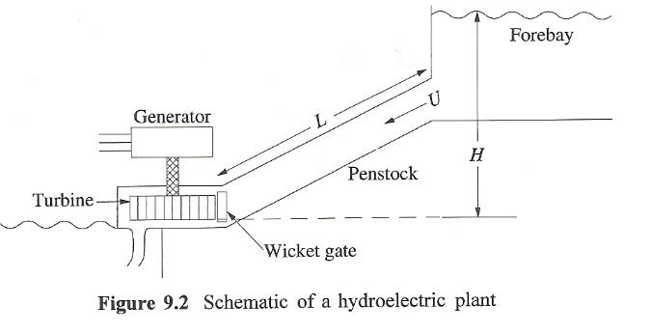
Basic Nonlinear Hydro Turbine Model
Basic hydro system is shown below
  Hydro turbines work be converting the kinetic energy in the water into mechanical energy
  assumes the water is incompressible
At the gate assume a velocity of U, a cross-sectional penstock area of A; then the
volume flow is A*U=Q;
Source: 9.2, Kundur, Power System Stability and Control, 1994
31

Slide 33
Basic Nonlinear Hydro Turbine Model
From Newton's second law of motion the change in the flow volume Q
As per [a] paper, this equation is normalized to
T_{W} is called the water time
constant, or water starting time
[a] "Hydraulic Turbine and Turbine Control Models for System Dynamic Studies," IEEE Trans. Power Syst., Feb, 92
32

Slide 34
Basic Nonlinear Hydro Turbine Model
With h_{base} the static head, q_{base} the flow when the gate is fully open, an interpretation of T_{w} is the time (in seconds) taken for the flow to go from stand-still to full flow if the total head is h_{base}
If included, the head losses, h_{loss}, vary with the square of the flow
The flow is assumed to vary as linearly with the gate position (denoted by c)
Power developed is proportional to flow rate times the head, with a term q_{nl} added to model the fixed turbine (no load) losses
  The term A_{t} is used to change the per unit scaling to that of the electric generator
33

Slide 35
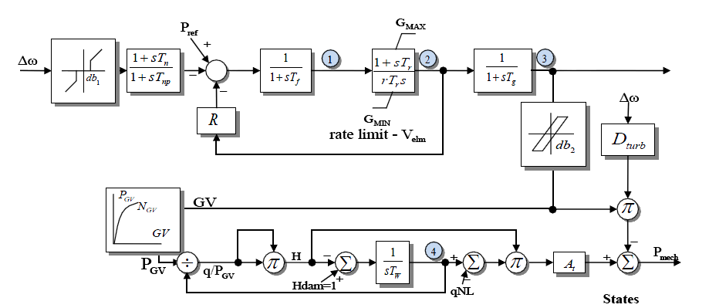
Model HYGOV
This simple model, combined with a governor, is implemented in HYGOV
About 6% of WECC governors use this model;
average T_{W} is
two seconds
The gate position (GV) to gate power (P_{GV})
is sometimes represented with a nonlinear curve
H_{loss} is assumed small and not included
34

Slide 36
PID Controllers
Governors and exciters often use proportional-integral-derivative (PID) controllers
  Developed in 1890’s for automatic ship steering by observing the behavior of experienced helmsman
PIDs combine
  Proportional gain, which produces an output value that is proportional to the current error
  Integral gain, which produces an output value that varies with the integral of the error, eventually driving the error to zero
  Derivative gain, which acts to predict the system behavior. This can enhance system stability, but it can be quite susceptible to noise
35

Slide 37
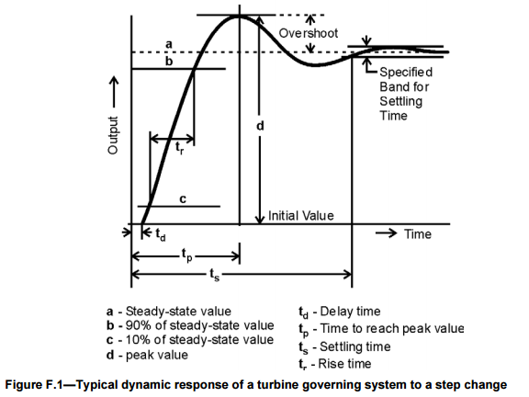
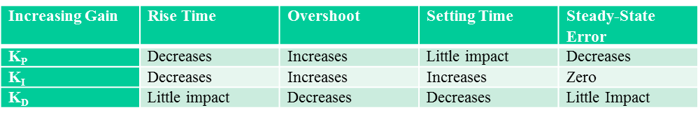
PID Controller Characteristics
Four key characteristics
of control response are
1) rise time, 2) overshoot,
3) settling time and
4) steady-state errors
Image source: Figure F.1, IEEE Std 1207-2011
36

Slide 38
PID Example: Car Cruise Control
Say we wish to implement cruise control on a car by controlling the throttle position
  Assume force is proportional to throttle position
  Error is difference between actual speed and desired speed
With just proportional control we would never achieve the desired speed because with zero error the throttle position would be at zero
The integral term will make sure we stay at the desired point
With derivative control we can improve control, but as noted it can be sensitive to noise
37

Slide 39
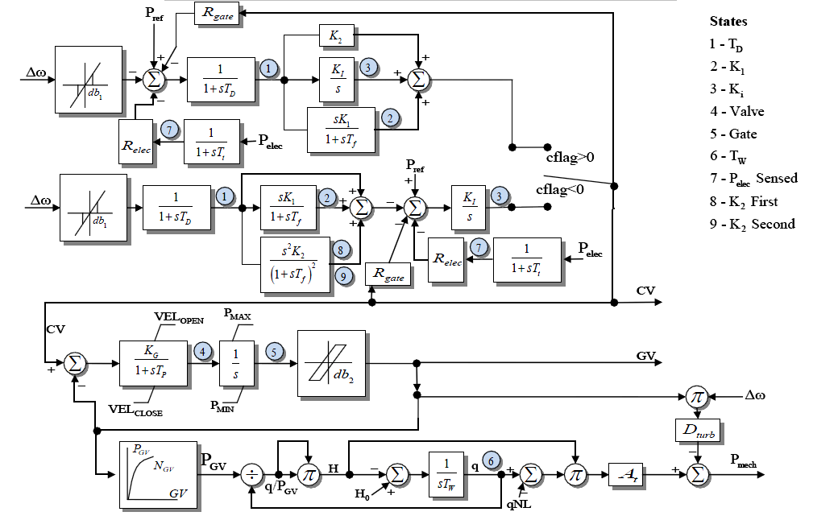
HYG3
The HYG3 models has a PID or a double derivative
Looks more complicated
than it is since depending
on cflag only one of
the upper paths is used
About 15% of current WECC governors at HYG3
38

Slide 40
Load Modeling
The assumed model for the load can have a significant impact on simulation results, particularly the voltage response
Constant power loads are, in general, not a good choice
Traditionally load models have been divided into two groups
  Static: load is a algebraic function of bus voltage and sometimes frequency
  Dynamic: load is represented with a dynamic model, with induction motor models the most common
The simplest load model is a static constant impedance
  Has been widely used
  Allowed the Y_{bus} to be reduced, eliminating essentially all non-generator buses
  Presents no issues as voltage falls to zero
  No longer commonly used

Slide 41
ZIP Load Model (Static, can be used in Power Flow)
The most common static load model is the ZIP, in which the load is represented as
Some models allow more general voltage dependence
Constant impedance is a special case of this model
The voltage exponent for reactive power is often > 2

Slide 42
Discharge Lighting Models
Discharge lighting (sending electricity through a gas such as fluorescent lamps) have been at major portion of the load (10-15%) though now it is getting increasingly replaced by LEDs
Discharge lighting has been modeled for sufficiently high voltage with a real power as constant current and reactive power with a high voltage dependence
  Linear reduction for voltage between 0.65 and 0.75 pu
  Extinguished (i.e., no load) for voltages below
May need to change with newer electronic ballasts – e.g., reactive
power increasing as the voltage drops!

Slide 43
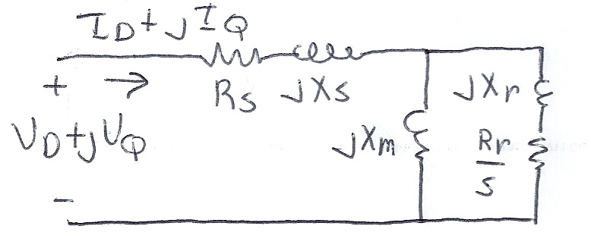
Dynamic Load Models
Most stability models now include a combination of static models with dynamic models
The major dynamic component of the load has been induction motors
Induction motors operate close to synchronous speed, but not a synchronous speed; a key value is their slip, s; the slip then is a parameter in their circuit model

Slide 44
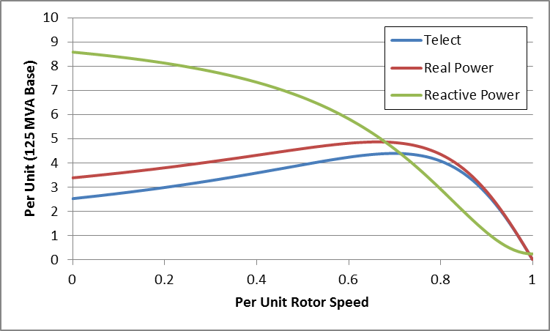
Induction Model Torque-Speed Curves
The below graph shows the torque-speed curve for this induction machine; note the high reactive power consumption on starting (which is why the lights may dim when starting a cloth dryer!)
From the graph you can see with a 100 MW load (0.8 pu on the 125 MW base), the slip is about 0.025

Slide 45
Induction Motor Stalling
Height of the torque-speed curve varies with the square of the terminal voltage
When the terminal voltage decreases, such as during a fault, the mechanical torque can exceed the electrical torque
  This causes the motor to decelerate, perhaps
  quite quickly, with the rate proportional to
  its inertia
  This deceleration causing the slip to increase,
  perhaps causing the motor to stall with s=1,
  resulting in a high reactive current draw
  Too many stalled motors can prevent the
  voltage from recovering

Slide 46
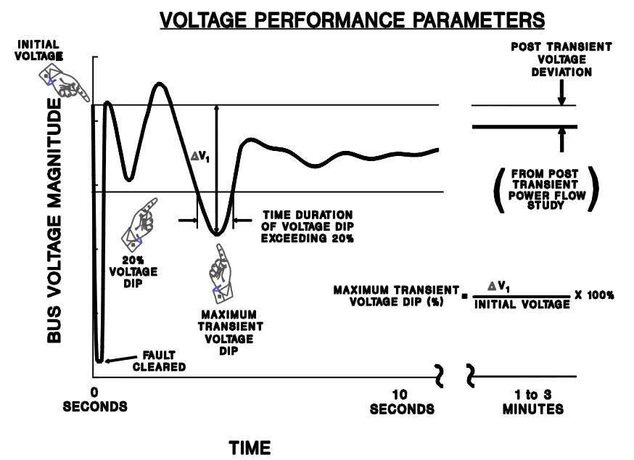
Transient Limit Monitors
During a transient contingency how fast the voltage recovers is a key metric
Similar performance criteria exist for frequency deviations
Image from WECC Planning and Operating Criteria

