Slide 1
ECEN 460
Power System Operation and Control
Spring 2025
Lecture 21: Load Modeling, Modal Analysis
Prof. Tom Overbye
Special Guest Lecture Given by Sanjana Kunkolienkar
Dept. of Electrical and Computer Engineering
Texas A&M University
overbye@tamu.edu

Slide 2
Announcements
Please read Chapter 13
By April 9 do Problem Set A
Schedule for the rest of the semester is
  Lab 10 week of April 7 consisting of time for the design groups to meet; all groups need to turn in a brief progress report in lieu of a lab report
  Lab 3 week of April 14 (optional, ungraded machine lab)
  Lab 11 (project presentations) by the individual teams to their TA before the end of classes (on or before April 29)
  Exam 2 on Wednesday April 23 during class
  Design project due at 9:30 am on May 1 (i.e., at the end of our final slot; no final)
1

Slide 3
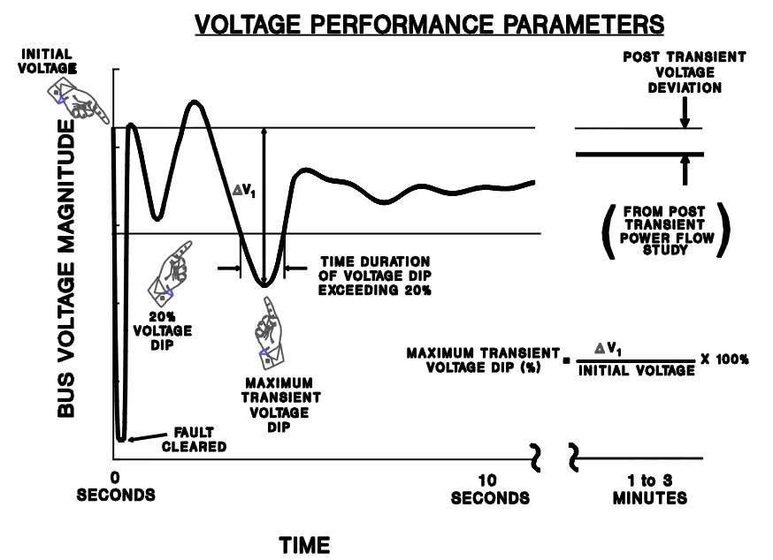
Transient Limit Monitors
During a transient contingency how fast the voltage recovers is a key metric
Similar performance criteria exist for frequency deviations
Image from WECC Planning and Operating Criteria

Slide 4
Composite Load Models
Many aggregate loads are best represented by a combination of different types of load
  Known as composite load models
  Important to keep in mind that the actual load is continually changing, so any aggregate load is at best an approximation
  Hard to know load behavior to extreme disturbances without actually faulting the load
Early models included a number of loads at the transmission level buses (with the step-down transformer), with later models including a simple distribution system model

Slide 5
CLOD Model
The CLOD model represents the load as a combination of large induction motors, small induction motors, constant power, discharge lighting, and other

Slide 6
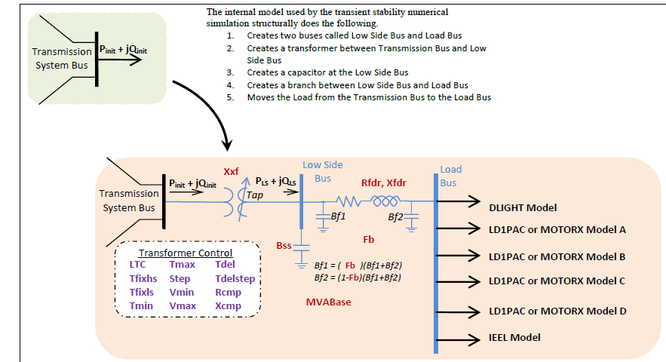
Composite Load Model
Contains up to four motors or single phase induction motor models; also includes potential for solar PV

Slide 7
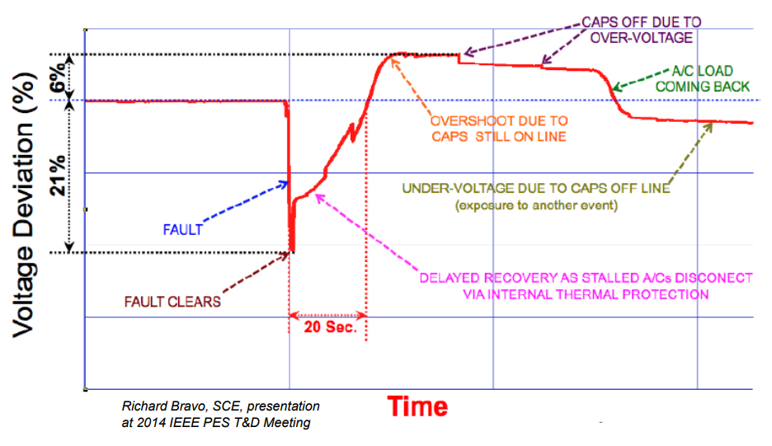
A Concern: Fault Induced Delayed Voltage Recovery (FIDVR)
FIDVR is a situation in which the system voltage remains significantly reduced for at least several seconds following a fault (at either the transmission or distribution level)
  It is most concerning in the high voltage grid, but found to be unexpectedly prevalent in the distribution system
Stalled residential air
conditioning units are a
key cause of FIDVR –
they can stall within the
three cycles needed to
clear a fault
Image Source: NERC, Fault Induced Delayed Voltage Recovery (FIDVR) Advisory, July 2015

Slide 8
Oscillations
An oscillation is just a repetitive motion that can be either undamped, positively damped (decaying with time) or negatively damped (growing with time)
If the oscillation can be written as a sinusoid then
The damping ratio is
The percent damping is just the damping ratio multiplied by 100; goal is sufficiently positive damping
7

Slide 9
Power System Oscillations
Power systems can experience a wide range of oscillations, ranging from highly damped and high frequency switching transients to sustained low frequency (< 1 Hz) inter-area oscillations affecting an entire interconnect
Types of oscillations include
  Transients: Usually high frequency and highly damped
  Local plant: Usually from 1 to 5 Hz
  Inter-area oscillations: From 0.15 to 1 Hz
  Slower dynamics: Such as AGC, less than 0.15 Hz
  Subsynchronous resonance: 10 to 50 Hz (less than synchronous)

Slide 10
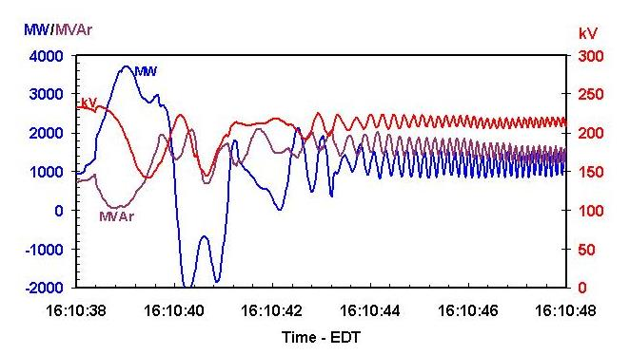
Example Oscillations
The left graph shows an oscillation that was observed during a 1996 WECC Blackout, the right from the 8/14/2003 blackout

Slide 11
Causes of Power System Oscillations
The response of a simple system can be divided into its natural response versus its forced response
  The natural response tells how the system will response to an initial disturbance without any additional (external) influences; this response shows the system’s modes
  A forced response is associated with an external disturbance; if the external disturbance is periodic then the system will oscillate at least partially at this frequency
  Often forced oscillations are due to control failures
Resonance occurs when a forced response is at a similar frequency to one of the system’s modes
An power system can experience both types of oscillations

Slide 12
Phasor Measurement Units (PMUs) and SynchroPhasors
Initially a challenge with understanding power system dynamics was the lack of high speed, synchronized measurements
  Supervisory Control and Data Acquisition (SCADA) measured the system analog values every couple of seconds
This has gradually changed over the last several decades with the now widespread deployment of phasor measurement units (PMUs) that are able to use time synchronized measurements to accurately determine values at rates of 30 times per second

Slide 13
Modes
A mode is a concept from linear system analysis
  Electric grids certainly are not linear, but usually their response to small disturbances is approximated as linear
A mode corresponds to one of the eigenvalues of the response or, for oscillations, a complex pair of eigenvalues
A mode has a frequency and damping; all parts of the system oscillate with this pattern
The mode shape tells how parts of the system participate in the mode
There can be multiple modes in a system; power systems can have many modes

Slide 14
Small Signal Analysis (SSA)
Small signal stability is the ability of the power system to maintain synchronism following a small disturbance
  System is continually subject to small disturbances, such as changes in the load
The operating equilibrium point (EP) obviously must be stable
Small signal analysis (SSA) is studied to get a feel for how close the system is to losing stability and to get additional insight into the system response
  There must be positive damping
13

Slide 15
Model-Based SSA
Assume the power system is modeled in our standard form as
The system can be linearized about an equilibrium point
Eliminating Δy gives
If there are just classical generator models then D is the power flow Jacobian; otherwise it also includes the stator algebraic equations.
We won’t be covering model-based SSA in 460
14

Slide 16
Small Signal Analysis and
Measurement-Based Modal Analysis
The alternative to model-based SSA is to use measurement-based modal analysis to determine the observed dynamic properties of a system
  Input can either be measurements from devices (such as PMUs) or dynamic simulation results
  The same approach can be used regardless of the measurement source
Focus in this section is on the measurement-based approach
15

Slide 17
Ring-down Modal Analysis
Ring-down analysis seeks to determine the frequency and damping of key power system modes following some disturbance
There are several different techniques, with the Prony approach the oldest (from 1795); introduced into power in 1990 by Hauer, Demeure and Scharf
Regardless of technique, the goal is to represent the response of a sampled signal as a set of exponentially damped sinusoidals (modes)
16

Slide 18
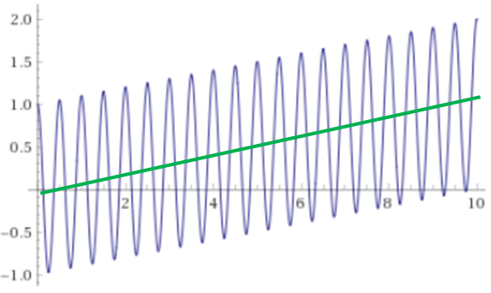

Goal: Extracting Modes from the Signals
The goal is to gain information about the electric grid by extracting modal information from its signals
  The frequency and damping of the modes is key
The premise is we’ll be able to reproduce a complex signal, over a period of time, as a set a of sinusoidal modes
  We’ll also allow for linear
  detrending
$$0.1t+cos\left(2π2t\right)$$
17

Slide 19
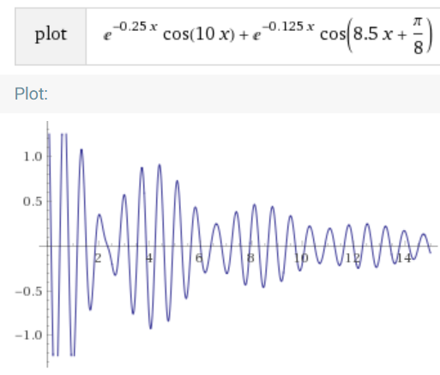
Example: Summation of Two Damped Exponentials
This example was created by going from the modes to
a signal
We’ll be going in the opposite direction (i.e.,
from a measured signal to the modes)
18

Slide 20
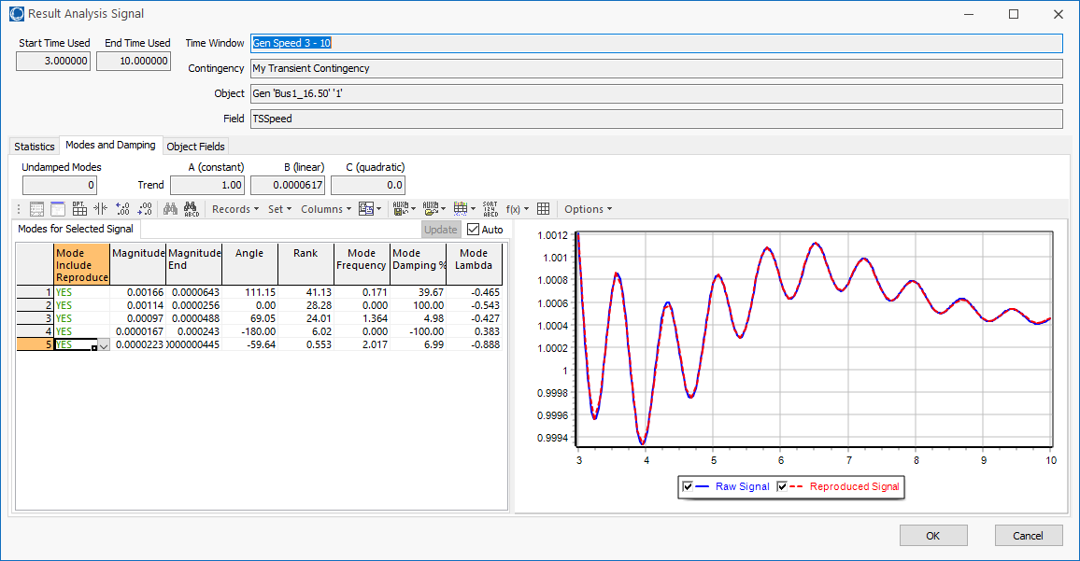
Example: One Signal
This could be any signal; image shows the result of the original signal (blue) and the reproduced signal (red)
19

Slide 21
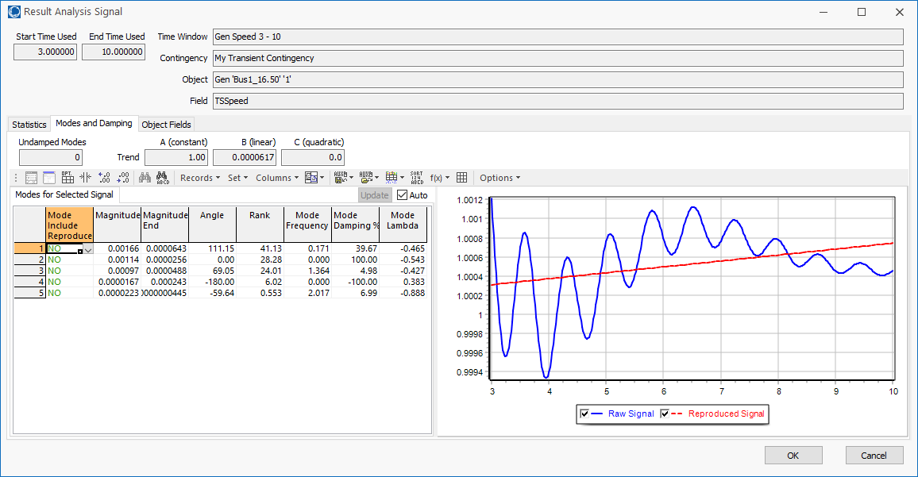
Verification: Linear Trend Line Only
20

Slide 22
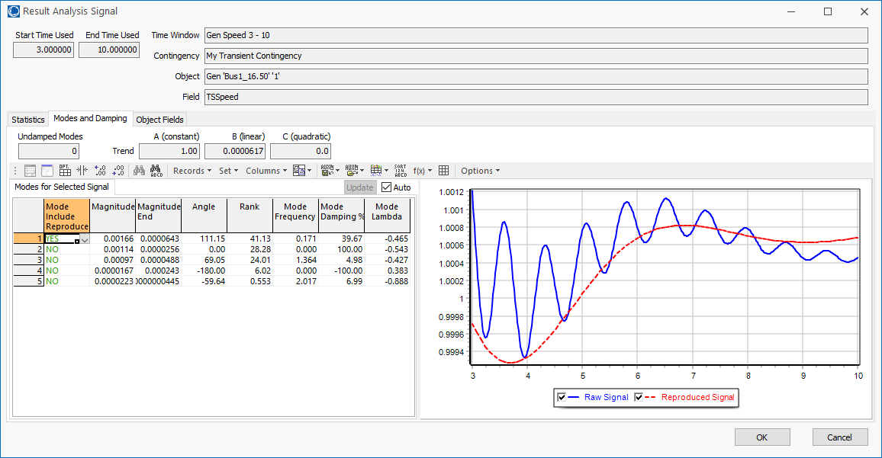
Verification: Linear Trend Line + One Mode
21

Slide 23
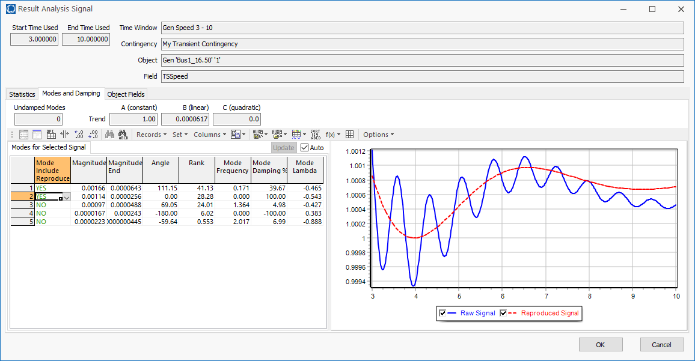
Verification: Linear Trend Line + Two Modes
22

Slide 24
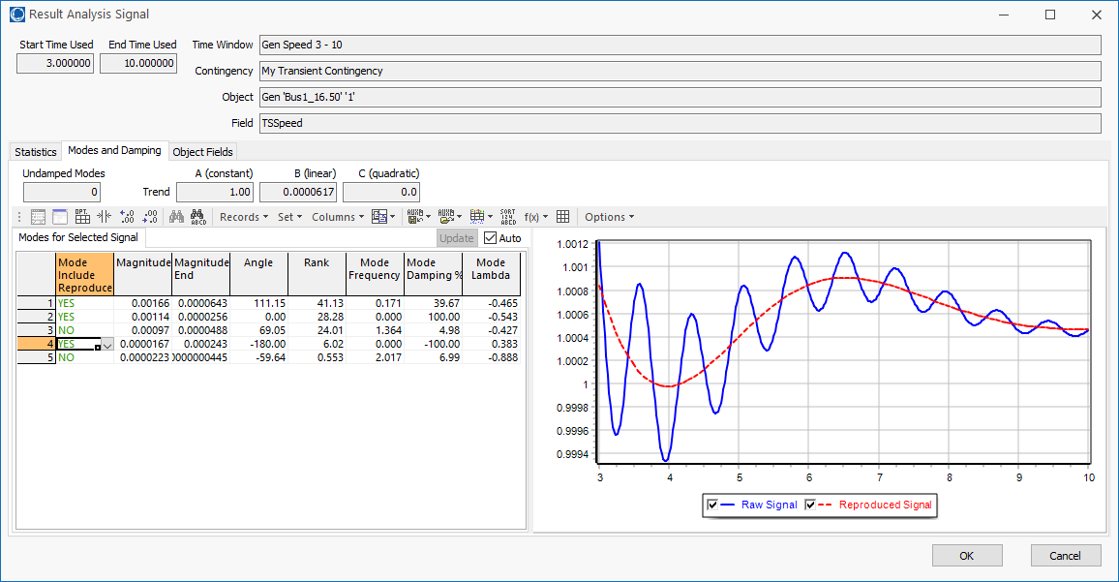
Verification: Linear Trend Line + Three Modes
23

Slide 25
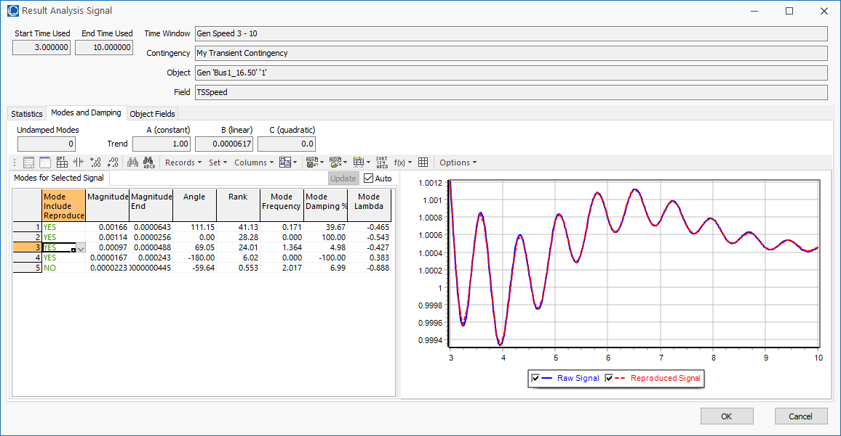
Verification: Linear Trend Line + Four Modes
24

Slide 26

Verification: Linear Trend Line + Five Modes
It is hard to tell a difference
on this one, illustrating that modes manifest differently in different signals
25

Slide 27
Measurement-Based Modal Analysis
There are a number of different approaches
The idea of all techniques is to approximate a signal, y_{org}(t), by the sum of other, simpler signals (basis functions)
  Basis functions are usually exponentials, with linear and quadratic functions used to detrend the signal
  Properties of the original signal can be quantified from basis function properties
    Examples are frequency and damping
  Signal is considered over time with t=0 as the start
Approaches sample the original signal y_{org}(t)
26

Slide 28
Measurement-Based Modal Analysis
Vector y consists of m uniformly sampled points from y_{org}(t) at a sampling value of ΔT, starting with t=0, with values y_{j} for j=1…m
  Times are then t_{j}= (j-1)ΔT
  At each time point j, the approximation of y_{j} is
In 460 we won’t be dwelling on the equations
27

Slide 29
Measurement-Based Modal Analysis
Error (residual) value at each point j is
The closeness of the fit can be quantified using the Euclidean norm of the residuals
Hence we need to determine α and b
In 460 we won’t be dwelling on the equations; the key here is to understand the concepts
28

Slide 30
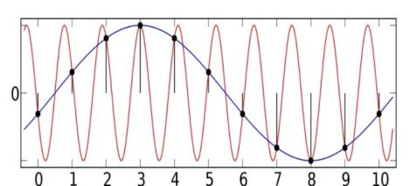
Sampling Rate and Aliasing
The Nyquist-Shannon sampling theory requires sampling at twice the highest desired frequency
  For example, to see a 5 Hz frequency we need to sample the signal at a rate of at least 10 Hz
Sampling shifts the frequency spectrum by 1/T (where T is the sample time), which causes frequency overlap
This is known as aliasing, which
can cause a high frequency
signal to appear to be a lower
frequency signal
  Aliasing can be reduced by fast sampling and/or low
  pass filters
29
Image: upload.wikimedia.org/wikipedia/commons/thumb/2/28/AliasingSines.svg/2000px-AliasingSines.svg.png

Slide 31
One Solution Approach: The Matrix Pencil Method
There are several algorithms for finding the modes. We’ll use the Matrix Pencil Method
  This is a newer technique for determining modes from noisy signals (from about 1990, introduced to power system problems in 2005); it is an alternative to the Prony Method
  The Matrix Pencil Method is useful when there is signal noise
Given m samples, with L=m/2, the first step is to form the Hankel Matrix, Y such that
Reference: A. Singh and M. Crow, "The Matrix Pencil for Power System Modal Extraction," IEEE Transactions on Power Systems, vol. 20, no. 1, pp. 501-502, Institute of Electrical and Electronics Engineers (IEEE), Feb 2005.
30

Slide 32
Algorithm Details, cont.
Then calculate Y’s singular values using an economy singular value decomposition (SVD)
The ratio of each singular value is then
compared to the largest singular value σ_{c};
retain the ones with a ratio > than a threshold
  This determines the modal order, M
  Assuming V is ordered by singular
  values (highest to lowest), let V_{p} be
  then matrix with the first M columns of V
In 460 you should understand what an SVD is doing since the approach is widely used in many applications
The computational
complexity increases
with the cube of the number of measurements!
This threshold is a value that can be changed; decrease it to get more modes.
31

Slide 33
Aside: Matrix Singular Value Decomposition (SVD)
The SVD is a factorization of a matrix that generalizes the eigendecomposition to any m by n matrix to produce
where Σ is a diagonal matrix of the singular values
The singular values are non-negative, real numbers that can be used to indicate the major components of a matrix (the gist is they provide a way to decrease the rank of a matrix)
The original concept is more than 100 years old, but has found lots of recent applications
32

Slide 34
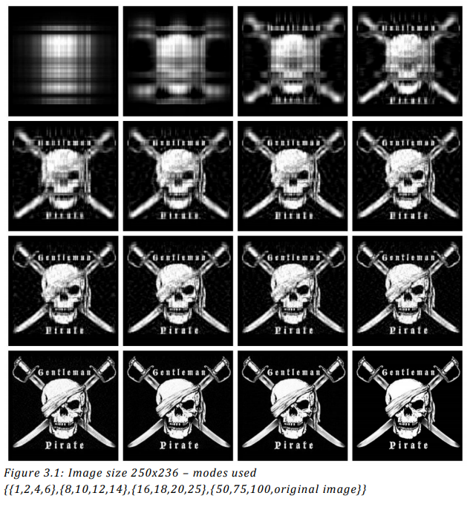
Aside: SVD Image Compression Example
Images can be represented with matrices. When an SVD is applied and only the largest singular values are retained
the image is compressed.
SVD is used in many other applications as well, including facial recognition and principal component analysis (PCA)
Image Source: www.math.utah.edu/~goller/F15_M2270/BradyMathews_SVDImage.pdf
33

Slide 35
Matrix Pencil Method with Many Signals
The Matrix Pencil approach can be used with one signal or with multiple signals
Multiple signals are handled by forming a Y_{k} matrix for each signal k using the measurements for that signal and then combining the matrices
The required computation
scales linearly with the number of signals
34

Slide 36
Matrix Pencil Method with Many Signals
However, when dealing with many signals, usually the signals are somewhat correlated, so vary few of the signals are actually need to be included to determine the desired modes
Ultimately we are finding
The α is common to all the signals (i.e., the system modes) while the b vector is signal specific (i.e., how the modes manifest in that signal)
35

Slide 37
Quickly Determining the b Vectors
A key insight is from an approach known as the Variable Projection Method (from Borden, 2013) that for any signal k
Where m is the number of measurements
and n is the number of modes
A. Borden, B.C. Lesieutre, J. Gronquist, "Power System Modal Analysis Tool Developed for Industry Use," Proc. 2013 North American Power Symposium, Manhattan, KS, Sept. 2013
36

Slide 38
Matrix Pencil Method with Many Signals
However, when dealing with many signals, usually the signals are somewhat correlated, so vary few of the signals are actually need to be included to determine the desired modes
Ultimately, we are finding
The α is common to all the signals (i.e., the system modes) while the b vector is signal specific (i.e., how the modes manifest in that signal)
37

Slide 39
Aside: Pseudoinverse of a Matrix
The pseudoinverse of a matrix generalizes concept of a matrix inverse to an m by n matrix, in which m >= n
  Specifically this is a Moore-Penrose Matrix Inverse
Notation for the pseudoinverse of A is A⁺
Satisfies AA⁺A = A
If A is a square matrix, then A⁺ = A⁻¹
Quite useful for solving the least squares problem since the least squares solution of Ax = b is x = A⁺ b
Can be calculated using an SVD
38

Slide 40
Least Squares Matrix Pseudoinverse Example
Assume we wish to fix a line (mx + b = y) to three data points: (1,1), (2,4), (6,4)
Two unknowns, m and b; hence x = [m b]^{T}
Setup in form of Ax = b
39

Slide 41
Least Squares Matrix Pseudoinverse Example, cont.
Doing an economy SVD
Computing the pseudoinverse
In an economy SVD the Σ matrix has dimensions of m by m if m < n or n by n if n < m
40

Slide 42
Least Squares Matrix Pseudoinverse Example, cont.
Computing x = [m b]^{T} gives
With the pseudoinverse approach we immediately see the sensitivity of the elements of x to the elements of b
  New values of m and b can be readily calculated if y changes
Computationally the SVD is order mn²+n³ (with n < m)
  In this example it means it scales linearly with the number of points; matrices with m >> n are common
41

Slide 43
Computational Considerations
When there is just one signal, the procedure scales with the cube of the number of measurements
  This value is usually relatively small, say 20 seconds of data sampled at 10 Hz for 200 measurements
If multiple signals are included, it scales linearly with the number of signals
However, a key insight is once α has been determined, each b_{k} can be determined with a matrix multiply of a matrix with dimensions of the number of modes and number of measurements
We can quickly determine how well
α matches each signal
42

Slide 44
Modal Analysis in PowerWorld
Goal is to make modal analysis easy to use, and easy to visualize the results
Provided tool can be used with either transient stability results or actual system signals (e.g., from PMUs)
Three ways to access in PowerWorld
  From the Modal Analysis button (in Add-Ons)
  On the Transient Stability Analysis form left menu, Modal Analysis (right below SMIB Eigenvalues)
  By right-clicking on a transient stability or plot case information display, and selecting Modal Analysis Selected Columns or Modal Analysis All Columns
43

Slide 45
Modal Analysis: Three Generator Example
A short fault at t=0 gets the below three generator case oscillating with multiple modes (mostly clearly visible for the red and the green curve)
44

Slide 46
Modal Analysis: Three Generator Example
Open the case B3_CLS_UnDamped
  This system has three classical generators without damping; the default event is a self clearing fault at bus 1
Run the transient stability for 5 seconds
To do modal analysis, on the Transient Stability page select Results from RAM, view just the generator speed fields, right-click and select Modal Analysis All Columns
  This display the Modal Analysis Form
45

Slide 47
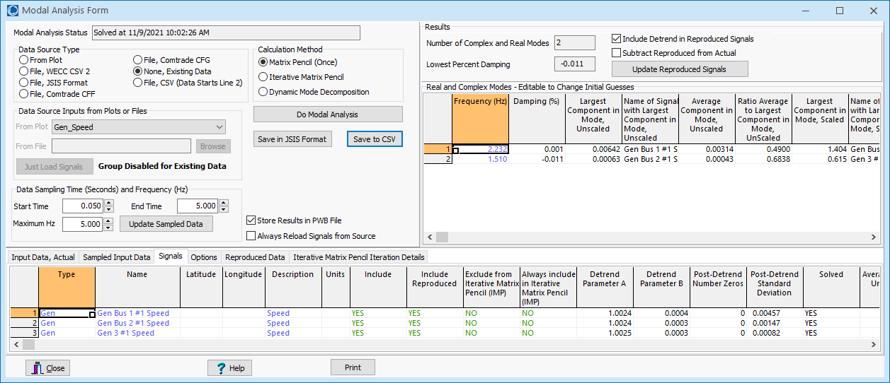
Modal Analysis Form
First click on Do Modal Analysis to run the modal analysis
Key results are shown in the upper-right of the form. There are two main modes, one at 2.23Hz and one at 1.51; both have very little damping.
Right-click on signal to view its dialog
Signals to
include
46

Slide 48
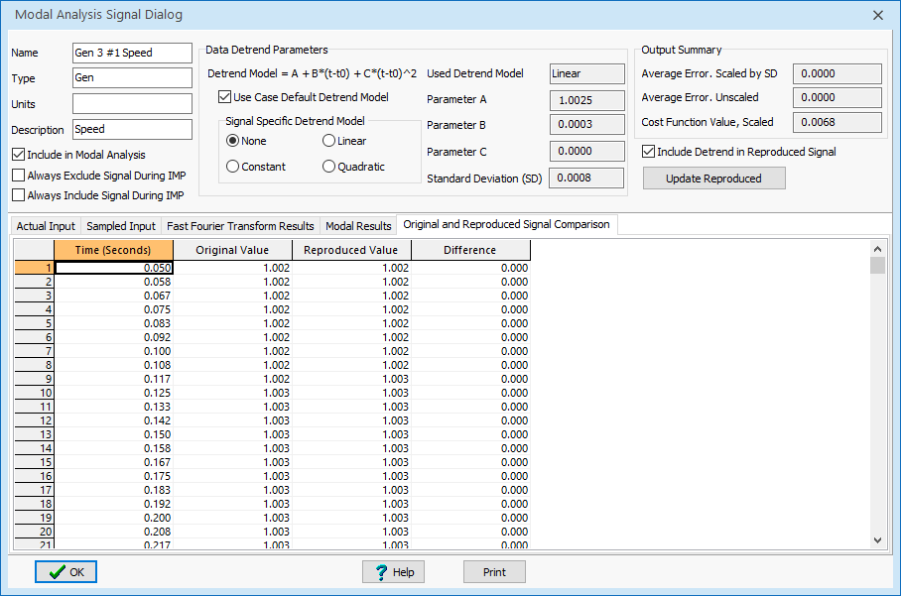
Three Generator Example: Signal Dialog
The Signal Dialog provides details about each signal, including its modal components and a comparison between the original and reproduced signals (example for gen 3)
Plotting the original and reproduced signals shows a near exact match
47

Slide 49
Caution: Setting Time Range Incorrectly Can Result in Unexpected Results!
Assume the system is run with no disturbance for two seconds, and then the fault is applied and the system is run for a total of seven seconds (five seconds post-fault)
  The incorrect approach would be to try to match the entire signal; rather just match from after the fault
  Trying to match the full
  signal between 0 and 7 seconds
  required eleven modes!
  By default the Modal Analysis Form
  sets thedefault start time to
  immediately after the last event
48

Slide 50
GENROU Example with Damping
Open the case B3_GENROU, which changes the GENCLS to GENROU models, adding damping
  Also each has an EXST1 exciter and a TGOV1 governor
  The simulation runs for seven seconds, with the fault occurring at two seconds; modal analysis is done from the time the fault is cleared until the end of the simulation.
The image shows the generator speeds. The initial rise in the speed is caused by the load dropping during the fault, causing a power mismatch; this is corrected by the governors. Note the system now has damping; modal analysis tells us how much.
49

Slide 51
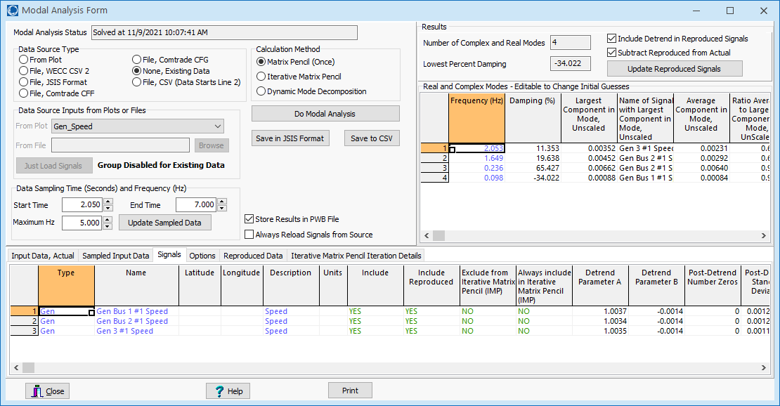
GENROU Example with Damping
Mode frequency, damping, and largest contribution of each mode in the signals. The slower mode is associated with the governors.
Start time
default value
50

Slide 52
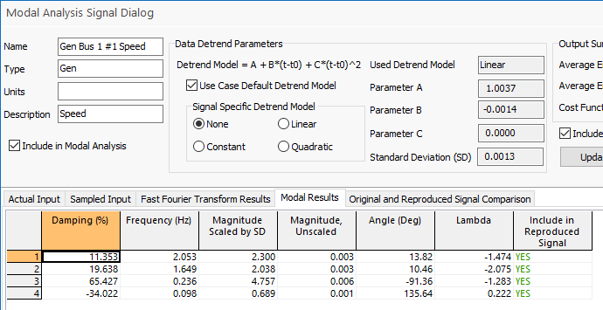
GENROU Example with Damping
Left image show how well the speed for generator 1 is approximated by the modes
More signal details
Just the 2.05 Hz mode
51

