Slide 1
ECEN 460
Power System Operation and Control
Spring 2025
Lecture 22: Modal Analysis, Stabilizers
Voltage Stability
Prof. Tom Overbye
Special Guest Lecture Given by Sanjana Kunkolienkar
Dept. of Electrical and Computer Engineering
Texas A&M University
overbye@tamu.edu

Slide 2
Announcements
Please read Chapter 13
By April 9 do Problem Set A
Schedule for the rest of the semester is
  Lab 10 week of April 7 consisting of time for the design groups to meet; all groups need to turn in a brief progress report in lieu of a lab report
  Lab 3 week of April 14 (optional, ungraded machine lab, Wednesday times only; since Friday is a Reading Day the Friday lab folks can go to a Wednesday lab
  Lab 11 (project presentations) by the individual teams to their TA before the end of classes (on or before April 29)
  Exam 2 on Wednesday April 23 during class; similar format to other exam; comprehensive but more emphasis on material since the first exam
  Design project due at 9:30 am on May 1 (i.e., at the end of our final slot; no final)
1

Slide 3
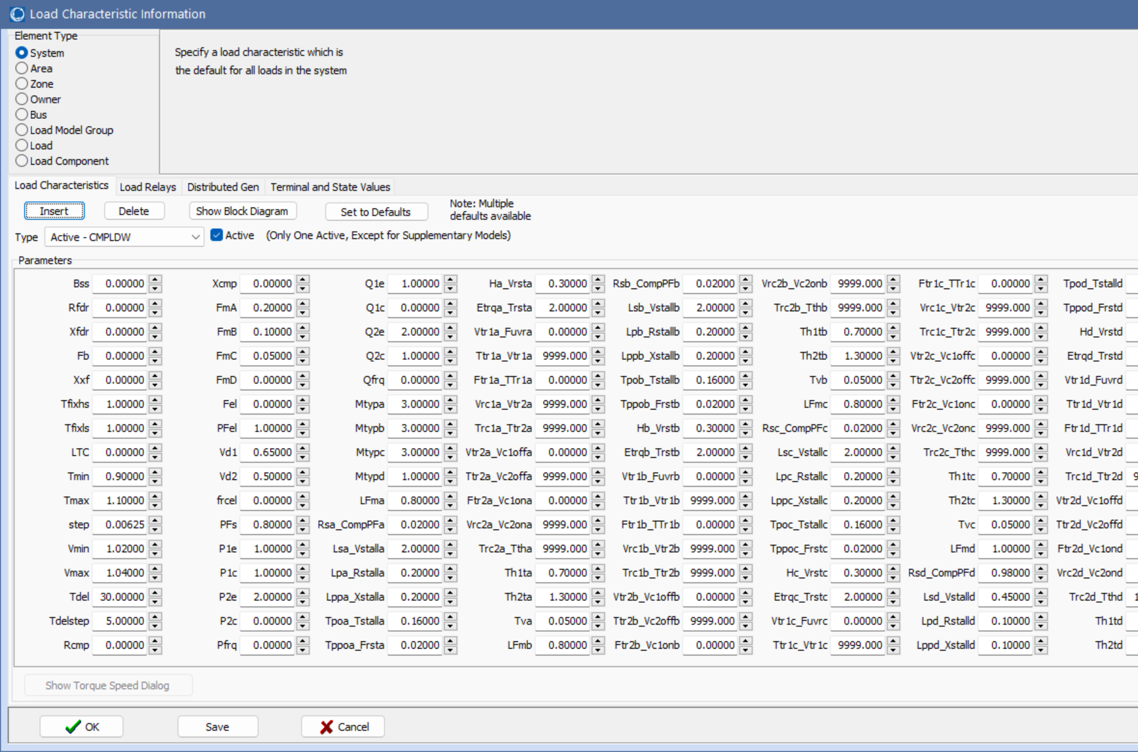
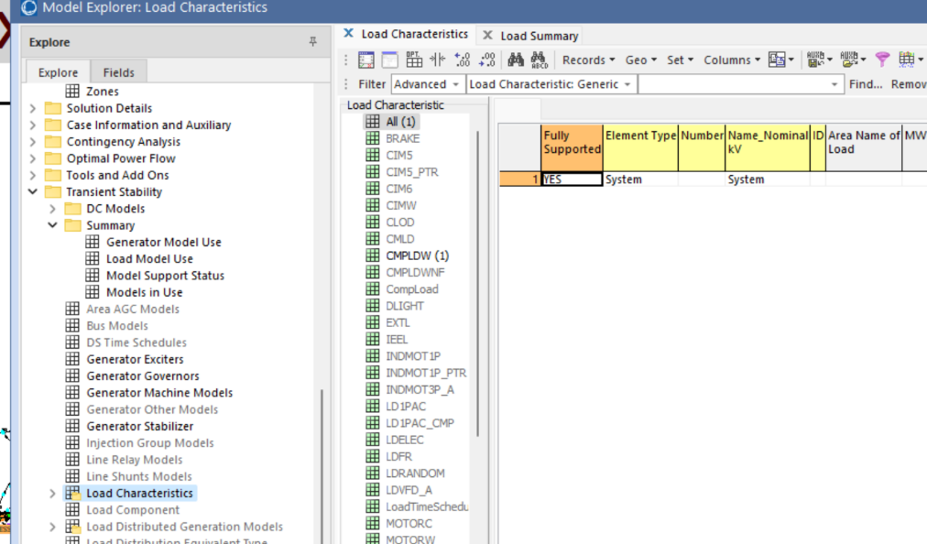
Running 2000 Bus Case with Composite Loads
Show Texas2000_CMPLDW; this is the previous 2000 bus case with the CMPLDW model applied to all loads
To see and modify the parameters
in the Model Explorer select
Transient Stability, Load
Characteristics
Run the generator drop scenario varying these parameters; with this model the grid is no longer well damped (prone to oscillations)

Slide 4
Modal Analysis in PowerWorld
Goal is to make modal analysis easy to use, and easy to visualize the results
Provided tool can be used with either transient stability results or actual system signals (e.g., from PMUs)
Three ways to access in PowerWorld
  From the Modal Analysis button (in Add-Ons)
  On the Transient Stability Analysis form left menu, Modal Analysis (right below SMIB Eigenvalues)
  By right-clicking on a transient stability or plot case information display, and selecting Modal Analysis Selected Columns or Modal Analysis All Columns
3

Slide 5
Modal Analysis: Three Generator Example
A short fault at t=0 gets the below three generator case oscillating with multiple modes (mostly clearly visible for the red and the green curve)
4

Slide 6
Modal Analysis: Three Generator Example
Open the case B3_CLS_UnDamped
  This system has three classical generators without damping; the default event is a self clearing fault at bus 1
Run the transient stability for 5 seconds
To do modal analysis, on the Transient Stability page select Results from RAM, view just the generator speed fields, right-click and select Modal Analysis All Columns
  This display the Modal Analysis Form
5

Slide 7
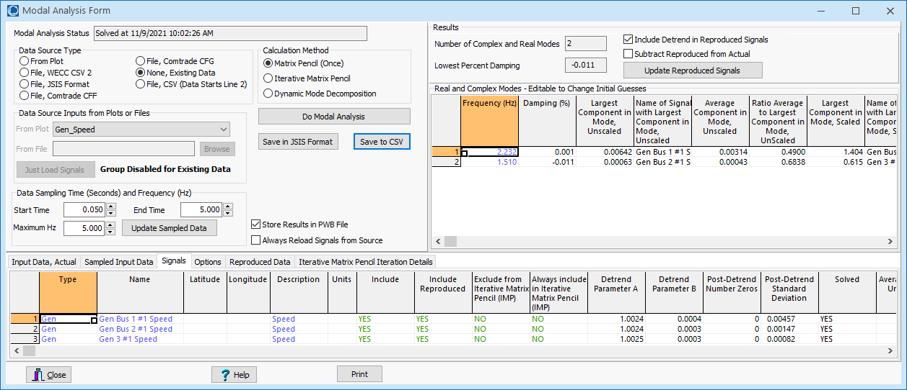
Modal Analysis Form
First click on Do Modal Analysis to run the modal analysis
Key results are shown in the upper-right of the form. There are two main modes, one at 2.23Hz and one at 1.51; both have very little damping.
Right-click on signal to view its dialog
Signals to
include
6

Slide 8
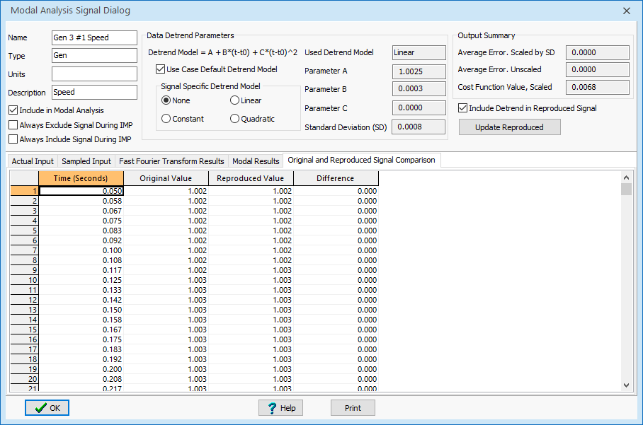
Three Generator Example: Signal Dialog
The Signal Dialog provides details about each signal, including its modal components and a comparison between the original and reproduced signals (example for gen 3)
Plotting the original and reproduced signals shows a near exact match
7

Slide 9
Caution: Setting Time Range Incorrectly Can Result in Unexpected Results!
Assume the system is run with no disturbance for two seconds, and then the fault is applied and the system is run for a total of seven seconds (five seconds post-fault)
  The incorrect approach would be to try to match the entire signal; rather just match from after the fault
  Trying to match the full
  signal between 0 and 7 seconds
  required eleven modes!
  By default the Modal Analysis Form
  sets thedefault start time to
  immediately after the last event
8

Slide 10
GENROU Example with Damping
Open the case B3_GENROU, which changes the GENCLS to GENROU models, adding damping
  Also each has an EXST1 exciter and a TGOV1 governor
  The simulation runs for seven seconds, with the fault occurring at two seconds; modal analysis is done from the time the fault is cleared until the end of the simulation.
The image shows the generator speeds. The initial rise in the speed is caused by the load dropping during the fault, causing a power mismatch; this is corrected by the governors. Note the system now has damping; modal analysis tells us how much.
9

Slide 11
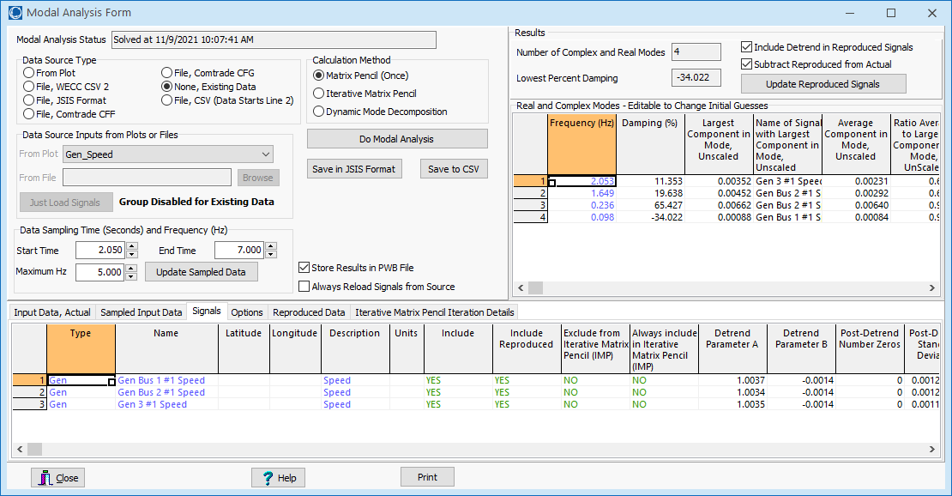
GENROU Example with Damping
Mode frequency, damping, and largest contribution of each mode in the signals. The slower mode is associated with the governors.
Start time
default value
10

Slide 12
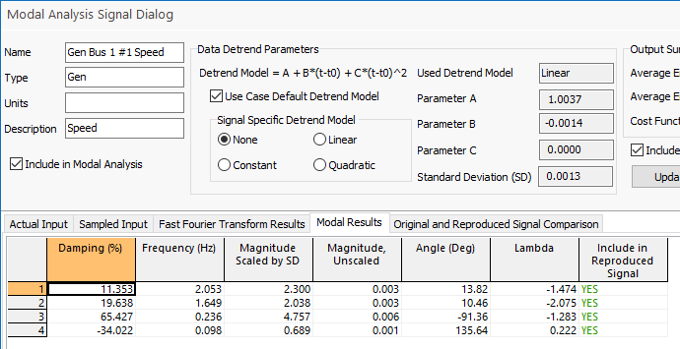
GENROU Example with Damping
Left image show how well the speed for generator 1 is approximated by the modes
More signal details
Just the 2.05 Hz mode
11

Slide 13
Dealing with Multiple Signals
When there are many signals, usually they are at least somewhat correlated, so we do not need to include all the signals in the calculation of α.
Based on the previous quick calculation of b_{k}, we can determine how well the signals match the α.
A natural algorithm for improving is to include the signals that do not match α well. That is, have high residuals.
This gave rise to what is called the Iterative Matrix Pencil algorithm.
12

Slide 14
Iterative Matrix Pencil Method
When there are a large number of signals the iterative matrix pencil method works by
  Selecting an initial signal to calculate the α vector
  Quickly calculating the b vectors for all the signals, and getting a cost function for how closely the reconstructed signals match their sampled values
  Selecting a signal that has a high cost function, and repeating the above adding this signal to the algorithm to get an updated α
An open access paper describing this is W. Trinh, K.S. Shetye, I. Idehen, T.J. Overbye, "Iterative Matrix Pencil Method for Power System Modal Analysis," Proc. 52nd Hawaii International Conference on System Sciences, Wailea, HI, January 2019; available at scholarspace.manoa.hawaii.edu/handle/10125/59803
13

Slide 15
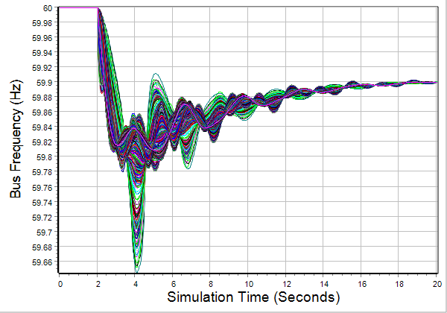
Texas 2000 Bus Synthetic Grid Example
For this example we’ll again use the Texas 2000 bus grid, saved as TSGC_2000_GenDrop
Use the Iterative Matrix Pencil Method to examine its modes
  The contingency is the loss of two large generators (at bus 7098 and 7099)
The measurements will be the frequencies at all 2000 buses
14

Slide 16
2000 Bus System Example, Initially Just One Signal
Initially our goal is to understand the modal frequencies and their damping
First we’ll consider just one of the 2000 signals; arbitrarily I selected bus 8126 (Mount Pleasant)
15

Slide 17
Some Initial Considerations
The input is a dynamics study running using a ½ cycle time step; data was saved every 3 steps, so at 40 Hz
  The contingency was applied at time = 2 seconds
We need to pick the portion of the signal to consider and the sampling frequency
  Because of the underlying SVD, the algorithm scales with the cube of the number of time points (in a single signal)
I selected between 2 and 17 seconds
I sampled at ten times per second (so a total of 150 samples)
16

Slide 18
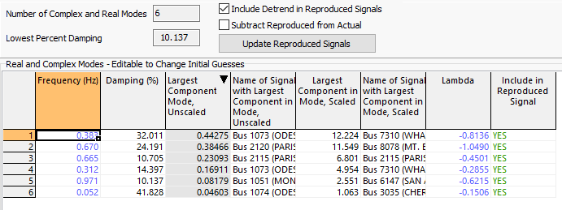
2000 Bus System Example, One Signal
The results from the Matrix Pencil Method are
Calculated mode information
Verification of
results
17

Slide 19
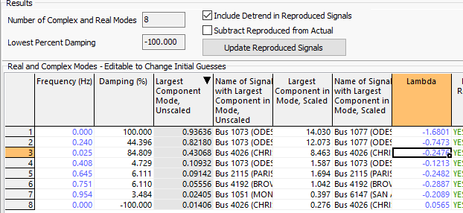
Some Observations
These results are based on the consideration of just one signal
The start time should be at or after the event!
If it isn’t then…
The results show the algorithm trying to match the first two flat seconds; this should not be done!!
18

Slide 20
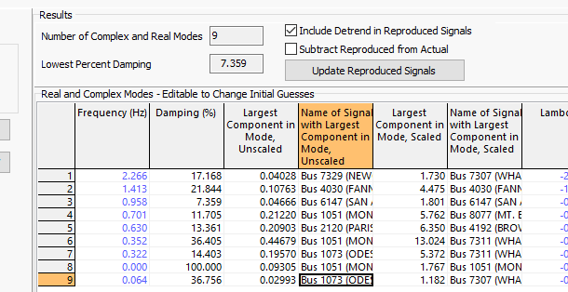
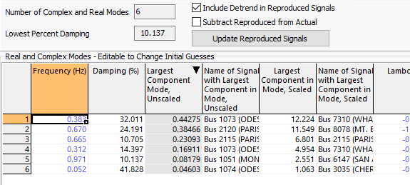
2000 Bus System Example, Two Signals
With two signals
The new match on the bus that was previously worst (Bus 7061) is now quite good!
With one signal

Slide 21
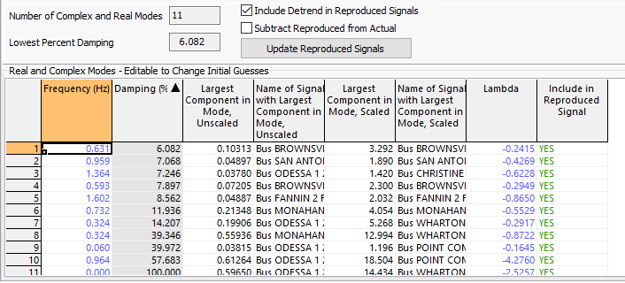
2000 Bus System Example, Iterative Matrix Pencil
The Iterative Matrix Pencil intelligently adds signals until a specified number is met
  Doing ten iterations takes about four seconds

Slide 22
Takeaways So Far
Modal analysis can be quickly done on a large number of signals
  Computationally is an O(N³) process for one signal, where N is the number of sample points; it varies linearly with the number of included signals
  The number of sample points can be automatically determined from the highest desired frequency (the Nyquist-Shannon sampling theory requires sampling at twice the highest desired frequency)
  Determining how all the signals are manifested in the modes is quite fast!!

Slide 23
Visualizing the Modes
If the grid has embedded geographic coordinates, the contributions for the mode to each signal can be readily visualized utilizing geographic data views (GDVs)
Image shows the magnitudes of the components for the 0.63 Hz mode; the display was pruned to only show some of the values

Slide 24
Damping Oscillations: Power System Stabilizers (PSSs)
A PSS adds a signal to the excitation system to improve damping
  A common signal is proportional to the generator’s speed; other inputs, such as like power, voltage or acceleration, can be used
  The signal is usually measured locally (e.g. from the shaft)
Both local modes and inter-area modes can be damped.
Regular tuning of PSSs is important
Fully considering power system stabilizers can get quite involved
  Here we’ll just focus on covering the basics, and doing a simple PSS design. The goal is providing insight and tools that can help power system engineers understand the PSS models, determine whether there is likely bad data, understand the basic functionality, and do simple planning level design

Slide 25
Dynamic Models in the Physical Structure
Mechanical System
Electrical System
Stabilizer
Load
Relay
Line
Relay
Exciter
Supply control
Pressure control
Speed control
Voltage Control
Network control
Load control
Fuel
Source
Furnace and Boiler
Turbine
Generator
Network
Loads
Machine
Load
Char.
Fuel
Steam
Torque
V, I
P, Q
Governor
P. Sauer and M. Pai, Power System Dynamics and Stability, Stipes Publishing, 2006.

Slide 26
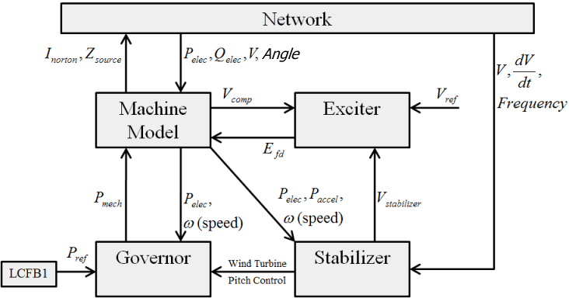
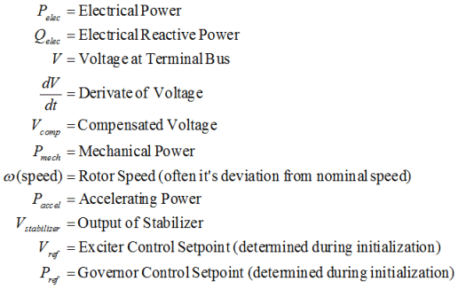
Power System Stabilizer (PSS) Models

Slide 27
PSSs Regulations
On ERCOT PSSs are required on all synchronous generators greater than 10 MW installed after January 2008
  If a generator has a PSS then they need to be kept in-service; they also need to be tuned to help damp out oscillations between 0.2 to 2 Hz.
WECC requires PSSs for synchronous generators connected to the bulk electric grid, and has a number specific requires associated with PSS values (see NERC VAR-501-WECC-3.1)

Slide 28
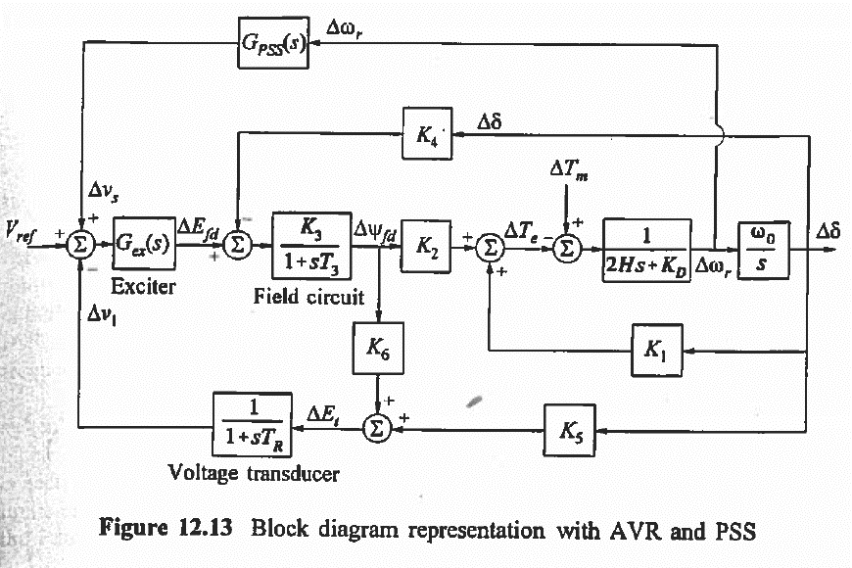
Classic Block Diagram of a System with a PSS
  PSS is here
Image Source: Kundur, Power System Stability and Control

Slide 29
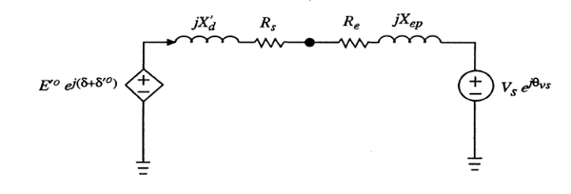
PSS Basics
Stabilizers can be motivated by considering a classical model supplying an infinite bus
Assume internal voltage has an additional component
This can add additional damping if sin(δ) is positive
In a real system there is delay, which requires compensation

Slide 30
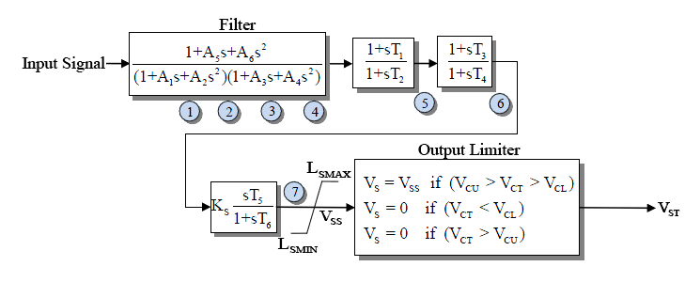
Example PSS
An example single input stabilizer is shown below (IEEEST)
  The input is usually the generator shaft speed deviation, but it could also be the bus frequency deviation, generator electric power or voltage magnitude
The model can be simplified by setting some parameters to zero
V_{ST} is an input into the exciter

Slide 31
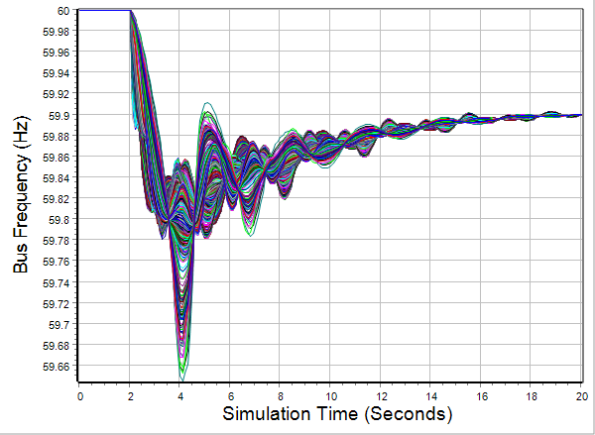
2000 Bus System Results With Stabilizers
The case has 334 IEEST stabilizers, all with the same parameters (which would not be the case in a real system)
Results are
given for the
previous
generator
drop
contingency

Slide 32
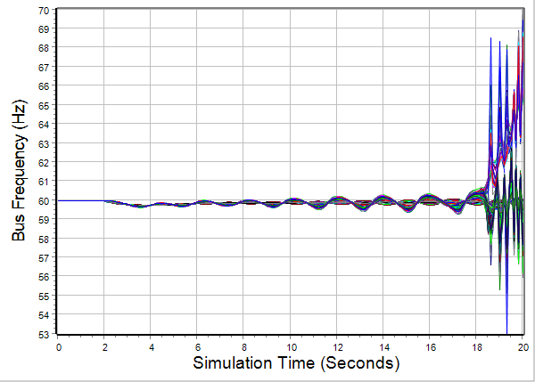
2000 Bus System Results Without Stabilizers
Clearly the case is unstable; note the change in scale

Slide 33
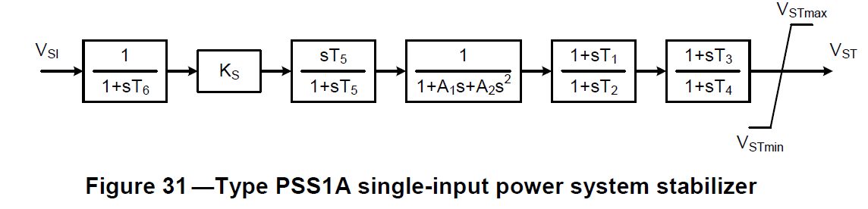
Washout Filters and Lead-Lag Compensators
Two common attributes of PSSs are washout filters and lead-lag compensators
Since PSSs are associated with damping oscillations, they should be immune to slow changes. These low frequency changes are “washed out” by the washout filter; this is a type of high-pass filter.
Lead-lag compensators
Washout filter

Slide 34
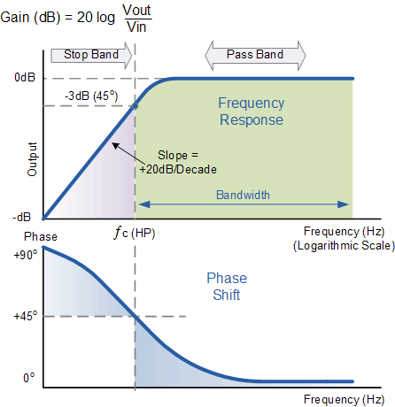
Washout Filter
The filter changes both the magnitude
and angle of the signal at low frequencies
The breakpoint frequency is when the phase shift
is 45 degrees and the gain is -3 dB (1/sqrt(2))
A larger T value shifts the breakpoint to lower frequencies;
at T=10 the breakpoint frequency is 0.016 Hz
Image Source: www.electronics-tutorials.ws/filter/filter_3.html

Slide 35
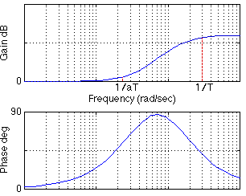
Lead-Lag Compensators
For a lead-lag compensator of the below form with α <= 1 (equivalently a >= 1)
There is no gain or phase shift at
low frequencies, a gain at high
frequencies but no phase shift
Equations for a design maximum
phase shift α at a frequency f are
given

Slide 36
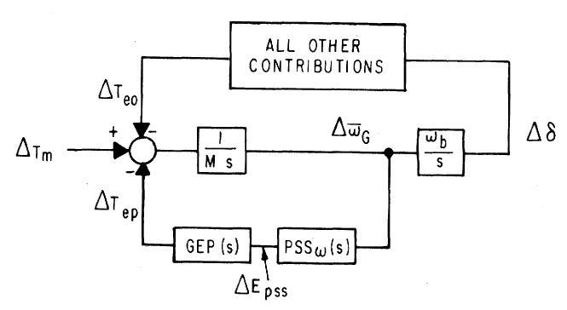
Stabilizer Design
As noted by Larsen, the basic function of stabilizers is to modulate the generator excitation to damp generator oscillations in frequency range of about 0.2 to 2.5 Hz
  This requires adding a torque that is in phase with the speed variation; this requires compensating for the gain and phase characteristics of the generator, excitation system, and power system (GEP(s))
  We need to compensate for the
  phase lag in the GEP
The stabilizer input is
often the shaft speed
Image Source: Figure 1 from Larsen, 1981, Part 1

Slide 37
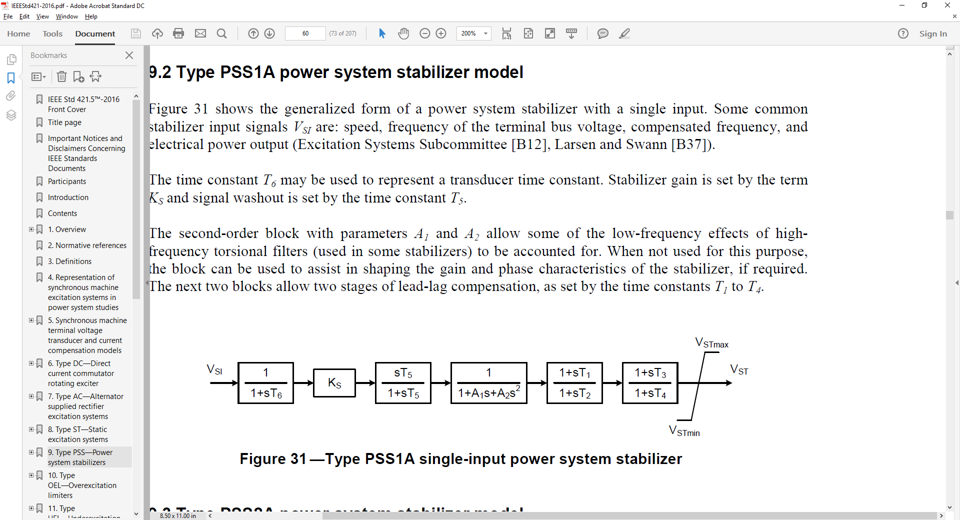
Stabilizer Design
T₆ is used to represent measurement delay; it is usually zero (ignoring the delay) or a small value (< 0.02 sec)
The washout filter removes low frequencies; T₅ is usually several seconds (with an average of say 5)
  Some guidelines say less than ten seconds to quickly remove the low frequency component
  Some stabilizer inputs include two washout filters
Image Source:
EEE Std 421.5-2016

Slide 38
Stabilizer Design Values
With a washout filter value of T₅ = 10 at 0.1 Hz
(s = j0.2π = j0.63) the gain is 0.987; with T₅ = 1 at 0.1 Hz the gain is 0.53
Ignoring the second order block, the values to be tuned are the gain, K_{s}, and the time constants on the two lead-lag blocks to provide phase compensation
  We’ll assume T₁=T₃ and T₂=T₄

Slide 39
Stabilizer Design Phase Compensation
Goal is to move the eigenvalues further into the left-half plane
Initial direction the eigenvalues move as the stabilizer gain is increased from zero depends on the phase at the oscillatory frequency
  If the phase is close to zero, the real component changes significantly but not the imaginary component
  If the phase is around -45° then both change about equally
  If the phase is close to -90° then there is little change in the real component but a large change in the imaginary component

Slide 40
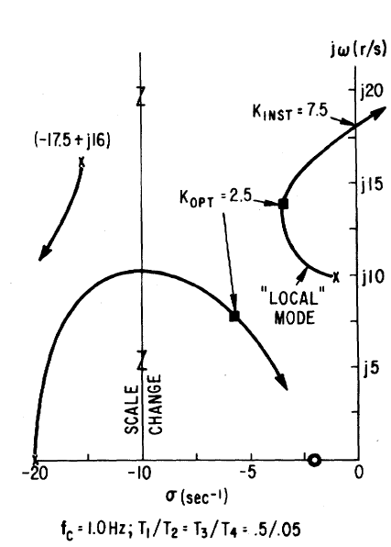
Stabilizer Design Tuning Criteria
Eigenvalues moves as K_{s} increases
A practical method is to find K_{INST}, then
set K_{OPT} as about 1/3 to ½ of this value
  K_{OPT} is where the damping is maximized; K_{INST} is the gain at which sustained oscillations or an instability occur

Slide 41
Stabilizer Design Tuning
Basic approach is to provide enhanced damping at desired frequencies; the challenge is power systems can experience many different types of oscillations, ranging from the high frequency local modes to the slower (< 1.0 Hz usually) inter-area modes
Usually the PSS should be set to compensate the phase so there is little phase lag at inter-area frequencies
  This can get modified slightly if there is a need for local stability enhancement
An approach is to first set the phase compensation, then tune the gain; this should be done at full output

Slide 42
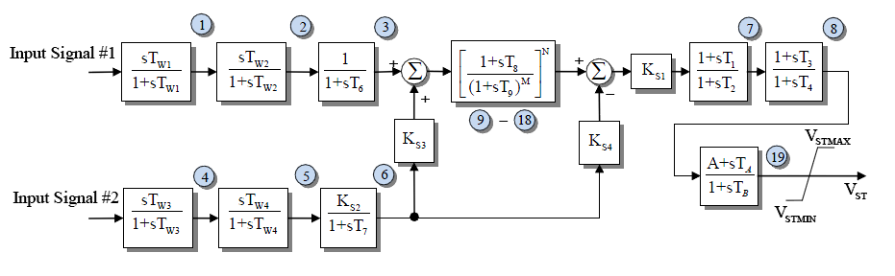
PSS2A Example Values
Based on about 1000 WECC PSS2A models
  T₁=T₃ about 64% of the time and T₂=T₄ about 69% of the time
  The next page has a plot of the T1 and T2 values; the average T1/T2 ratio is about 6.4

Slide 43
Example T₁ and T₂ Values

Slide 44
PSS Tuning Example
Open the case wscc_9bus_Start, apply the default dynamics contingency of a self-clearing fault at Bus 8.
Use Modal Analysis to determine the major modal
frequency and
damping

Slide 45
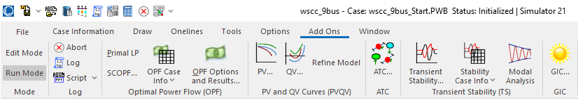
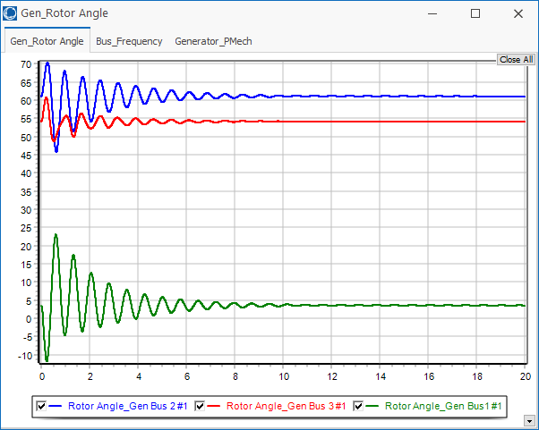
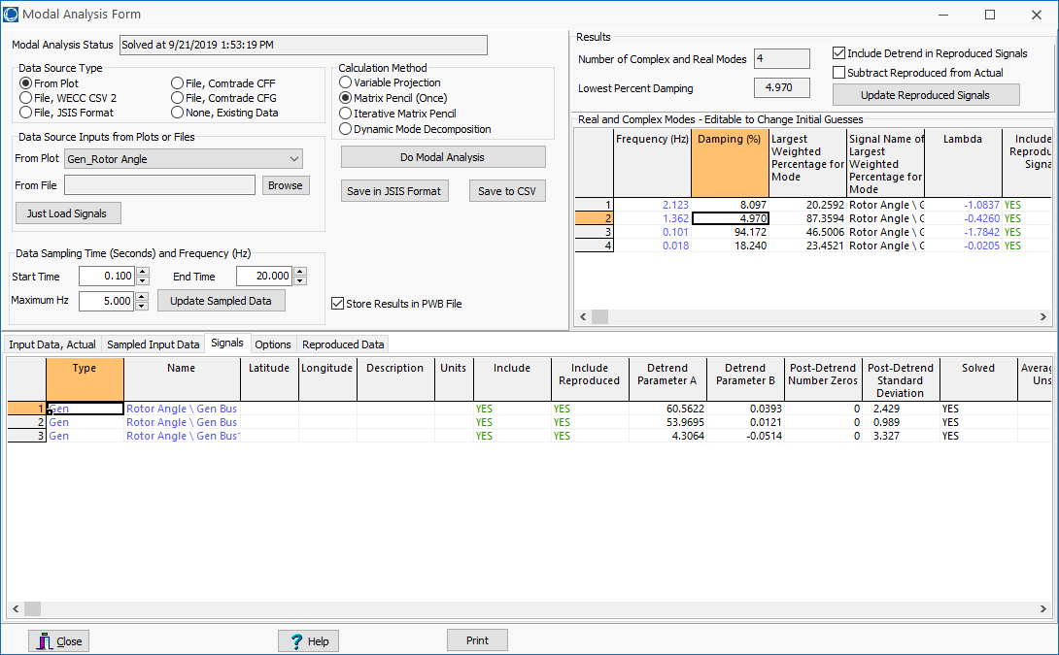
PSS Example: Getting Initial Frequency, Damping
The Modal Analysis button provides quick access
  Frequency is
  1.36 Hz with
  5% damping
  Easy access to
  plot data

Slide 46
PSS Tuning Example: Add PSS1As at Gens 2 and 3
To increase the generator speed damping, we’ll add PSS1A stabilizers using the local shaft speed as an input
First step is to determine the phase difference between the PSS output and the PSS input; this is the value we’ll need to compensate
This phase can be determined either
analytically, actually testing the
generator or using simulation results
  We’ll use
  simulation
  results

Slide 47
PSS Example: Using Stabilizer Reference Signals
PowerWorld now allows reference sinusoidals to be
easily played into the stabilizer input
  This should be done at the desired modal frequency
Modal analysis can then be used to quickly determine the phase delay between the input and the signal we wish to damp
Open the case wscc_9Bus_Stab_Test
  This has SignalStab stabilizers modeled at each generator; these models can play in a fixed frequency signal

Slide 48
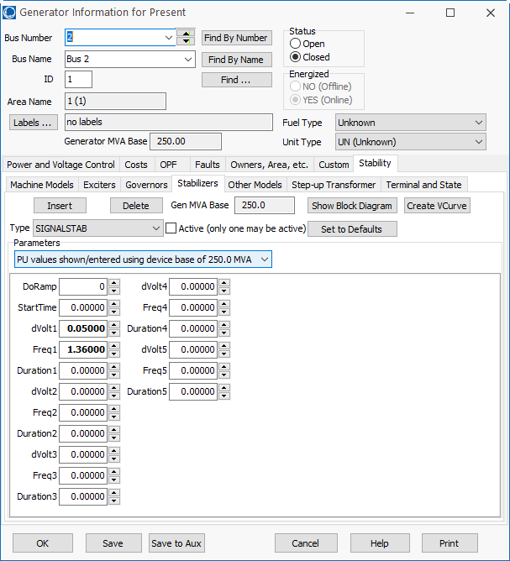
SignalStab Input and Results
Enable the SignalStab stabilizer at the bus 2 generator and run the simulation
  At time=0 the stabilizer receives a sinusoidal input with a magnitude of 0.05 and a frequency of 1.36 Hz

Slide 49
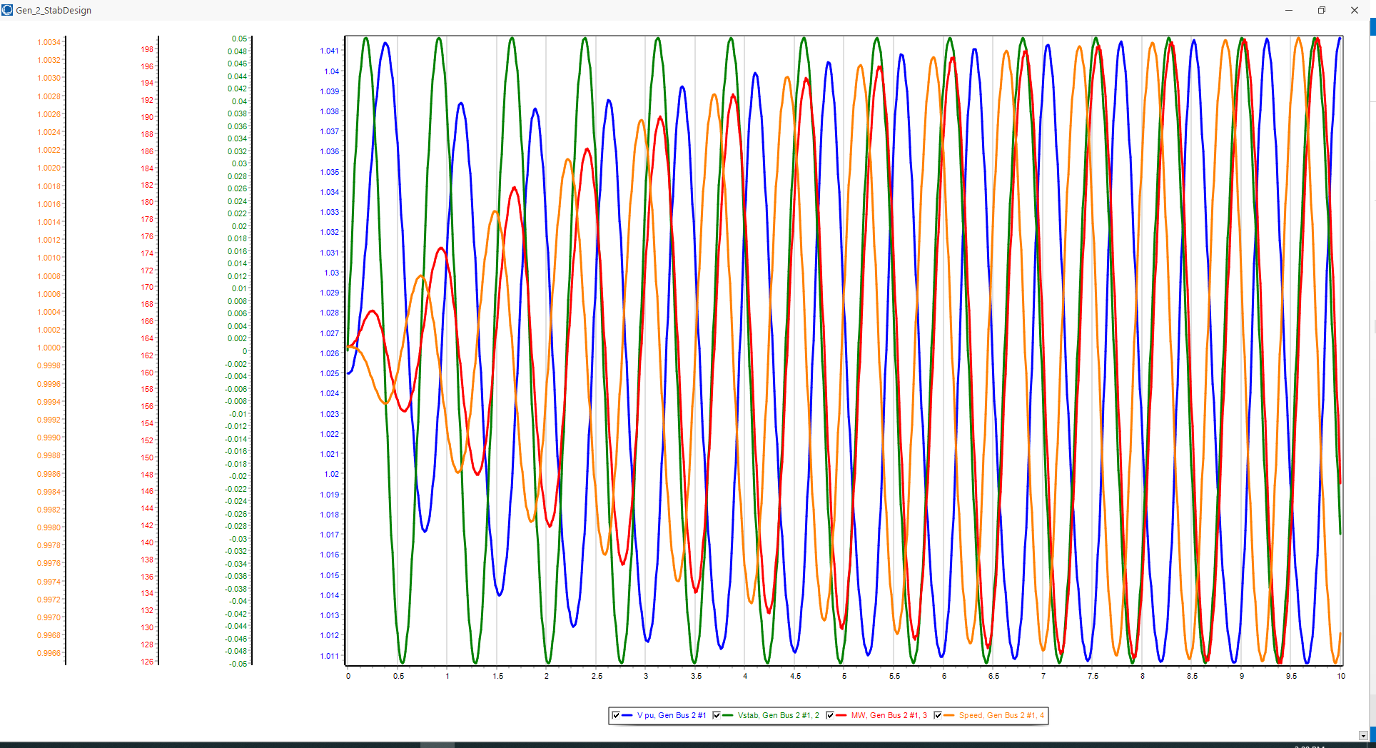
PSS Example: Gen2 Reference Signal Results
Graph shows four signals at bus 2, including the stabilizer input and the generator’s speed
  The phase relationships are most important
  Use modal analysis to determine the exact phase values for the 1.36 Hz mode; analyze the data between 5 and 10 seconds

Slide 50
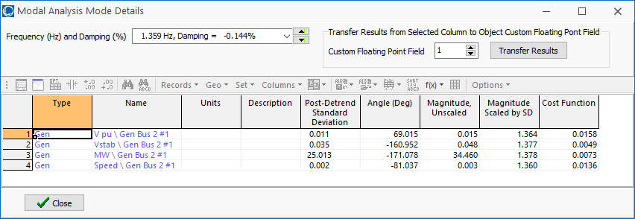
PSS Tuning Example: 1.36 Hz Modal Values
The change in the generator’s speed is driven by the stabilizer input sinusoid, so it will be lagging. The below values show is lags by
(-161+360) – (-81.0) = 280 degrees
  Because we want to damp the speed not increased it, subtract off 180 degrees to flip the sign. So we need 100 degrees of compensation; with two lead-lags it is 50 degrees each

Slide 51
PSS Tuning Example: 1.36 Hz Lead-Lag Values
In designing a lead-lag of the form
to have a specified phase shift of φ at a frequency f the value of α is
In our example with φ = 50° then

Slide 52
PSS Tuning Example: 1.36 Hz Lead-Lag Values
Hence T₁=T₃=0.321, T₂=T₄=0.042. We’ll assumed T₆=0, and T₅=10, and A₁=A₂=0
The last step is to determine K_{s}. This is done by finding the value of K_{s} at just causes instability (i.e., K_{INST}), and then setting K_{s} to about 1/3 of this value
  Instability is easiest to see by plotting the output (V_{ST}) value for the stabilizer

Slide 53
PSS Tuning Example: Setting the Values for Gen 2
Instability occurs with KS = 55, hence the optimal value is about 55/3=18.3
This increases the damping from 5% to about 16.7%
  This is saved as case
  WSCC_9bus_Stab

Slide 54
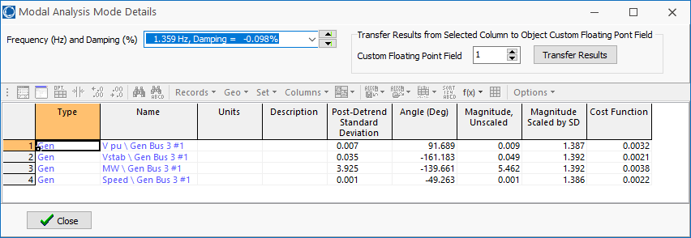
PSS Tuning Example: Setting the Values for Gen 3
The procedure can be repeated to set the values for the bus 3 generator, where we need a total of 68 degrees of compensation, or 34 per lead-lag
The values are α = 0.283, T₁=0.22, T₂=0.062, K_{S} for the verge of instability is 36, so K_{S} optimal is 12.

Slide 55
PSS Tuning Example: Final Solution
  With stabilizers at buses 2 and 3 the damping has been increased to 25.7%

Slide 56
Example 2: Adding a PSS to a 42 Bus System
Goal is to try to improve damping by adding one PSS1A at a large generator at Lion345 (bus 42)
  Example event is a three-phase fault is applied to the middle of the 345 kV transmission line between Prairie (bus 22) and Hawk (bus 3) with both ends opened at 0.05 seconds
  The starting case name is Bus42_PSS

Slide 57
Example 2: Decide Generators to Tune, Frequency
Generator speeds and rotor angles are observed to have a poorly damped oscillation around 0.6 Hz.

Slide 58
Example 2: Determine Phase Compensation
Using a SignalStabStabilizer at bus 42 (Lion345), the phase lag of the generator’s speed, relative to the stabilizer input is 199 degrees; flipping the sign requires phase compensation of 19 degrees or 9.5 per lead-lag
Values are α = 0.72; for 0.6 Hz, T₁= 0.313, T₂=0.225; set T₃ and T₄ to match; gain at instability is about 450, so the gain is set to 150.
  The case with the test signal is Bus42_PSS_Test
  Adding this single stabilizer increases the damping to 4.24%

Slide 59
Example 2: Determine Phase Compensation for the Other Gens
Adding and tuning three more stabilizers (at Grafton345 and the two units at Lake345) increases the damping to 8.16%
  However, these
  changes are impacting
  modes in other
  areas of the system

Slide 60
Power System Voltage Stability
Voltage Stability: The ability to maintain system voltage so that both power and voltage are controllable. System voltage responds as expected (i.e., an increase in load causes proportional decrease in voltage).
Voltage Instability: Inability to maintain system voltage. System voltage and/or power become uncontrollable. System voltage does not respond as expected.
Voltage Collapse: Process by which voltage instability leads to unacceptably low voltages in a significant portion of the system. Typically results in loss of system load.
59

Slide 61
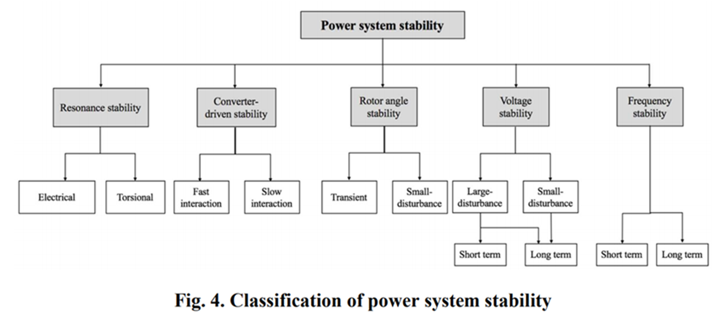
Power System Stability Terms
[a] IEEE/PES Power System Dynamic Performance Committee, “Stability definitions and characterization of dynamic behavior in systems with high penetration of power electronic interfaced technologies”, PES-TR77, April 2020

Slide 62
Small Disturbance Voltage Stability
Small disturbance voltage stability can be assessed using a power flow (maximum loadability)
Depending on the assumed load model, the power flow can have multiple (or no solutions)
PV curve is created by plotting power versus voltage
Assume V_{slack}=1.0
Where B is the line susceptance =-10,
V∠θ is the load voltage
61

Slide 63
Small Disturbance Voltage Stability
Question: how do the power flow solutions vary as the load is changed?
A Solution: Calculate a series of power flow solutions for various load levels and see how they change
Power flow Jacobian
62

Slide 64
Maximum Loadability: Singular Power Flow Jacobian
An important paper considering this was by Sauer and Pai from IEEE Trans. Power Systems in Nov 1990, “Power system steady-state stability and the load-flow Jacobian”
Other earlier papers were looking at the characteristics of multiple power flow solutions
Work with the power flow optimal multiplier around the same time had shown that optimal multiplier goes to zero as the power flow Jacobian becomes singular
The power flow Jacobian depends on the assumed load model (we’ll see the impact in a few slides)
63

Slide 65
Bifurcations
In general, bifurcation is the division of something into two branches or parts
For a dynamic system, a bifurcation occurs when small changes in a parameter cause a new quality of motion of the dynamic system
Two types of bifurcation are considered for voltage stability
  Saddle node bifurcation is the disappearance of an equilibrium point for parameter variation; for voltage stability it is two power flow solutions coalescing with parameter variation
  Hopf bifurcation is cause by two eigenvalues crossing into the right-half plane
64

Slide 66
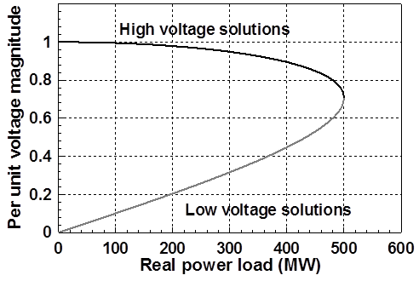
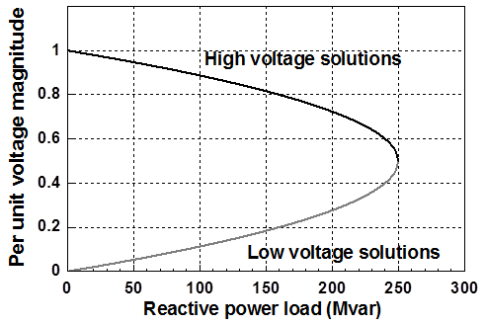
PV and QV Curves
PV curves can be traced by plotting the voltage as the real power is increased; QV curves as reactive power is increased
  At least for the upper portion of the curve
Two bus example PV and QV curves
65

Slide 67
Small Disturbance Voltage Collapse
At constant frequency (e.g., 60 Hz) the complex power transferred down a transmission line is S=VI*
  V is phasor voltage, I is phasor current
  This is the reason for using a high voltage grid
Line real power losses are given by RI² and reactive power losses by XI²
  R is the line’s resistance, and X its reactance; for a high voltage line X >> R
Increased reactive power tends to drive down the voltage, which increases the current, which further increases the reactive power losses
66

Slide 68
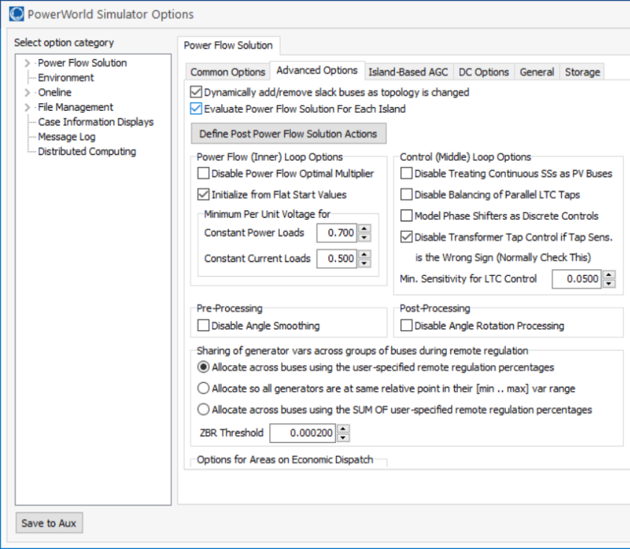
PowerWorld Two Bus Example
Commercial power flow software usually auto converts constant power loads at low voltages; set these fields to zero to disable this conversion
Case is Bus2_PV
67

Slide 69
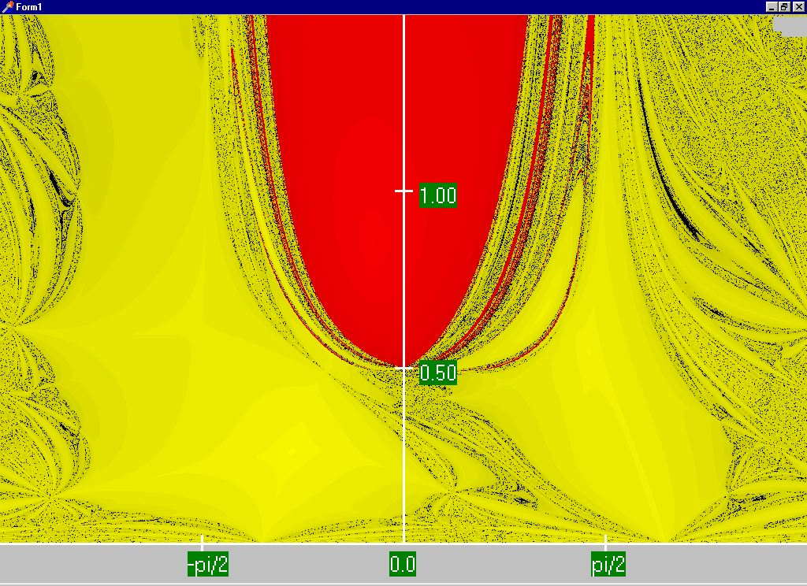
Power Flow Region of Convergence
Convergence
regions with
P=100 MW,
Q=0 Mvar
68

Slide 70
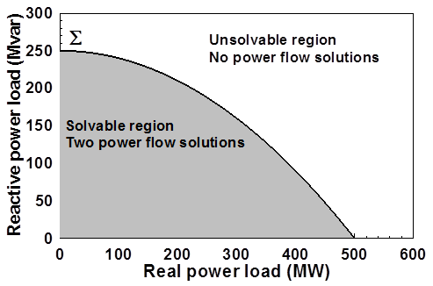
Load Parameter Space Representation
With a constant power model there is a maximum loadability surface, Σ
  Defined as point in which the power flow Jacobian is singular
  For the lossless two bus system it can be determined as
69

Slide 71
Load Model Impact
With a static load model regardless of the voltage dependency the same PV curve is traced
  But whether a point of maximum loadability exists depends on the assumed load model
    If voltage exponent is > 1 then multiple solutions do not exist (see B.C. Lesieutre, P.W. Sauer and M.A. Pai “Sufficient conditions on static load models for network solvability,” NAPS 1992, pp. 262-271)
Change the load to constant impedance; hence it becomes a linear model
70

Slide 72
Application: Conservation Voltage Reduction (CVR)
If the “steady-state” load has a true dependence on voltage, then a change (usually a reduction) in the voltage should result in a total decrease in energy consumption
If an “optimal” voltage could be determined, then this could result in a net energy savings
Some challenges are 1) the voltage profile across a feeder is not constant, 2) the load composition is constantly changing, 3) a decrease in power consumption might result in a decrease in useable output from the load, and 4) loads are dynamic and an initial decrease might be balanced by a later increase
71

Slide 73

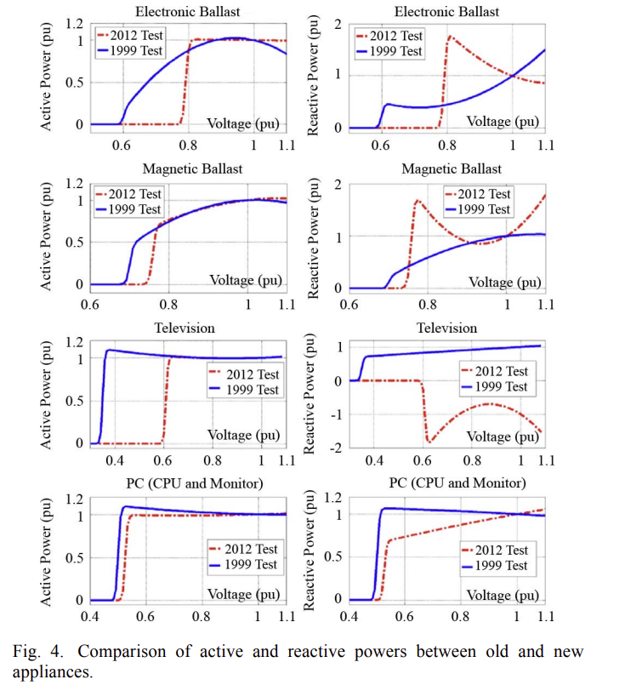
CVR Issues
The gist of the 2023 NREL paper is distributed generation (like PV) can help with CVR through better feeder voltage regulation
Figure 4 from A, Bokhari, et. al., “Experimental Determination of the ZIP Coefficients for Modern Residential, Commercial, and Industrial Loads,” IEEE Trans. Power Delivery, June. 2014
72

Slide 74
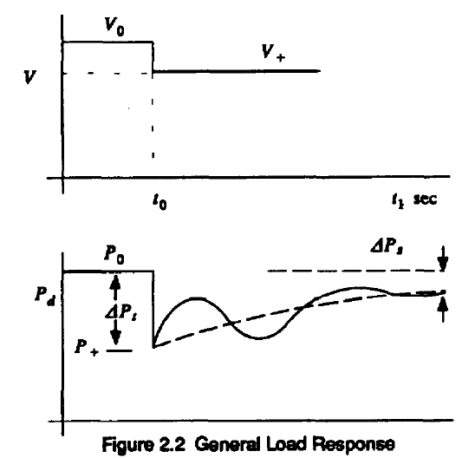
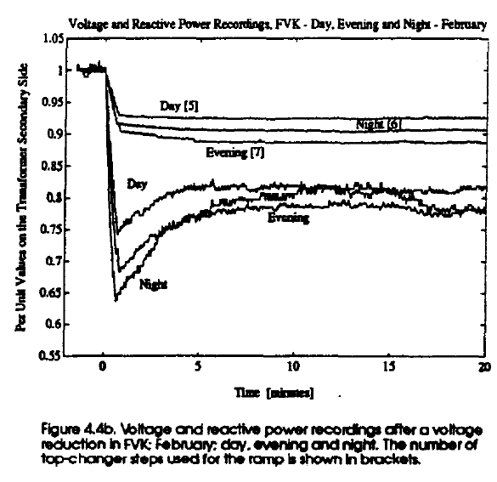
Dynamic Load Response
As first reported in the below paper, following a change in voltage there will be a dynamic load response
  Residential supply voltage should be between 114 and 126 V
If there is a heating
load the response
might be on the
order of ten minutes
Longer term issues
can also come into
play
Useful paper and figure reference: D. Karlsson, D.J. Hill, “Modeling and Identification of Nonlinear Dynamic Loads in Power Systems,” IEEE. Trans. on Power Systems, Feb 1994, pp. 157-166
73

Slide 75
Determining a Metric to Voltage Collapse
The goal of much of the voltage stability work was to determine an easy way to calculate a metric (or metrics) of the current operating point to voltage collapse
  PV and QV curves (or some combination) can determine such a metric along a particular path
  Goal was to have a path independent metric.
  The closest boundary point was considered,
  but this could be quite misleading
  if the system was not going to
  move in that direction
  Any linearization about the current operating point (i.e., the Jacobian) does not consider important nonlinearities like generators hitting their reactive power limits
74

Slide 76
Assessing Voltage Margin Using PV and QV Curve Analysis
A common method for assessing the distance in parameter space to voltage instability (or an undesirable voltage profile) is to trace how the voltage magnitudes vary as the system parameters (such as the loads) are changed in a specified direction
  If the direction involves changing the real power (P) this is known as a PV curve; if the change is with the reactive power (Q) then this is a QV curve
PV/QV curve analysis can be generalized to any parameter change, and can include the consideration of contingencies
75

Slide 77
PV and QV Analysis in PowerWorld
Requires setting up what is known in PowerWorld as an injection group
  An injection group specifies a set of objects, such as generators and loads, that can inject or absorb power
  Injection groups can be defined by selecting Case Information, Aggregation, Injection Groups
The PV and/or QV analysis then varies the injections in the injection group, tracing out the PV curve
This allows optional consideration of contingencies
The PV tool can be displayed by selecting Add-Ons, PV
This has already been done in the Bus2_PV case
76

Slide 78
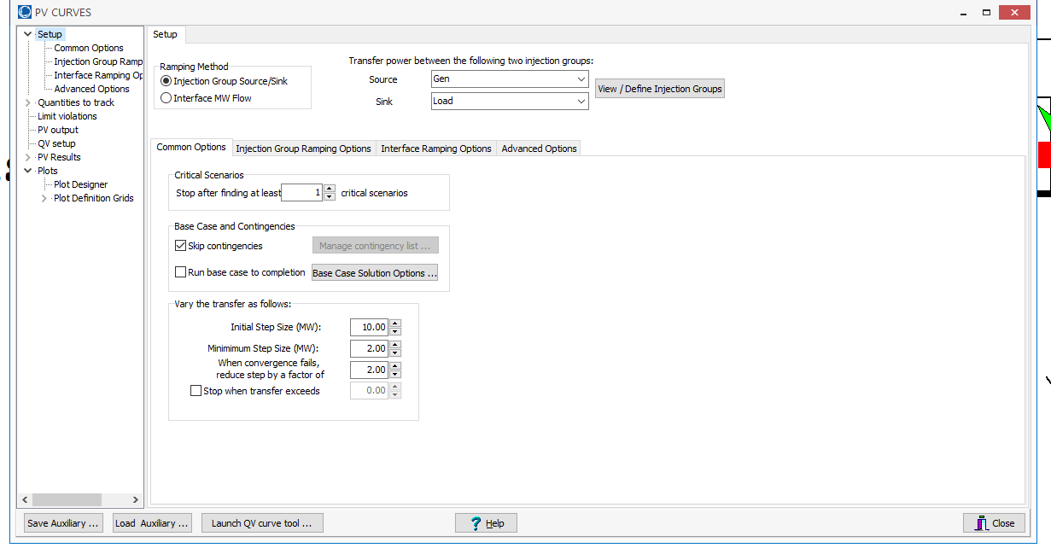
PV and QV Analysis in PowerWorld:
Two Bus Example
Setup page defines the source and sink and step size
Define the source and sink
Optionally contingencies
can be considered
Step sizes for tracing the curve
77

Slide 79
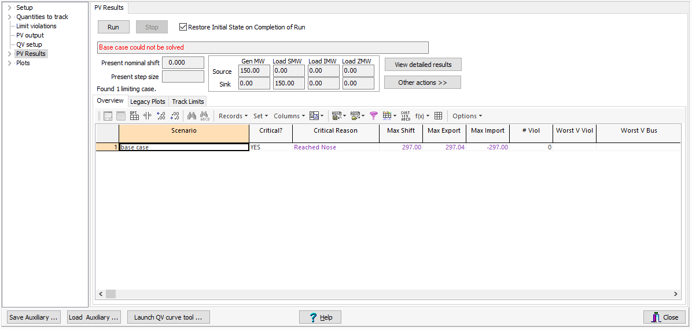
PV and QV Analysis in PowerWorld:
Two Bus Example
The PV Results Page does the actual solution
  Plots can be defined to show the results
    This should be done beforehand
  Other Actions, Restore initial state restores the pre-study state
Option to restore initial state
Click the Run button to run the PV analysis;
Check the Restore Initial State on Completion of Run to restore the pre-PV state (by default it is
not restored)
78

Slide 80
PV and QV Analysis in PowerWorld:
Two Bus Example
To restore the starting case, on the PV Results page select Other Actions, Restore Initial State
79

Slide 81
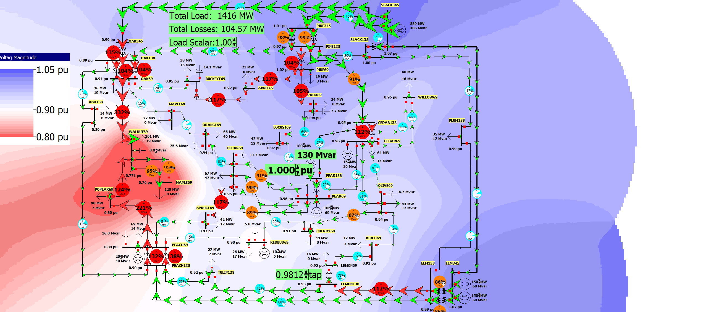
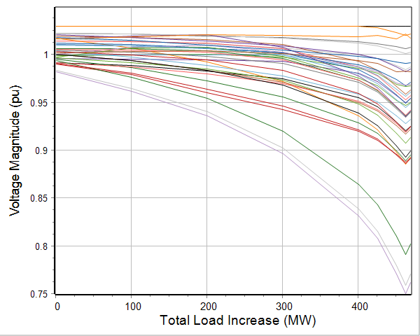
PV and QV Analysis in PowerWorld:
37 Bus Example
Usually other limits also need to be considered in doing a realistic PV analysis; example case is Bus37_PV
80

Slide 82
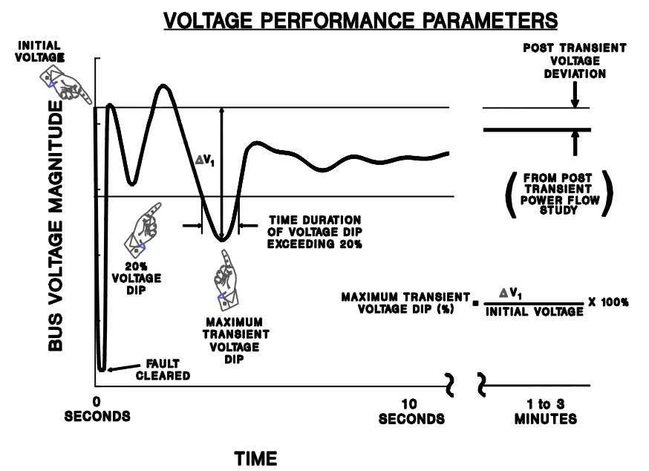
Shorter Term Dynamics
On a shorter time-scale (minutes down to seconds) voltage stability is impacted by controls hitting limits (such as the action of generator over excitation limiters), the movement of voltage control devices (such as LTC transformers) and load dynamics
  Motor stalling can have a major impact
The potential for voltage
instability can be quantified
by looking at the amount
and duration of voltage
dips following an event
Image from WECC Planning and Operating Criteria
81

Slide 83
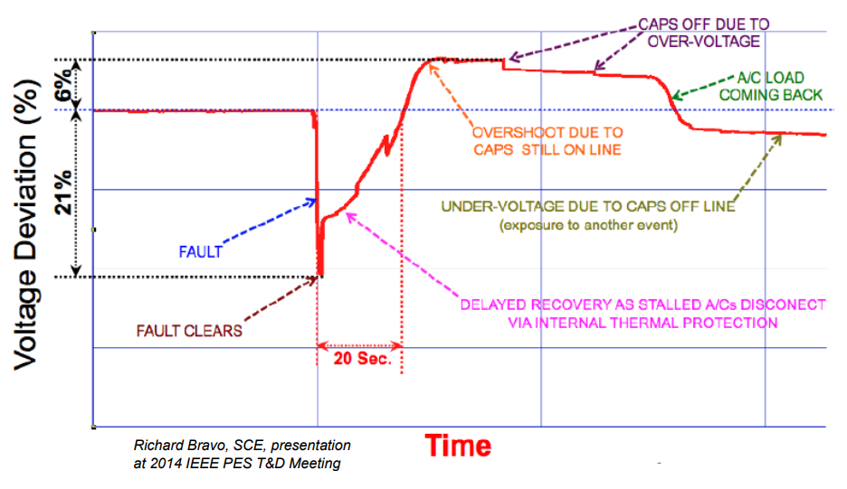
Fault Induced Delayed Voltage Recovery (FIDVR)
FIDVR is a situation in which the system voltage remains significantly reduced for at least several seconds following a fault (at either the transmission or distribution level)
  It is most concerning in the high voltage grid, but found to be unexpectedly prevalent in the distribution system
Stalled residential air
conditioning units are a
key cause of FIDVR –
they can stall within the
three cycles needed to
clear a fault
Image Source: NERC, Fault Induced Delayed Voltage Recovery (FIDVR) Advisory, July 2015
82

