Slide 1
ECEN 460 Power System Operation and Control Spring 2025
Lecture 24: Wind and Solar
Prof. Tom Overbye
Dept. of Electrical and Computer Engineering
Texas A&M University
overbye@tamu.edu

Slide 2
Announcements
Please read Chapter 13
Schedule for the rest of the semester is
No labs this Friday (Reading Day)
Lab 11 (project presentations) by the individual teams to their TA ideally before the end of classes (on or before April 29)
Exam 2 on Wednesday April 23 during class; comprehensive but more emphasis on material since the first exam; similar format to first exam, closed book, closed notes, but two 8.5 by 11 inch note sheets and calculators allowed
Design project due at 9:30 am on May 1 (i.e., at the end of our final slot; no final)
1

Slide 3
Renewable Resource Introduction and Modeling
With the advent of more renewable generation in power systems worldwide it is important to have correct models
Hydro systems have already been covered
Solar thermal and geothermal are modeled similar to existing stream generation, so they are not covered here
Coverage will focus on introducing wind and solar generation, along with their associated power flow and stability level models for wind and solar PV for integrated system studies
More detailed EMTP-level models may be needed for individual plant issues, like subsynchronous resonance
Models are evolving, with a desire by many to have as generic as possible models
2

Slide 4
Inverter-Based Resources (IBRs)
The term inverter-based resources (IBRs) is used to refer to devices that connect to the power grid through an inverter
An inverter is a device that takes a dc input and converts it to ac at a specified frequency; a rectifier is the inverse of an inverter, dc to ac
Inverters can produce or absorb reactive power, providing great flexibility; however, they are limited by their power rating
IBRs are now widely used in the power grid to connect in wind turbines, solar photovoltaic arrays (pv), storage, and HVDC
A short document describing IBRs is available from NERC at
www.nerc.com/pa/Documents/2023_NERC_Guide_Inverter-Based-Resources.pdf
3

Slide 5
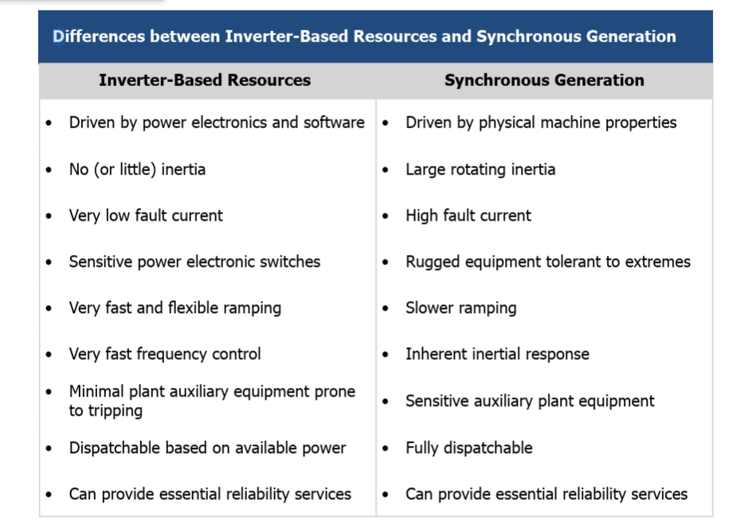
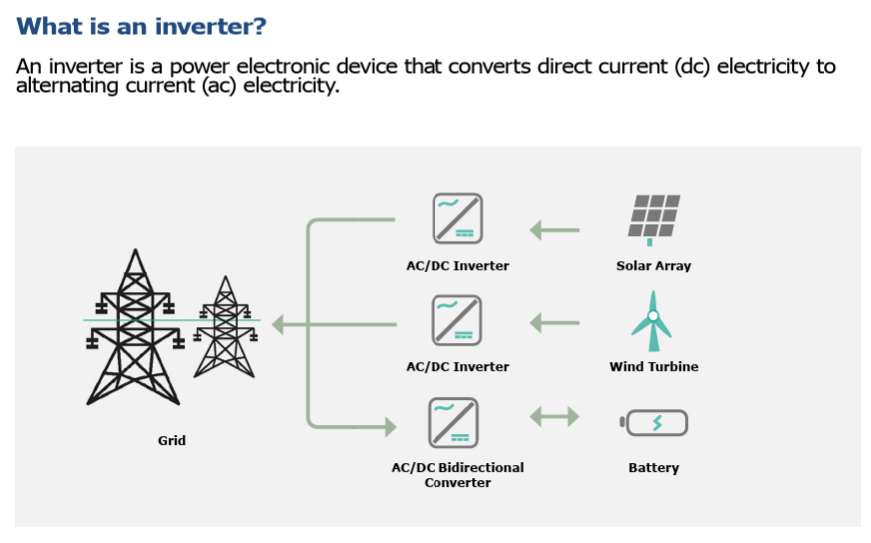
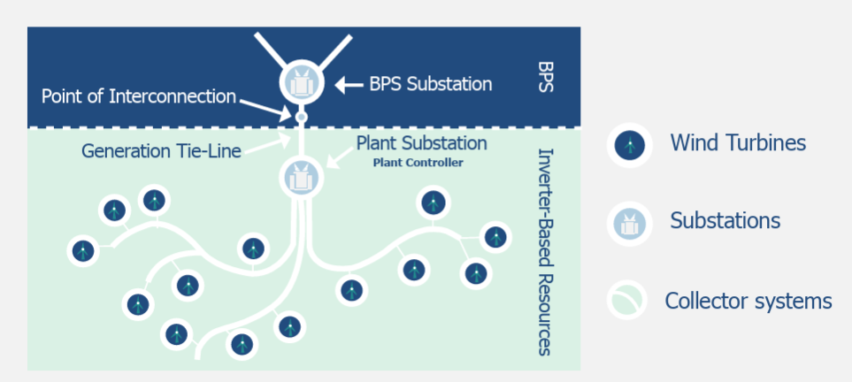
Differences between IBRs and Synchronous Generators
Images from www.nerc.com/pa/Documents/2023_NERC_Guide_Inverter-Based-Resources.pdf
4

Slide 6
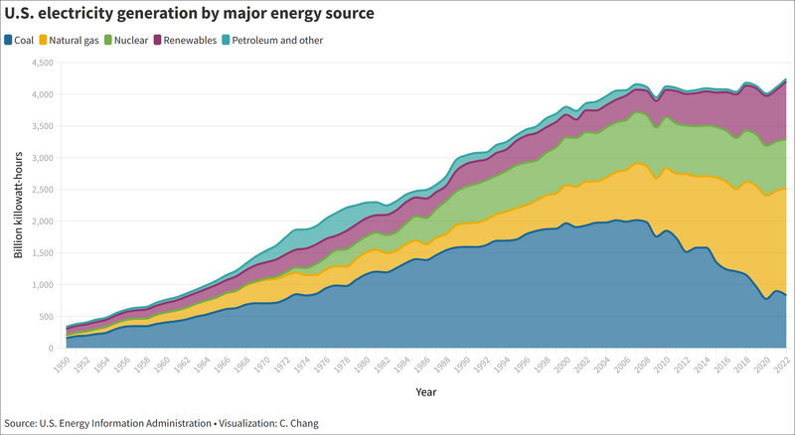
Changing Sources of Generation
In the US and worldwide the sources of electricity are rapidly changing
5

Slide 7
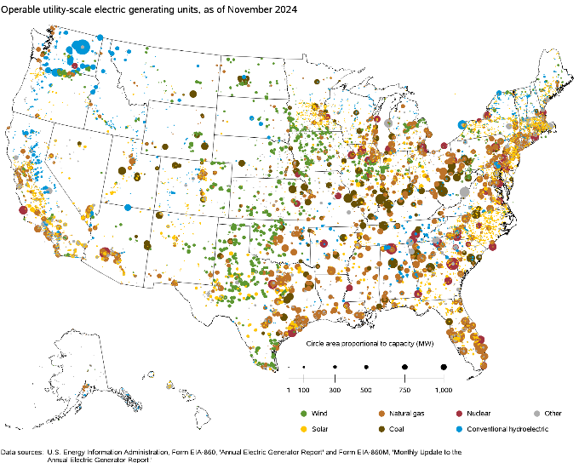
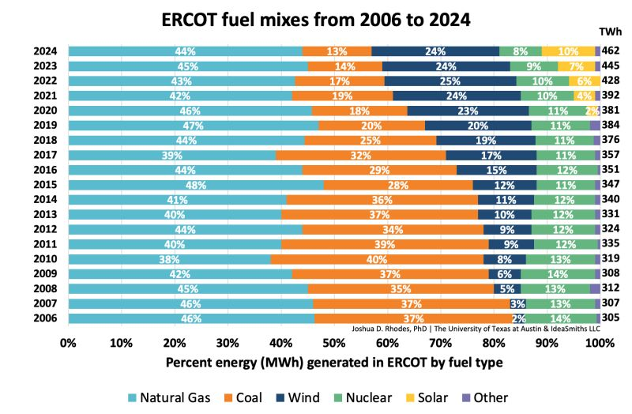
Changing Sources of Generation, cont.
The sources variety substantially by state, the below image shows the change in the ERCOT (Texas) generation
6

Slide 8
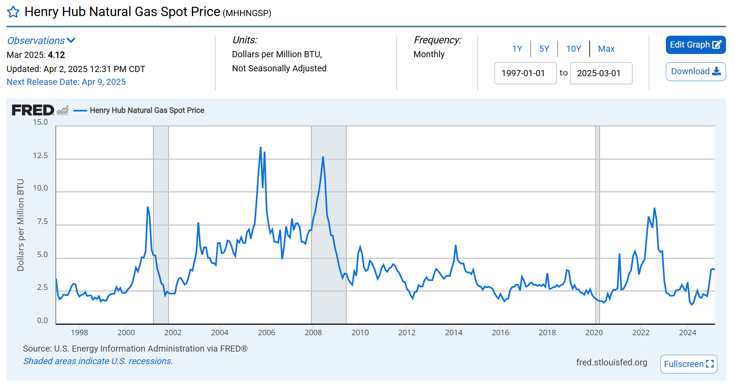
Natural Gas Prices, A Key Driver of Electricity Prices
Source: fred.stlouisfed.org/series/DHHNGSP
7

Slide 9
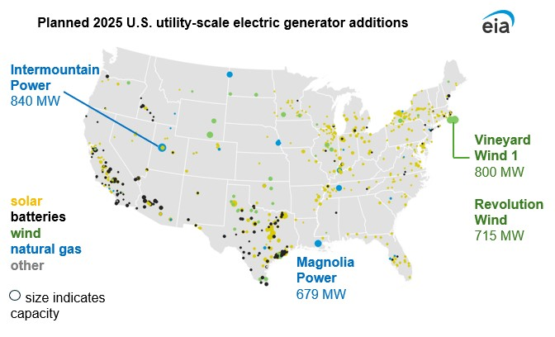
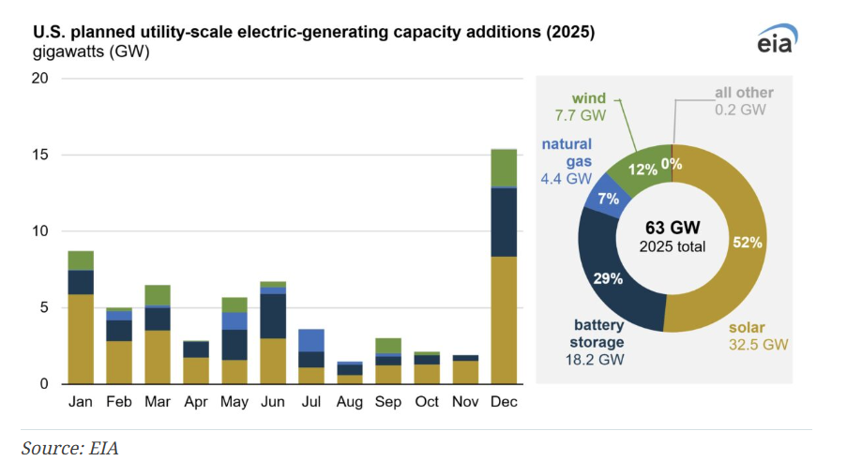
Planned New Generation 2025
Vineyard Wind 1 is under construction and might enter operation in 2025; Revolution Wind might go into operation in 2026
Two 1100 MW nuclear units, Vogtle 3 and 4, entered commercial operation on 2023 and 2024 respectively; Texas is expected to add 6.7 GW of new storage in 2025
8

Slide 10
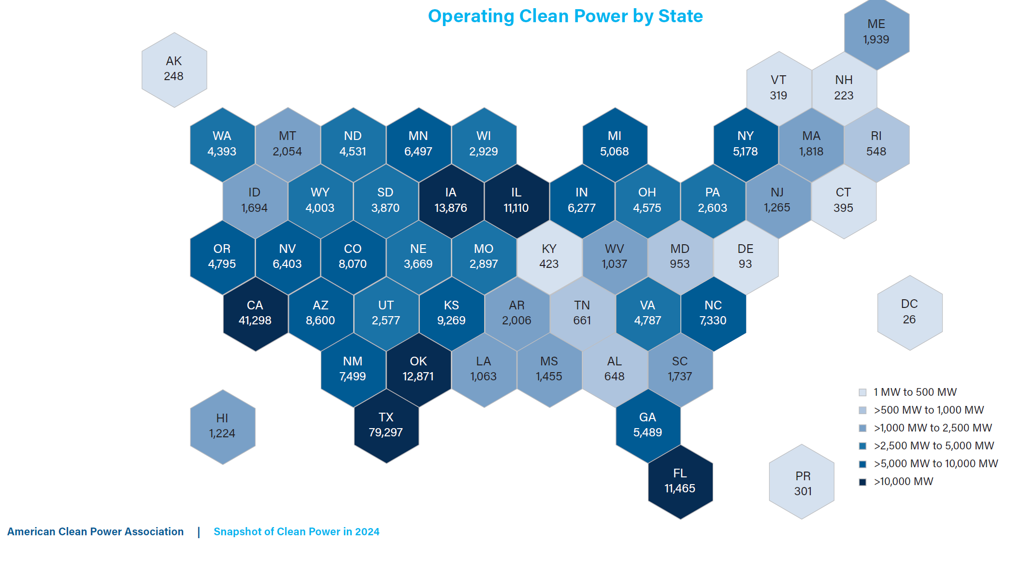
US Wind and Solar Capacity by State, 2024
Total US capacity at the end of Q4 2024 is about 155 GW of wind, 130 GW of solar, and 29 GW of storage (compared to a total US generation capacity of about 1300 GW)
9

Slide 11
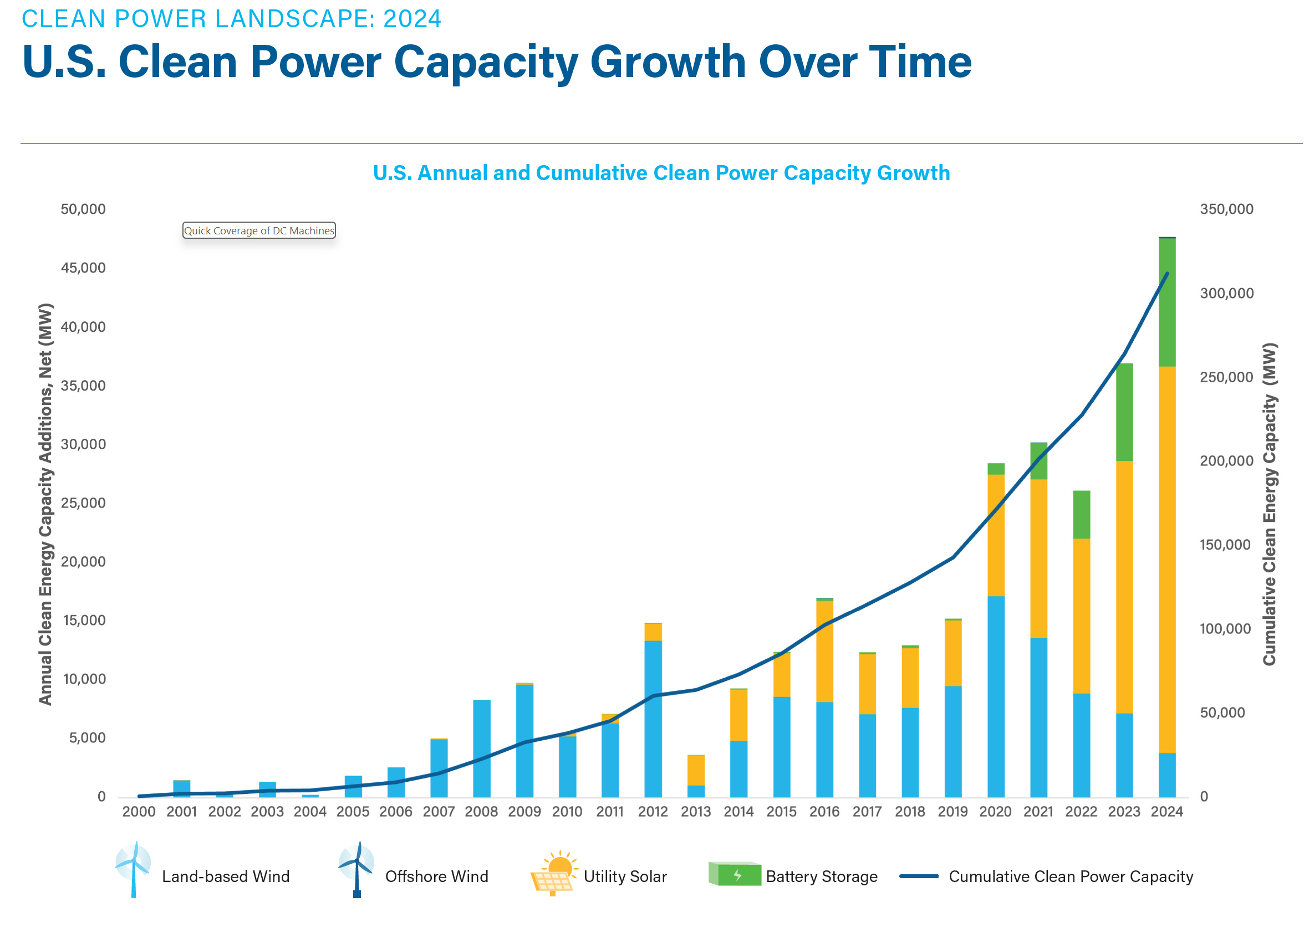
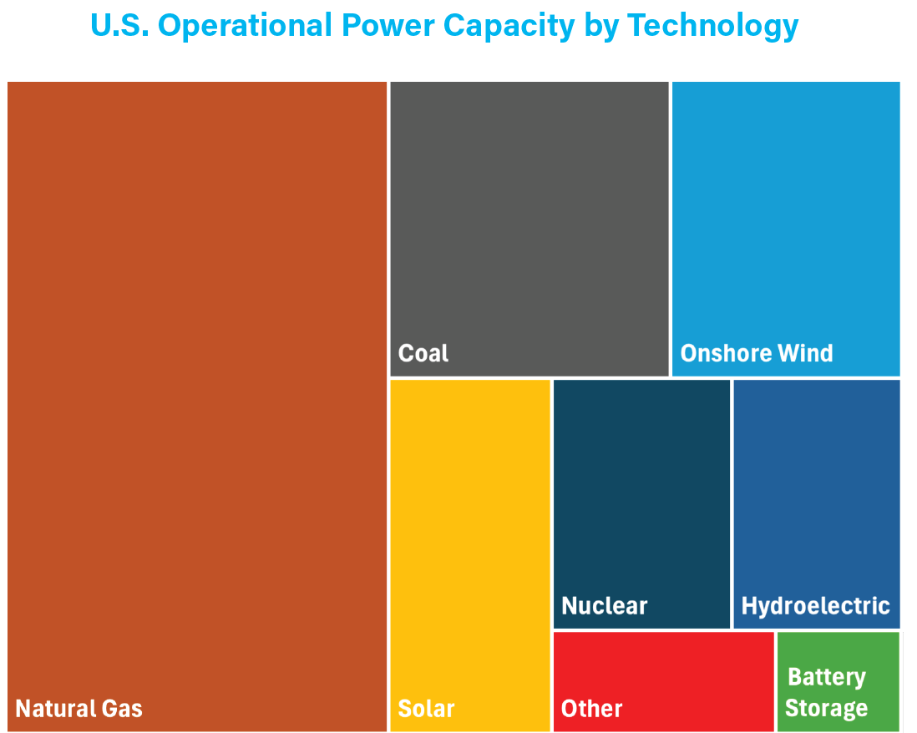
US Annual & Cumulative Wind & Solar Growth
Source: American Clean Power Quarterly, 2024 Q4
10

Slide 12
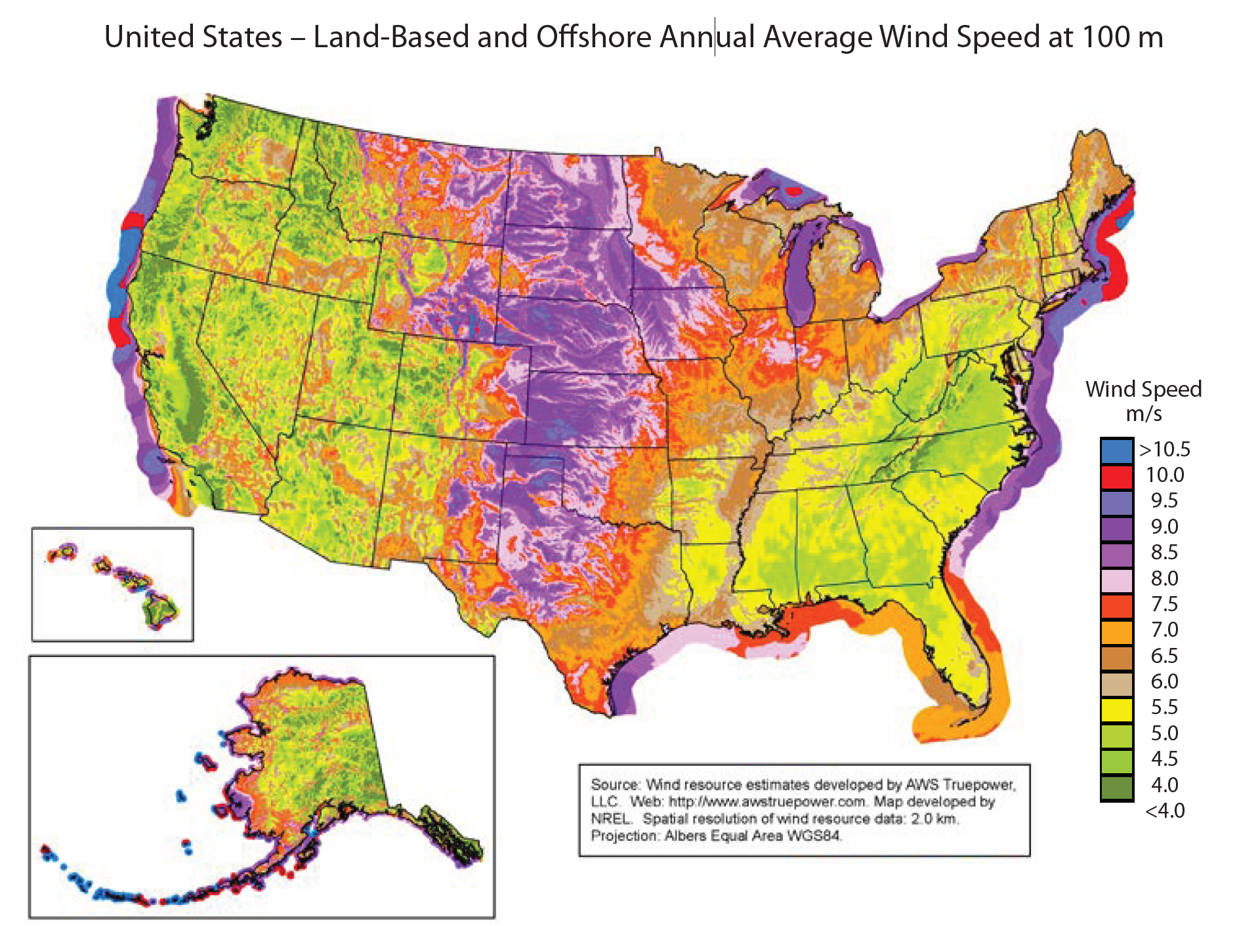
North America Wind Resources at 100 m
Wind speeds at say 100 m above the ground can be substantially higher than closer to the surface; above 7.5 m/s is economic
Source: www.nrel.gov/docs/fy15osti/64733.pdf
11

Slide 13
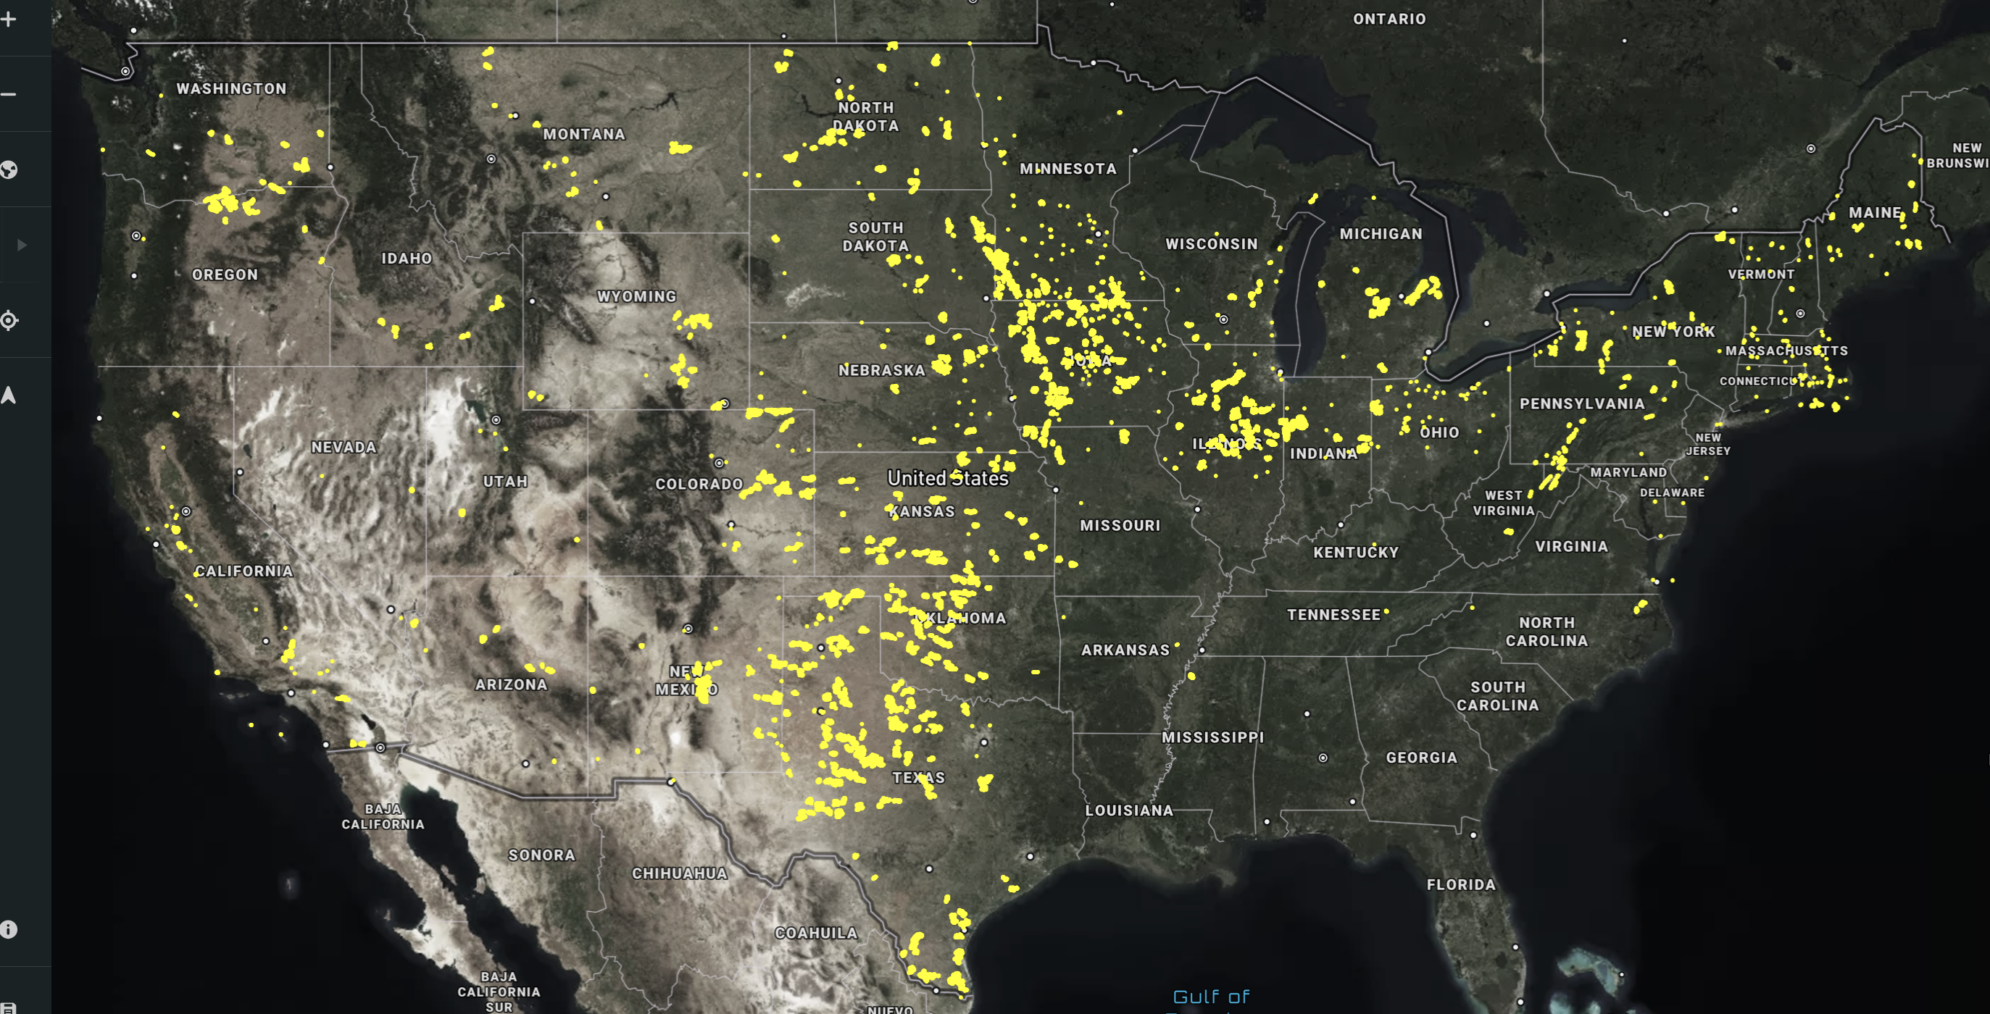
US Wind Farm Locations, Feb 2025
Many wind turbines are usually sited together, in groups known as either wind farms, wind parks, or wind power plants; single devices are known as wind turbines, with the term windmill usually used for devices that pump water
12
Image source: USGS at https://eerscmap.usgs.gov/uswtdb/

Slide 14
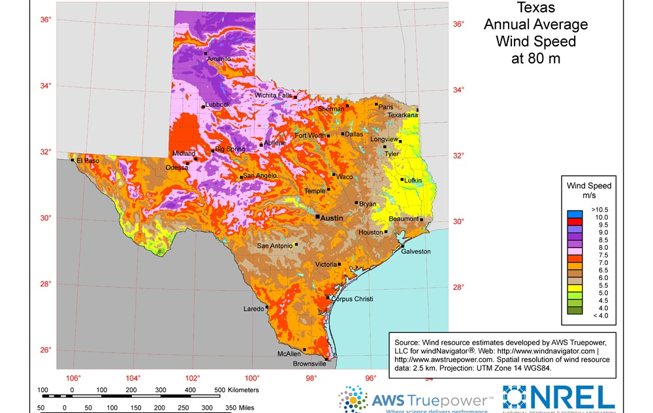
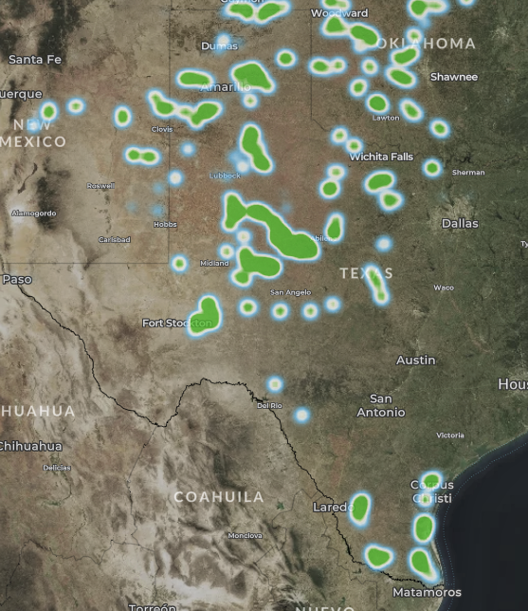
Wind Map Texas– 80m Height
Wind farms in Texas
https://windexchange.energy.gov/files/u/visualization/image/tx_80m.jpg
13

Slide 15
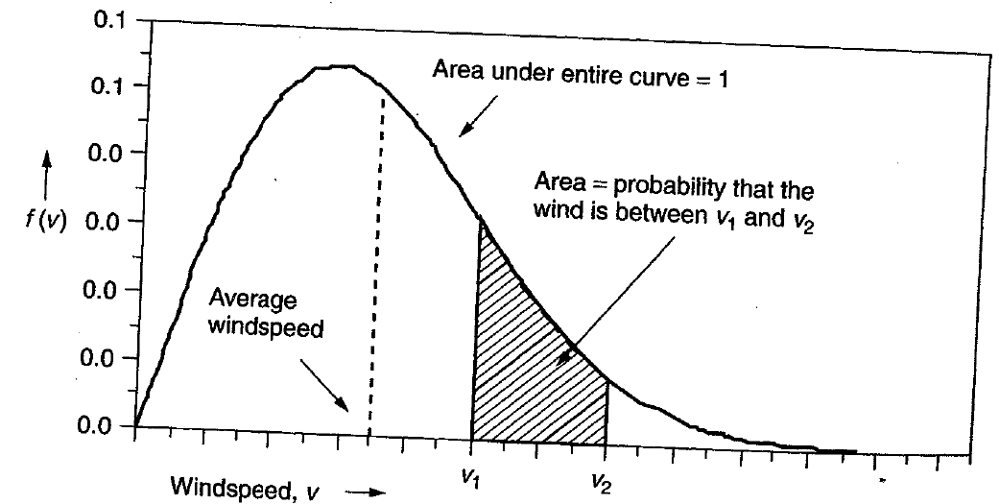
Power in the Wind
The power in the wind is proportional to the cube of the wind speed
Velocity increases with height, with more increase over rougher terrain (doubling at 100m compared to 10m for a small town, but only increasing by 60% over crops or 30% over calm water)
Maximum rotor efficiency is 59.3%, from Betz' law
Expected available energy depends on the wind speed probability density function (pdf)
14

Slide 16
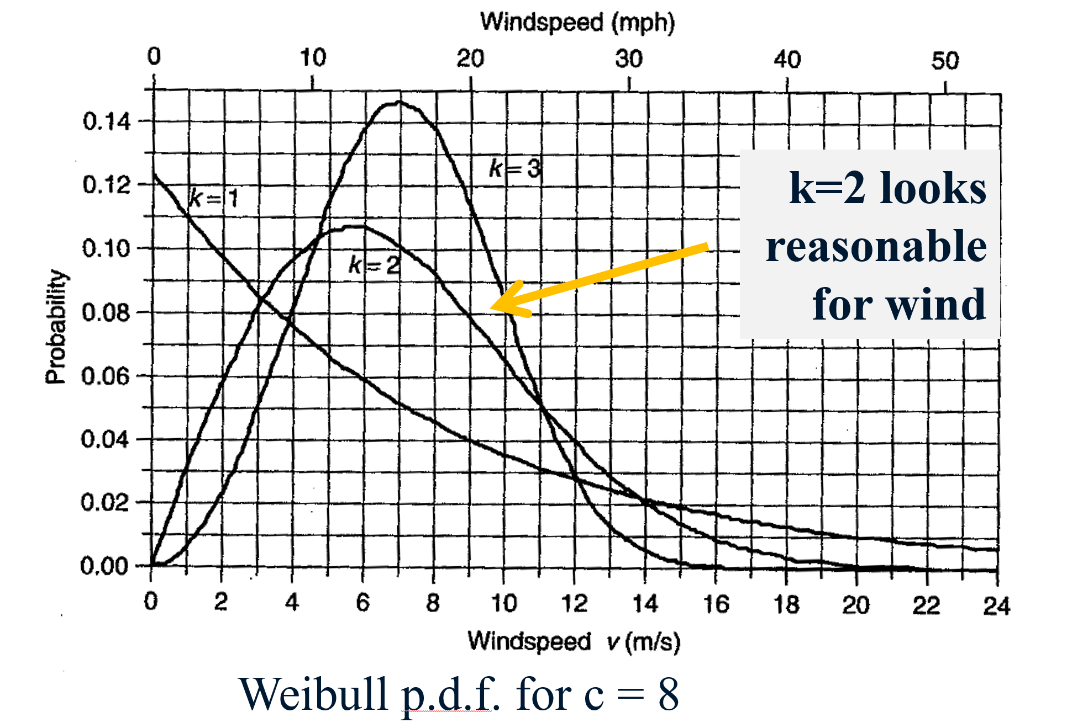
Determining Available Wind Energy
Because the power in the wind varies with the cube of the wind speed, just knowing the average wind speed is not sufficient to determine the available wind energy; the wind speed probability distribution function (pdf) is also needed
When the actual wind pdf is not available, it is common to assume a Rayleigh pdf, which is a Weibull pdf with a k = 2
For Rayleigh
15

Slide 17
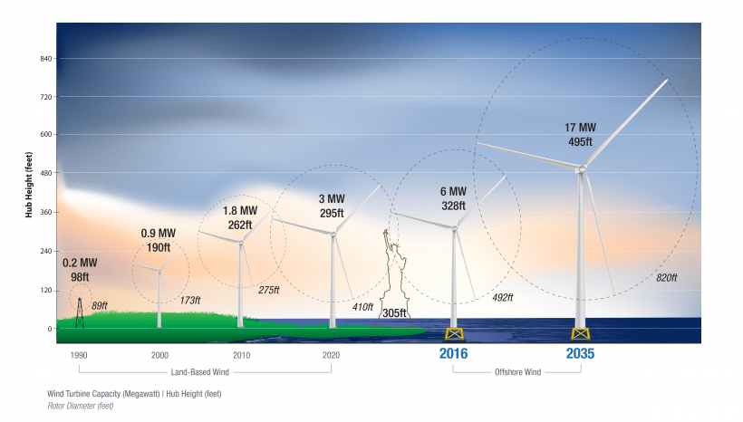
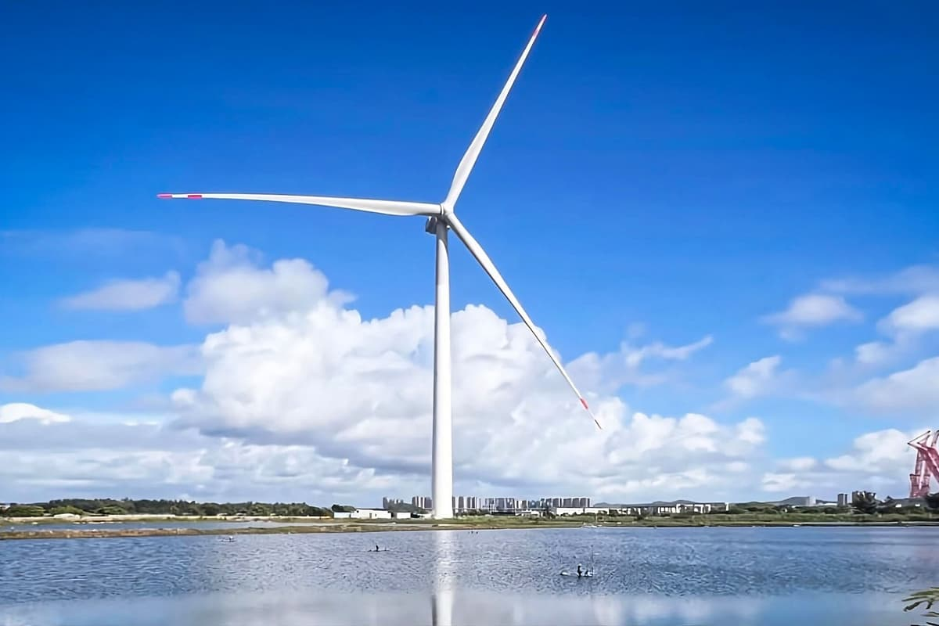
Wind Turbine Height and Size
The current largest wind turbines by capacity are about 26 MW with rotor diameters of about 340m; the below picture is for an 18 MW generator
Average on-shore capacities are now over 3 MW, with hub heights approaching 100 m
16
https://www.energy.gov/eere/articles/wind-turbines-bigger-better

Slide 18
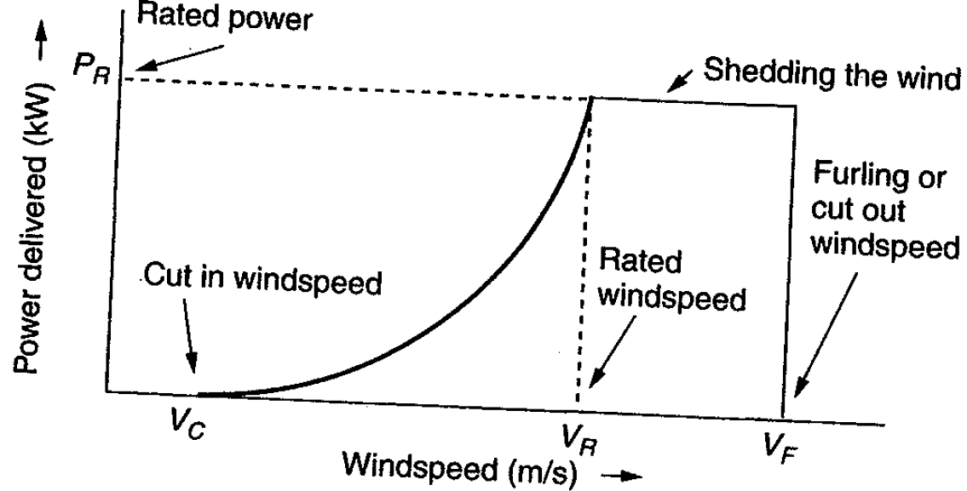
Extracted Power
WTGs are designed for rated power and windspeed
For speeds above this blades are pitched to operate at rated power; at furling speed the WTG is cut out
17

Slide 19
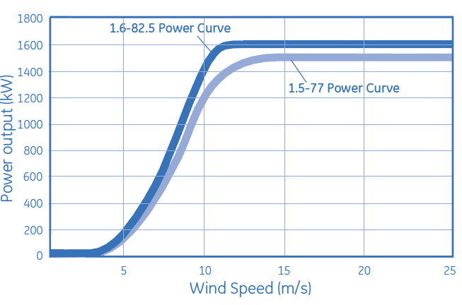
Example: GE 1.5 and 1.6 MW Turbines
Power speed curves for the GE 1.5 and 1.6 MW WTGs
Hub height is 80/100 m; cut-out at 25 m/s wind
Source: http://site.ge-energy.com/prod_serv/products/wind_turbines/en/15mw/index.htm
18

Slide 20
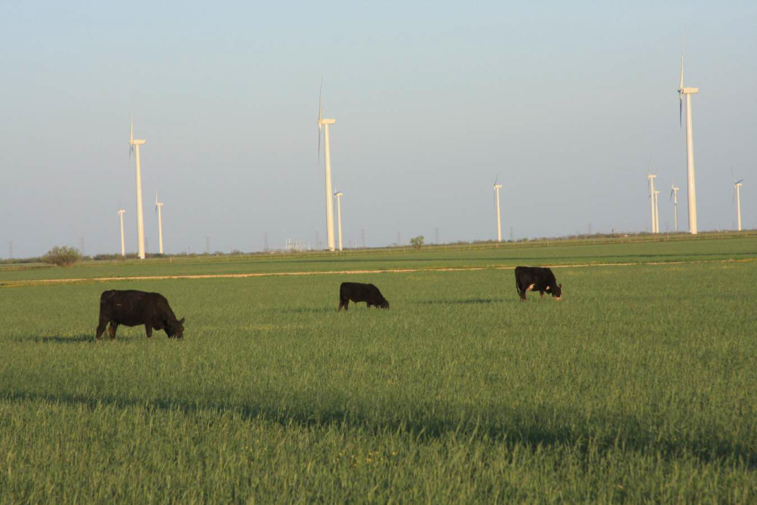
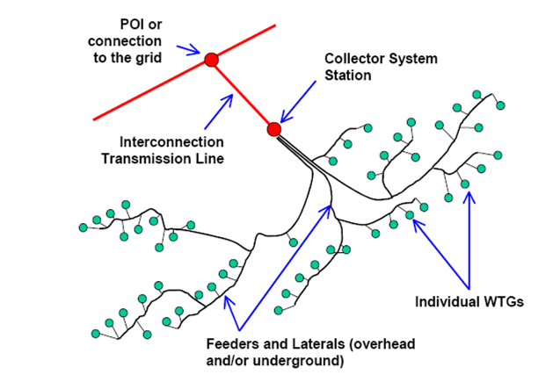
Wind Farms (or Parks)
Usually, wind farm is modeled in aggregate for grid studies; wind farm can consist of many small (1 to 3 MW) wind turbine-generators (WTGs) operating at low voltage (e.g. 0.6kV) stepped up to distribution level (e.g., 34.5 kV)
Photo Source: www.energyindustryphotos.com/photos_of_wind_farm_turbines.htm
19

Slide 21
Economies of Scale
Presently large wind farms produce electricity more economically than small operations
Factors that contribute to lower costs are
Wind power is proportional to the area covered by the blade (square of diameter) while tower costs vary with a value less than the square of the diameter
Larger blades are higher, permitting access to faster winds, but size limited by transportation for most land wind farms
Fixed costs associated with construction (permitting, management) are spread over more MWs of capacity
Efficiencies in managing larger wind farms typically result in lower O&M costs (on-site staff reduces travel costs)
20

Slide 22
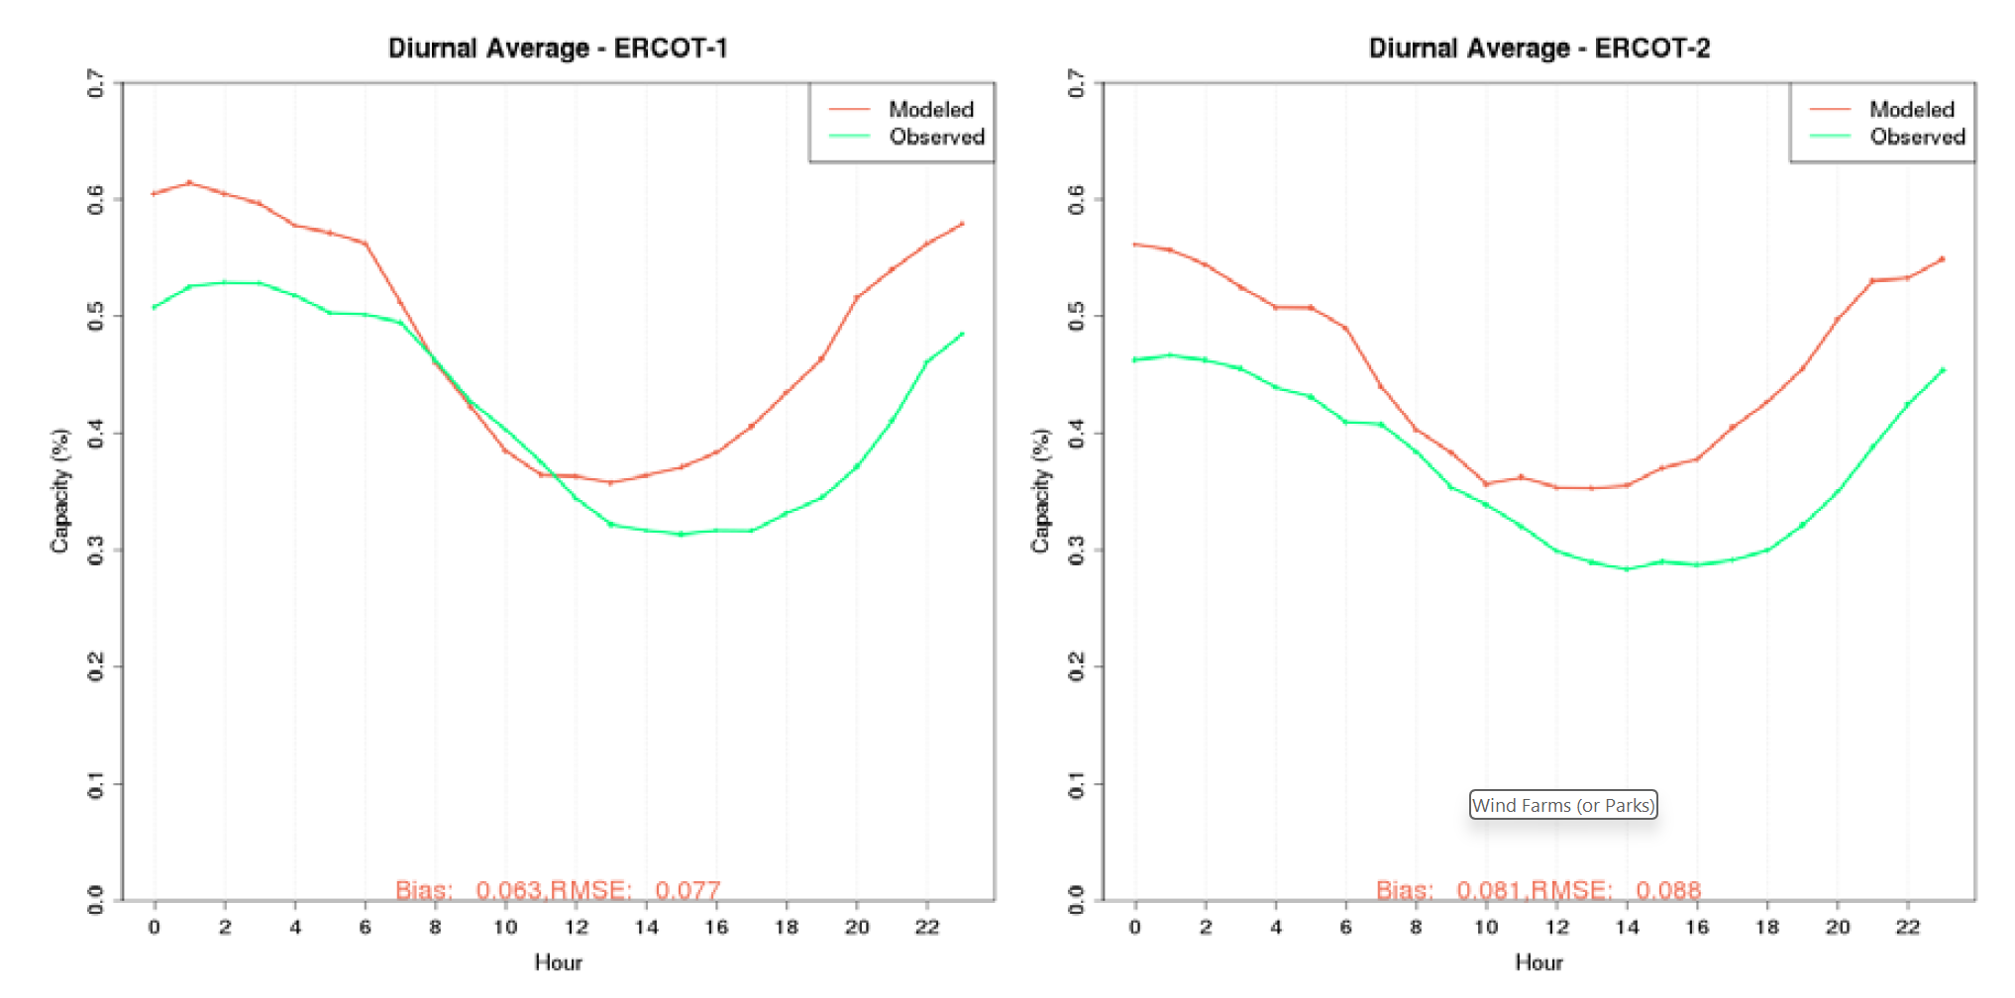
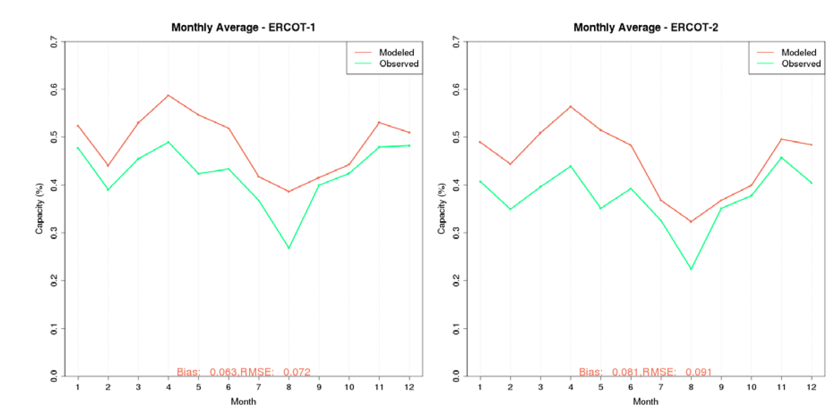
Wind Patterns
Wind speeds, of course, vary. However, they usually exhibit daily and seasonal patterns that the be leveraged in electric grid planning and operation; the below images show data for ERCOT locations, both daily and monthly
Images: www.ercot.com/files/docs/2017/02/17/MemoReport_AWST_ERCOT_27Mar2015.pdf
21

Slide 23
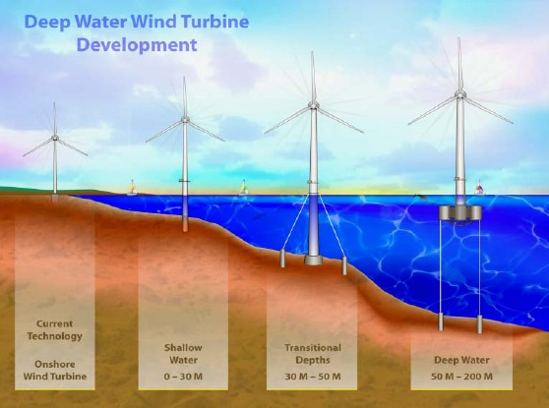
Offshore Wind
Offshore wind turbines currently need to be in relatively shallow water, so maximum distance from shore depends on the seabed
Worldwide capacity is about 70 GW, with half of it in China and almost one quarter in the UK
US offshore wind is only 42 MW; while there had been lots of interest, there are also major challenges including greatly increased costs
Capacity factors tend to increase as turbines move further off-shore
Image Source: National Renewable Energy Laboratory
22

Slide 24
Offshore: Advantages and Disadvantages
All advantages/disadvantages are somewhat site specific
Advantages
Can usually be sited much closer to the load (which is often by the coasts)
Offshore wind speeds are higher and steadier
Easier to transport large wind turbines by ship
Minimal sound impacts and visual impacts (if far enough offshore), no land usage issues
Disadvantages
High construction costs, particularly since they are in windy (and hence wavy) locations
Higher maintenance costs
Some environmental issues (e.g., seabed disturbance)
23

Slide 25
Types of Wind Turbines for Power Flow and Stability
Several different approaches to aggregate modeling of wind farms in power flow and transient stability
Wind turbine manufacturers provide detailed, public models of their WTGs; these models are incorporated into software packages; for example, GE 1.5, 1.6 and 3.6 MW WTGs (see Modeling of GE Wind Turbine-Generators for Grid Studies, version 6.01, October 2017, GE Energy)
Proprietary models are included as user defined models; covered under NDAs to maintain confidentiality
Generic models are developed to cover the range of WTGs, with parameters set based on the individual turbine types
Concern by some manufacturers that the generic models to not capture their WTGs' behavior, such as during low voltage ride through (LVRT)
24

Slide 26
Types of Wind Turbines for Power Flow and Stability
Electrically there are four main generic types of wind turbines
Type 1: Induction machine; treated as PQ bus with negative P load; dynamically modeled as an induction motor
Type 2: Induction machine with varying rotor resistance; treated as PQ bus in power flow; induction motor model with dynamic slip adjustment
Type 3: Doubly Fed Asynchronous Generator (DFAG) (or DFIG); treated as PV bus in power flow
Type 4: Full Asynchronous Generator; treated as PV bus in power flow
New wind farms (or parks) are all of Type 3 or 4
25

Slide 27
Generic Modeling Approach
The generic modeling approach is to divide the wind farm models by functionality
Generator model: either an induction machine for Type 1 and 2's or a voltage source converter for Type 3 and 4
Reactive power control (exciter): none for Type 1, rotor resistance control for Type 2, commanded reactive current for Type 3 and 4
Drive train models: Type 1 and 2 in which the inertia appears in the transient stability
Aerodynamics and Pitch Models: Model impact of changing blade angles (pitch) on power output
26

Slide 28
Wind Turbine Issues
Models are designed to represent the system level impacts of the aggregate wind turbines during disturbances such as low voltages (nearby faults) and frequency deviations
Low voltage ride through (LVRT) is a key issue, in which the wind turbines need to stay connected to the grid during nearby faults
Active and reactive power control is also an issue
27

Slide 29
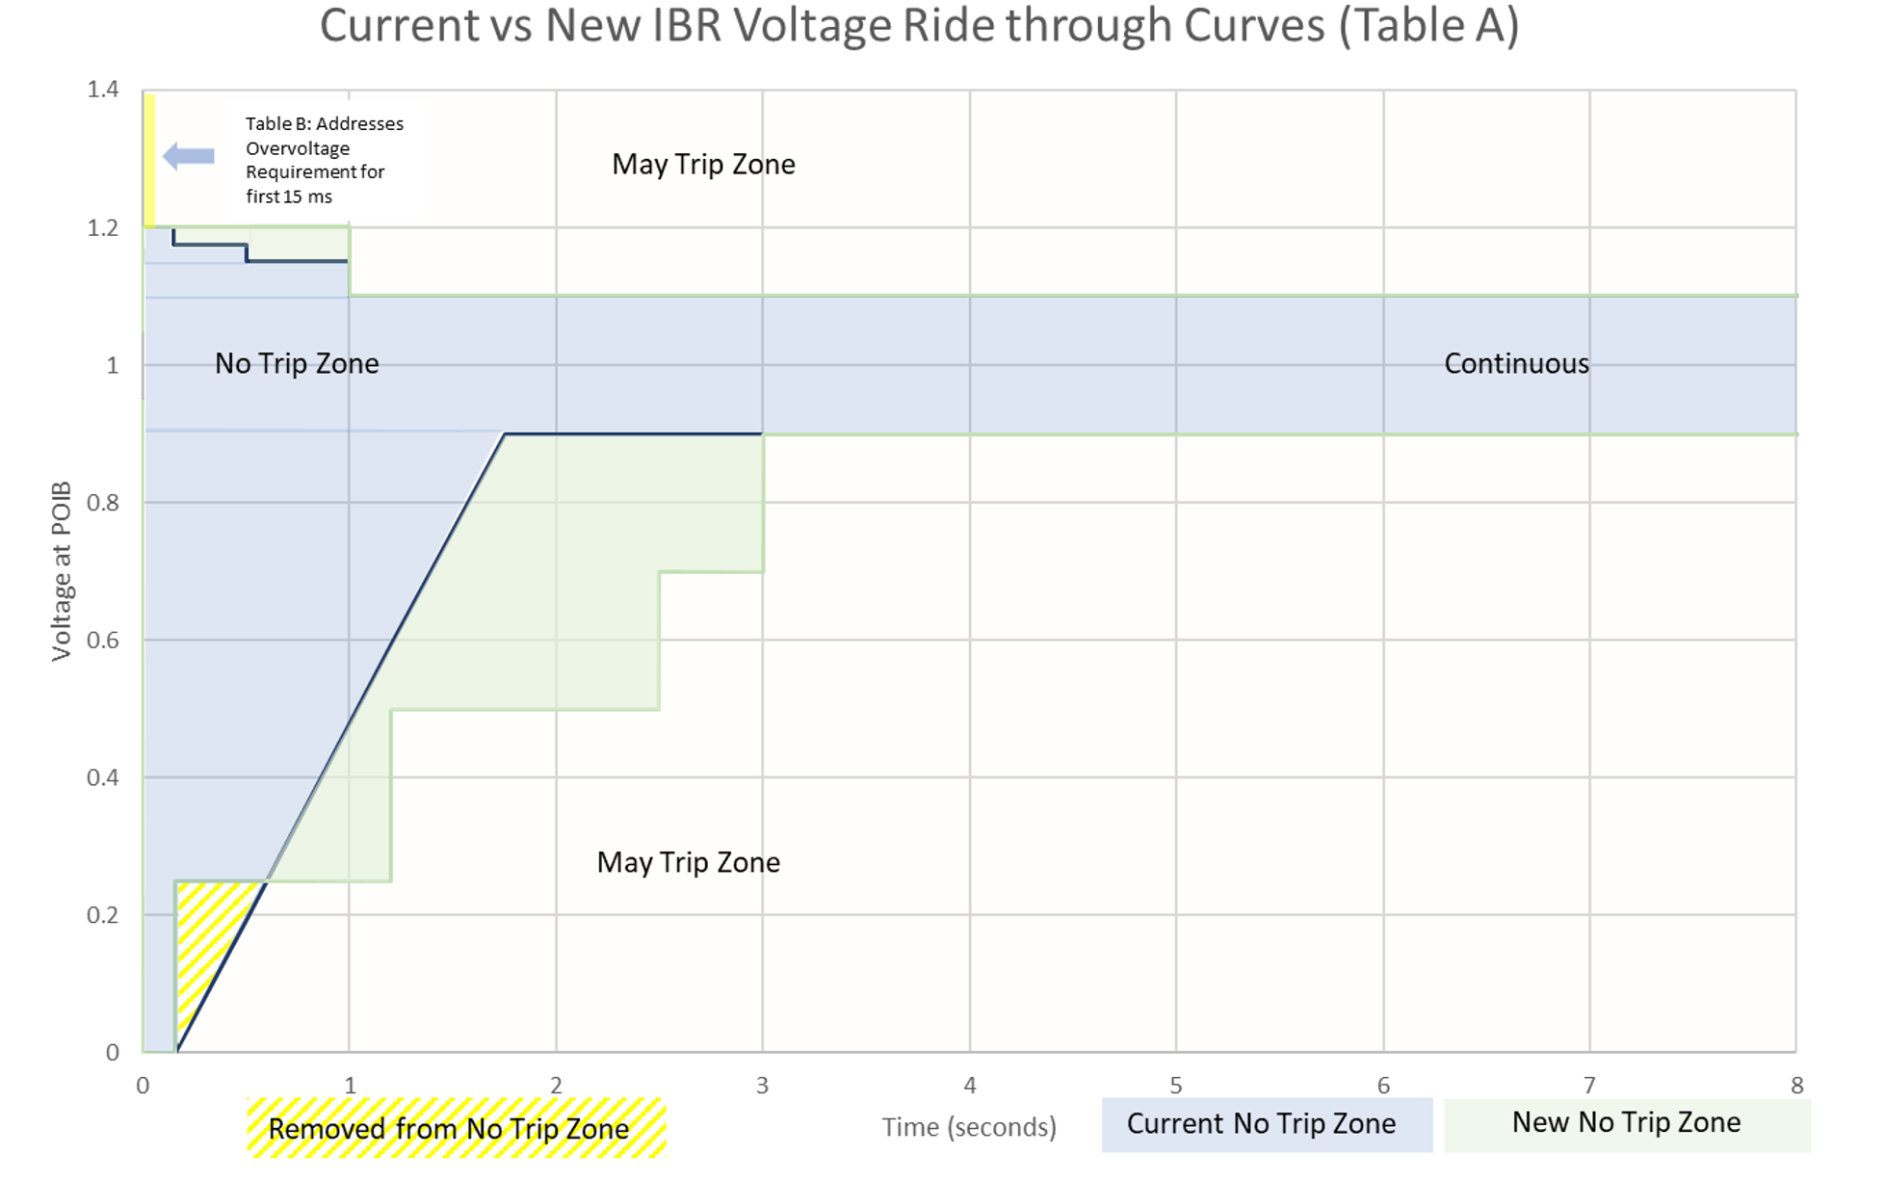
Low Voltage Ride Through (LVRT)
The concern is if during low voltages, such as during faults, the IBRs trip, it could quickly setup a cascading situation particularly in areas with lots of wind, solar or storage
For WTGs rapid tripping had been a strategy to protect the DFAG from high rotor currents and over voltages in the dc capacitor.
When there were just a few WTGs, tripping was acceptable
Different interconnects have varying requirements, with ERCOT having a more restrictive
Image source: ERCOT, 2023
28

Slide 30
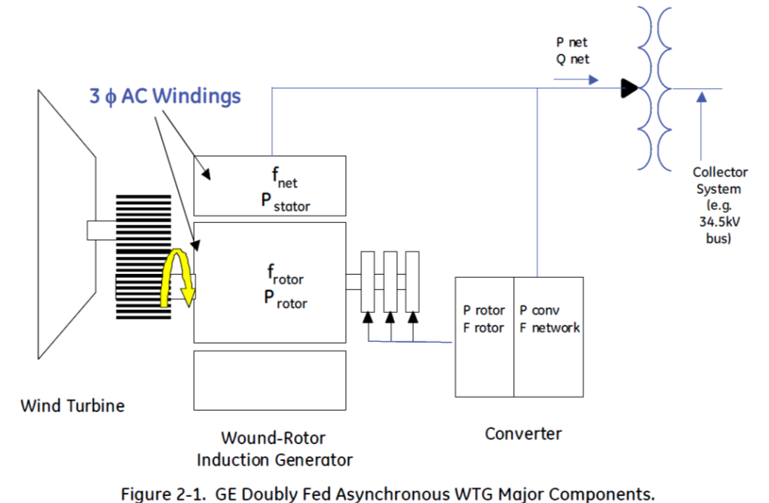
Type 3: Doubly Fed Asynchronous Generators (DFAG)
Doubly fed asynchronous generators (DFAG) are usually a conventional wound rotor induction generator with an ac-dc-ac power converter in the rotor circuit
Power that would have been lost in external rotor resistance is now used
Electrical dynamics are dominated by the voltage- source inverter, which has dynamics much faster than the transient stability time frame
Image Source: Figure 2.1 from Modeling of GE Wind Turbine-Generators for Grid Studies, version 4.6, March 2013, GE Energy
29

Slide 31
Type 3 Converters
A voltage source converter (VSC) takes a dc voltage, usually held constant by a capacitor, and produces a controlled ac output
A phase locked loop (PLL) is used to synchronize the phase of the wind turbine with that of the ac connection voltage
Operates much faster than the transient stability time step, so is often assumed to be in constant synchronism
Under normal conditions the WTG has a controllable real power current and reactive power current
WTG voltages are not particularly high, say 600V
30

Slide 32
Type 3 Converters
Type 3 machines can operate at a potentially widely varying slip
Example, rated speed might be 120% (72 Hz for a 60 Hz system) with a slip of -0.2, but with a control range of +/- 30%
Control systems are used to limit the real power during faults (low voltage)
Current ramp rate limits are used to prevent system stress during current recovery
Reactive current limits are used during high voltage conditions
31

Slide 33
Type 4 Converters
Type 4 WTGs pass the entire output of the WTG through the ac-dc-ac converter
Hence the system characteristics are essentially independent of the type of generator
Because of this decoupling, the generator speed can be as variable as needed
This allows for different generator technologies, such as permanent magnet synchronous generators (PMSGs)
Traditionally gearboxes have been used to change the slow wind turbine speed (e.g., 15 rpm) to a more standard generator speed (e.g., 1800 rpm); with Type 4 direct drive technologies can also be used
32

Slide 34
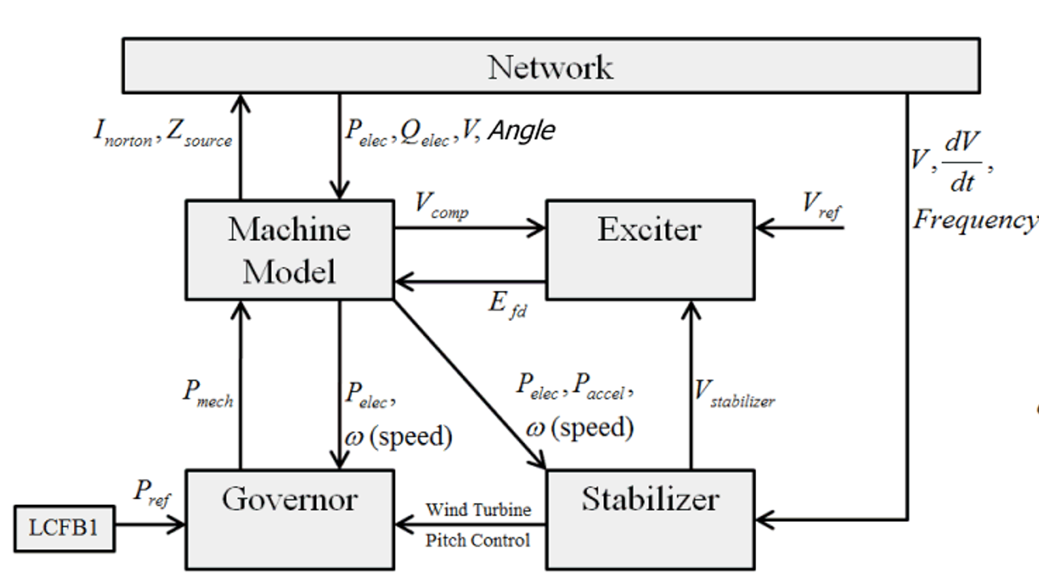
Stability Modeling of Wind Turbines
As we’ve seen, traditionally the industry has used a modular approach for generator models
Machine
Exciter
Governor
Stabilizer
Under Excitation Limiter
Over Excitation Limiter
Relay Models
Compensator Model
33

Slide 35
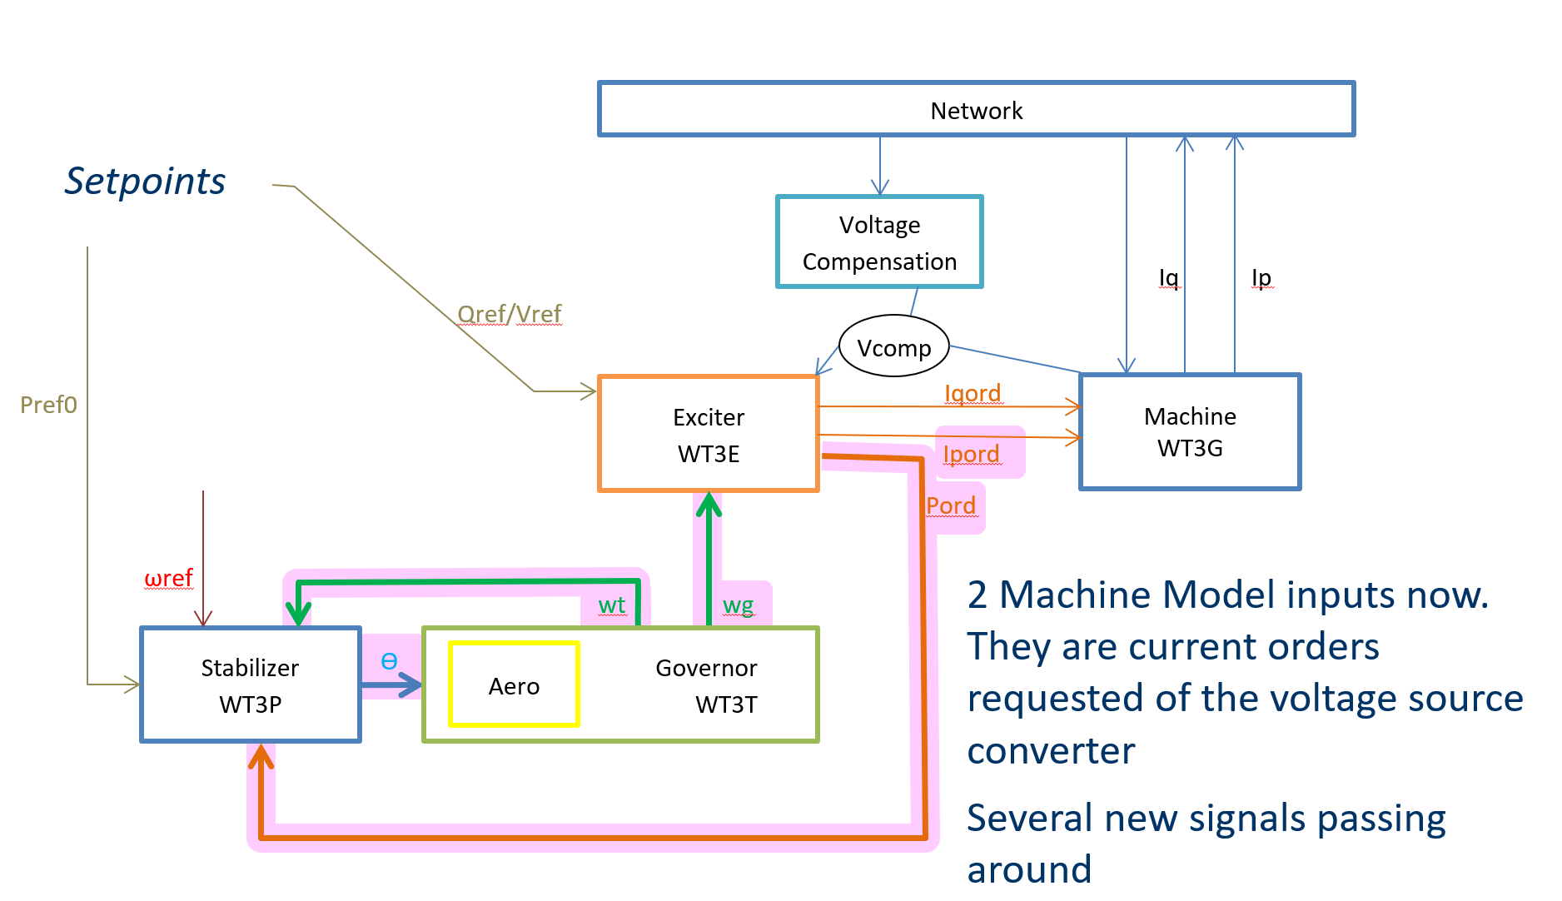
This Approach Has Been Followed with Wind
When wind started to appear in larger amounts, “first generation” models were developed following this same approach
This initial models were a good start, but they are now considered obsolete
First Generation model had few mechanisms to provide control features of
Real Power or Torque Control
Reactive Power
Voltage Control
34

Slide 36
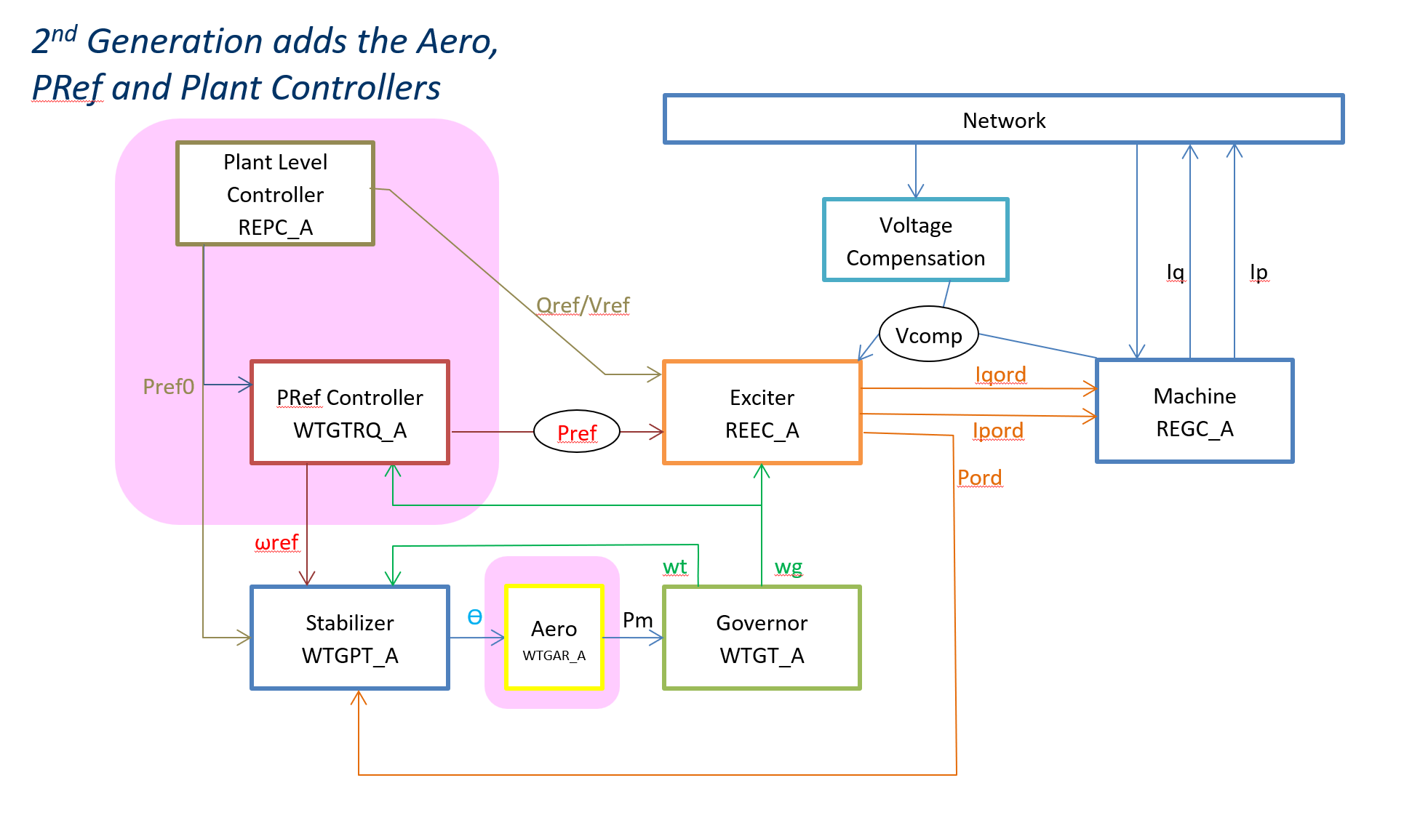
Second Generation Stability Models
The second generation models are a similar format, but provide for more realistic control; they have also been expanded to include solar and storage
Second Generation Type 3 Models
35

Slide 37
2nd Generation Type 3 Wind Turbine (REGC_A, REEC_A, WTGT_A, WTGAR_A, WTGPT_A, WTGTRQ_A, REPC_A)
2nd Generation adds the Aero, PRef and Plant Controllers
Network
Plant Level Controller REPC_A
Voltage Compensation
Iq
Ip
Qref/Vref
Vcomp
Pref0
PRef Controller WTGTRQ_A
Exciter REEC_A
Iqord
Machine REGC_A
Pref
Ipord
Pord
ωref
wt
wg
Stabilizer WTGPT_A
ϴ
Aero WTGAR_A
Pm
Governor WTGT_A
36

Slide 38
2nd Generation Type 4 Wind Turbine (REGC_A, REEC_A, WTGT_A, REPC_A)
Network
Plant Level Controller REPC_A
Voltage Compensation
Iq
Ip
Qref/Vref
Vcomp
Exciter REEC_A
Iqord
Machine REGC_A
Pref
Ipord
wg
Note: If REEC_A parameter Pflag = 0, then WTGT_A really doesn’t do anything so it can be omitted completely
Tm0
Governor WTGT_A
37

Slide 39
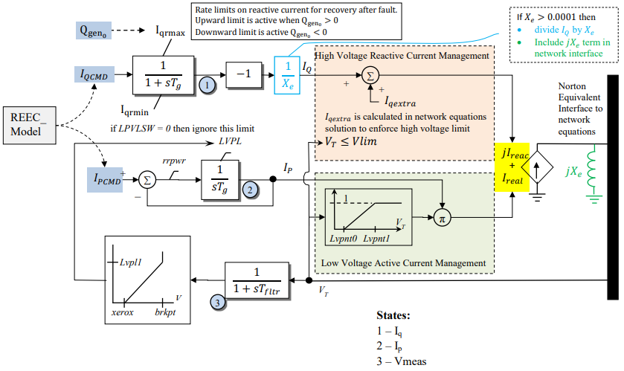
Second Generation “Machine” Model, REGC_A (or REGCA1)
“Machine Model”: really a network interface
Inputs from
REEC* electrical models
38

Slide 40
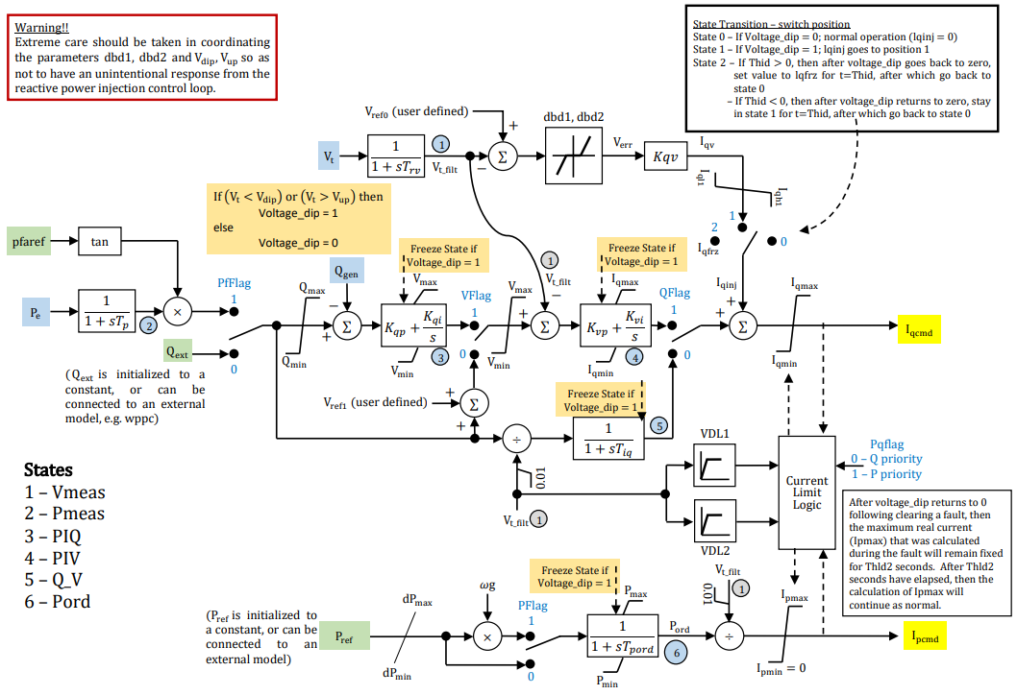
REEC_A (same as REECA1)
Electrical Model
Outputs
REGC* machine model
Qext Input from
REPC* Plant Controller
Pref Input from
REPC* Plant Controller WTGTRQ* Pref Controller
wg Input from
WTGT* mechanical
Outputs
REGC* machine model
39

Slide 41
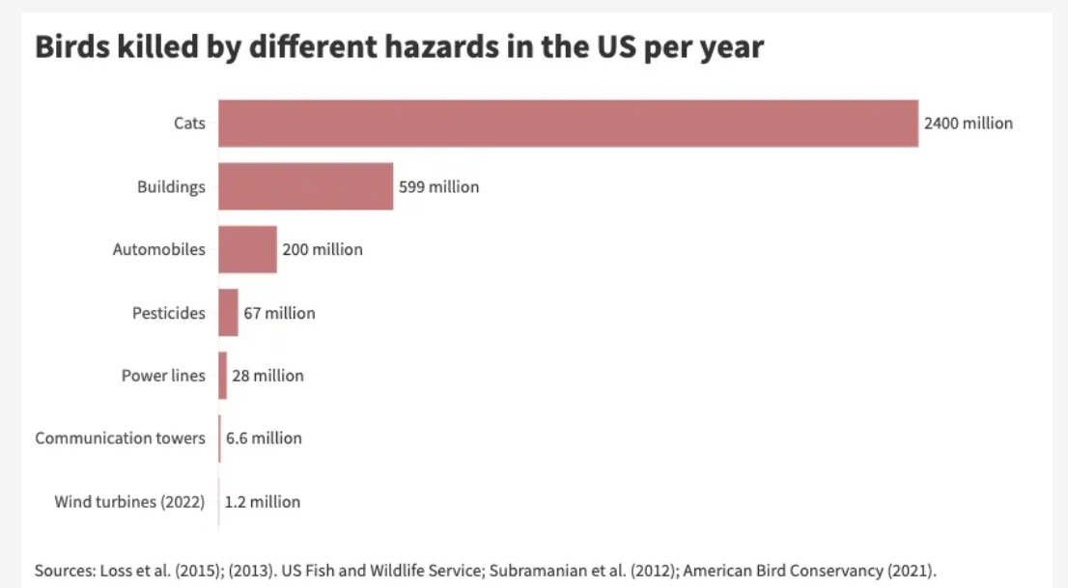
Additional Wind Farm Issues
Wind turbines certainly kill birds and bats, but so do lots of other things; however, wind turbines can kill the longer-lived, larger birds such as raptors that can be especially sensitive to adult mortabilites
40

Slide 42
Additional Wind Farm Issues, cont.
Wind turbines can enhance the well-being of many people (e.g., financially), but some living nearby may be affected by noise and shadow flicker
Noise comes from 1) the gearbox/generator and 2) the aerodynamic interaction of the blades with the wind
Noise impact is usually moderate (50-60 dB) close (40m), and lower further away (35-45 dB) at 300m
However, wind turbine frequencies also need to be considered, with both a “hum” frequency above 100 Hz, and some barely audible low frequencies (20 Hz or less)
Shadow flicker is more of an issue in high latitude countries since a lower sun casts longer shadows
Night lighting and aesthetics in general can be concerns
41

Slide 43
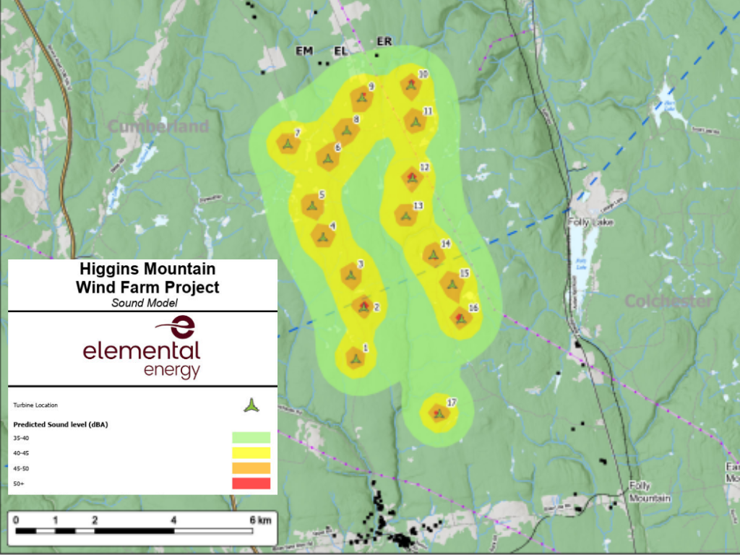
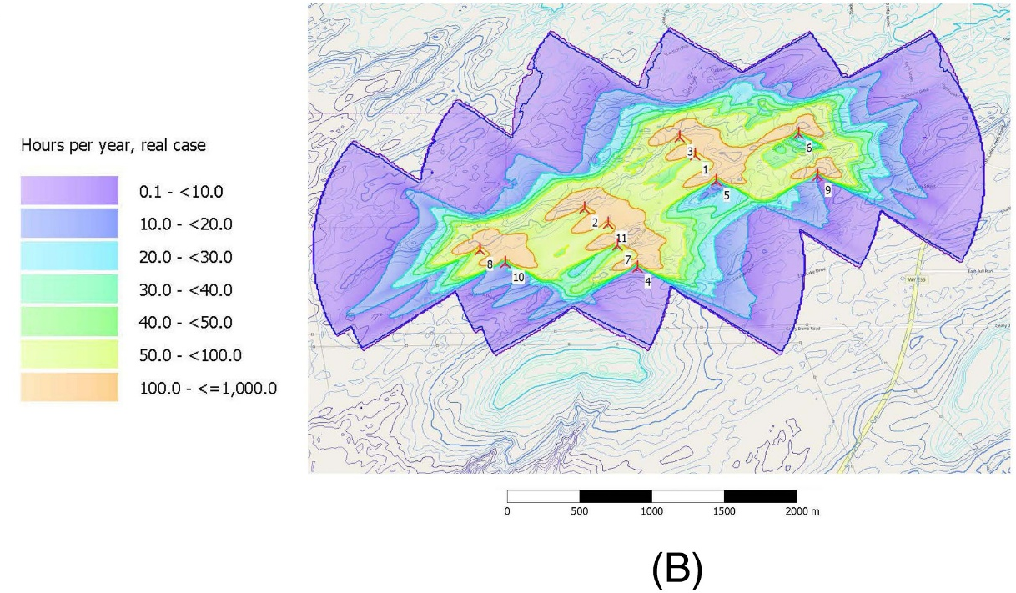
Example Noise and Shadow Flicker Maps
With noise, 40-50 dB is refrigerator or quiet office; however, low frequencies can be a concern for some people
Left source: www.sciencedirect.com/science/article/pii/S2214629621005582; right source: https://netzeroatlantic.ca/hub/wind/onshore
42

Slide 44
Solar Photovoltaic (PV)
Photovoltaic definition- a material or device that is capable of converting the energy contained in photons of light into an electrical voltage and current
Solar cells are diodes, creating dc power, which in grid applications is converted to ac by an inverter
For terrestrial applications, the capacity factor is limited by night, relative movement of the sun, the atmosphere, clouds, shading, etc.
A ballpark figure for Texas is about 25%; US high of about 29%, some states go below 17%
"One sun" is defined a 1 kw/m²,which is the maximum insolation the reaches the surface of the earth (sun right overhead)
43

Slide 45
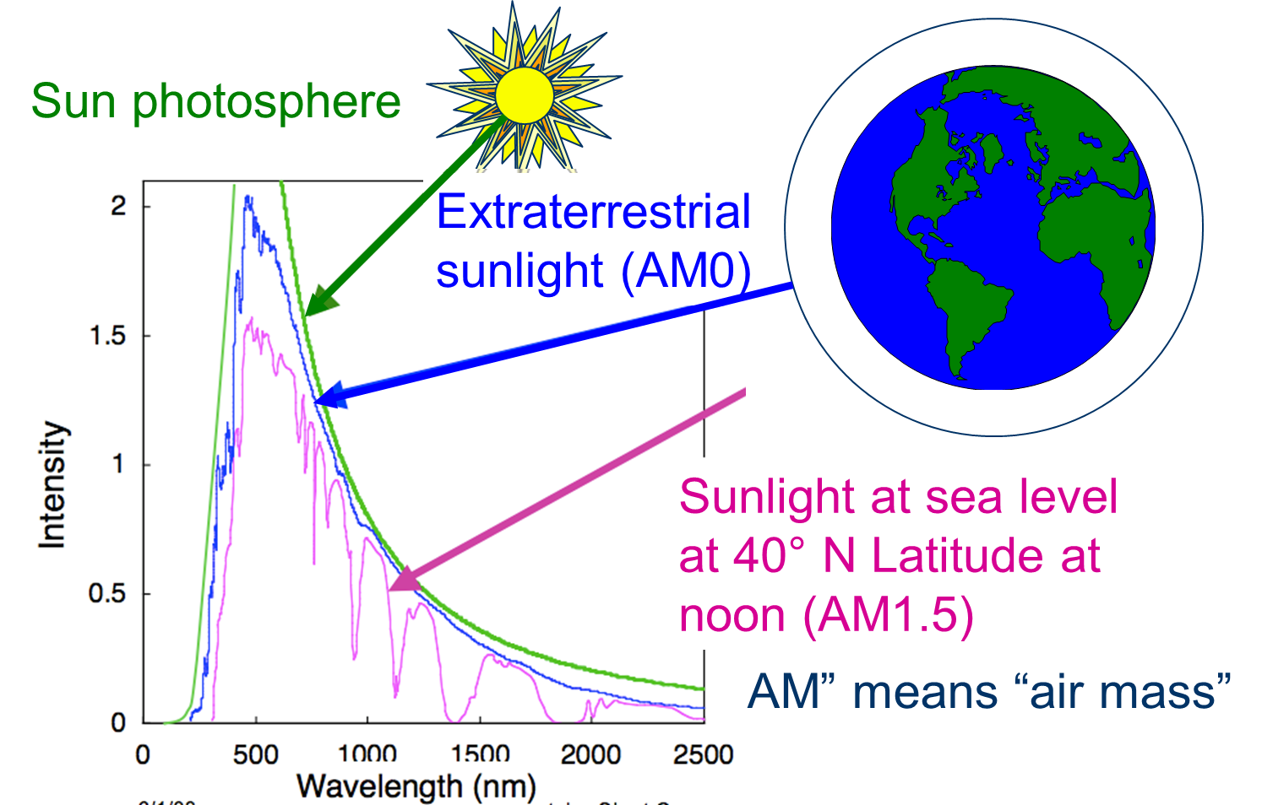
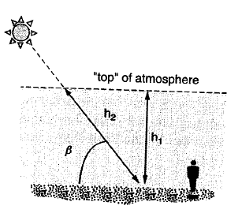
The Sun as a Resource
In space the amount of solar radiation (i.e., sunlight) just depends on the distance from the sun, with a 100% capacity factor
On earth the amount of solar radiation (i.e., sunlight) available at a location depends on many things, and varies significantly because of atmospheric attenuation
44

Slide 46
Solar Radiation versus Irradiance
Various terms are used to describe the energy emitted by the sun
Solar radiation refers to the total energy emitted by the sun (visible, infrared, ultraviolet), and is mostly used in scientific fields
Solar irradiance refers to the amount of energy received (e.g., watts per square meter), and is used more in engineering
The terms solar insolation or just insolation are also used
With solar PV there are several standard values
Direct normal irradiance (DNI) is the amount of power received on a surface perpendicular to the sun
Diffuse horizontal irradiance (DHI) is the amount of power received from light scattering
Global horizontal irradiance (GHI) is the total amount on a horizontal surface
45

Slide 47
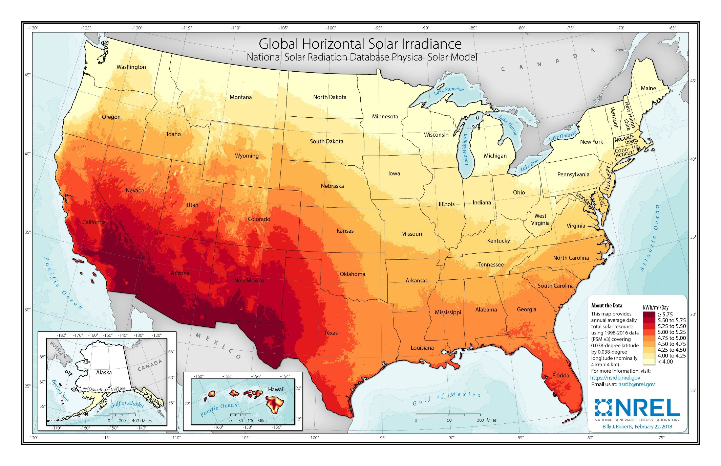
US Global Horizontal Irradiance (GHI)
The capacity factor is usually about 1.25 times this number divided by 24 hours per day
46

Slide 48
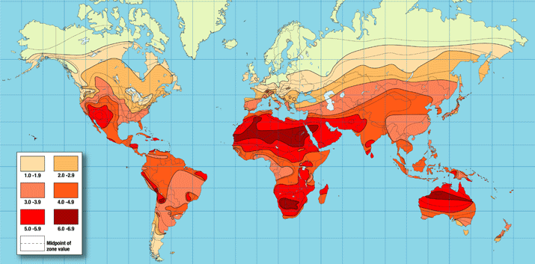
Worldwide Annual Insolation
47

Slide 49
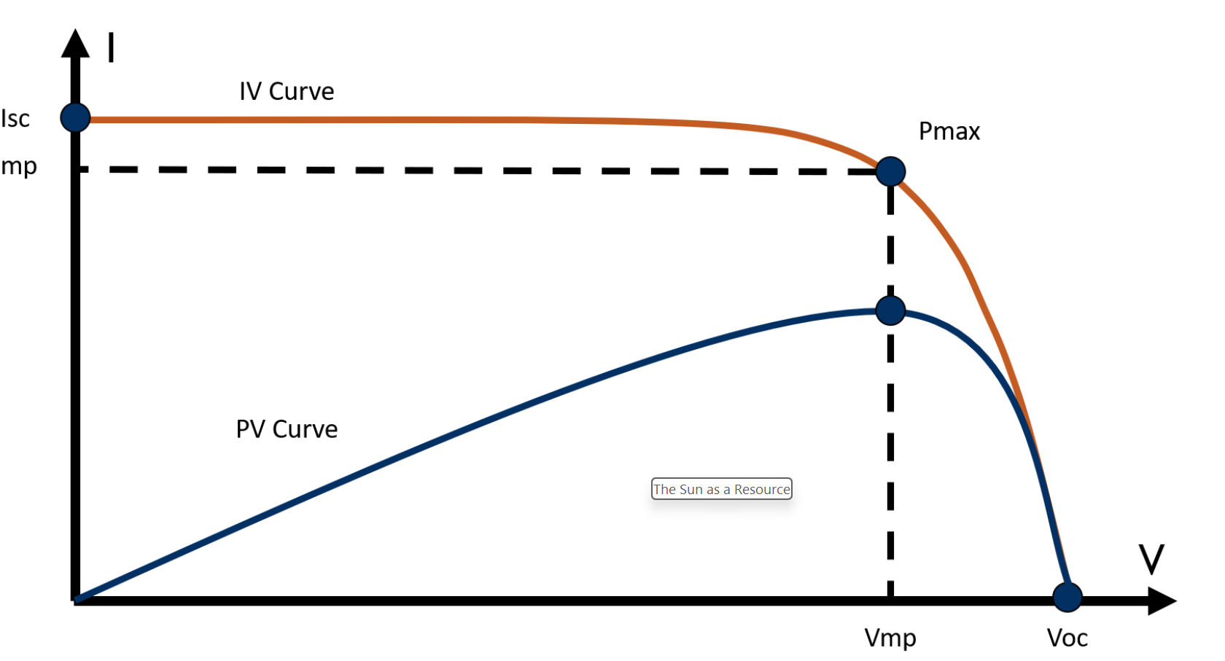
Solar Photovoltaics (PV)
Photovoltaics is the conversion of light into electricity using semiconductors known as solar cells
It dates back to 1883, but really got going in the late 1950’s, driven by NASA
Solar cells produce a dc output, with the right image showing an example IV curve
Solar modules are groups of solar cells; a PV panel is one or more modules wired together ready to mount
A PV system often includes an inverter to produce ac electricity
PV panels can either have a fixed mount, or be on a tracker; trackers can be one-axis or two-axis
48

