Slide 1
ECEN 460
Power System Operation and Control
Spring 2025
Lecture 26:
Prof. Tom Overbye
Special Guest Lecture by Sanjana Sanjana Kunkolienkar Dept. of Electrical and Computer Engineering
Texas A&M University
overbye@tamu.edu

Slide 2
Announcements
Design project due at 9:30 am on May 1 (i.e., at the end of our final slot; no final)
1

Slide 3
Cost of Blackouts
Electricity has varying value and hence the costs associated with blackouts can vary substantially
  Momentary (less than five minutes) can have almost no impact for residential customers (certainly with exceptions!) while costing industrials potentially millions if production is interrupted
Costs impact are sensitive to the duration and extent of the blackout as well
  Long duration blackouts impacting a wide area are the worst case scenarios
2

Slide 4
Larger Scale Blackouts
The North American Electric Reliability Corporation (NERC) requires reporting of events the interrupt more than 300 MWs or affect at least 50,000 customers
  From 1984 to 2006 there were 861 events reported, but only about 300 met the criteria
  Average of blackouts that met the criteria affected several hundred thousand customers, but large outages affected many more (like August 14, 2003 with more than 50 million people).
This data is now kind of dated, partially because of changes in the availability of information to researchers
Source: www.uvm.edu/~phines/publications/2008/Hines_2008_blackouts.pdf
3

Slide 5
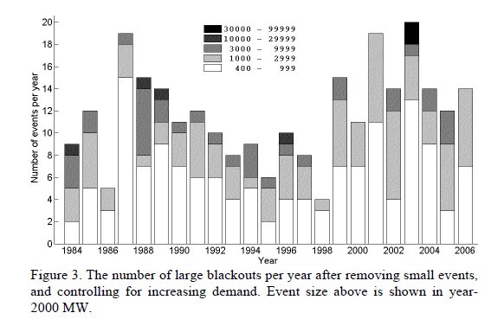
Large Blackouts in North America By Event Size
4

Slide 6
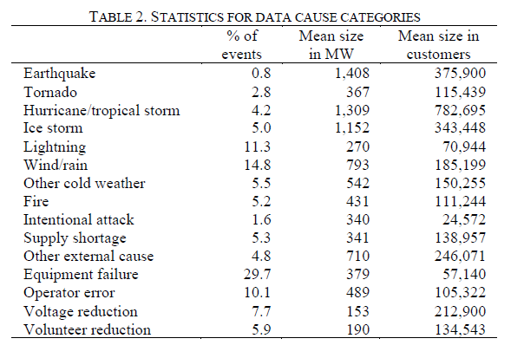
Causes of Large Blackouts
5

Slide 7
Weather Related Large-Scale Blackouts
A majority of the extremely large blackouts in the US are due to weather related causes
  Hurricanes, ice storms, tornados are key causes
Little can be done operationally for prevention
  Operational changes can help with quicker restoration
Prior planning can reduce the blackout extent
  Tree trimming
  Locating transmission/distribution underground can be effective but quite costly
6

Slide 8
Avoidable Transmission Level Blackouts
Many major blackouts can be prevented.
Time frames of the blackouts, minutes to hours, allow for operator intervention
  Tokyo 1987 (20 minutes), WECC 1996 (six minutes), Eastern Interconnect 2003 (about an hour), Italy 2003 (25 minutes), India 2012
And of course many are prevented, and hence do not make the news. For example, near voltage collapse in Delmarva Peninsula, 1999.
7

Slide 9
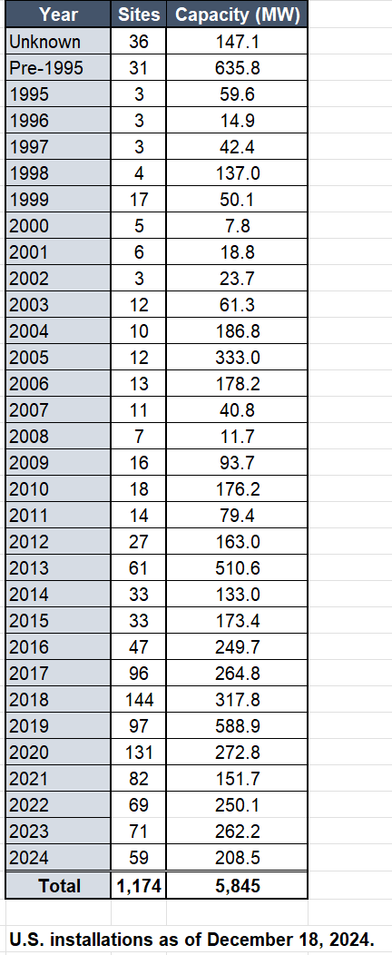
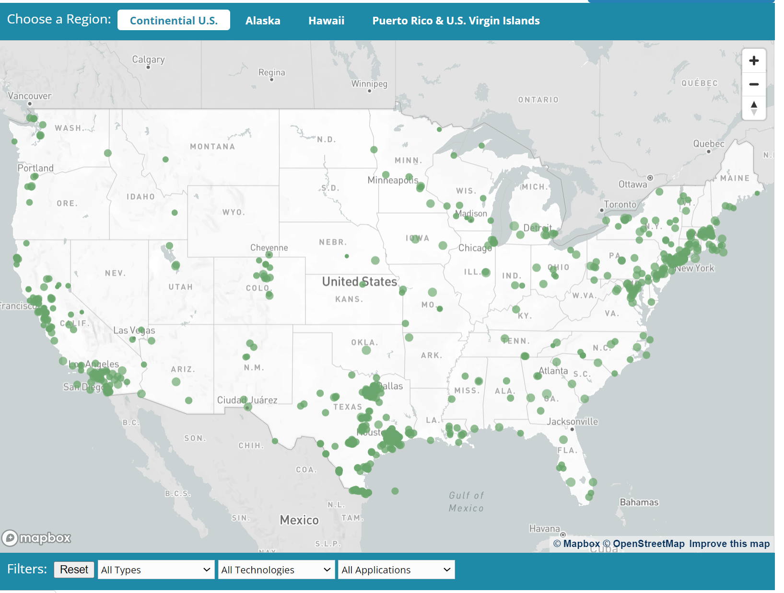
Blackouts and Micro-Grids/Distributed Generation
The effects of short-term blackouts can be eliminated or reduced through the use of uninterruptible power supplies (UPSs) and backup generation
Micro-grids, which have the ability to run autonomously
from the main grid, offer the potential for additional reliability
  Having sufficient generation capacity, and a long-term fuel
  source are key
The DOE has a website that
shows microgrid installations
  https://doe.icfwebservices.com/microgrid
  As of 2024 they noted 1174
  operational microgrids with a total of
  5.845 GW of reliable capacity
8

Slide 10
Restoration
The cost of blackouts certainly increases the longer the power is out
How quickly power can be restored depends on whether there was equipment damage
  Downed lines take time to rebuild
  Houses damaged by flooding need to be disconnected before service can be restored
  Some generation, such as nuclear plants, can take days to restart
  Damage to HEV transformers could be catastrophic!
9

Slide 11
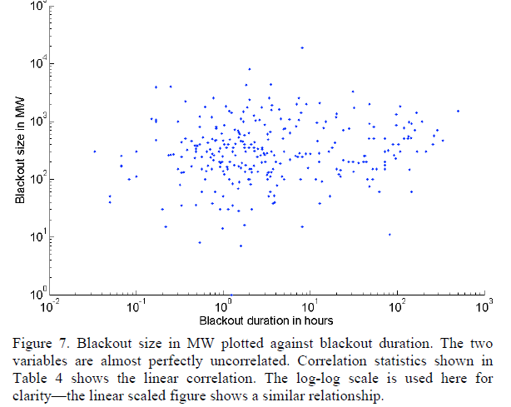
Restoration, cont.
For larger
blackouts there
appears to
be little
correlation
between
the size of the
event and
the restoration
time
10

Slide 12
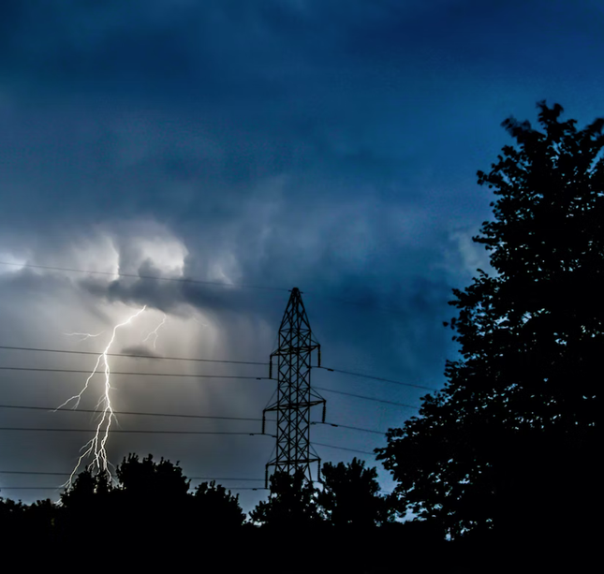
Black Start Restoration
Power system restoration or black start (or blackstart)
  A procedure to restore power in the event of a partial or total shutdown of the power system
  A highly complex decision problem
Object is to serve the load as soon as possible without violating operating constraints
  Actions are time critical
Primarily manual work by operators
Offline restoration planning usually based
on simulations
11

Slide 13
Background On Power System Black Start
Key NERC Standard is EOP-005, 2009
  Transmission operators must have black start plans, verify them with steady-state and dynamic simulations, and run training exercises and testing
  Parts of a black start plan
    High level strategy for coordination and restoration
    Nuclear power plant off-site power supply
    Black start generating resources
    Cranking paths to next-start units
    Acceptable limits to voltage and frequency during restoration
    Load restoration and prioritization process
    Communication process and transfer of operational control
Recent report covering black start:
  J. G. O’Brien, M. Cassiadoro, T. Becejac, G. B. Sheble, J. D. Follum, U. Agrawal, E. S. Andersen, M. Touhiduzzaman, and J. E. Dagle, “Electric grid blackstart: Trends, challenges, and opportunities,” Pacific Northwest National Lab, Richland, WA, Tech. Rep., 2021
12

Slide 14
Issues in Black Start Procedure Design
Active power balance
  Need to maintain system frequency within limits by system stability and protection settings
  Accomplished by picking up loads in increments
Frequency control
  Initial black start islands are in isochronous control mode
  Transition to droop control with AGC and appropriate frequency bias
  Synchronizing islands, need to control frequency appropriately
Reactive power balance and overvoltage control
  Energizing few high voltage lines
  Operating generators at minimum voltage levels
  Deactivating switched shunt capacitors, connecting shunt reactors
  Adjusting transformer taps, picking up reactive loads
13

Slide 15
General Stages of Black Start Restoration
Ensure breakers are opened up to isolate the system
Start up black start units in separate islands, energizing associated buses on isochronous control
Add balancing loads and energize cranking paths to next-start units
Start up additional units and expand areas, transitioning to AGC control
Synchronize islands to reform transmission network
Continue to add load as additional generation comes online
Island 2
10 MW
300 MW Capacity
70 MW Output
Island 1
20 MW Capacity
8 MW Output
Next Start D
Black Start 1
15 MW
House Load
400 MW Capacity
70 MW Output
10 MW
Next Start 2
400 MW Capacity
12 MW Output
15 MW
Island 2: Now with 3 generators on line. Prepare for Constant Frequency Control.
Black Start A
60 MW Capacity
30 MW Output
Island 1:
420 MW Capacity
20 MW Load
Island 2:
760 MW Capacity
170 MW Load
100 MW
40 MW
Source: ERCOT, Frequency Control During Black Start Operations, 2014
14

Slide 16
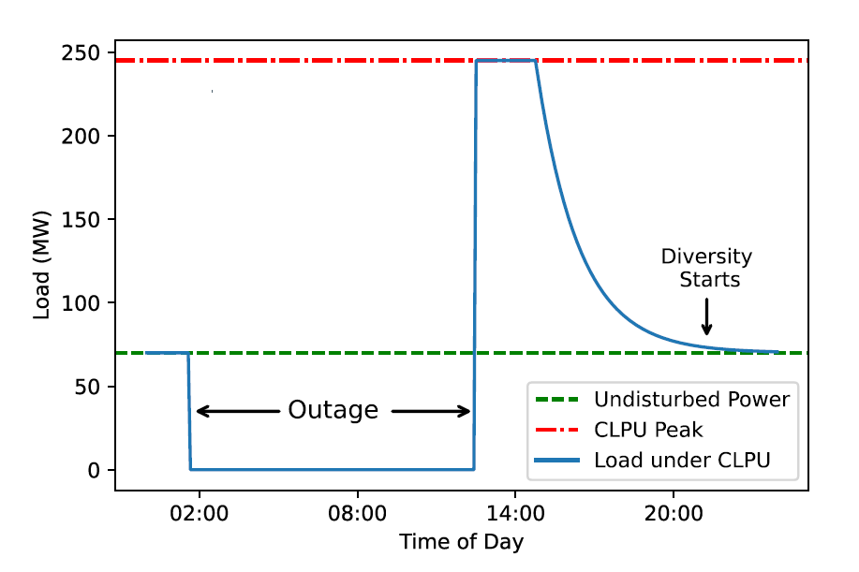
Cold Load Pick-Up Modeling
When loads are energized after an extended outage, cold load pick-up (CLPU) is in effect
This means the load’s consumed power may be 3-10 times as large as the undisturbed load value
  The reason for CLPU effects is the loss of load “diversity” – that is, loads such as air conditioners that ordinarily operate at different, small intervals will instead be operating all at the same time
  This increased load may last for 30 minutes or longer, until load diversity starts back again
  If an outage is shorter, the CLPU effects will not be as severe because there is not enough time for full loss of diversity
J. Penaranda and A. B. Birchfield, "Application and Parameter Sensitivities of a State-Space Cold Load Pickup Model for a Synthetic Restoration Test Case," 2022 North American Power Symposium (NAPS), Salt Lake City, UT, USA, 2022, pp. 1-6
15

Slide 17
Grid Resilience
Grid resilience is currently a topic with lots of interest
Resilience in general is defined as (Merriam Webster Dictionary)
  “An ability to recover from or adjust easily to misfortune or change”
EPRI & North American Transmission Forum (NATF)
  The ability of the system and its components (… equipment and human …) to minimize damage and improve recovery from non-routine disruptions, including High Impact, Low Frequency (HILF) events, in a reasonable amount of time”
The impact of blackouts is not linear!
  Having 100 million people out of service can be more than tens times worse than 10 million out. A ten day blackout can be more than tens times worse than a one day blackout.
These definitions are from the 53rd North American Power Symposium keynote address by Dan Smith of Lower Colorado River Authority, November 2021

Slide 18
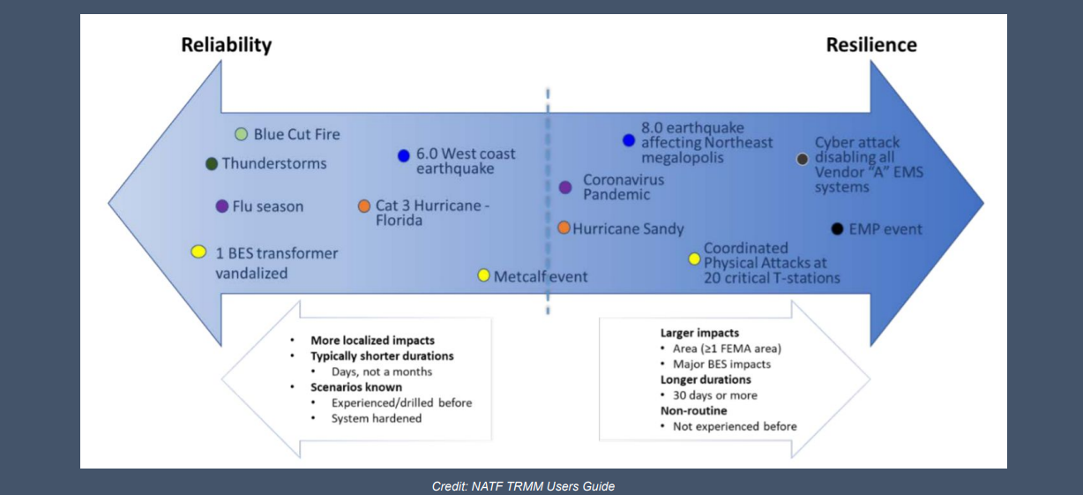
Reliability – Resilience Continuum
Slide is from the 53rd North American Power Symposium keynote address by Dan Smith of Lower Colorado River Authority, November 2021; credit NATF

Slide 19
High-Impact, Low-Frequency Events
In order to enhance electric grid resiliency we need to consider the almost unthinkable events
These include what the
North American Electric
Reliability Corporation
(NERC) calls High-Impact,
Low-Frequency Events
(HILFs); others call them
black sky days, or severe resiliency events (SREs)
  Large-scale, potentially long duration blackouts
  HILFs identified by NERC were 1) a coordinated cyber, physical or blended attacks, 2) pandemics, 3) geomagnetic disturbances (GMDs), and 4) HEMPs
Image Source: NERC, 2012

Slide 20
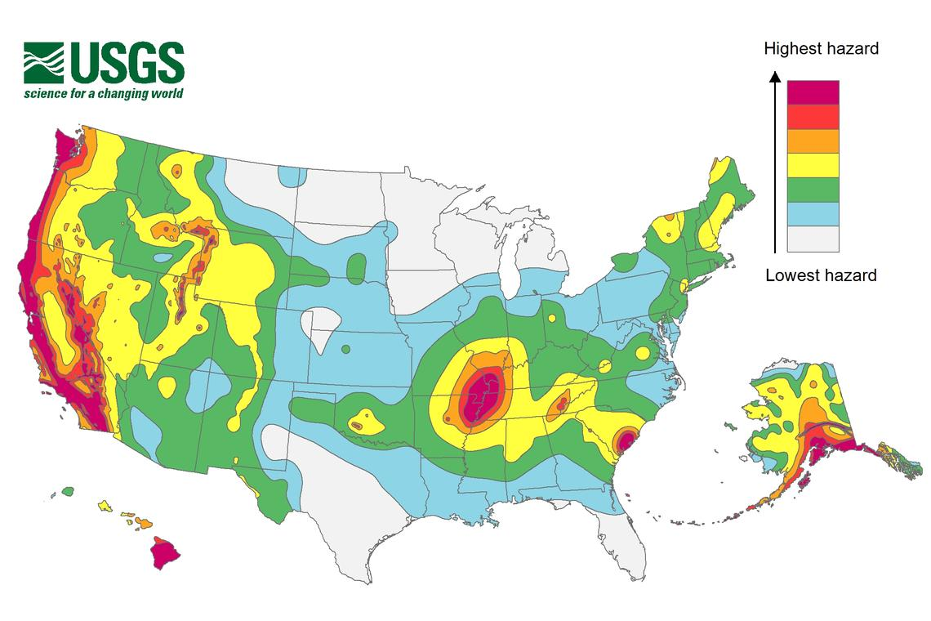
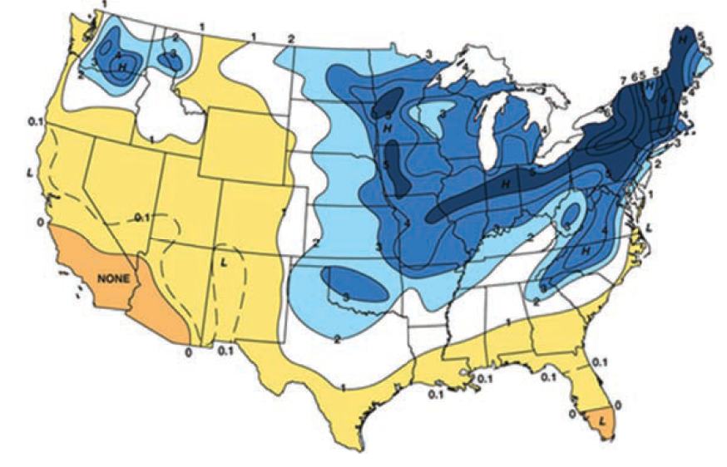
Resilient to What?
A key question on resiliency is to determine the likely threats
  Some are geographic, and may are hard to quantify
Earthquake Risk
Freezing Rain Risk
The impact of wind and solar output on the weather is also a growing concern
Source: Enhancing the Resilience of the Nation’s Electricity System, 2017

Slide 21
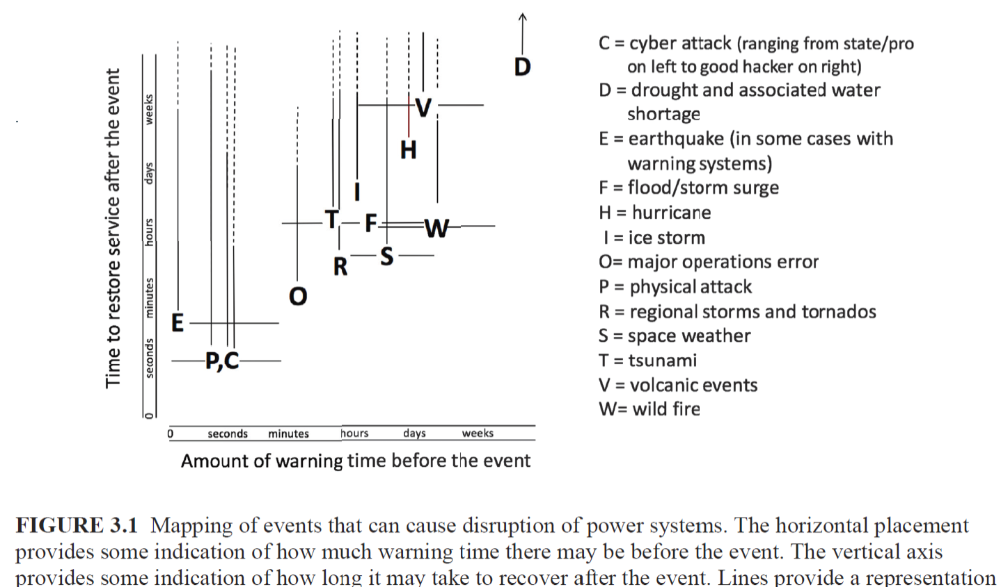
Some Electric Grid Risks
Source: Enhancing the Resilience of the Nation’s Electricity System, 2017

Slide 22
How to Approach HILF Events
The goal in studying HILFs is seldom to replicate a specific event
  Many have not occurred, and within each class there can be great variability (e.g., a physical attack)
Nor is it to ensure there is no loss of service
Rather, it is to be broadly prepared, and to be able to do at least a reasonable cost/benefit analysis
HILF simulations can help in preparing for the unexpected
Understanding, and ultimately enhancing resiliency, requires consideration during three periods 1) prior to an event , 2) during it 3) afterward
Several techniques, such as improved control room rare event situational awareness and better black start procedures, are generally applicable

Slide 23
Challenges
An all hazards approach to considering resiliency is crucial, but there is no a “one-size-fits-all” solution
Identifying particular strategies to improve resiliency, to at least some degree, is relatively easy
The challenge is developing appropriate priorities for actions, and determining the appropriate political and organizational support to make it happen
  Just expecting electric utilities to make the investments necessary, while many are losing customer revenue to self-generation, might not be realistic
HILFs (or perhaps Severe Resiliency Events [SREs] is better) come in a continuum of frequencies and impacts

Slide 24
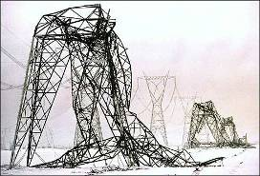
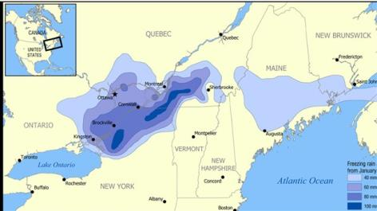
Examples of Larger-Scale or Long Duration Outages
Quebec geomagnetic disturbance blackout of 1989
Northeast ice storm of 1998: A week long ice
storm that resulted in more than three inches
of ice on transmission lines, causing the collapse
of 770 transmission towers and the replacement
of 26,000 distribution poles
Northeast blackout from August 14, 2003
Hurricane Katrina (2005) with loss of service
to 2.7 million customers, with 250,000
still out after 4 weeks
Hurricane Maria (2017) in Puerto Rico,

Slide 25
HILF Two Main Categories
HILF events can be divided into two broad categories: 1) those not caused by human agents, and 2) those caused by human agents
Modeling the non-human events is somewhat easier because the goal is to (at least generally) replicate what has occurred, or what could occur
With human agent events the challenge is to protect the grid from potential events, without exposing vulnerabilities to an adversary or giving out potential mechanisms of attack
Synthetic grids are good for both

Slide 26
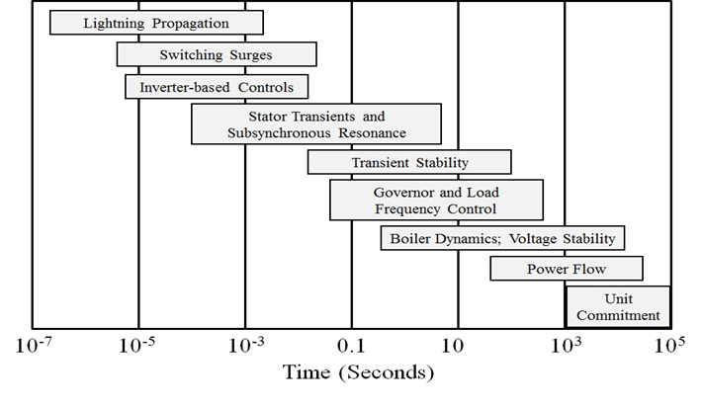
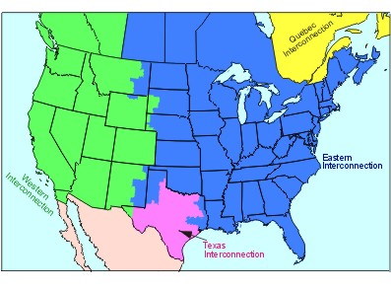
Electric Grid Resiliency Modeling Challenges
When considering resiliency events stability-level models often need to be used; this requires considering many different types of models
  We recently did a study modeling a combined East-West grid, and it has 250 types of models
The grid’s operating point is constantly changing including the load, and generator and line/transformer statuses
Top Image: Sauer, P.W., M. A. Pai, Power System Dynamics and Stability, Stripes Publishing, 2007

Slide 27
General Grid Resilience Comments
Understanding resilience requires considering how grids will respond to particular disturbances
Substantially changing the topologies of existing grids is not an option
In contrast to cyber security, there are seldom easy “patches” that can be applied to fix vulnerabilities
Simplistic studies of how a grid disturbance could cascade often lead to incorrect conclusions; sequential power flows, sequentially taking out overloaded devices are not particularly helpful
Full detail models of large-scale actual grids including the protection system usually don’t exist and modeling them would requiring knowing the associated remedial action schemes

Slide 28
Economic Valuation of Resilience
While certainly challenging, metrics are needed to help
determine the value of resilience to society
  If we need to improve resiliency, someone needs to pay
This is becoming a more challenging problem as more
customers provide self-generation
  Is the ability of some customers to self generate, at least for a period of
  time, a net gain to the grid’s resiliency? How does one assess the
  resiliency of their systems?
Given that both reliability and resilience are often desired,
their needs to be a co-optimization of their benefits.

Slide 29
Example: Geomagnetic Disturbances (GMDs)
GMDs are caused by solar corona mass ejections (CMEs), and range from minor and frequent to severe and extremely rare
A GMD caused a blackout in 1989 of Quebec
They have the potential to severely disrupt the electric grid by causing quasi-dc geomagnetically induced currents (GICs) in the high voltage grid
Until recently power engineers had few tools to help them assess the impact of GMDs
GMD assessment tools are now moving into the realm of power system planning and operations engineers
28

Slide 30
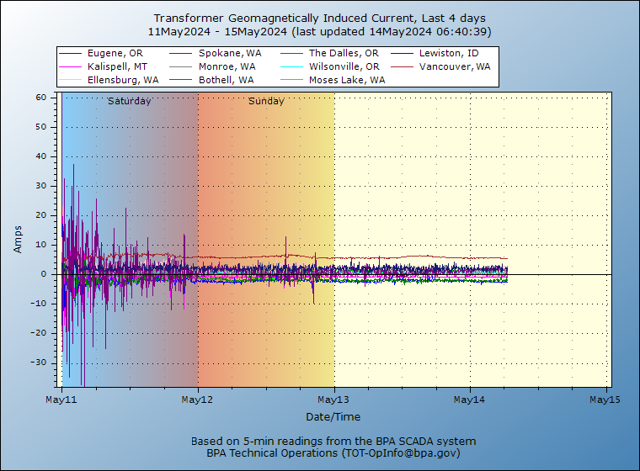
May 10 to 13, 2024 Geomagnetic Disturbance (GMD)
A fairly large GMD caused just
barely visible northern lights
as far south as College Station,
TX (latitude of 30.6°)
While the Kp-index went up
to its max value (9), it was not
an overly severe GMD
  nT/minute of < 100, where 500
  would be a 1989 event, and
  2500 for Carrington
It caused more grid impacts
than expected
Image: transmission.bpa.gov/Business/Operations/gic/gic.aspx

Slide 31
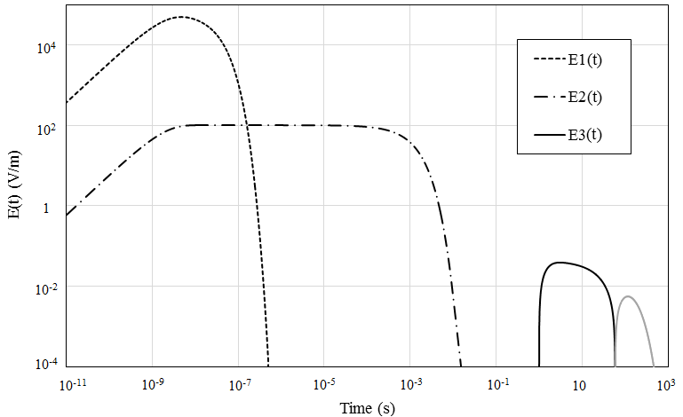
HILF Example: Nuclear EMPs
Broadly defined, an electromagnetic pulse (EMP) is any transient burst of electromagnetic energy
High altitude nuclear explosions can produce continental scale EMPs; called HEMPs
The impacts of an HEMP
are typically divided into
three time frames:
E1, E2 and E3
  E1 impacts electronics,
  E2 is similar to
  lightning, E3 is similar
  to a very large, but short duration GMD

Slide 32
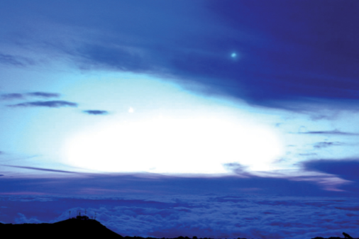
Nuclear EMP History
The presence of EMPs was theorized by Enrico Fermi prior to the first explosion in July 1945
  Many wires were shielded, but still some data was lost due to EMP
Starfish Prime was an explosion of a 1.44 megaton nuclear weapon at an altitude of 400 km over the Pacific Ocean in July 1962
  Part of series of tests known as
  Operation Fishbowl
  The EMPs were much larger than expected,
  driving instruments off scale
  Impacts seen in Honolulu (1445 km away),
  including knocking out about 300 street lights,
  setting off alarms, and damaging a microwave link
  Some low earth orbit satellites were also damaged
Starfish Prime observed on Maui in 1962, Source US EMP Commission Report, 2017
31

Slide 33
Electric Fields and Geomagnetically Induced Currents (GICs)
The induced electric field at the surface is dependent on deep earth (hundreds of km) conductivity
  Electric fields are vectors (magnitude and angle); values expressed in units of volts/mile (or volts/km);
  A 2500 nT/minute storm could produce 5 to 10 volts/km
The electric fields cause GICs to flow in the high voltage transmission grid
The induced voltages that drive the GICs can be modeled as dc voltages in the transmission lines.
  The magnitude of the dc voltage is determined by integrating the electric field variation over the line length
  Both magnitude and direction of electric field is important
32

Slide 34
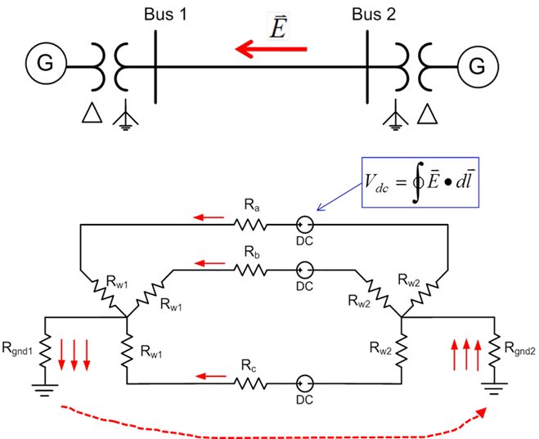
Geomagnetically Induced Currents (GICs)
Both GMDs and HEMPs cause electric fields, with values dependent on the deep earth conductivity
Along length of a high voltage transmission line, electric fields can be modeled as a dc voltage source superimposed on the lines
These voltage sources produce quasi-dc
geomagnetically induced currents (GICs)
that are superimposed on the ac
(60 Hz) flows
33

Slide 35
Simulated GICs in High Voltage Transmission Grid

Slide 36
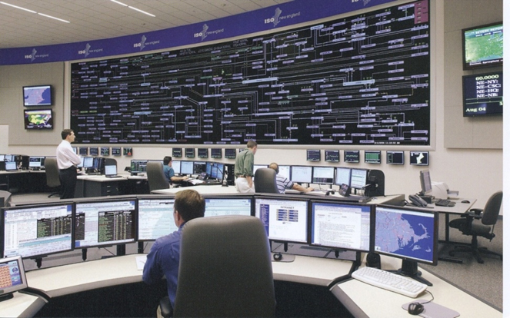
The Impact of a Large GMD From an Operations Perspective
Would be maybe a day warning but without specifics
  Satellite at Lagrange point one million miles
  from earth would give more details, but
  with less than 30 minutes lead time
  Could strike quickly; rise time of minutes,
  rapidly covering a good chunk of the continent
Reactive power loadings on hundreds of
high voltage transformers could rapidly rise
Increased transformer reactive loading causes heating issues and potential large-scale voltage collapses
Control room personnel would be overwhelmed
The storm could last for days with varying intensity
35

Slide 37
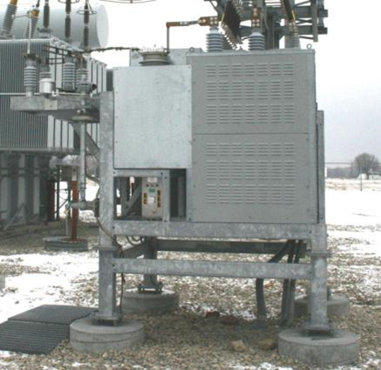
GIC Mitigation
Tools are needed to determine mitigation strategies
  Cost-benefit analysis
GIC flows can be reduced both through operational strategies such as opening lines, and through
longer term approaches such as
installing blocking devices
Redispatching the system can
change transformer loadings,
providing margins for GICs
Algorithms are needed to provide real-time
situational awareness for use during GMDs
36

Slide 38
Integrating Weather (and Other Resiliency Events) into Electric gird Planning
Human activity depends on the weather, and this has always been reflected in the electric load
Traditionally some power flow parameters have depended on the weather (e.g., line ratings, turbine max MW, line resistance)
Over the last several decades this dependence has grown substantially with the increase in wind and solar generation
  They now provide about 17% of US electric energy (> 30% in ERCOT); there are times when most of the electricity in regions is supplied by these sources
  They are extremely dependent on the weather
Major power system input parameters are now heavily weather dependent (e.g., wind and solar generator Max MW)

Slide 39
Availability of Weather Information
We started this effort three years back by using historical weather station measurements (mostly identified by their ICAOs [International Civil Aviation Organization], e.g. KLIT, KCLL)
  We had lots of data, but much of it had missing values; we also only had surface wind values and no direct solar measurements
  Such measurements at specific locations can still be very useful (e.g., at electrical substations)
There are many other sources of free weather information, with good coverage provided by Weather DataSet Needs for Planning and Analyzing Modern Power Systems, Energy Systems Integration Group (ESIG), October 2023
  www.esig.energy/wp-content/uploads/2023/10/ESIG-Weather-Datasets-summary-report-2023.pdf

Slide 40
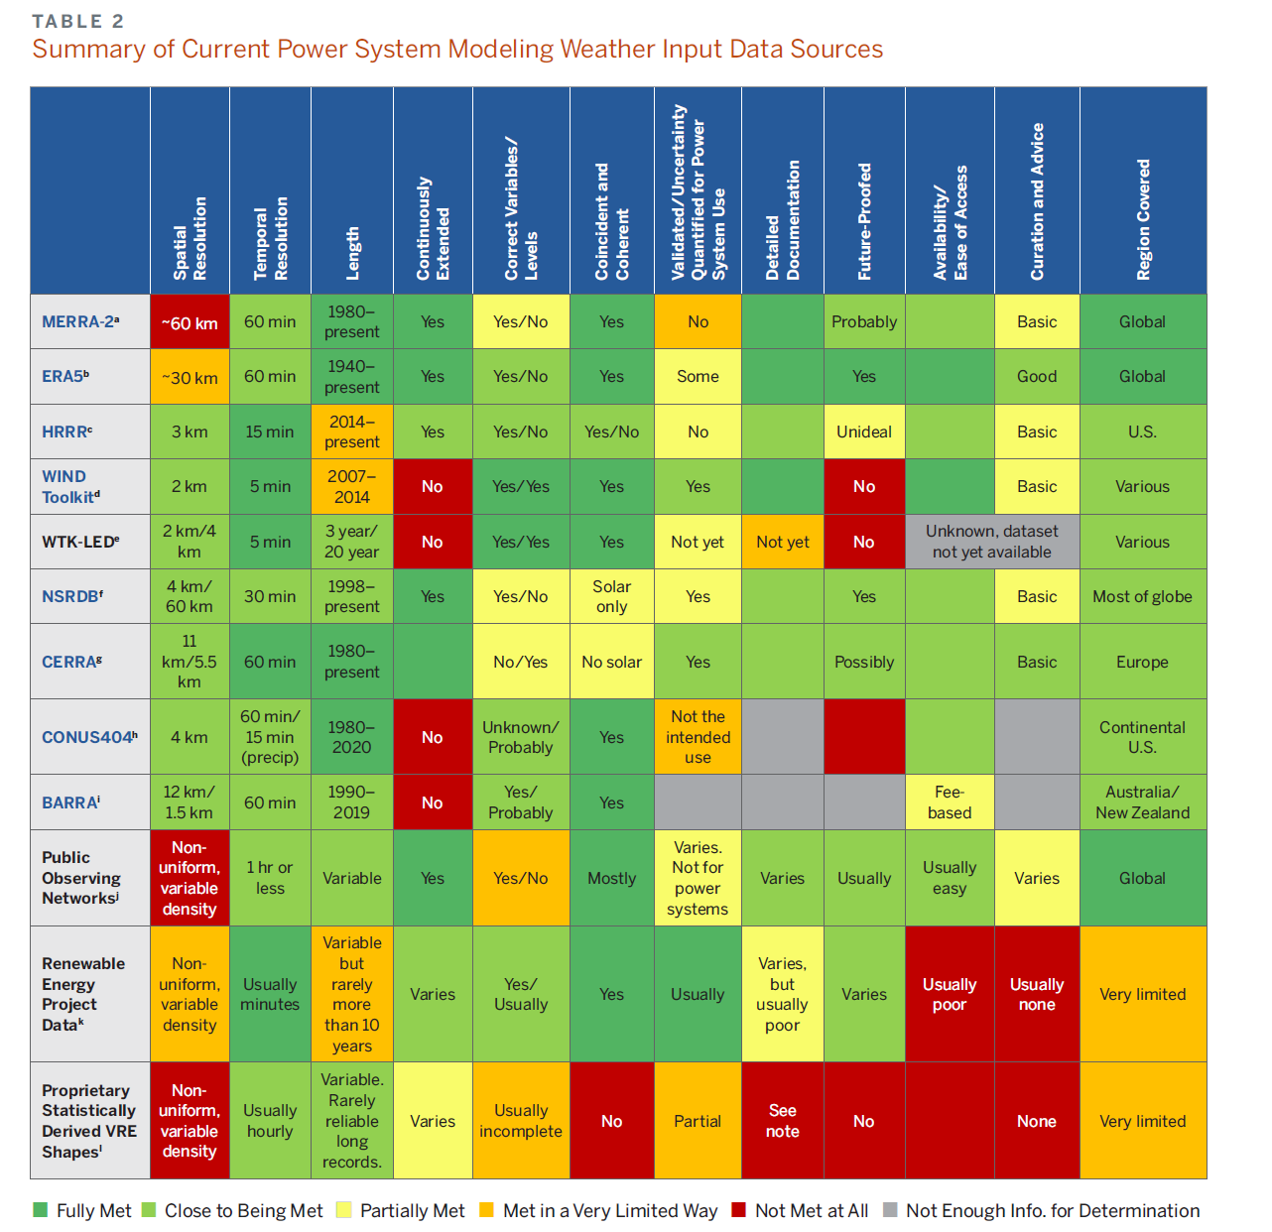
ESIG Report (10/2023)
“These widespread changes lead to the increasing weather-dependence of supply and demand, making power system planning dramatically more complex and requiring much more comprehensive weather data for robust system planning.”
“The work required to achieve a long-term solution to weather data needs is not trivial, but it is manageable and is much less costly than blindly building trillions of dollars of infrastructure without the basic tools to cost effectively optimize it and assess its reliability.”
PowerWorld had started working in planning weather integration about a year before the ESIG report appeared, but much progress has been made in the last year
39

Slide 41
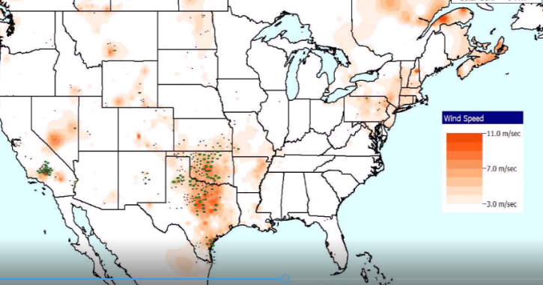
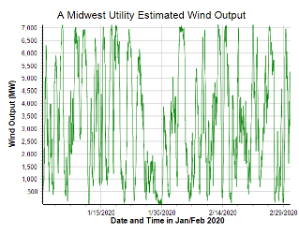
Weather Resiliency Example: Renewable Resource Droughts
With the rapid growth in wind and solar resources, a growing concern is how to handle wind and solar “droughts” with the generic term of renewable resource droughts used to describe them
The below example is a wind drought that occurred in the Midwest in late January 2020

Slide 42
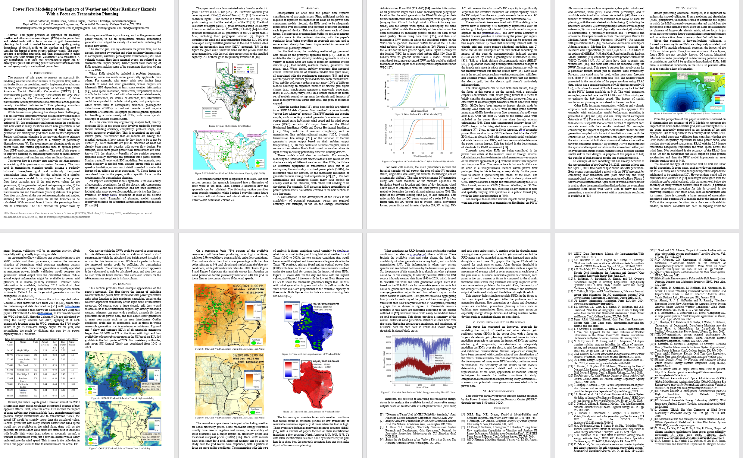
HICSS 2025 Paper on Power Flow Weather Modeling
There is a paper from the 59th Hawaii International Conference on System Sciences (HICSS) titled, “Power Flow Modeling of the Impacts of Weather and Other Resiliency Hazards With a Focus on Transmission Planning,”; it is available at overbye.engr.tamu.edu/publications
41

Slide 43
Some Strategies to Prepare:
Component Hardening, Physical Security
Electric grids are comprised of components, and resiliency can be enhanced by hardening particularly vulnerable components
  Transmission lines in likely icing location, undergrounding some lines, transformers with better handling of geomagnetically induced currents (GICs), water protection
  This needs to be done considering the cost versus benefit
  Vegetation management should also be considered
Physical security is an area of increased concern, with unmanned aerial vehicles being a fast rising threat

Slide 44
Enhancing Bulk Grid Simulations to Handle HILF Scenarios
The stressed operation associated with the high impact, low frequency events presents modeling challenges
Luckily, over the last several years the software is being enhanced to deal with these situations
  My next presentation goes in-depth on geomagnetic disturbance (GMD) and high altitude electromagnetic pulse (HEMP) modeling
There is also a need to consider high voltage transmission system design that lessens the likelihood of cascading outages
Improving situational awareness during times of extreme grid stress is key

Slide 45
Adaptive Islanding
One promising resiliency technique is to design interconnected grids to split (island)
  This is known as controlled islanding and can be enhanced to be adaptive islanding
  A distribution system example is a microgrid
The islands need to be chosen so they have sufficient generation to match load
Often control is still centralized
A more involved islanding issue is to setup the grid so smaller parts can function with full autonomy

Slide 46
Resiliency and Coupled Infrastructures
As our societies become more dependent on electricity, short and small duration blackouts become more concerning, and large-scale, long duration outages can be catastrophic
There are many couplings between electric grids and other infrastructures such as natural gas, water, cyber, and increasing transportation
These couples need to be more fully considered in electric grid resiliency modeling and simulation

