Slide 1
New Developments in GMD Modeling Including Integration of Harmonic Analysis
Thomas J. Overbye
O’Donnell Foundation Chair III
Texas A&M University
overbye@tamu.edu
SERC GMD Working Group
August 2025

Slide 2
Overview
The purpose of this presentation is to show some of the more recent developments associated geomagnetic disturbance (GMD) including the integration of harmonic analysis with traditional GMD analysis
The motivation for this work is geomagnetically induced currents (GICs), whether due to geomagnetic disturbances (GMDs) or High Altitude Electromagnetic Pulses (HEMPs), can cause significant harmonics
These harmonics can trip devices, such as capacitors
These impacts need to be considered in doing GIC analysis
A GIC state estimator is also presented

Slide 3
Acknowledgment
Work presented here has been supported by a variety of sources including PSERC, the Texas A&M Smart Grid Center, U.S. Department of Energy, ARPA-E, NSF, EPRI, US National Labs, PowerWorld, and others. Their support is gratefully acknowledged!
Slides also include contributions from many of my students, postdocs, staff and colleagues at TAMU, and at PowerWorld Corporation

Slide 4
My Background in GMD Analysis
Professor at Texas A&M since 2017; previously at UIUC for 25 years
  At TAMU I am also the director of the Smart Grid Center (SGC)
I started writing the code that became PowerWorld Simulator in grad school, and am a co-founder of PowerWorld Corporation in 1996 with a goal to make grid analysis as easy as possible
  Since both UIUC and TAMU encourage faculty to do consulting and/or have external business relationships, I have continued to work with the PowerWorld code development including OPF, stability, visualization, GMD, HEMP, and weather
I got involved in GMD modeling in summer 2011, and started implementing it in PowerWorld Simulator shortly thereafter; I’m currently working on harmonics integration with EPRI’s GICHarm

Slide 5
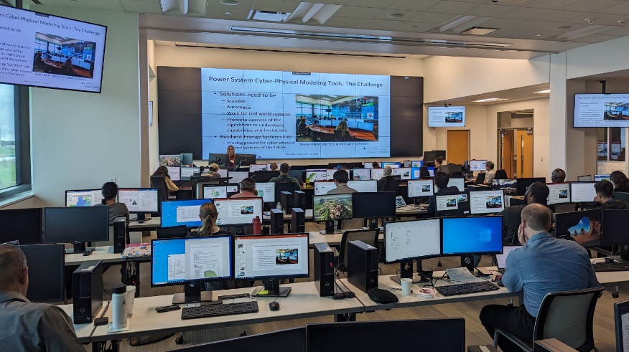
Aside: Texas A&M SGC Electric Power Short Courses
Building on its success from prior semesters, the Texas A&M Smart Grid Center (SGC) will be offering at least three more short courses in Fall 2025 at our control lab/training facility in Bryan TX; more information is at
epg.engr.tamu.edu/short-courses-main/
  Primer on the Planning and Operation
  of Large-Scale Electric Grids
  (September 9 to 11)
  Fundamental of Electric Transmission
  Planning (October 7 to 9)
  Introduction to Artificial Intelligence
  in Power Systems (November 4 to 6)

Slide 6
Electric Grid Resiliency and High-Impact, Low Frequency (HILF) Events
While reliability has been an important aspect of grid operations for years, recently there is also a focus on resiliency, including being able to manage what are known as High-Impact, Low-Frequency (HILF) events
  Others call them black sky days or
  severe resiliency events (SREs)
HILFs identified by NERC were
1) a coordinated cyber, physical or
blended attacks, 2) pandemics,
3) geomagnetic disturbances (GMDs),
and 4) High Altitude Electromagnetic Pulses (HEMPs)
Image Source: NERC, 2012

Slide 7
What is Grid Resilience?
Merriam Webster Dictionary (resilience in general)
  “An ability to recover from or adjust easily to misfortune or change”
EPRI & North American Transmission Forum (NATF)
  The ability of the system and its components (… equipment and human …) to minimize damage and improve recovery from non-routine disruptions, including High Impact, Low Frequency (HILF) events, in a reasonable amount of time”
The impact of blackouts is not linear!
  Having 100 million people out of service can be more than tens times worse than 10 million out. A ten day blackout can be more than tens times worse than a one day blackout.
These definitions are from the 53rd North American Power Symposium keynote address by Dan Smith of Lower Colorado River Authority, November 2021

Slide 8
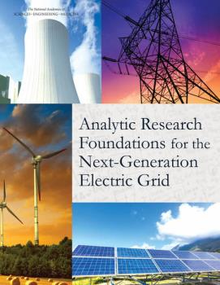
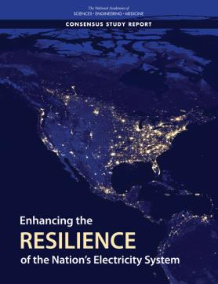
Several Recent Reports on Resiliency
Analytic Research Foundations for the Next-Generation Electric Grid, 2016
  Make everything as simple as possible but not simpler [maybe from Einstein]
Enhancing the Resilience of the Nation’s Electricity System, 2017
US Department of Energy Transmission Innovation Symposium, 2021
  www.energy.gov/oe/transmission-innovation-symposium
T.J. Overbye, K.R. Davis, A.B. Birchfield, “The Electric Grid and Severe Resiliency Events.” National Academy of Engineering Bridge Journal, vol. 53, no. 2, 2023, pp. 73-79, June 2023.
Focus here is on one group of HILFs: GMDs

Slide 9
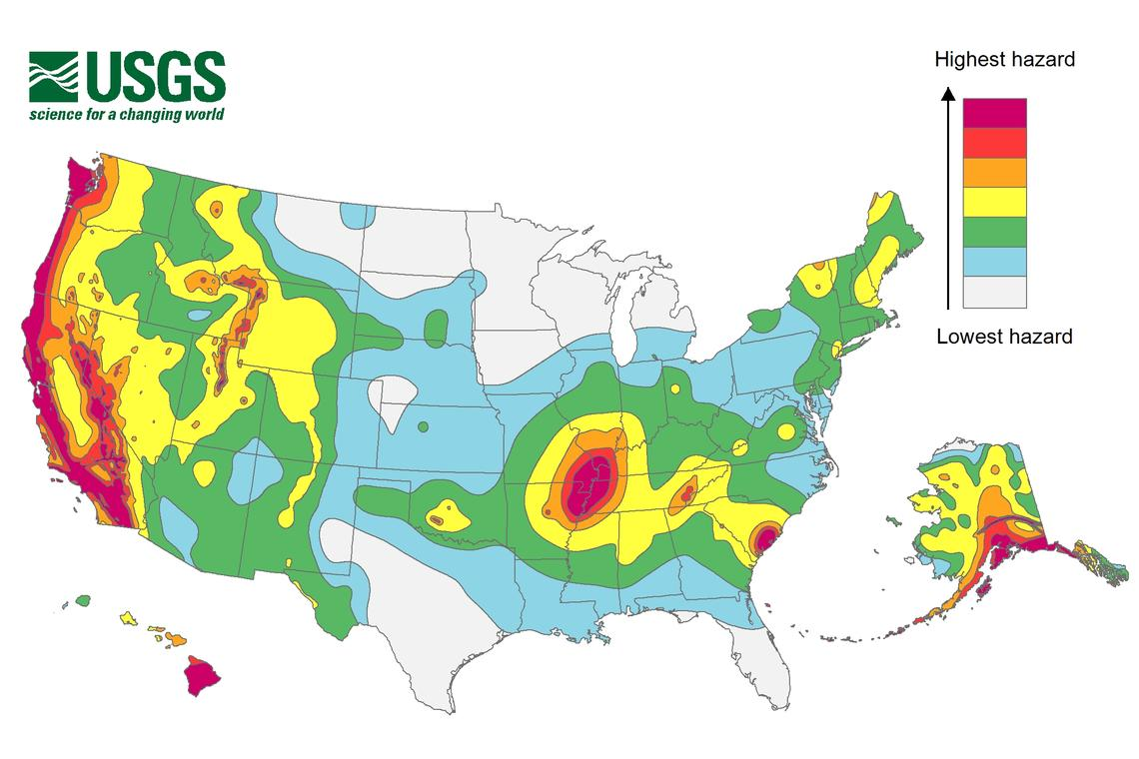
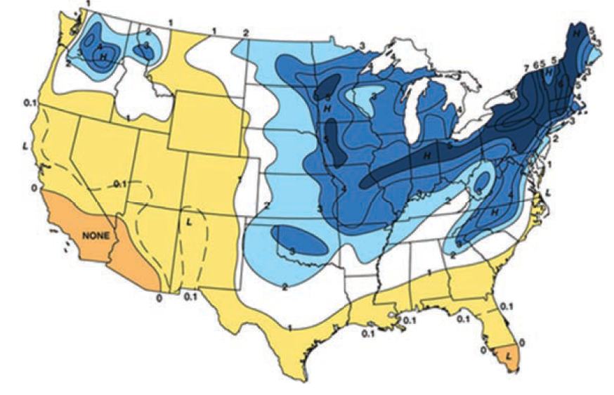
Resilient to What?
A key question on resiliency is to determine the likely threats
  Some are geographic, and may are hard to quantify
Earthquake Risk
Freezing Rain Risk
The impact of wind and solar output on the weather is also a growing concern
Source: Enhancing the Resilience of the Nation’s Electricity System, 2017

Slide 10
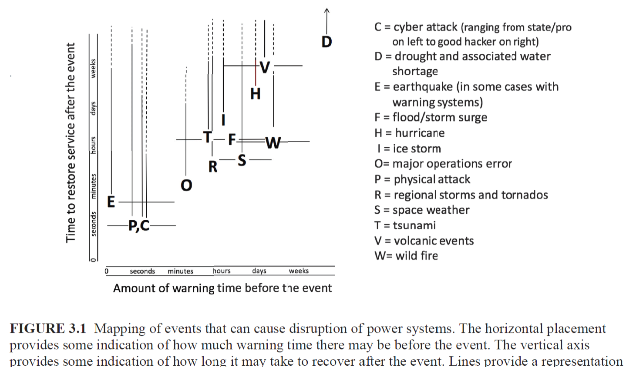
Some Electric Grid Risks
Source: Enhancing the Resilience of the Nation’s Electricity System, 2017

Slide 11
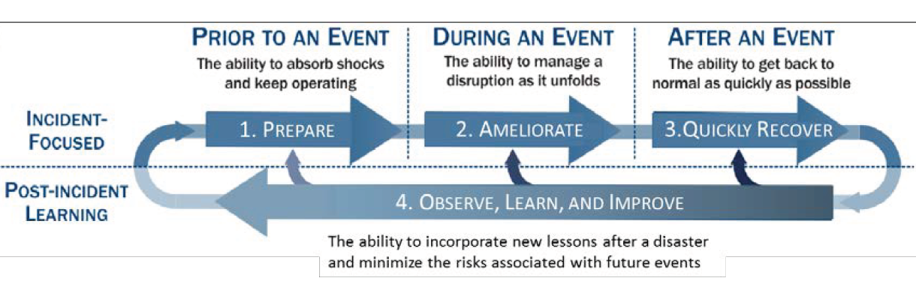
Major Considerations with Resiliency
Understanding, and ultimately enhancing resiliency, requires consideration during three periods
  Prior to an event
  During an event
  After an event
All three require
planning
ahead of time and
flexibility
as events unfold
This is presented as Figure 1.2a in the National Academies’ Enhancing the Resilience of the Nation’s Electricity System report (2017), and is originally from
S.E. Flynn, “America the resilient: Defying terrorism and mitigating natural disasters.” Foreign Affairs, vol. 87: 2–8 (2008) and as illustrated by the National Infrastructure Advisory Council (NIAC) in 2010.

Slide 12
How to Approach HILF Events
The goal in studying HILFs is seldom to replicate a specific event
  Many have not occurred, and within each class there can be great variability (e.g., a physical attack)
Nor is it to ensure there is no loss of service
Rather, it is to be broadly prepared, and to be able to do at least a reasonable cost/benefit analysis
HILF simulations can help in preparing for the unexpected, allowing plans to be developed for all levels of events
Several techniques, such as improved control room rare event situational awareness and better black start procedures, are generally applicable

Slide 13
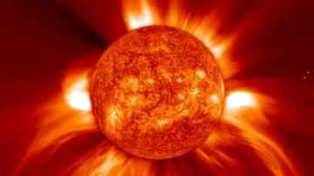
Geomagnetic Disturbances (GMDs)
GMDs are caused by solar corona mass ejections
(CMEs) impacting the earth’s magnetic field
  CMEs come in different sizes, and they may not be
  directed towards the earth
  Largest GMD in the last 200 years was in 1859;
  it is known at the Carrington Event and caused Northern Lights as far south as Mexico and Hawaii; an 1859 article in American Journal of Science is at
    babel.hathitrust.org/cgi/pt?id=uva.x001679510&view=1up&seq=405
  A GMD caused a blackout in 1989 of Quebec
  They have the potential to severely disrupt the electric grid by causing quasi-dc geomagnetically induced currents (GICs) in the high voltage grid

Slide 14
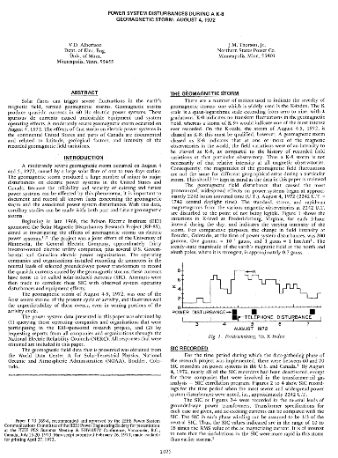
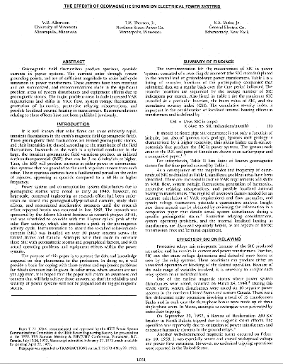
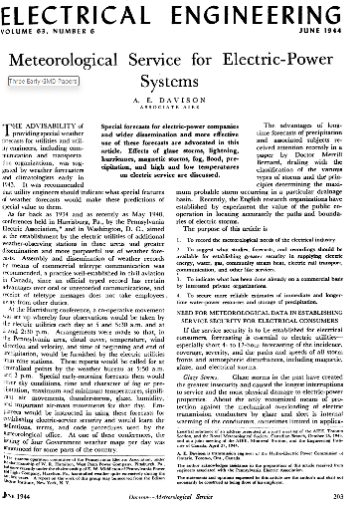
Three Early GMD Papers

Slide 15
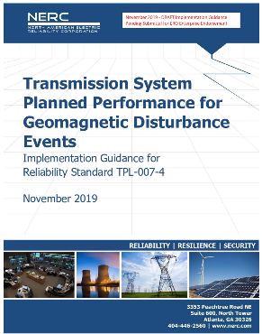
GMDs and Planning
GMD assessment tools have moved into the realm of planning and operations
NERC now has planning standards in the area,
with TPL-007-4 (Transmission Planned
Performance for Geomagnetic Disturbance Events)
establishing requirements for the planned
performance of the bulk electric system during GMDs
Planning challenge is what to do, if anything,
beyond the standards. That is, what would you do if
a GMD of magnitude xx occurred?
Source: www.nerc.com/pa/Stand/Reliability%20Standards/tpl-007-4.PDF

Slide 16
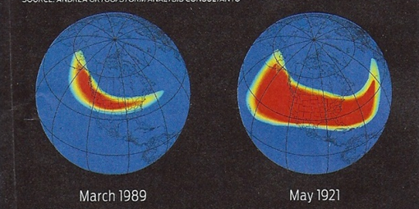
GMD and the Grid Planning
Large solar corona mass ejections (CMEs) can cause large changes in the earth’s magnetic field (i.e., dB/dt). These changes in turn produce a non-uniform electric field at the surface
  Changes in magnetic flux are often given in nT per minute; from a 60 Hz perspective they are almost dc, with the
  term quasi-dc commonly used
  1989 North America storm produced
  a change of 500 nT/minute, while a
  stronger storm, such as the ones in
  1859 or 1921, could produce
  2500 nT/minute variation
  Storm “footprint” can be continental in scale

Slide 17
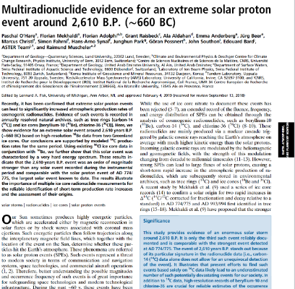
What is the Maximum Possible GMD
Could millions die as some have speculated?
Previously many thought the 1859 Carrington Event was the largest possible
However, a March 2019 article in the
Proceedings of the U.S. National Academy of
Sciences indicates that larger GMDs could
occur, with ice core evidence indicating
potentially much larger events occurring in
775 , 994, and now 2610 BC
We’re still not exactly sure on the largest
potential GMD!
Source: www.pnas.org/content/early/2019/03/05/1815725116

Slide 18
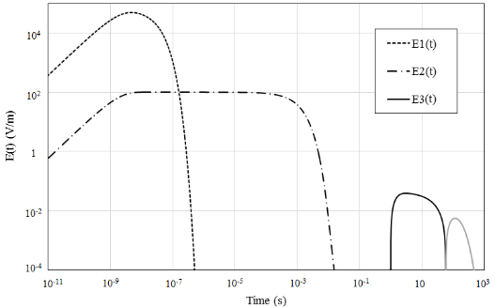
Magnetic Field Variations Due to HEMPs
Another way the earth’s magnetic field could be perturbed would be by a high altitude nuclear explosions, causing what are known as a high altitude electromagnetic pulses (HEMPs)
The impacts of an HEMP
are typically divided into
three time frames:
E1, E2 and E3
  E1 impacts electronics,
  E2 is similar to
  lightning, E3 is similar
  to a very large, but short duration GMD

Slide 19

Nuclear EMP History: Starfish Prime
Starfish Prime was an explosion of a 1.44 megaton nuclear weapon at an altitude of 400 km over the Pacific Ocean in July 1962
  Part of series of tests known as
  Operation Fishbowl
  The EMPs were much larger than
  expected, driving instruments off scale
  Impacts seen in Honolulu (1445 km
  away), including knocking out about
  300 streetlights, setting off alarms, and
  damaging a microwave link
  Some low earth orbit satellites were
  also damaged
Starfish Prime observed on Maui in 1962: Source: US EMP Commission Report from July 2017 [a]; from Los Alamos Lab
[a] apps.dtic.mil/sti/pdfs/AD1051492.pdf

Slide 20
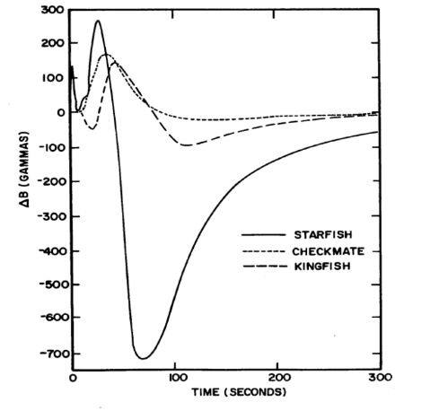
Measured Change in the Earth’s Magnetic Field During Fishbowl Tests
Checkmate and Kingfish were nuclear tests that were part of Operation Fishbowl. A gamma is one nT. For reference the Quebec GMD had 500 nT/minute and the 1859 Carrington GMD event is estimated have had a variation of perhaps 2500 nT/minute
The focus of this class is on GMD, but some of the techniques can also be used with HEMP analysis
Image: 1985 ORNL “Study to Assess the Effects of Magnetohydrodynamic Electromagnetic Pulse on
Electric Power Systems Phase I Final Report,” May 1985, Figure 1

Slide 21
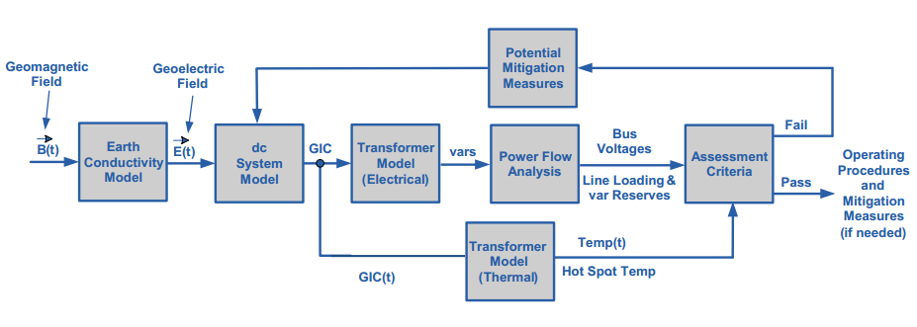
Power Flow GIC Impact Analysis
Starting in 2011 power flow packages have gradually gained the ability to model the impacts of GICs, first in the power flow, and later its time-domain stability analysis
  Initially this was limited to uniform magnitude and direction electric fields, but now a variety of time and spatially varying fields are supported
  The NERC diagram
  shows the overall
  process
This talk will add
an additional
feedback loop for
harmonic analysis

Slide 22
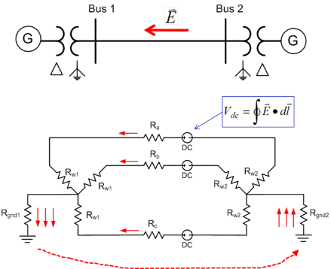
Geomagnetically Induced Currents (GICs)
GMDs cause slowly varying electric fields
Along length of a high voltage transmission line, electric fields can be modeled as a dc voltage source superimposed on the lines
These voltage sources produce quasi-dc
geomagnetically induced currents (GICs)
that are superimposed on the ac
(60 Hz) flows
Assuming a known electric field,
calculating the GICs is computationally
very straightforward since it involves
solving a linear system

Slide 23
GICs, Generic EI, 5 V/km East-West

Slide 24
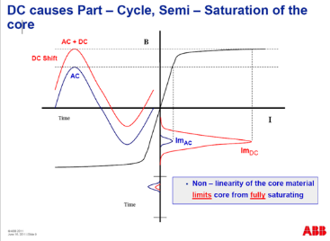
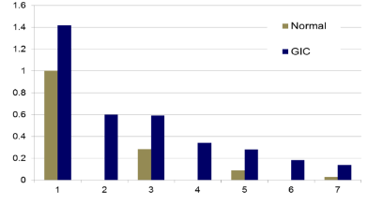
Transformer Impacts of GICs
The GICs superimpose on the ac current, causing transformers saturation for part of the ac cycle
This can cause large harmonics; in the positive sequence these harmonics can be represented by increased reactive power losses in the transformer
  The impact of these harmonics can now be considered in GIC analysis, something will be introduced in a few slides
Harmonics
Images: Craig Stiegemeier and Ed Schweitzer, JASON Presentations, June 2011

Slide 25
GMD Enhanced Power Analysis Software
By integrating GIC calculations directly within power flow and transient stability engineers can see the impact of GICs on their systems, and consider mitigation options
GIC calculations use many of the existing model parameters such as line resistance. Some non-standard values are also needed; either provided or estimated
  Substation grounding resistance
  transformer grounding configuration, transformer coil resistance, whether auto-transformer, three-winding transformer, etc.

Slide 26
Overview of GMD Assessments
It is a quite interdisciplinary problem
Other considerations
The two key concerns from a big storm are 1) large-scale blackout due to voltage collapse, 2) permanent transformer damage due to overheating

Slide 27
Adding Harmonic Analysis to GIC Calculations
Standard power flow GIC analysis involves
  Using an assumed electric field, calculate the GICs
  Solve a GIC-enhanced power flow in which the transformer reactive power losses include a GIC dependent component
With harmonic analysis this can optionally become
  Using an assumed electric field, calculate the GICs
  Solve a GIC-enhanced power flow, in which the transformer reactive power losses include a GIC dependent component
  Calculate the harmonics, with bus voltage total harmonic distortion (THDv) key
  Determine if any devices (e.g., capacitors) need to be outaged; if so, remove them and goto to 1; otherwise done

Slide 28
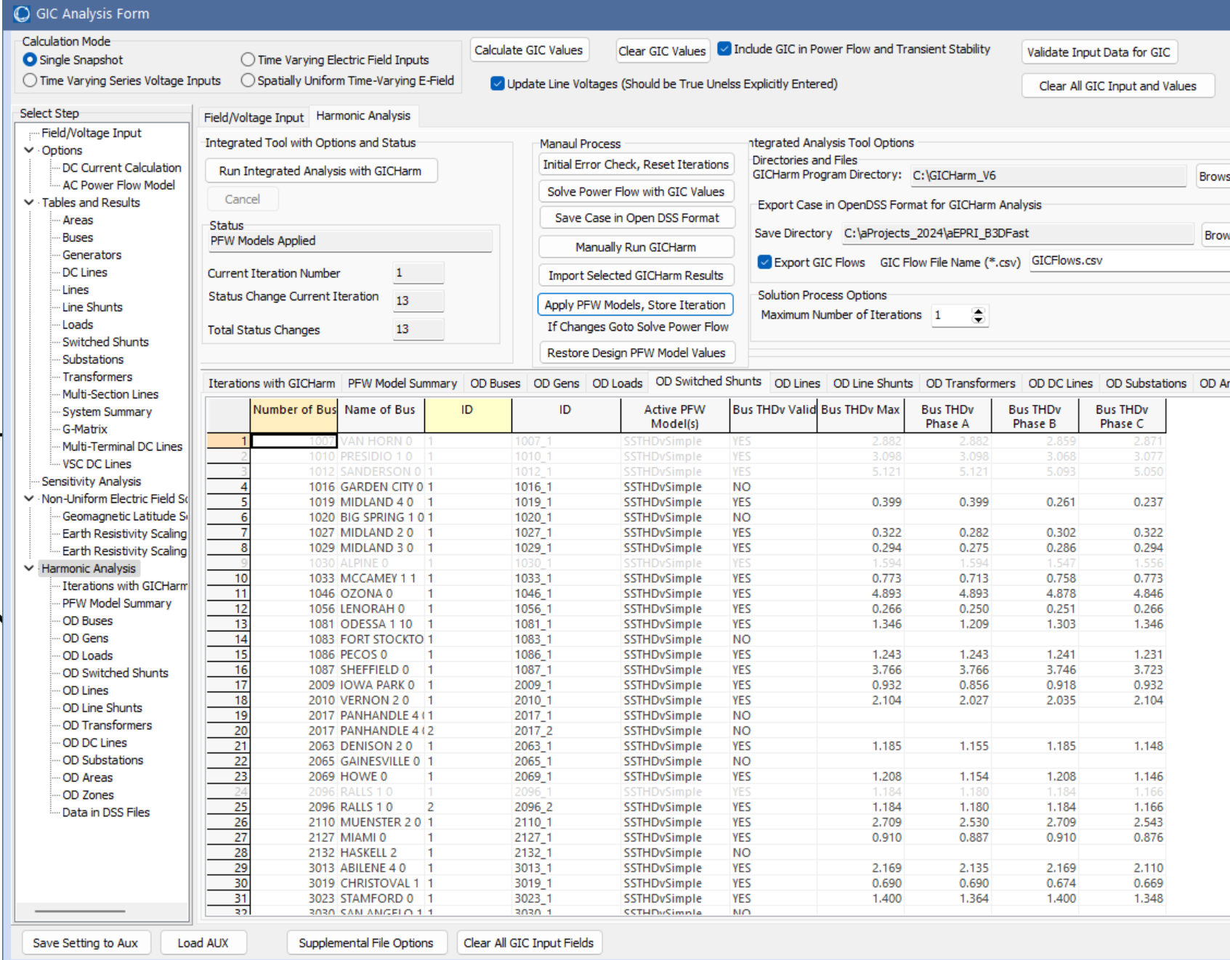
Integrated Harmonic Analysis in PowerWorld Simulator
The Simulator GIC Analysis
Form now has a page to
make this process fully
automatic
  A manual process is also
  provided to help in the initial
  setup of a simulation
  Scripting commands will be
  added in the new future
This requires GICHarm
be installed on the
computer

Slide 29
Background: Electric Grid Harmonics
Large-scale electric grids usually operate at 50 or 60 Hz for their fundamental frequency
  Smaller systems (e.g., aircraft) operate at higher frequencies, which has advantages in for devices such as generators and motors
  However, inductive reactance increases linearly with frequency, so higher frequencies are not practical for large-scale grids
Integer multiples of the fundamental frequency are known as harmonics; harmonics have always been present in grids
Harmonics can be created in different ways, including power electronics loads and by GICs causing transformer saturation (the focus here)

Slide 30
Two Useful References
There are several good books on harmonics and the associated topic of power quality
For people looking for a quick overview, a good reference is web.ecs.baylor.edu/faculty/grady/understanding_power_system_harmonics_grady_april_2012.pdf (Grady2012)
A great (and free) document looking at the assessment of the harmonics caused by GMDs is EPRI’s “Assessment Guide: Geomagnetic Disturbance Harmonic Impacts and Asset Withstand Capabilities” (EPRI2019)
  Available at www.epri.com/research/products/000000003002017707

Slide 31
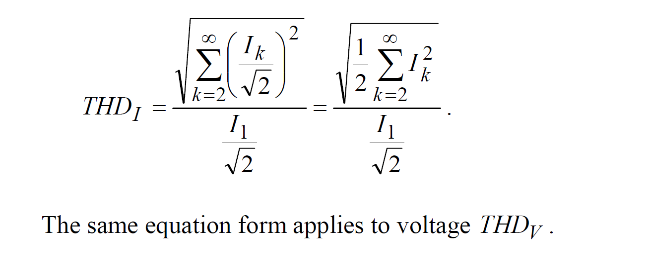
Background: Total Harmonic Distortion (THD)
Total harmonic distortion (THD) is used to quantify the amount of harmonics in a signal; It is defined as the rms value of the harmonics above the fundamental, divided by the rms of the fundamental
  It can be applied to
  currents and voltages
If there are no
harmonics then the
THD is zero
Table from Grady2012

Slide 32
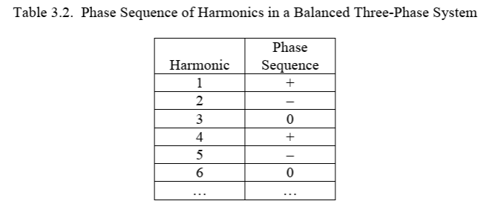
Background: Electric Grid Harmonics
If a grid is balanced then each harmonic has a phase sequence:
Switching devices generate odd harmonics, whereas GICs can also cause even harmonics
Table from Grady2012

Slide 33
Impact of Harmonics
In general harmonics can cause a variety of problems both on the utility side and the customer side. Grady2012 notes 1) resonance, 2) tripping of sensitive loads, 3) blown fuses/device failures, 4) transformer overheating, 5) motor heating, 6) overloaded neutrals, 7) telephone interference
EPRI2019 notes impacts on transformers, shunt capacitors, surge arresters, transmission cables, overhead ac lines, HVDC, SVCs, voltage-source converters (VSCs), wind/solar generation, loads
  “Although capacitors are reasonably robust to harmonics, the tendency for capacitors to amplify harmonic currents and voltages, combined with relatively short thermal time constants, make capacitors arguably the most vulnerable to GMD of the major power system components”

Slide 34
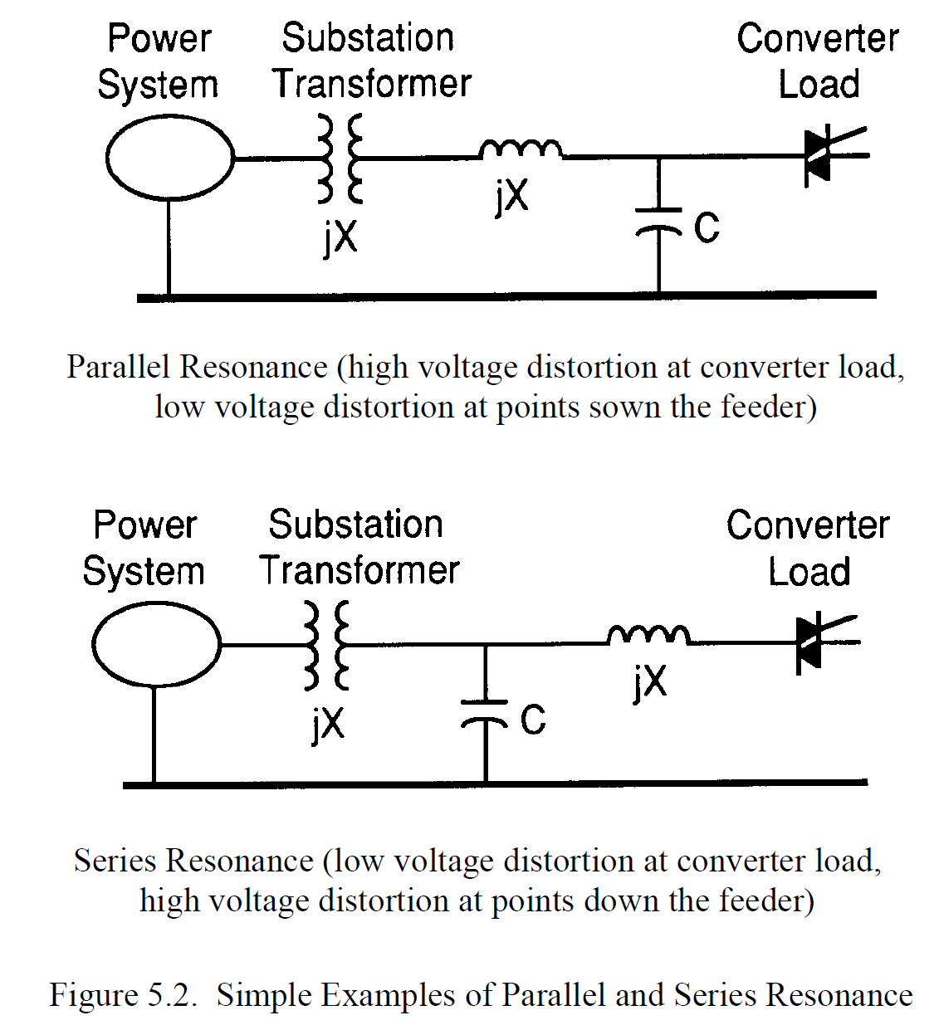
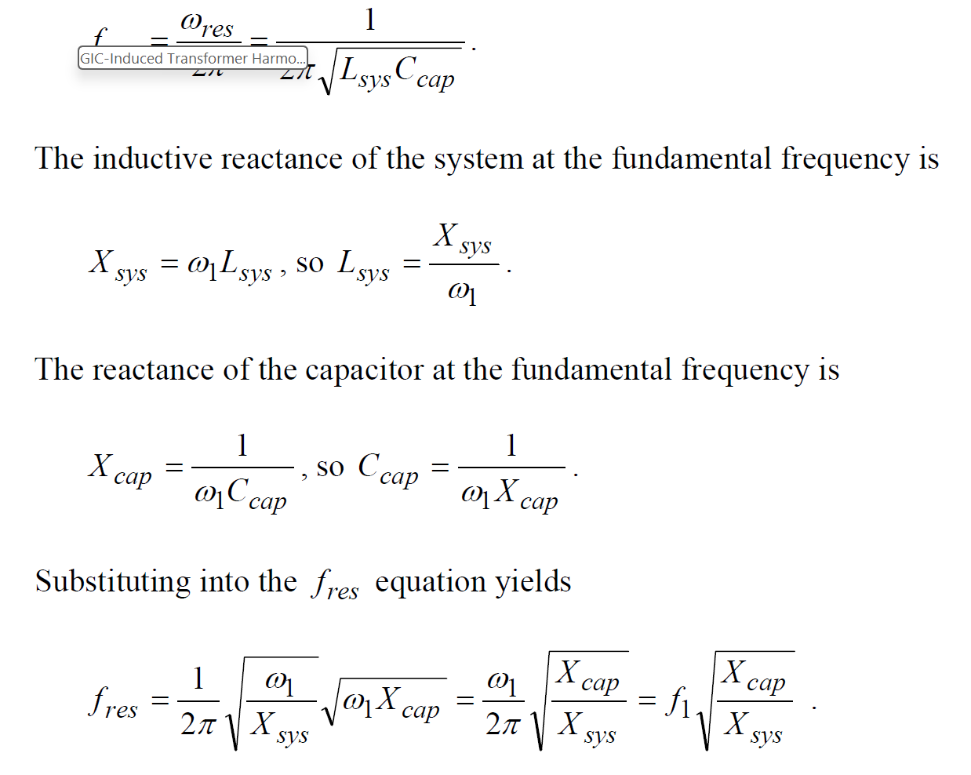
Resonance in LC Circuits
An LC circuit has a resonance
frequency which can amplify the
voltages and currents
Images: Grady2012

Slide 35
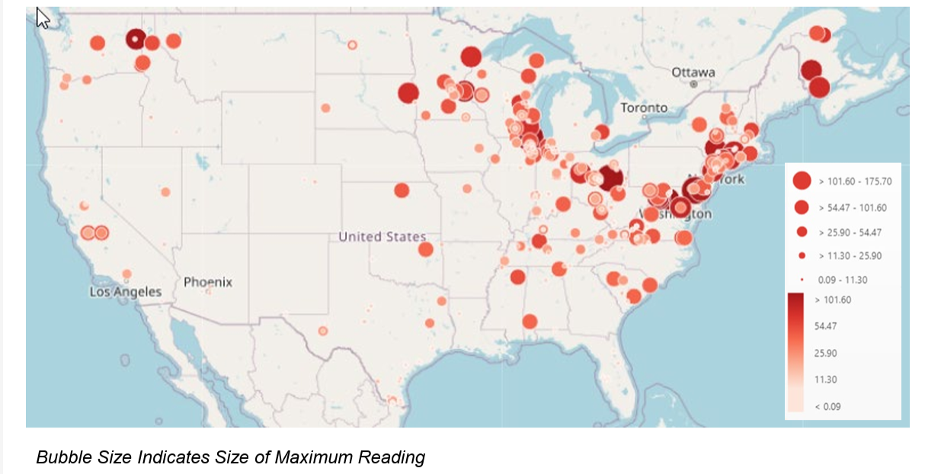
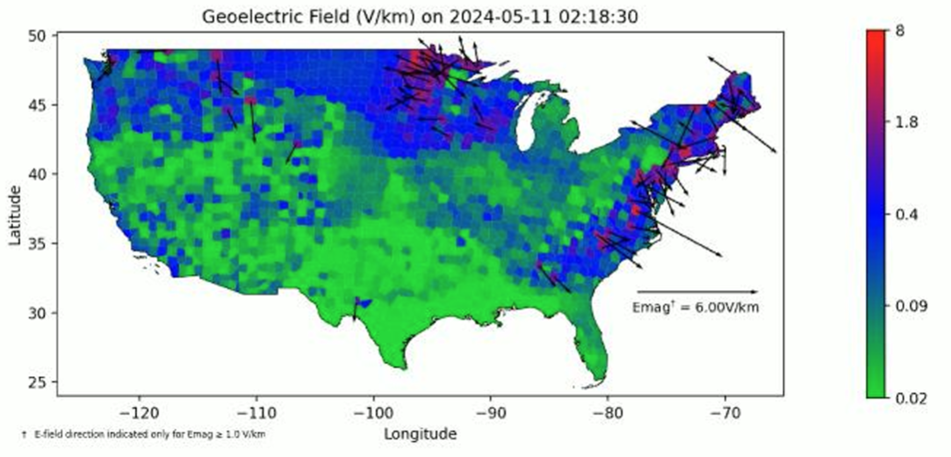
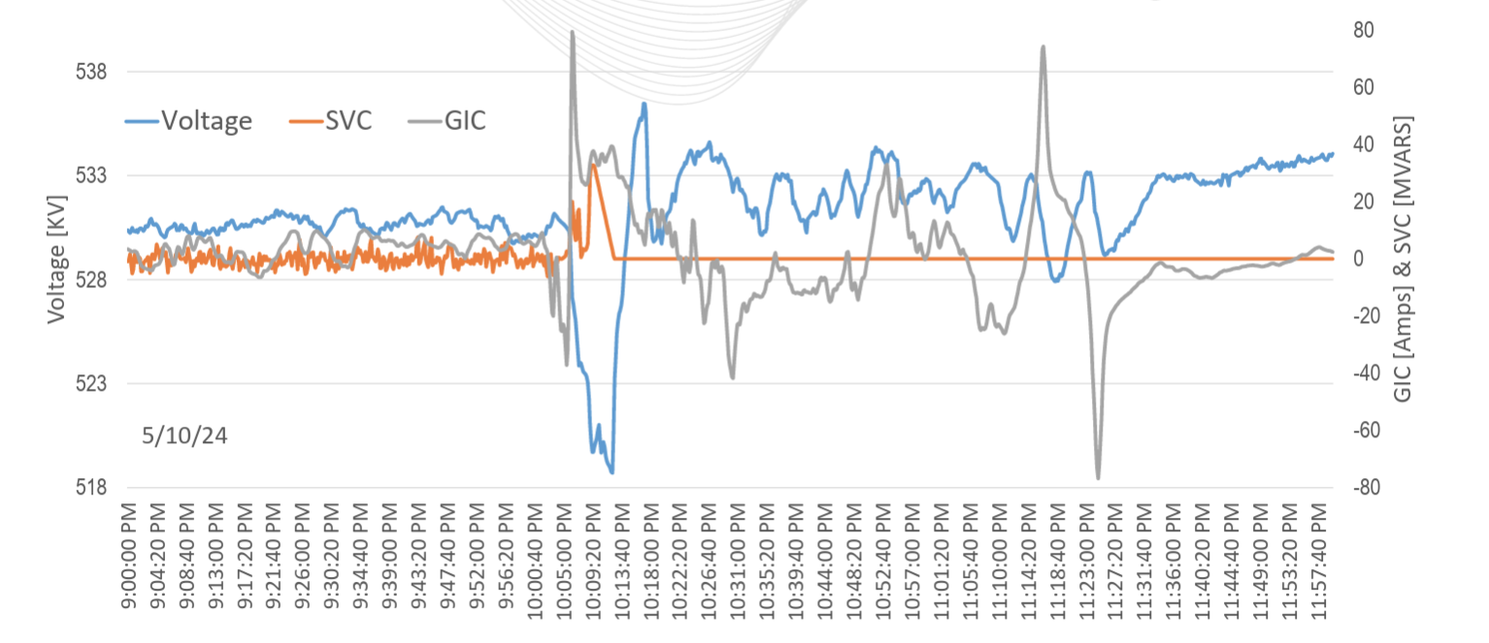
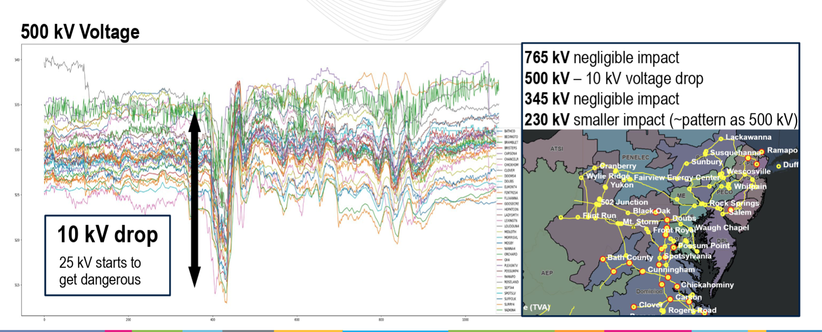
Some Values from the May 2024 GMD
Last year the May 2024 GMD (Gannon Storm) caused GICs of more than 100 amps
  EPRI
  NERC: Total GICs
  PJM, SVC trip
  PJM
Images: www.nerc.com/pa/RAPA/GMD/Documents/October_2024_GMD_Workshop_Materials.pdf

Slide 36
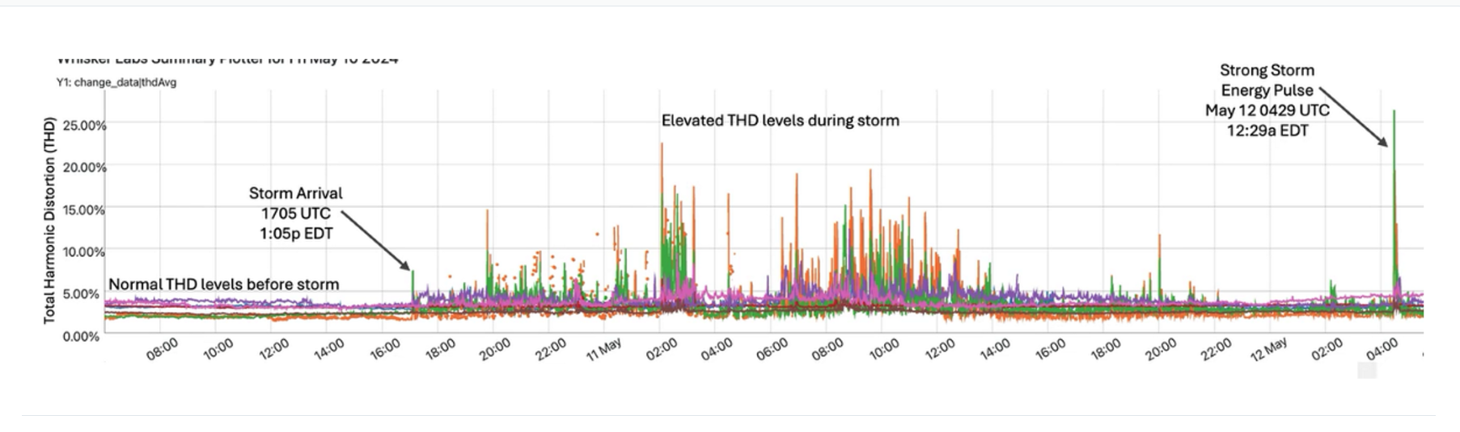
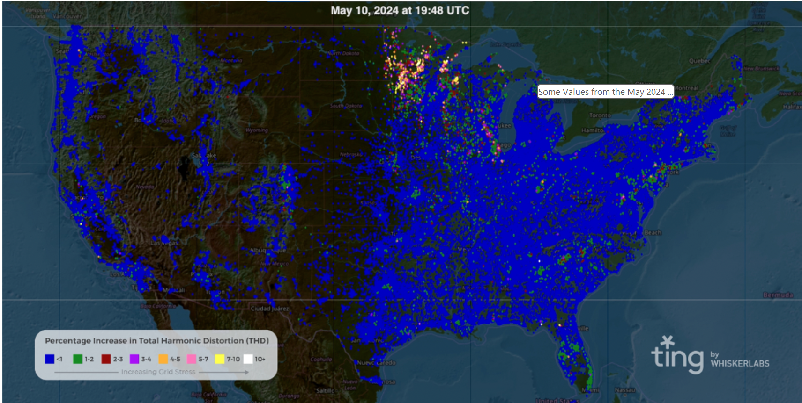
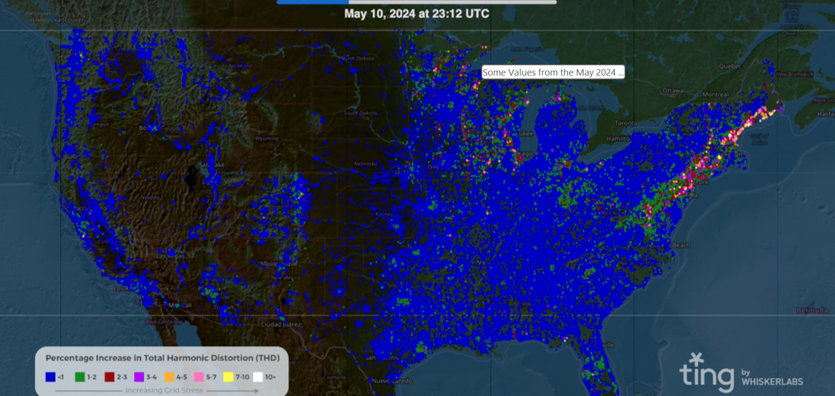
Some Values from the May 2024 GMD, cont.
Various measurements of THDs during the 05/2024 GMD both from utilities and from the Whisker Lab’s Tin Sensor Network
Image sources: www.whiskerlabs.com/analysis-of-total-harmonic-distortion-on-the-us-electric-grid/

Slide 37
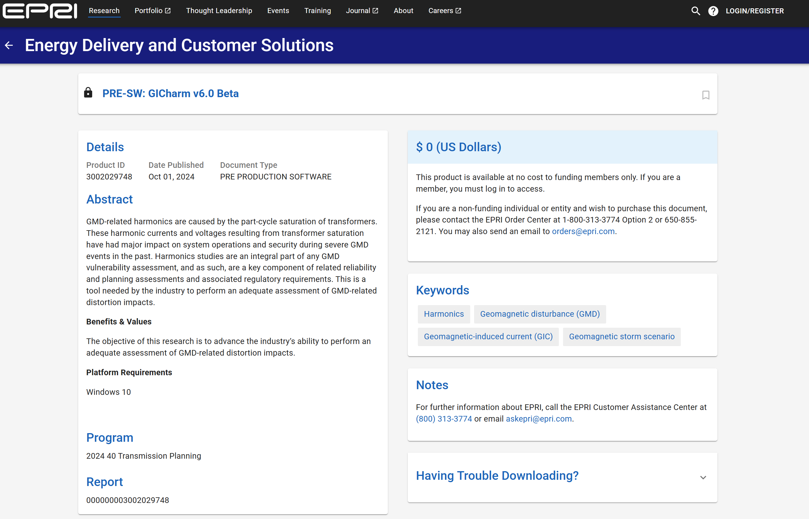
GIC Harmonic Analysis in PowerWorld Simulator
The first step is to install GICHarm (v6), which is available open source from EPRI at epri.com/research/products/000000003002029748
GICHarm requires
EPRI’s OpenDSS (also
open source); just use
the version of OpenDSS
that is included with
the GICHarm download

Slide 38
GIC Harmonic Analysis
Adding harmonic analysis requires performing the following steps
  Solve the power flow with the desired GMD (or HEMP) electric field; the power flow should include models representing the sensitivity of components (e.g., shunt capacitors) to harmonics (e.g., THDv), and should have the ability to store at least the bus THDv values
  Save the power flow model in OpenDSS format
  Use GICHarm to solve for the harmonics
  Load the harmonic information (e.g., bus THDv) into the power flow
  If harmonics are below trip values then done; others trip the associated devices and go to 1.
The PowerWorld GICHarm integration automates this; more at
www.powerworld.com/files/OverbyeGICHarmIntegrationJuly2025.pdf

Slide 39
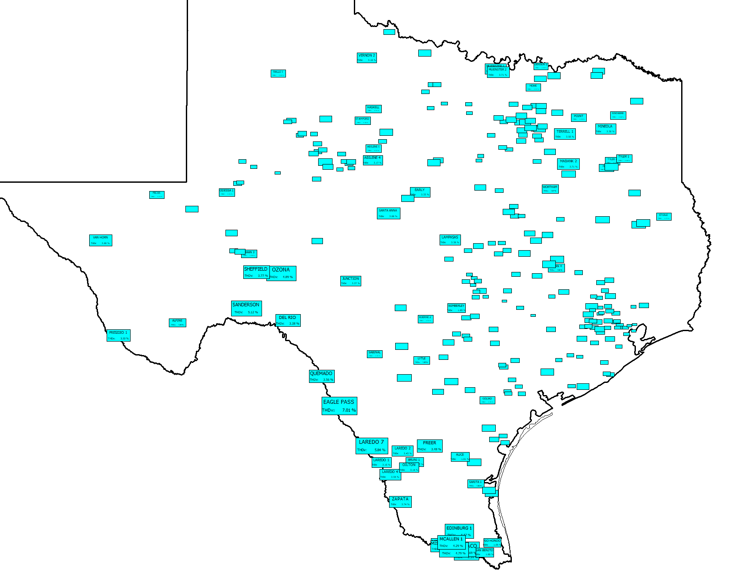
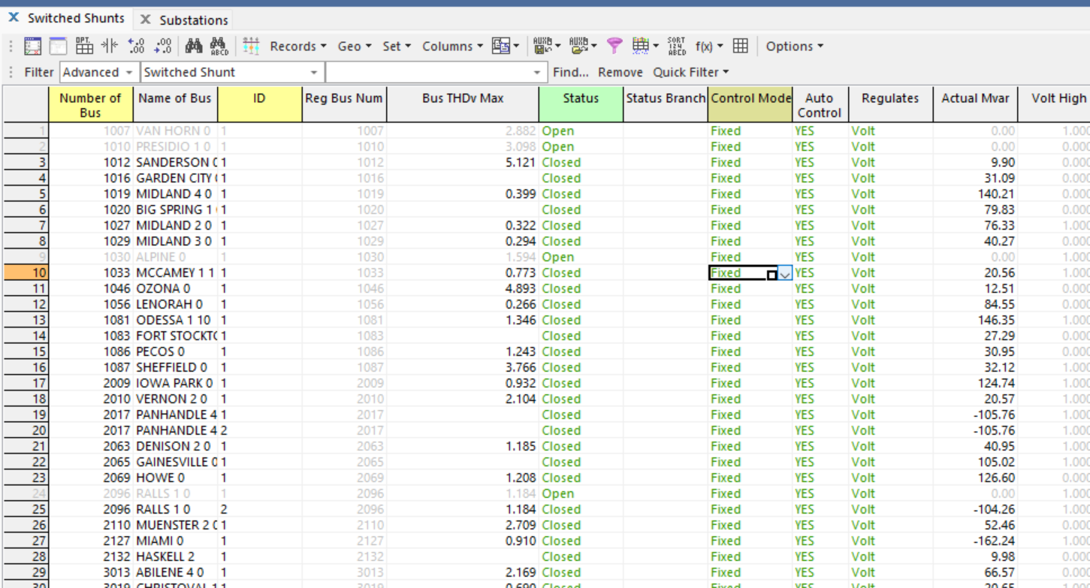
Full Simulator Support of Harmonic Information
Since harmonics is fully integrated into Simulator, all of Simulator’s capabilities are available for the display of the associated information; e.g., case information displays, dialogs, onelines including full geographic data view (GDV) support
  2000 Bus Case, Substation GDV of THDv
  Simulator Case Info Display Showing GICHarm Bus THDv

Slide 40
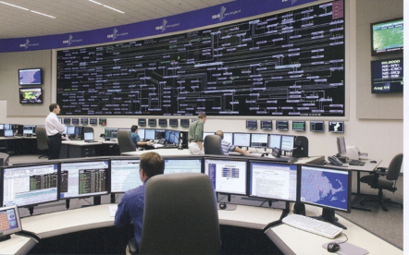
The Impact of a Large GMD
From an Operations Perspective
Maybe a day warning but without specifics
  Satellite at Lagrange point one million miles
  from earth would give more details, but with
  less than 30 minutes lead time
  Could strike quickly; rise time of minutes,
  rapidly covering a good chunk of the continent
Reactive power loadings on hundreds of
high voltage transformers could rapidly rise
Increased transformer reactive loading causes heating issues and potential large-scale voltage collapses; power system software like state estimation could fail; control room personnel overwhelmed
The storm could last for days with varying intensity
ISO New England Control Room

Slide 41
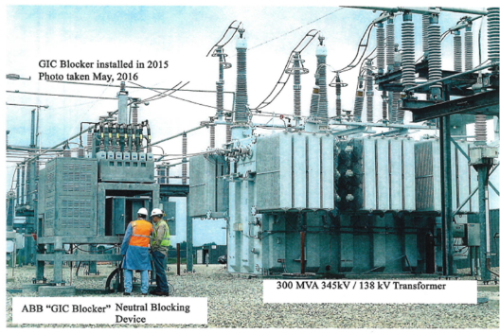
GIC Mitigation
Tools are needed for mitigation strategies
  Cost-benefit analysis
GIC flows can be reduced both
through operational strategies such
as opening lines, and through longer
term approaches (e.g. blocking devices)
Redispatching the system can
change transformer loadings,
providing margins for GICs
Algorithms are needed to provide real-time situational awareness for use during GMDs, with a GIC state estimator being developed

Slide 42
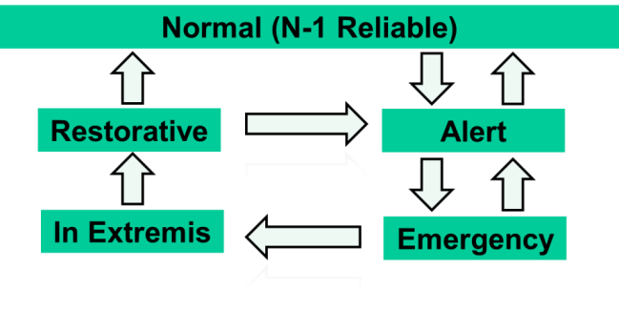
Developing More Specific Operating Procedures
Depending upon the values of different GIC monitors, more specific operating procedures could be developed. For example
  If the GICs on all monitored transformers are below xxx then no action is needed
  If the GICs on some monitored transformers are above [transformer specific limit] then do a specific set of actions (committing generators, switching capacitors, etc.)
  If the GICs on transformer(s) yyy and
  zzz are above [specific limits] then
  “In Extremis” operation is needed including the
  possibility of shutting down part of the grid
  to prevent equipment damage
Developing plans is relatively inexpensive,
but needs to be done well ahead of time.
Image Derived From L.H. Fink and K. Carlsen, “Operating under stress and strain,” IEEE Spectrum, March 1978, pp. 48-53

Slide 43
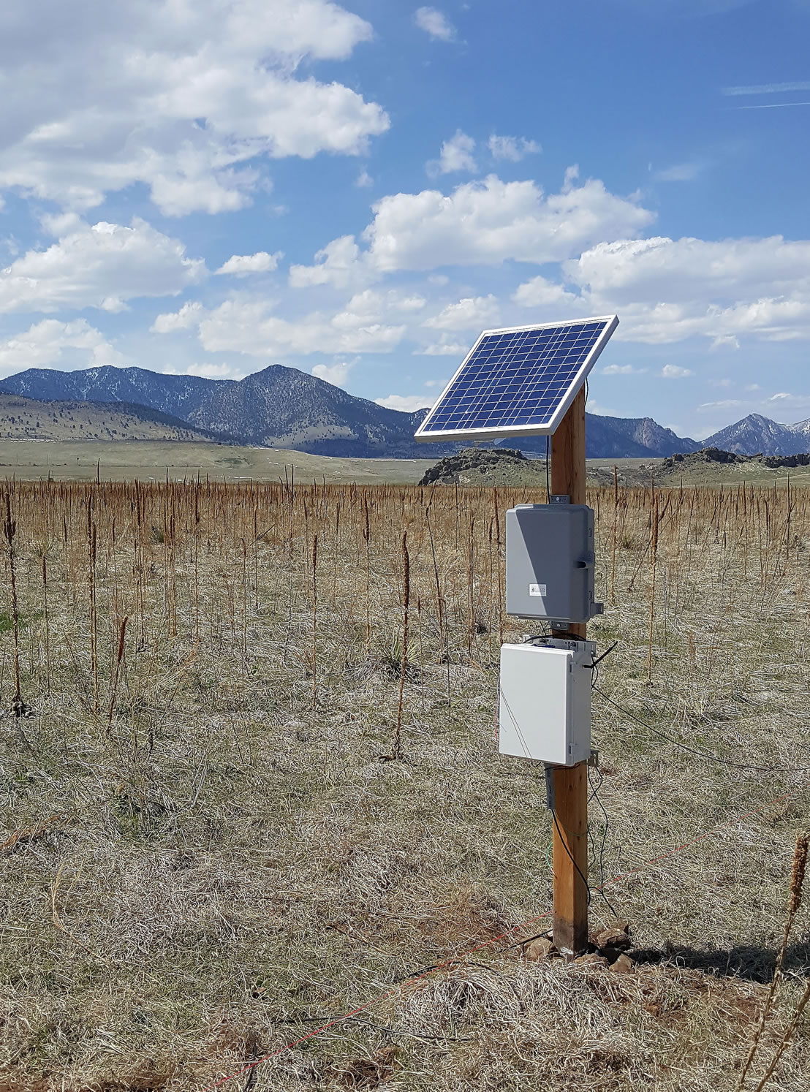
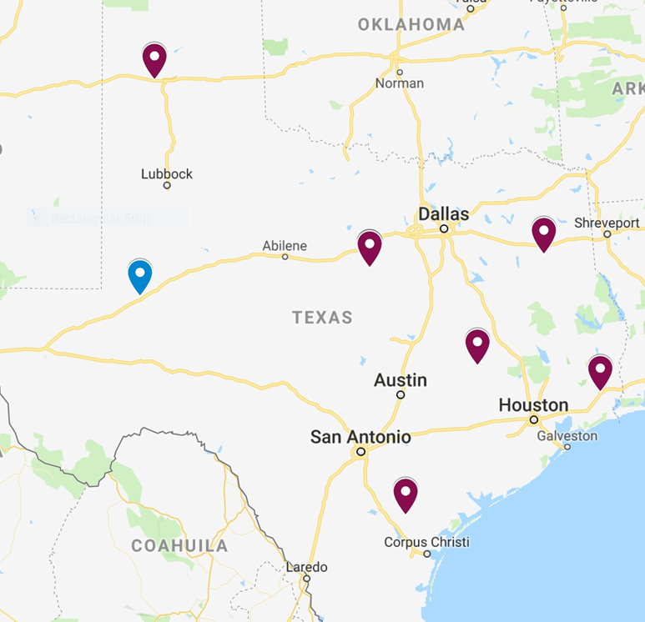
Real-Time Operations Situational Awareness (SA)
A combination of adequate monitoring and timely control can help prevent issues such as voltage collapse, cascading outages (especially under voltage tripping of generators and loads) for many GMDs
  Monitoring will include that of space weather, magnetic fields, and transformer GICs, apart from conventional power system monitoring
Real-time monitoring and
“state estimation” of GIC
related values can be crucial,
with an assumption that these
values may be rapidly varying
Texas A&M Magnetometer Network

Slide 44
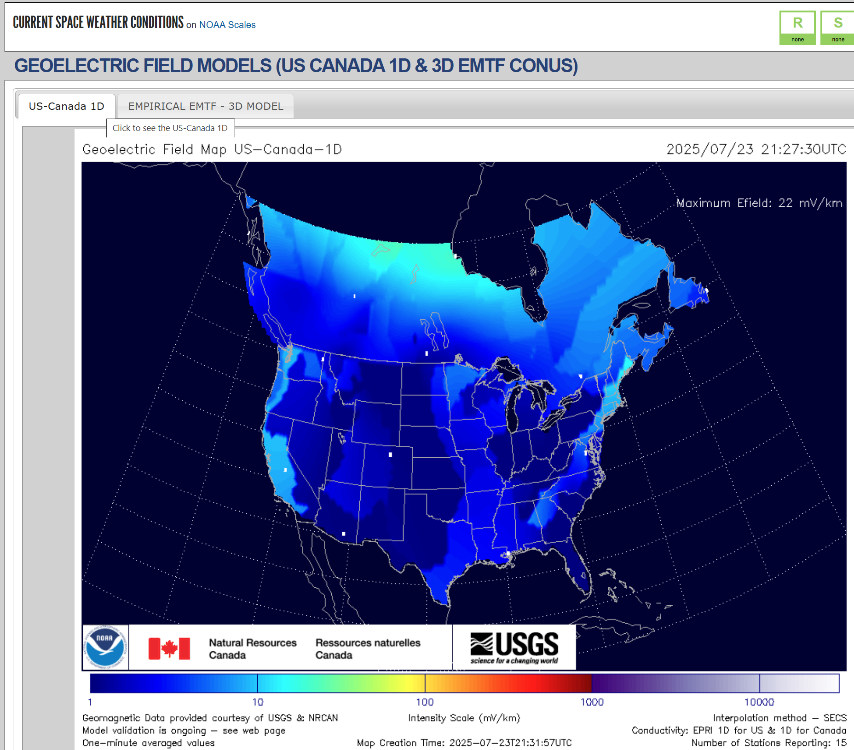
A Proposed GIC State Estimator
Key challenges with operating an electric grid during a GMD are 1) the input electric fields could be rapidly changing, 2) the input electric fields may not be fully known, and 3) there is a lack of real-time GIC measurements
Traditionally in power systems the combi-
nation of real-time measurements with a
model is solved using the state estimator
We are in the process of developing
a GIC state estimator in which the
inputs are the measured GICs and
electric fields (if available), and the
outputs are electric fields in regions

Slide 45
Summary and Future Directions
The electric grid is crucial to societies worldwide, and for decades into the future we will be relying on it
A perfect electric grid is impossible, and we need to be prepared for long-term, wide-area blackouts
However, much can and should be done to reduce to reduce this risk
This presentation has focused on GMDs including the integration of harmonic analysis with traditional GMD power flow
The results are promising, but more research is needed to develop the best approaches for doing this integration in a computationally tractable manner

