Slide 1
ECEN 615 Methods of Electric Power Systems Analysis
Lecture 7: Advanced Power Flow
Prof. Tom Overbye
Dept. of Electrical and Computer Engineering
Texas A&M University
overbye@tamu.edu

Slide 2
Announcements
Start reading Chapter 7 (the term reliability is now often used instead of security)
Homework 2 is due on Thursday Sept 25

Slide 3
Homework comments
You can do the program in the language of your choice.
An open source alternative to Matlab is Scilab (scilab.org).
One approach to developing code is to start small, get it working, then expand (start with solving a two bus power flow).
A singular Jacobian indicates too many unknowns. For example, with a two bus, one line dc power flow with z = j0.1 and bus 1 the slack, then
2

Slide 4
LU Algorithm Without Pivoting Processing by row
We will use the more common approach of having ones on the diagonals of L. Also in the common, diagonally dominant power system problems pivoting is not needed. The below algorithm is in row form (useful with sparsity!)
For i := 2 to n Do Begin // This is the row being processed
For j := 1 to i-1 Do Begin // Rows subtracted from row i
A[i,j] = A[i,j]/A[j,j] // This is the scaling
For k := j+1 to n Do Begin // Go through each column in i
A[i,k] = A[i,k] - A[i,j]*A[j,k]
End;
End;
End;
3

Slide 5
Forward Substitution
Forward substitution solves with values in b being over written (replaced by the y values) For i := 2 to n Do Begin // This is the row being processed
For j := 1 to i-1 Do Begin
b[i] = b[i] - A[i,j]*b[j] // This is just using the L matrix
End;
End;
4

Slide 6
Backward Substitution
Backward substitution solves (with values of y contained in the b vector as a result of the forward substitution)
For i := n to 1 Do Begin // This is the row being processed
For j := i+1 to n Do Begin
b[i] = b[i] - A[i,j]*b[j] // This is just using the U matrix
End;
b[i] = b[i]/A[i,i] // The A[i,i] values are <> 0 if it is nonsingular
End
5

Slide 7
Computational Complexity
Computational complexity indicates how the number of numerical operations scales with the size of the problem
Computational complexity is expressed using the “Big O” notation; assume a problem of size n
Adding the number of elements in a vector is O(n)
Adding two n by n full matrices is O(n²)
Multiplying two n by n full matrices is O(n³)
Inverting an n by n full matrix, or doing Gaussian elimination is O(n³)
Solving the traveling salesman problem by brute-force search is O(n!)
6

Slide 8
Computational Complexity
Knowing the computational complexity of a problem can help to determine whether it can be solved (at least using a particular method).
Scaling factors do not affect the computation complexity
an algorithm that takes n³/2 operations has the same computational complexity of one the takes n³/10 operations (though obviously the second one is faster!)
With O(n³) factoring a full matrix becomes computationally intractable quickly!
A 100 by 100 matrix takes a million operations (give or take)
A 1000 by 1000 matrix takes a billion operations
A 10,000 by 10,000 matrix takes a trillion operations!
7

Slide 9
MATPOWER
While 615 mostly uses PowerWorld Simulator, if you want to get experience with another package I would suggest Matpower.
MATPOWER is a package of free, open-source Matlab-language M-files for solving steady-state power system simulation and optimization problems, such as:
power flow (PF), continuation power flow (CPF),
extensible optimal power flow (OPF),
unit commitment (UC) and
stochastic, secure multi-interval OPF/UC.
Simple, standard, and easy to use.
There are also Python version: https://pypi.org/project/matpower/
8

Slide 10

MATPOWER Website: matpower.org
MATPOWER uses *.m files to load the power flow model. PowerWorld Simulator can import and export files in the MATPOWER format. However, many more advanced power system modeling concepts are not supported by MATPOWER.
9

Slide 11
Advanced Power Flow: Modeling Transformers with Off-Nominal Taps and Phase Shifts
If transformers have a turns ratio that matches the ratio of the per unit voltages than transformers are modeled in a manner similar to transmission lines.
However, it is common for transformers to have a variable tap ratio; this is known as an “off-nominal” tap ratio.
The off-nominal tap is t, initially we’ll consider it a real number
We’ll cover phase shifters shortly in which t is complex
10

Slide 12
Transformer Representation
The one–line diagram of a branch with a variable tap transformer
The network representation of a branch with off–nominal turns ratio transformer is
k
m
t :1
k
the tap is on
the side of bus k
11

Slide 13
Transformer Nodal Equations
From the network representation
Also
12

Slide 14
Transformer Nodal Equations
We may rewrite these two equations as
Y_{bus} is still symmetric here (though this will change with phase shifters)
This approach was first presented in F.L. Alvarado, “Formation of Y-Node using the Primitive Y-Node Concept,” IEEE Trans. Power App. and Syst., December 1982
13

Slide 15
The π-Equivalent Circuit for a Transformer Branch
k
m
14

Slide 16
Variable Tap Voltage Control
A transformer with a variable tap, i.e., the variable t is not constant, may be used to control the voltage at either the bus on the side of the tap or at the bus on the side away from the tap.
This constitutes an example of single criterion control since we adjust a single control variable (i.e., the transformer tap t) to achieve a specified criterion: the maintenance of a constant voltage at a designated bus.
Names for this type of control are on-load tap changer (LTC) transformer or tap changing under load (TCUL).
Usually on low side; there may also be taps on high side that can be adjusted when it is de-energized.
15

Slide 17
Variable Tap Voltage Control
An LTC is a discrete control, often with 32 incremental steps of 0.625% each, giving an automatic range of ± 10%.
It follows from the π – equivalent model for the transformer that the transfer admittance between the buses of the transformer branch and the contribution to the self admittance at the bus away from the tap explicitly depend on t.
However, the tap changes in discrete steps; there is also a built-in time delay in how fast they respond.
Voltage regulators are devices with a unity nominal ratio, and then a similar tap range.
16

Slide 18
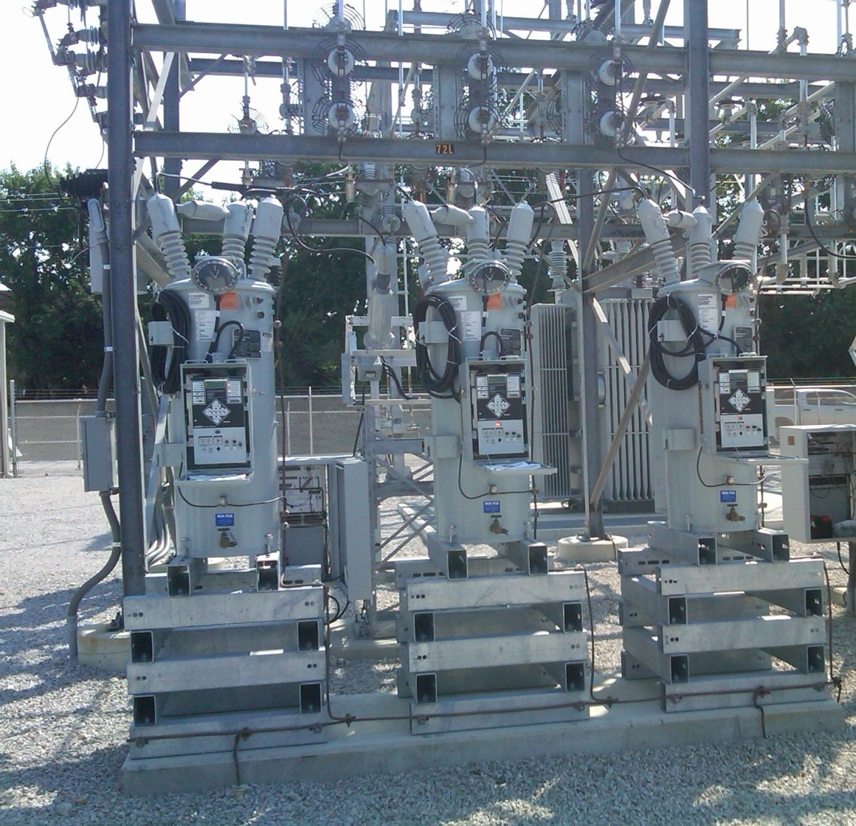
Ameren Champaign (IL) Test Facility Voltage Regulators
These are connected on the low side of a 69/12.4 kV transformer; each phase can be regulated separately.
17

Slide 19
Variable Tap Voltage Control in the Power Flow
LTCs (or voltage regulators) can be directly included in the power flow equations by modifying the Y_{bus} entries; that is by scaling the terms by 1, 1/t or 1/t² as appropriate.
If t is fixed then there is no change in the number of equations
If t is variable, such as to enforce a voltage equality, then it can be included either by adding an additional equation and variable (t) directly, or by doing an “outer loop” calculation in which t is varied outside of the NR solution.
The outer loop is used in PowerWorld because of limit issues.
18

Slide 20
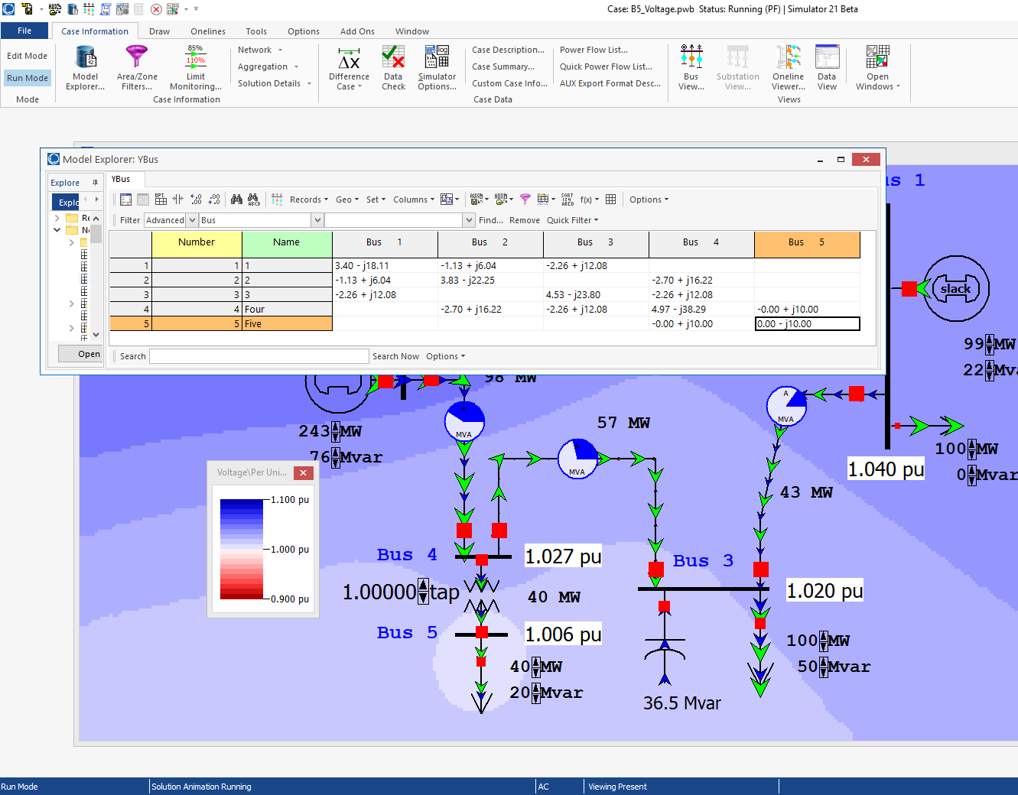
Five Bus PowerWorld Example
With an impedance of j0.1 pu between buses 4 and 5, the y node primitive with t=1.0 is
If t=1.1 then it is
PowerWorld Case: B5_Voltage
19

Slide 21
Circulating Reactive Power
Unbalanced transformer taps can cause large amounts of reactive power to circulate, increasing power system losses and overloading transformers.
PowerWorld Case: Bus3CirculatingVars
20

Slide 22
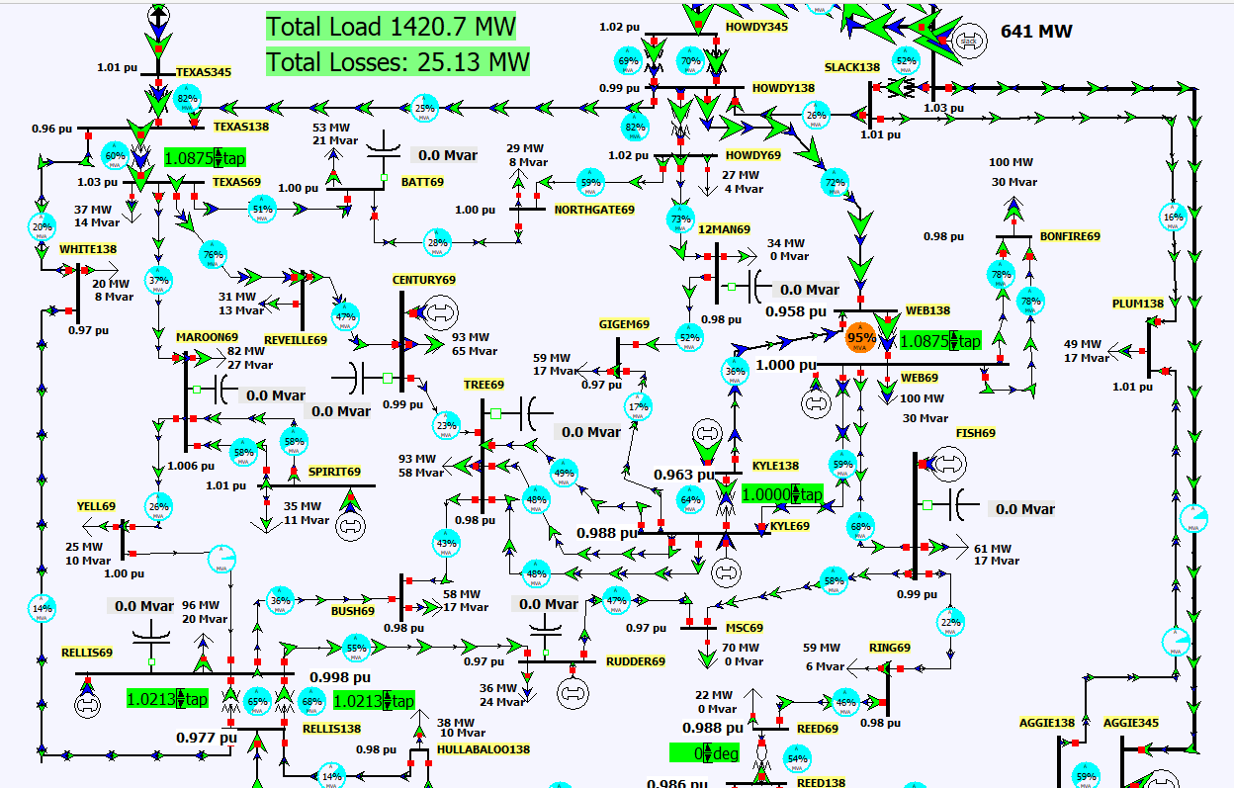
LTC Tap Coordination
Changing tap ratios can affect the voltages and var flow at nearby buses; hence coordinated control is needed.
PowerWorld Case: Aggieland37_LTC
21

Slide 23
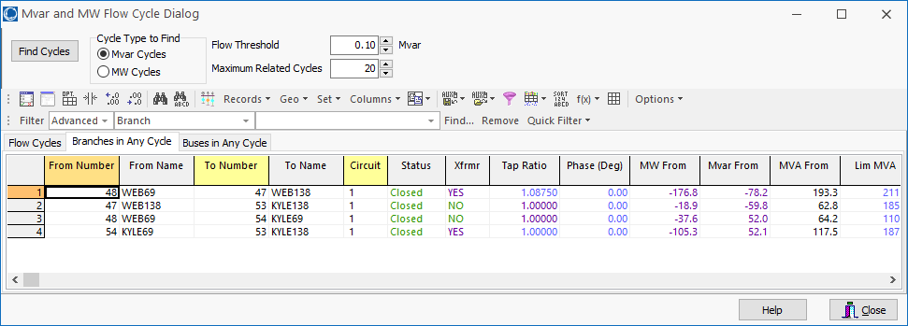
Auto Detection of Circulating Reactive or Real Power
Select Tools, Connections, Find Circulating MW or Mvar Flows to do an automatic determination of the circulating power in a case.
22

Slide 24
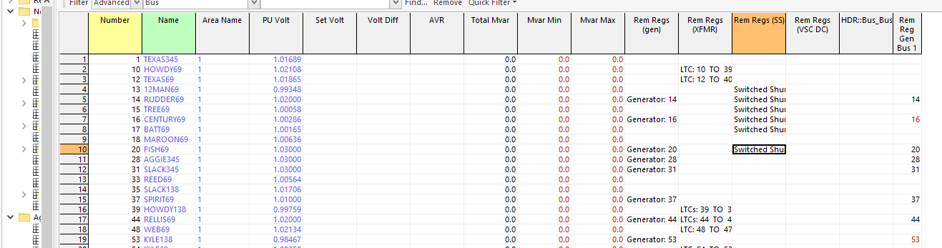
Coordinated Reactive Control
A number of different devices may be doing automatic reactive power control. They must be considered in some control priority.
One example would be 1) generator reactive power, 2) switched shunts, 3) LTCs
You can see the active controls in PowerWorld with Case Information, Solution Details, Remotely Regulated Buses.
23

Slide 25
Coordinated Reactive Control
The challenge with implementing tap control in the power flow is it is quite common for at least some of the taps to reach their limits.
Keeping in mind a large case may have thousands of LTCs!
If this control was directly included in the power flow equations then every time a limit was encountered the Jacobian would change.
Also taps are discrete variables, so voltages must be a range
Doing an outer loop control can more directly include the limit impacts; often time sensitivity values are used.
We’ll return to this once we discuss sparse matrices and sensitivity calculations.
24

Slide 26
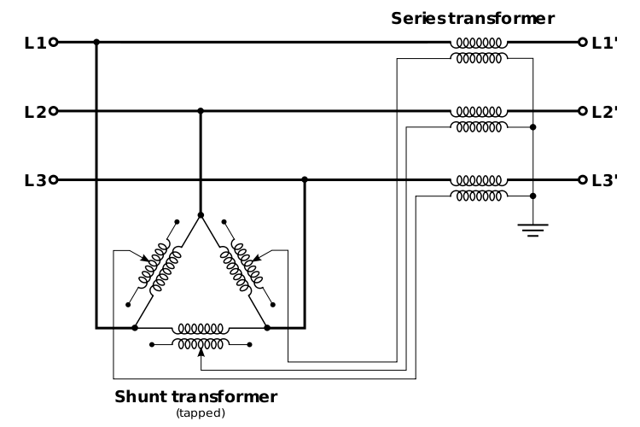
Phase-Shifting Transformers
Phase shifters are transformers in which the phase angle across the transformer can be varied in order to control real power flow.
Sometimes they are called phase angle regulators (PARs)
Quadrature booster (evidently British though I’ve never heard this term)
They are constructed by include a delta- connected winding that introduces a 90º phase shift that is added to the output voltage.
Image: http://en.wikipedia.org/wiki/Quadrature_booster
25

Slide 27
Phase-Shifter Model
We develop the mathematical model of a phase shifting transformer as a first step toward our study of its simulation.
Let buses k and m be the terminals of the phase–shifting transformer, then define the phase shift angle as Φ_{km}
The latter differs from an off–nominal turns ratio LTC transformer in that its tap ratio is a complex quantity, i.e., a complex number, t_{km}∠Φ_{km}
The phase shift angle is a discrete value, with one degree a typical increment.
26

Slide 28
Phase-Shifter Model
For a phase shifter located on the branch (k, m), the admittance matrix representation is obtained analogously to that for the LTC
Note, if there is a phase shift then Y_{bus} is no longer symmetric!! In a large case there are almost always some phase shifters. Y-Δ transformers also introduce a phase shift that is often not modeled
27

Slide 29
Integrated Phase-Shifter Control
Phase shifters are usually used to control the real power flow on a device.
Similar to LTCs, phase-shifter control can either be directly integrated into the power flow equations (adding an equation for the real power flow equality constraint, and a variable for the phase shifter value), or they can be handled in with an outer loop approach.
As was the case with LTCs, limit enforcement often makes the outer loop approach preferred.
Coordinated control is needed when there are multiple, close by phase shifters.
28

Slide 30
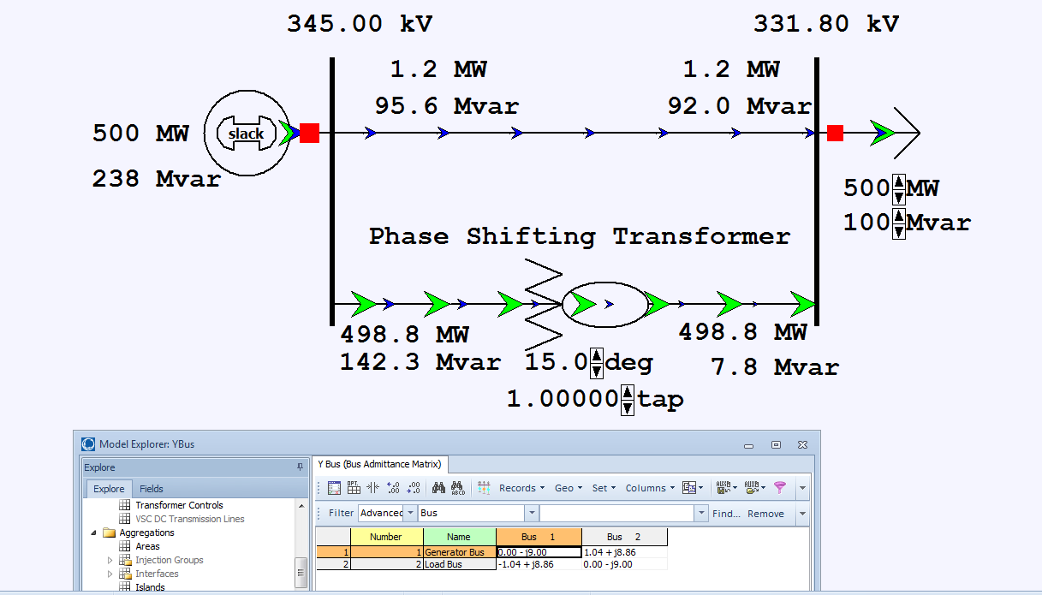
Two Bus Phase Shifter Example
Top line has x=0.2 pu, while the phase shifter has x=0.25 pu.
PowerWorld Case: B2PhaseShifter
29

Slide 31
Aggieland37 With Phase Shifters
PowerWorld Case: Aggieland37_PhaseShifter
30

Slide 32
Large Case Phase Shifter Limits and Step Size
31

Slide 33
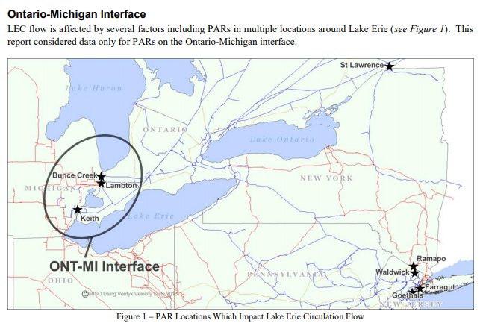
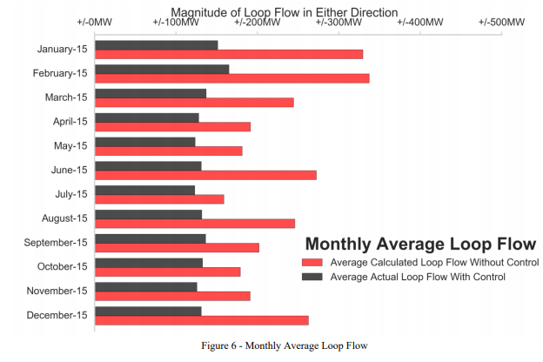
Example of Phase Shifters in Practice
The below report mentions issues associated with the Ontario-Michigan PARs.
https://www.nyiso.com/public/webdocs/markets_operations/committees/bic_miwg/meeting_materials/2017-02-28/2016%20Ontario-Michigan%20Interface%20PAR%20Evaluation%20Final%20Report.pdf
32

Slide 34
Impedance Correction Tables
With taps the impedance of the transformer changes; sometimes the changes are relatively minor and sometimes they are dramatic.
A unity turns ratio phase shifter is a good example with essentially no impedance when the phase shift is zero
Often modeled with piecewise linear function with impedance correction varying with tap ratio or phase shift
Next lines give several examples, with format being (phase shift or tap ratio, impedance correction)
(-60,1), (0,0.01), (60,1)
(-25,2.43),(0,1),(25,2.43)
(0.941,0.5), (1.04,1), (1.15,2.45)
(0.937,1.64), (1,1), (1.1, 1.427)
33

Slide 35
Three-Winding Transformers
Three-winding transformers are very common, with the third winding called the tertiary.
The tertiary is often a delta winding
Three-winding transformers have various benefits
Providing station service
Place for a capacitor connection
Reduces third-harmonics
Allows for three different transmission level voltages
Better handling of fault current
34

Slide 36
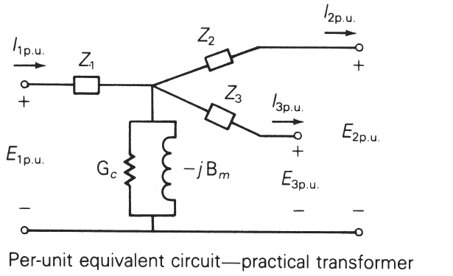
Three-Winding Transformers
Usually modeled in the power flow with a star equivalent; the internal “star” bus does not really exist.
Star bus is often given a voltage of 1.0 or 999 kV.
Impedances calculated using the wye-delta transform can result in negative resistance (about 900 out of 97,000 in EI model).
The winding impedances are measured between the windings with one winding shorted and the other open; for example Z₁₂ is measured from 1 with winding 2 shorted, 3 open.
Image from Power System Analysis and Design, by Glover, Overbye, Birchfield and Sarma 7th Edition
35

Slide 37
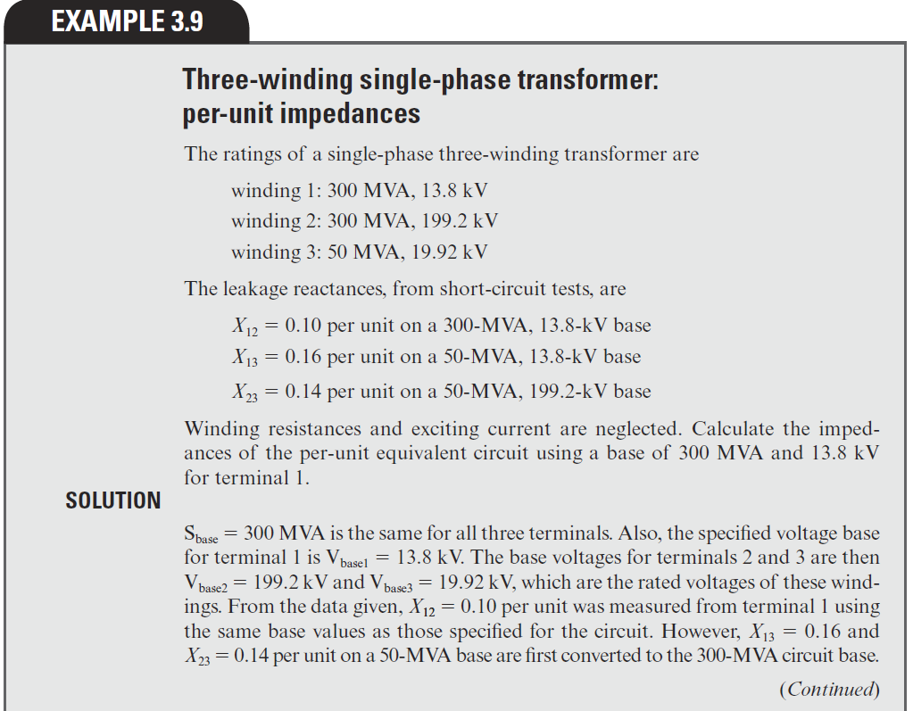
Three-Winding Transformer Example
Z₁₂ = Z₁ + Z₂
Z₁₃ = Z₁ + Z₃
Z₂₃ = Z₂ + Z₃
Hence
Z₁=0.5(Z₁₂+Z₁₃-Z₂₃)
Z₂=0.5(Z₁₂+Z₂₃-Z₁₃)
Z₃=0.5(Z₁₃+Z₂₃-Z₁₂)
Image from Power System Analysis and Design, by Glover, Overbye, Birchfield, and Sarma 7th Edition
36

Slide 38
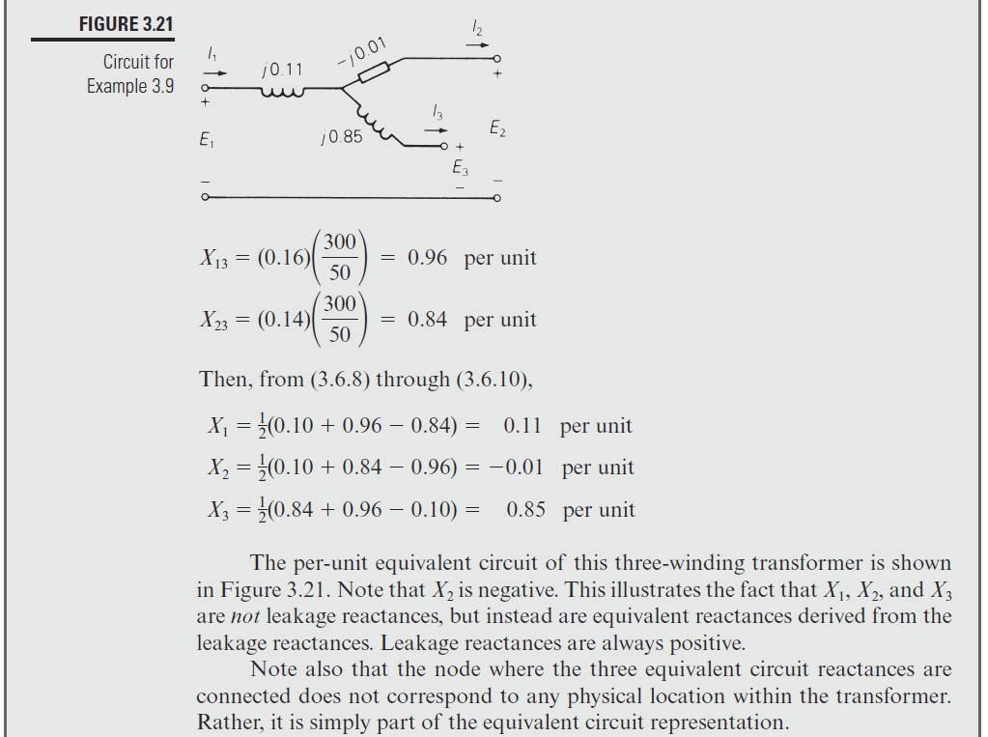
Three-Winding Transformer Example, cont.
Image from Power System Analysis and Design, by Glover, Overbye, Birchfield and Sarma 7th Edition
37

Slide 39
Transformer Vector Groups
Transformer vector groups are used to fully specify the connections between the windings on a three or two winding transformer.
Vector groups are not needed for power flow, but they are needed if the power flow is used to initialization fault analysis or harmonics, and are a needed input for geomagnetic disturbance (GMD) analysis.
A vector group consists of symbols in capital letters telling the connection type for the high-voltage winding (Y,D, or Z for zigzag) and small letters for the intermediate and low-voltage winding.
If a neutral point is brought out an N or n is used; for auto transformers the lower voltage symbol is replaced by an “a”
Phase displacement is given by clock numbers (0 to 11) indicating 30 degree intervals of lag from the high voltage winding
38

Slide 40
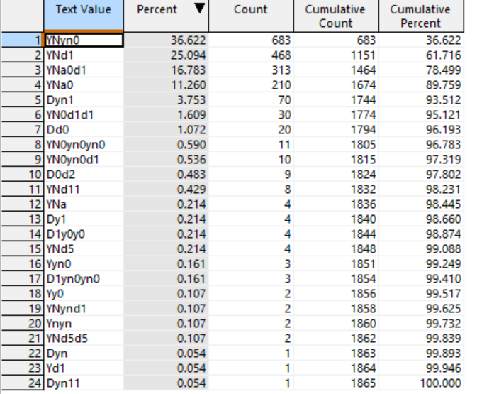
Transformer Vector Groups, Example
The table gives examples of vector groups used in a 10,000 bus industry power flow model.
Note the table contains a mixture of vector groups for three winding and two winding transformers
Such metrics are easy to obtain from data on any PowerWorld Case Info display by right-clicking on the field and selecting Set/Toggle/Columns, Get Column Metrics, to display the Grid Metrics, and then selecting the Histograms and Groupings page
39

Slide 41
Transformer Vector Groups, Standards
The complete format for the vector groups is given in either IEEE Std C57.12.70-2020 or IEC 60076-1.
Both of these standards require that the first field in the vector group is the high voltage winding, followed by the medium voltage winding, and then the lowest voltage winding (for a three winder)
The standards also specify that the high-voltage winding has a phase displacement of 0 (12 o’clock position)
Other software packages use a slightly different format in which the symbols are organized base on the From/To bus values, and the first phase displacement does not need to be zero.
Simulator supports both formats including for input and output.
40

