Slide 1
ECEN 615 Methods of Electric Power Systems Analysis
Lecture 11: Final Sparsity Issues, Sensitivity Analysis
Prof. Tom Overbye
Dept. of Electrical and Computer Engineering
Texas A&M University
overbye@tamu.edu

Slide 2
Announcements
Read Chapter 7.
Homework 2 is due now.
Homework 3 should be done before the exam, but is not to be turned in.
The first exam is on Thursday Oct 9 during class (Sanjana will make arrangements for the distance education students).
I posted my first exam from 2022 to Canvas as an example (in the Home and Exams section); I’ll post the answers in a week or so

Slide 3
Sparse Vector Example Application
In ongoing geomagnetic disturbance modeling work we need to determine the sensitivity of the results to the assumed substation grounding resistance
Since the induced voltages are quasi-dc, the network is modeled by setting up the conductance matrix G = R⁻¹
Initial work focused on calculating the driving point impedance values, which required knowing diagonal elements of R, which were easily calculated with sparse vector methods
But R_{ii} depends on the assumed grounding values are nearby substations, so we need to determine this impact as well; so we’d like small blocks of the inverse of R, which will require using the unions of the factorization paths to get some R_{ij}
2

Slide 4
Ordering for Shorter Paths, Computational Complexity
The paper 1990 IEEE Transactions on Power Systems paper “Partitioned Sparse A⁻¹ Methods” (by Alvarado, Yu and Betancourt) they introduce ordering methods for decreasing the length of the factorization paths.
Factorization paths also indicate the degree to which parallel processing could be used in solving Ax = b by LU factorization.
Operations in the various paths could be performed in parallel
The computational complexity of doing an FF/FB is O(n^{0.5}).
F. Safdarian, Z. Mao, W. Jang, and T. J. Overbye, “Power System Sparse Matrix Statistics,” IEEE Texas Power and Energy Conference, College Station, TX, February 2022
3

Slide 5
Computation with Complex and Blocked Matrices
In the previous analysis we have implicitly assumed that the values involved were real numbers (stored as singles or doubles in memory).
Nothing in the previous analysis prevents using other data structures for analysis.
Complex numbers would be needed if factoring the bus admittance matrix (Y_{bus}); this is directly supported in some programming languages and can be easily added to others; all values are complex numbers
Two by two block matrices are common for power flow Jacobian factorization; for this we use 2 by 2 blocks in the matrices and 2 by 1 blocks in the vectors
4

Slide 6
2 by 2 Block Matrix Computation
By treating our data structures as two by two blocks, we reduce the computation required to add fills substantially.
Half the number of rows, and four times fewer elements
Overall computation is reduced somewhat since we have four times fewer elements, but we do have more computation per element.
5

Slide 7
2 by 2 Block Matrix Example
In the backward substitution we had
For i := n downto 1 Do Begin
k = rowPerm[i];
p1 := rowDiag[k].next;
While p1 <> nil Do Begin
bvector[k] = bvector[k] – p1.value*bvector[p1.col];
p1 := p1.next;
End;
bvector[k] := bvector[k]/rowDiag[k].value;
End;
6

Slide 8
2 by 2 Block Matrix Example
We replace the scalar bvector entries by objects with fields .r and .i (for the real and imaginary parts) and we replace the p1.value field with four fields .ul, .ur, .ll and .lr corresponding to the upper left, upper right, lower left and lower right values.
The first multiply goes from
bvector[k] = bvector[k] – p1.value*bvector[p1.col] to
7

Slide 9
2 by 2 Block Matrix Example
The second numeric calculation changes from bvector[k] := bvector[k]/rowDiag[k].value
To
Which can be coded by directly doing the inverse as
8

Slide 10
Power System Control and Sensitivities
A major issue with power system operation is the limited capacity of the transmission system.
lines/transformers have limits (usually thermal)
no direct way of controlling flow down a transmission line (e.g., there are no valves to close to limit flow)
open transmission system access associated with industry restructuring is stressing the system in new ways
We need to indirectly control transmission line flow by changing the generator outputs.
Similar control issues with voltage.
9

Slide 11
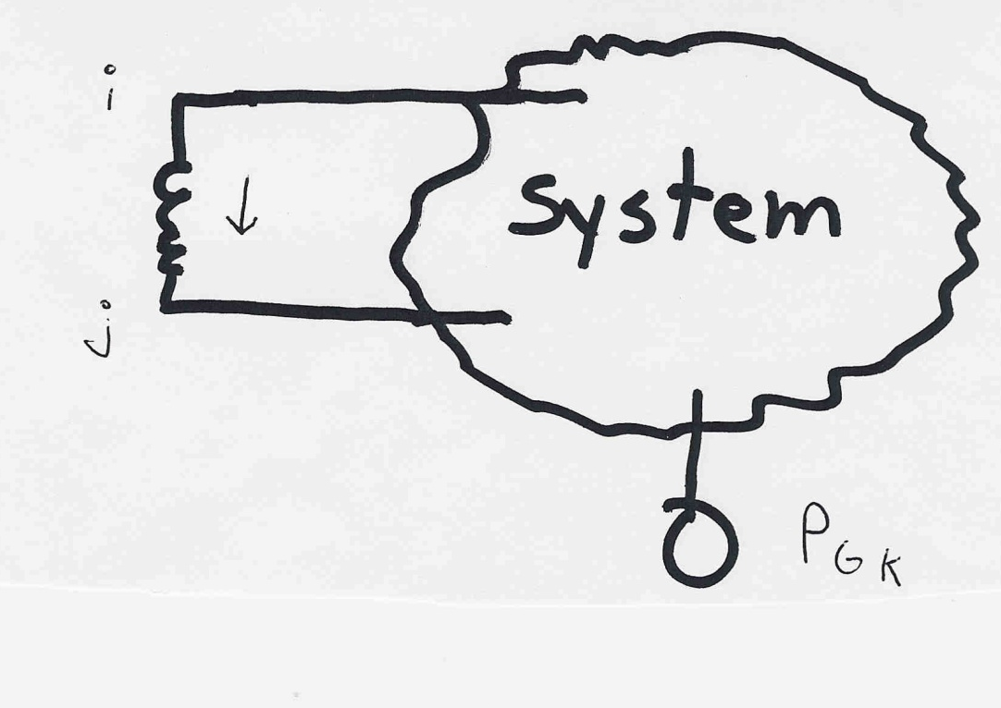
Indirect Transmission Line Control
What we would like to determine is how a change in generation at bus k affects the power flow on a line from bus i to bus j.
The assumption is that the change in generation is absorbed by the slack bus
10

Slide 12
Power Flow Simulation - Before
One way to determine the impact of a generator change is to compare a before/after power flow.
For example, below is a three-bus case with an overload.
11

Slide 13
Power Flow Simulation - After
Increasing the generation at bus 3 by 95 MW (and hence decreasing it at bus 1 by a corresponding amount), results in a 30.3 MW drop in the MW flow on the line from bus 1 to 2, and a 64.7 MW drop. on the flow from 1 to 3.
Expressed as a percent, 30.3/95 =32% and 64.7/95=68%
12

Slide 14
Analytic Calculation of Sensitivities
Calculating control sensitivities by repeat power flow solutions is tedious and would require many power flow solutions. An alternative approach is to analytically calculate these values.
13

Slide 15
Analytic Sensitivities
14

Slide 16
Three Bus Sensitivity Example
15

Slide 17
More General Sensitivity Analysis: Notation
We consider a system with n buses and L lines given by the set given by the set
Some authors designate the slack as bus zero; an alternative approach, that is easier to implement in cases with multiple islands and hence slacks, is to allow any bus to be the slack, and just set its associated equations to trivial equations just stating that the slack bus voltage is constant
We may denote the k^{th} transmission line or transformer in the system, _{k} , as
from node
to node
16

Slide 18
Notation, cont.
We’ll denote the real power flowing on _{k} from bus i to bus j as ƒ_{k}.
The vector of real power flows on the L lines is: which we simplify to
The bus real and reactive power injection vectors are
17

Slide 19
Notation, cont.
The series admittance of line  is g +jb and we define
We define the L×N incidence matrix
The component j of a_{i} is nonzero whenever line _{i} is coincident with node j. Hence A is quite sparse, with two nonzeros per row
18

Slide 20
Power Flow Sensitivity Analysis
The idea of power flow sensitivity analysis is to get an estimate of how some set of values would change with respect to a change in a set of control values.
Need to keep in mind which control responses are implicitly modeled, such as P and Q changes at the slack, Q at PV buses
The approach works by linearizing a system about an operating point; its usefulness depends on the validity of this approximation.
Sensitivities are widely used in power system analysis, with some algorithms doing sequential linearizations.
They are most valid for real power, less useful for reactive power
19

Slide 21
Analysis Example: Available Transfer Capability
The power system available transfer capability or ATC is defined as the maximum additional MW that can be transferred between two specific areas, while meeting all the specified pre- and post-contingency system conditions.
ATC impacts measurably the market outcomes and system reliability and, therefore, the ATC values impact the system and market behavior.
Total transfer capability (TTC ).
Amount of real power that can be transmitted across an interconnected transmission network in a reliable manner, including considering contingencies
ATC is the amount that is actually available; we’ll just look at TTC.
A useful reference on ATC is Available Transfer Capability Definitions and Determination from NERC, June 1996 (available online)
20

Slide 22
Total Transfer Capability (TTC) Evaluation
Goal is to load the lines up to their limits, though only when also considering contingencies
for the base case j = 0 and each contingency case
j = 1,2 … , J
21

Slide 23
Conceptual Solution Algorithm
Solve the initial power flow, corresponding to the initial system dispatch (i.e., existing commitments); set the change in transfer Δt⁽⁰⁾ = 0, k=0; set step size δ; j is used to indicate either the base case (j=0) or a contingency, j= 1,2,3…J
Compute Δt^{(k+1)} = Δt^{(k)} + δ
Solve the power flow for the new Δt^{(k+1)}
Check for limit violations: if violation is found set U^{j}_{m,n} = Δt^{(k)} and stop; else set k=k+1, and goto 2
22

Slide 24
Conceptual Solution Algorithm, cont.
This algorithm is applied for the base case (j=0) and each specified contingency case, j=1,2,..J
The final TTC, U_{m,n} is then determined by
This algorithm can be easily performed on parallel processors since each contingency evaluation is independent of the others
23

Slide 25
Five Bus Example: Reference
PowerWorld Case: B5_DistFact
24

Slide 26
Five Bus Example: Reference
 |  |  |  |  | ( MW )
 | 1 | 2 | 0 | 6.25 | 150
 | 1 | 3 | 0 | 12.5 | 400
 | 1 | 4 | 0 | 12.5 | 150
 | 2 | 3 | 0 | 12.5 | 150
 | 3 | 4 | 0 | 12.5 | 150
 | 4 | 5 | 0 | 10 | 1,000
25

Slide 27
Five Bus Example
We evaluate U_{2,3} using the previous procedure
Gradually increase generation at Bus 2 and load at Bus 3
We consider the base case and the single contingency with line 2 outaged (between 1 and 3): J = 1
Simulation results show for the base case that
And for the contingency that
Hence
26

Slide 28
Five Bus: Maximum Base Case Transfer
27

Slide 29
Five Bus: Maximum Contingency Transfer
28

Slide 30
Computational Considerations
Obviously, such a brute force approach can run into computational issues with large systems.
Consider the following situation:
10 iterations for each case
6,000 contingencies
2 seconds to solve each power flow
It will take over 33 hours to compute a single TTC for the specified transfer direction from m to n.
Consequently, there is an acute need to develop fast tools that can provide satisfactory estimates.
29

Slide 31
Sensitivity Problem Formulation
Denote the system state by
Denote the conditions corresponding to the existing commitment/dispatch by s⁽⁰⁾, p⁽⁰⁾ and f⁽⁰⁾ so that
Define the angle difference as
The V values are the voltage magnitudes
the power flow equations
line real power flow vector
30

Slide 32
Sensitivity Problem Formulation
g includes the real and reactive power balance equations
This is the real power line flow equation
31

Slide 33
Sensitivity Problem Formulation
For a small change, Δp, that moves the injection from p⁽⁰⁾ to p⁽⁰⁾ + Δp , we have a corresponding change in the state Δx with
We then apply a first order Taylor’s series expansion
32

Slide 34
Sensitivity Problem Formulation
We consider this to be a “small signal” change, so we can neglect the higher order terms (h.o.t.) in the expansion.
Hence we should still be satisfying the power balance equations with this perturbation; so
33

Slide 35
Sensitivity Problem Formulation
Also, from the power flow equations, we obtain
and then just the power flow Jacobian
34

Slide 36
Sensitivity Problem Formulation
With the standard assumption that the power flow Jacobian is nonsingular, then
We can then compute the change in the line real power flow vector
This equation is telling how the real power flow on the lines varies for a change in the generation at each generator assuming the change is absorbed at the slack bus
35

Slide 37
Sensitivity Comments
Sensitivities can easily be calculated even for large systems.
If Δp is sparse (just a few injections) then we can use a fast forward; if sensitivities on a subset of lines are desired, we could also use a fast backward
Sensitivities are dependent upon the operating point.
They also include the impact of marginal losses
Sensitivities could easily be expanded to include additional variables in x (such as phase shifter angle), or additional equations, such as reactive power flow.
36

Slide 38
Sensitivity Comments, cont.
Sensitivities are used in the optimal power flow; in that context a common application is to determine the sensitivities of an overloaded line to injections at all the buses.
In the below equation, how could we quickly get these values?
A useful reference is O. Alsac, J. Bright, M. Prais, B. Stott, “Further Developments in LP-Based Optimal Power Flow,” IEEE. Trans. on Power Systems, August 1990, pp. 697-711; especially see equation 3.
37

Slide 39
Sensitivity Example in PowerWorld
Open case B5_DistFact and then Select Tools, Sensitivities, Flow and Voltage Sensitivities.
Select Single Meter, Multiple Transfers, Buses page
Select the Device Type (Line/XFMR), Flow Type (MW), then select the line (from Bus 2 to Bus 3)
Click Calculate Sensitivities; this shows impact of a single injection going to the slack bus (Bus 1)
For our example of a transfer from 2 to 3 the value is the result we get for bus 2 (0.5440) minus the result for bus 3 (-0.1808) = 0.7248
With a flow of 118 MW, we would hit the 150 MW limit with (150-118)/0.7248 =44.1MW, close to the limit we found of 45MW
38

Slide 40
Sensitivity Example in PowerWorld
If we change the conditions to the anticipated maximum loading (changing the load at 2 from 118 to 118+44=162 MW) and we re-evaluate the sensitivity; we note it has changed little. (from -0.7248 to -0.7241)
Hence a linear approximation (at least for this scenario) could be justified
With what we know so far, to handle the contingency situation, we would have to simulate the contingency, and reevaluate the sensitivity values.
We’ll be developing a quicker (but more approximate) approach next
39

Slide 41
Linearized Sensitivity Analysis
By using the approximations from the fast decoupled power flow we can get sensitivity values that are independent of the current state. That is, by using the B’ and B’’ matrices.
For the real power line flows we can approximate
40

Slide 42
Linearized Sensitivity Analysis
Also, for each line 
and so,
41

Slide 43
Sensitivity Analysis: Recall the Matrix Notation
The series admittance of line  is g +jb and we define
We define the L×N incidence matrix
where the component j of a_{i} is nonzero whenever line _{i} is coincident with node j. Hence A is quite sparse, with at most two nonzeros per row
42

Slide 44
Linearized Active Power Flow Model
Under these assumptions the change in the real power line flows are given as
The constant matrix is called the injection shift factor matrix (ISF)
43

Slide 45
Injection Shift Factors (ISFs)
The element in row  and column n of  is called the injection shift factor (ISF) of line  with respect to the injection at node n.
Absorbed at the slack bus, so it is slack bus dependent
Terms generation shift factor (GSF) and load shift factor (LSF) are also used (such as by NERC).
Same concept, just a variation in the sign whether it is a generator or a load
Sometimes the associated element is not a single line, but rather a combination of lines (an interface)
Terms used in North America are defined in the NERC glossary: (http://www.nerc.com/files/glossary_of_terms.pdf)
44

Slide 46
ISF Interpretation
slack
node
is the fraction of the additional 1 MW injection at node n that goes though line 
45

Slide 47
ISF Properties
By definition, depends on the location of the slack bus.
By definition, for since the injection and withdrawal buses are identical in this case and, consequently, no flow arises on any line  .
The magnitude of is at most 1 since
Note, this is strictly true only for the linear (lossless) case. In the nonlinear case, it is possible that a transaction decreases losses. Hence a 1 MW injection could change a line flow by more than 1 MW.
46

Slide 48
Five Bus Example Reference
47

Slide 49
Five Bus ISF, Line 4, Bus 2 (to Slack)
48

Slide 50
Five Bus Example
The row of A correspond to the lines and transformers, the columns correspond to the non-slack buses (buses 2 to 5); for each line there
is a 1 at one end, a -1 at the other end (hence an assumed sign convention!).
Here we put a 1 for the lower numbered bus, so positive flow is assumed from the lower numbered bus to the higher number.
49

Slide 51
Five Bus Example
With bus 1 as the slack, the buses (columns) go for 2 to 5
50

Slide 52
Five Bus Example Comments
At first glance the numerically determined value of (128-118)/20=0.5 does not match closely with the analytic value of 0.5455; however, in doing the subtraction we are losing numeric accuracy
Adding more digits helps (128.40 – 117.55)/20 = 0.5425
The previous matrix derivation isn’t intended for actual computation;  is a full matrix so we would seldom compute all of its values
Sparse vector methods can be used if we are only interested in the ISFs for certain lines and certain buses
51

Slide 53
Distribution Factors and Basic Transactions
Various additional distribution factors may be defined
power transfer distribution factor (PTDF)
line outage distribution factor (LODF)
line addition distribution factor (LADF)
outage transfer distribution factor (OTDF)
These factors may be derived from the ISFs making judicious use of the superposition principle
A basic transaction involves the transfer of a specified amount of power t from an injection node m to a withdrawal node n
A basic transaction: w = (m,n,t)
52

Slide 54
Definition: PTDF
NERC defines a PTDF as
“In the pre-contingency configuration of a system under study, a measure of the responsiveness or change in electrical loadings on transmission system Facilities due to a change in electric power transfer from one area to another, expressed in percent (up to 100%) of the change in power transfer”
Transaction dependent
We’ll use the notation to indicate the PTDF on line  with respect to basic transaction w
In the lossless formulation presented here (and commonly used) it is slack bus independent
53

Slide 55
PTDFs
Note, the PTDF is independent of the amount Δt; which is often expressed as a percent
54

Slide 56
PTDF Evaluation
Defined in terms of the injection shift factors (ISFs); the slack bus dependence in each cancels out
The PTDFs to the slack bus are the ISFs
55

Slide 57
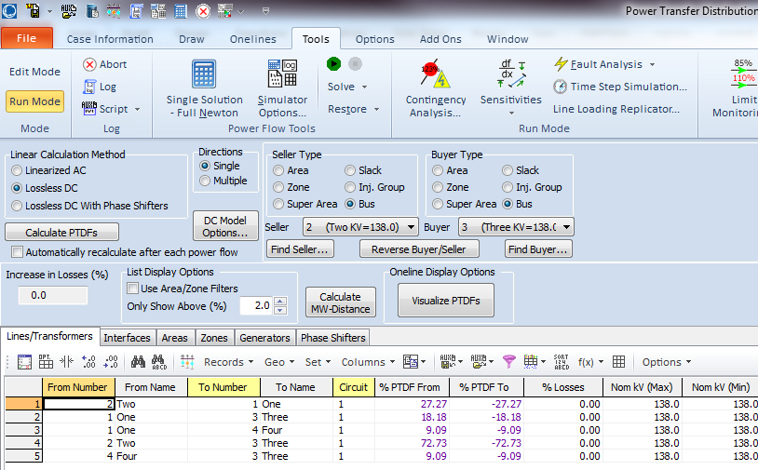
Calculating PTDFs in PowerWorld
PowerWorld provides a number of options for calculating and visualizing PTDFs
Select Tools, Sensitivities, Power Transfer Distribution Factors (PTDFs)
Results are shown for the five bus case for the Bus 2 to Bus 3 transaction
There is a button to visualize the PTDFs
56

Slide 58
Five Bus PTDF Visualization
PowerWorld Case: B5_DistFact_PTDF
57

Slide 59
Nine Bus PTDF Example
Display shows the PTDFs for a basic transaction from Bus A to Bus I. Note that 100% of the transaction leaves Bus A and 100% arrives at Bus I
PowerWorld Case: B9_PTDF
58

Slide 60
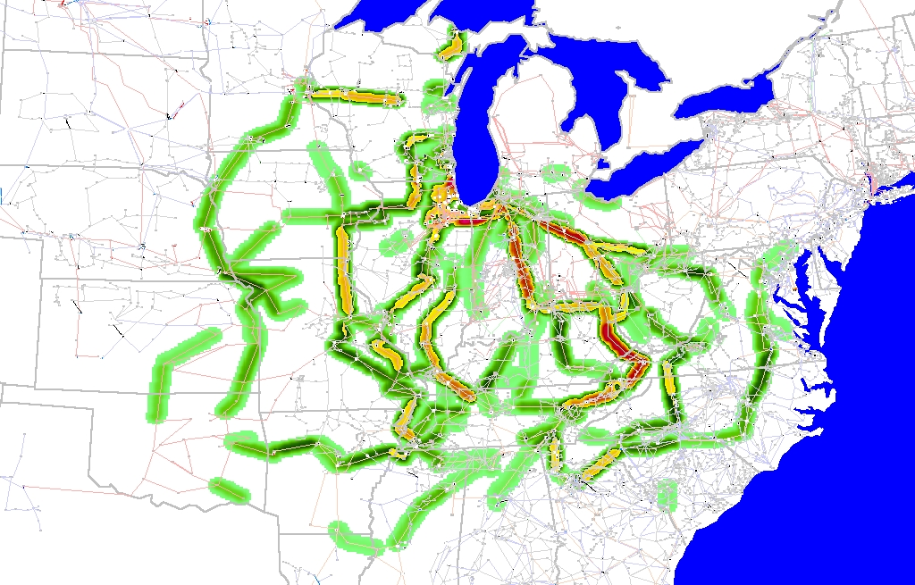
Eastern Interconnect Example: Wisconsin Utility to TVA PTDFs
In this example multiple generators contribute for both the seller and the buyer
Contours show lines that would carry at least 2% of a power transfer from Wisconsin to TVA
59

