Slide 1
ECEN 615 Methods of Electric Power Systems Analysis
Lecture 23: PowerWorld Tutorial
Prof. Tom Overbye
Dept. of Electrical and Computer Engineering
Texas A&M University
overbye@tamu.edu
Slides by: Sanjana Kunkolienkar
sanjanakunkolienkar@tamu.edu

Slide 2
Resources
Tutorial links: https://www.powerworld.com/WebHelp/Content/MainDocumentation_HTML/Tutorial_Link_To_Website_OnLine_Training.htm
Intro to simulator: https://www.powerworld.com/training/courses/introduction-to-powerworld-simulator
Web help: https://www.powerworld.com/WebHelp/
OPF specific help

Slide 3
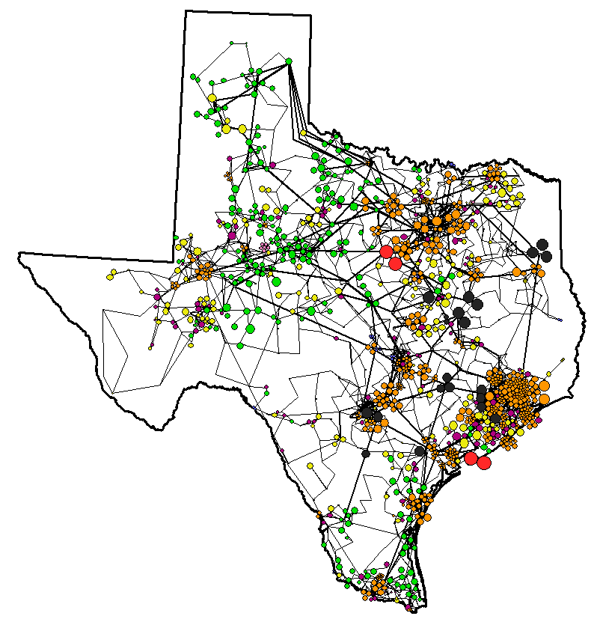
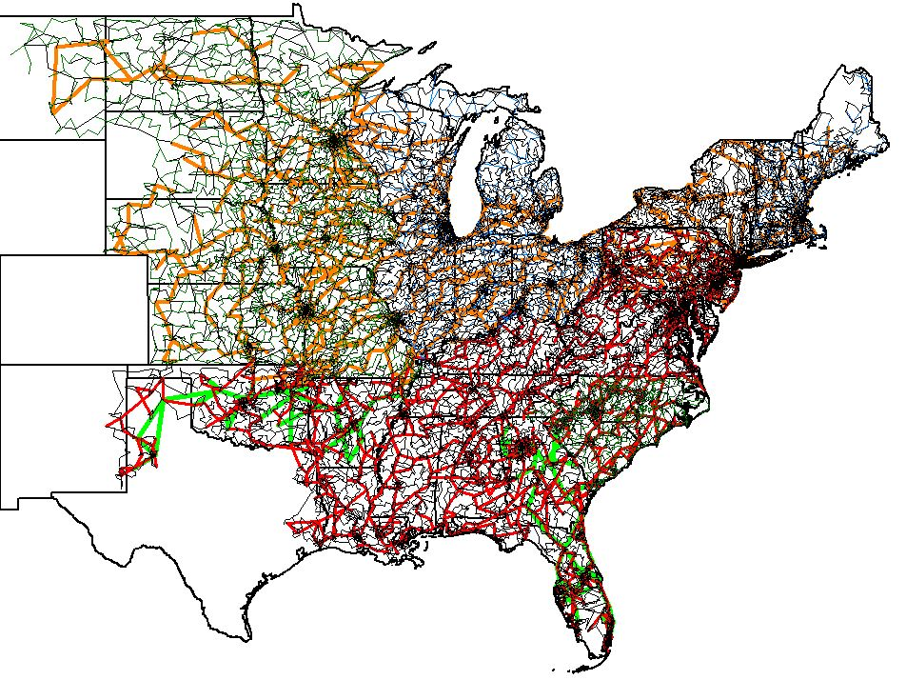
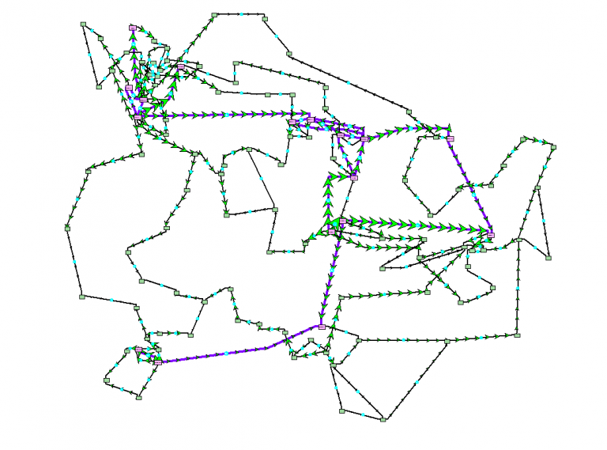
TAMU Electric Grid Repository
https://electricgrids.engr.tamu.edu/electric-grid-test-cases/
200 bus case on footprint of Central Illinois
2000 bus case on footprint of Texas
70,000 bus case on footprint of Eastern U.S.

Slide 4
Design Project Overview
Five new 1000 MW loads
Must be supplied at 230 kV
Use the 2000-bus Texas Synthetic Grid
Evaluate four scenarios
Optimize transmission additions and cost

Slide 5
High-Level Workflow
Explore the four scenarios
Add new transmission (same across scenarios)
Run DCOPF for each
Calculate costs
Verify N-1 for new devices
Finalize design

Slide 6
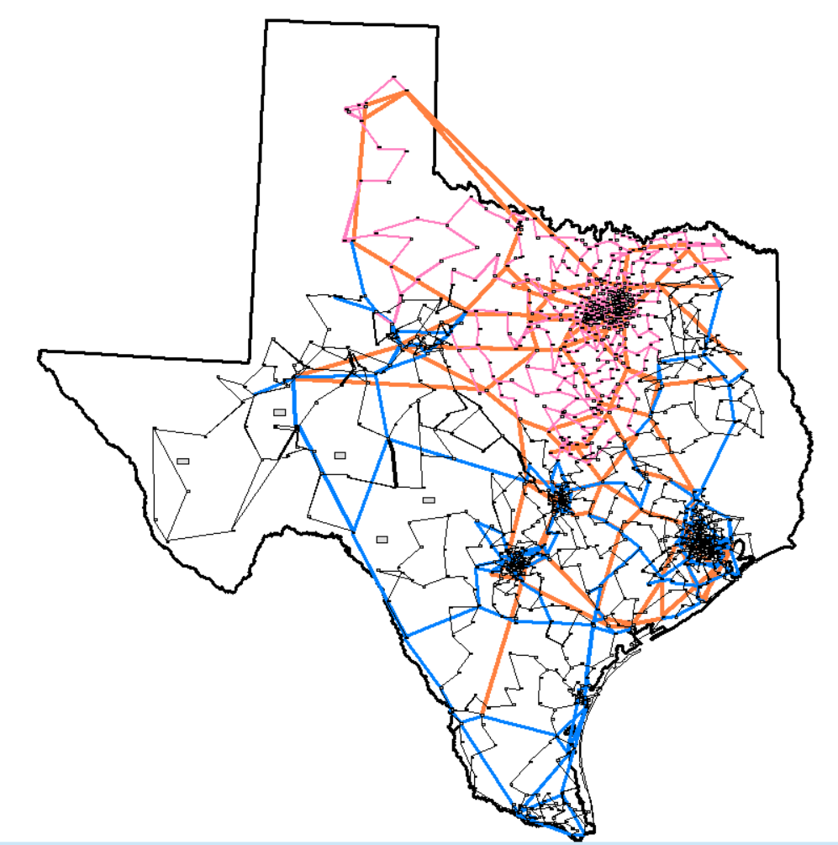
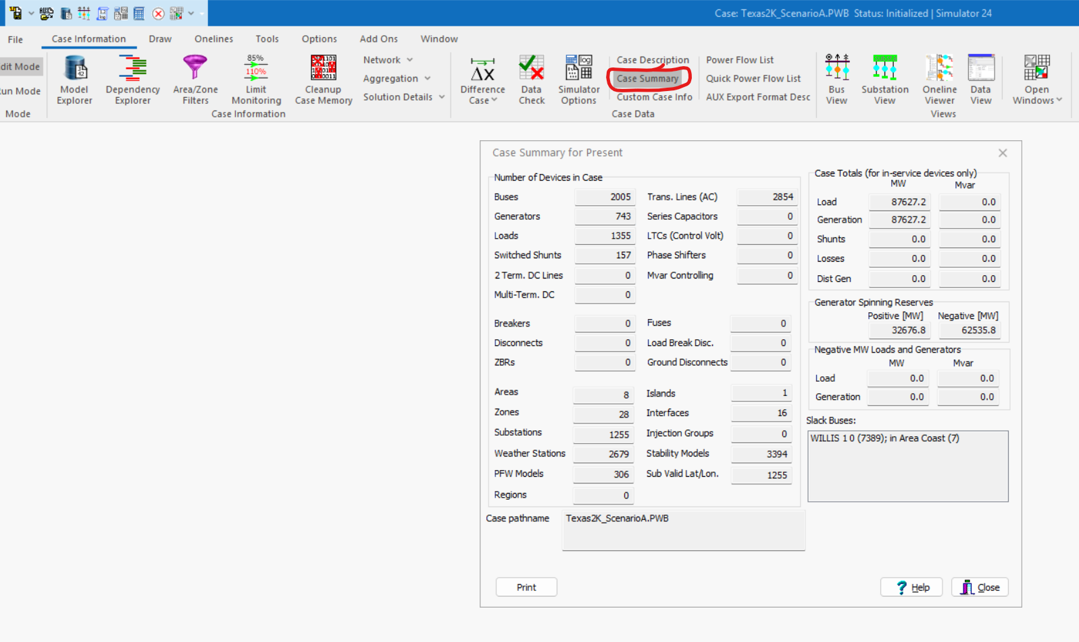
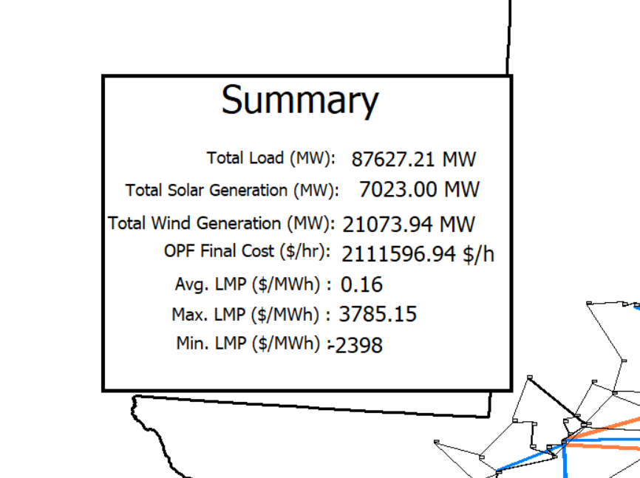
2000-Bus Grid
Voltage levels: 500 / 230 / 161 / 115 kV
Case Summary provides a high- level view of the case.
Summary already setup in the cases provided.

Slide 7
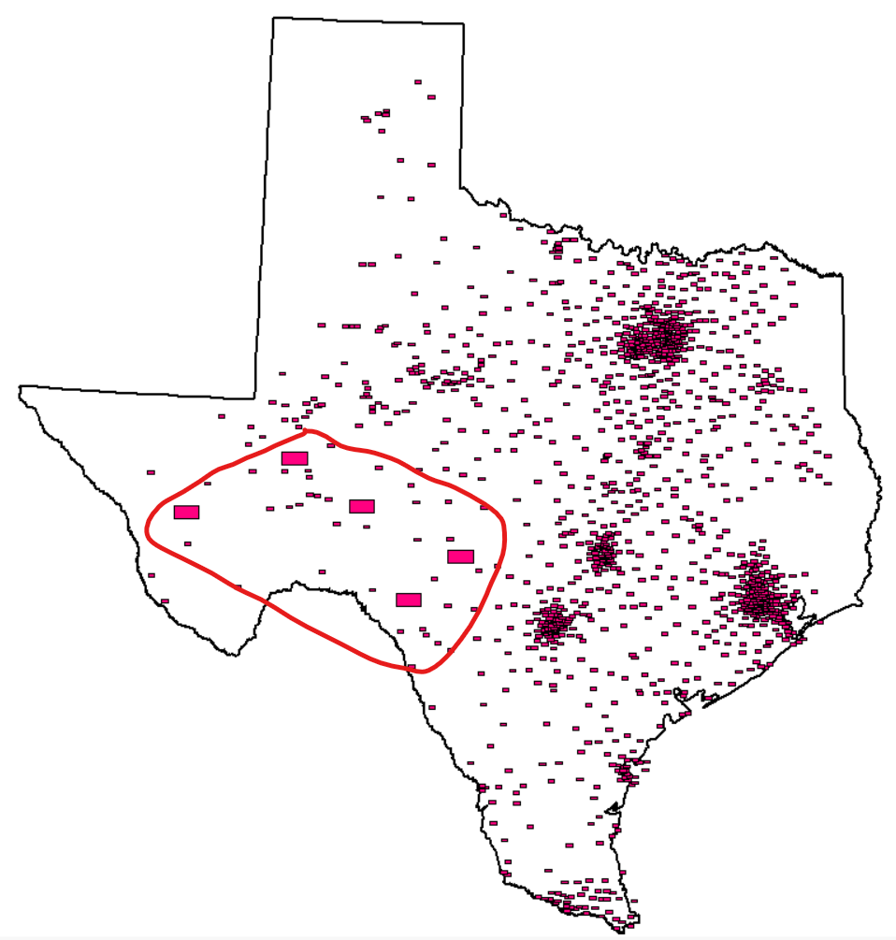
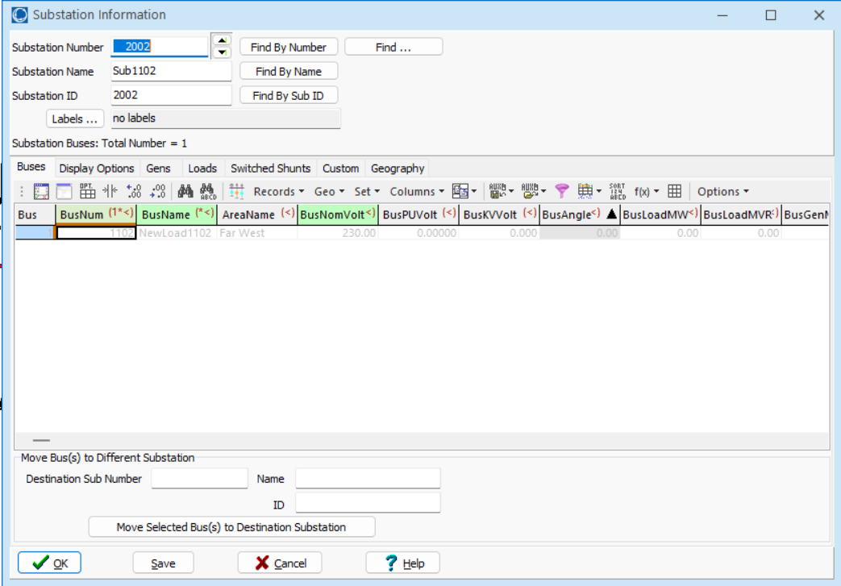
New Load Locations
5 new substations
To get substation information:
Right click on substation
Click on ‘substation information dialog’
Substation information can also be accessed using model explorer.

Slide 8
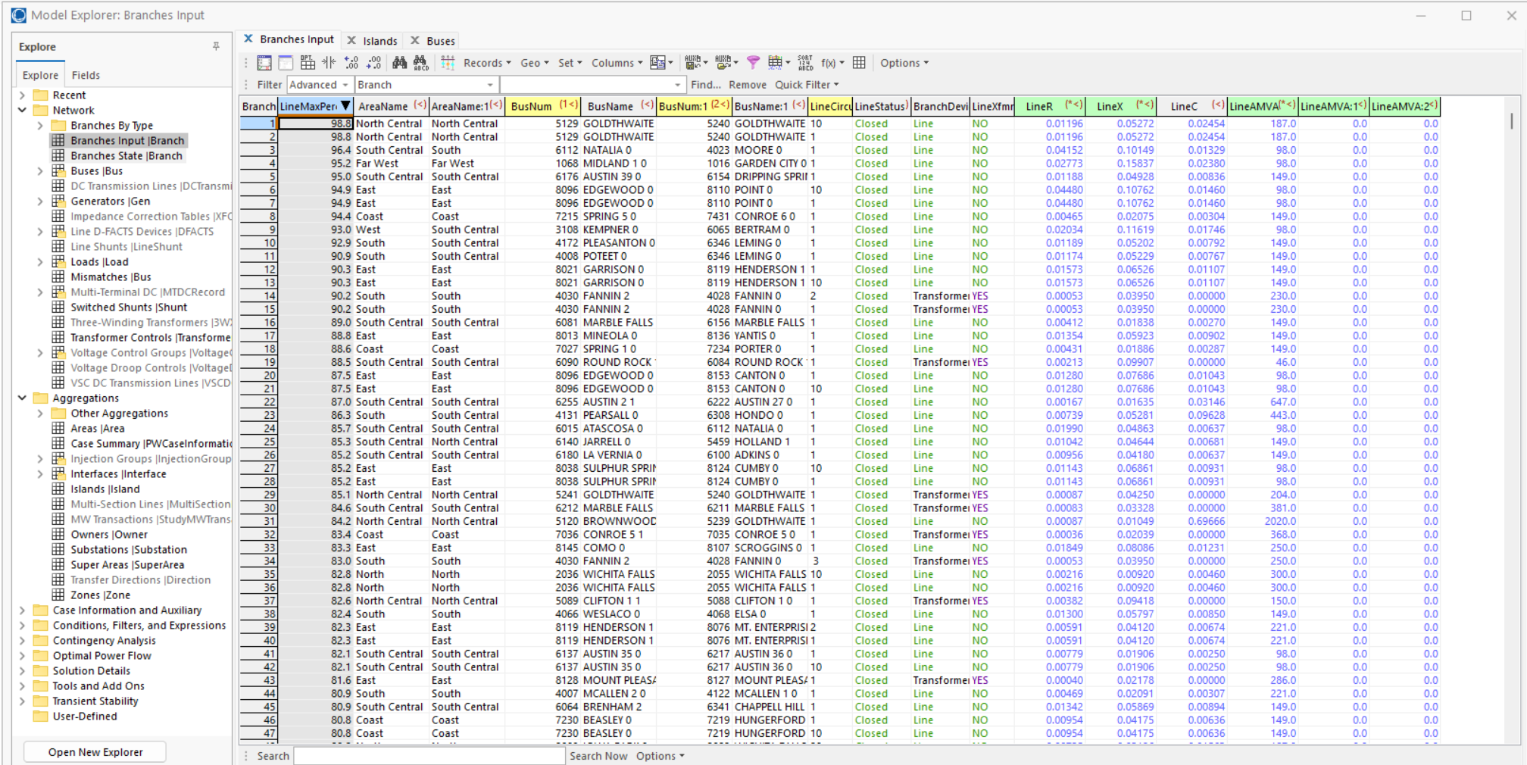
Model Explorer
Fields is used to add or remove a column here
Anything that is grayed out here is dead/not connected to the system.
Get information on any object.
Main objects you would frequently use are:
Buses
Branches
Generation
Loads
Substations

Slide 9
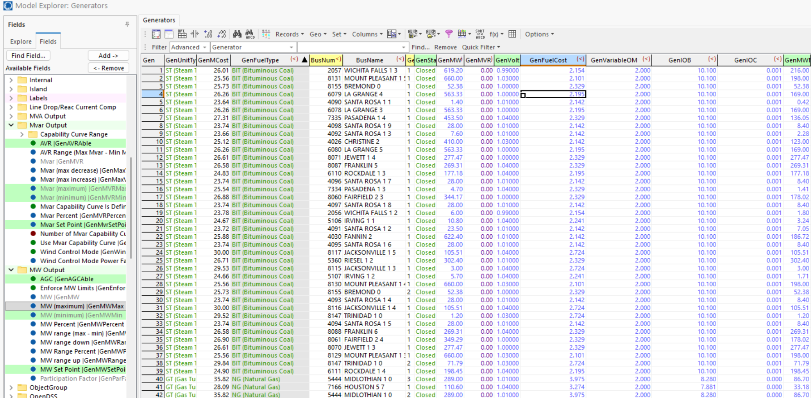
Adding columns
Select this and then click on Add and it will appear as a column.

Slide 10
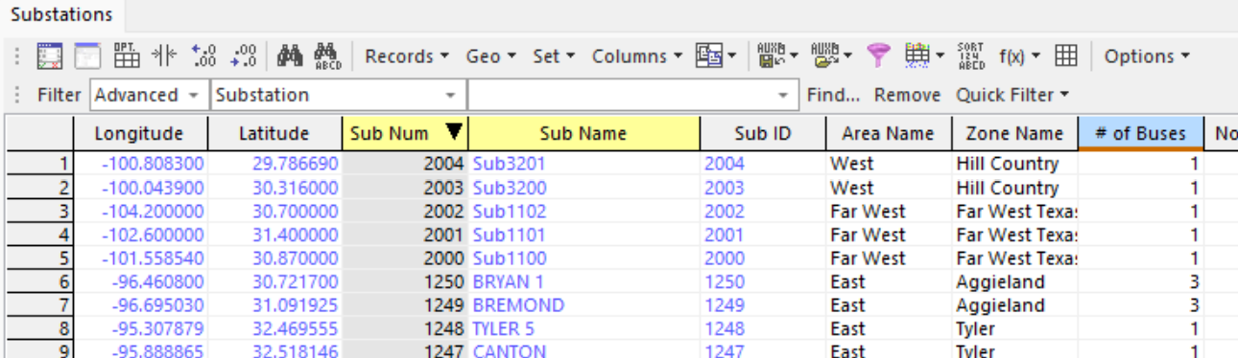
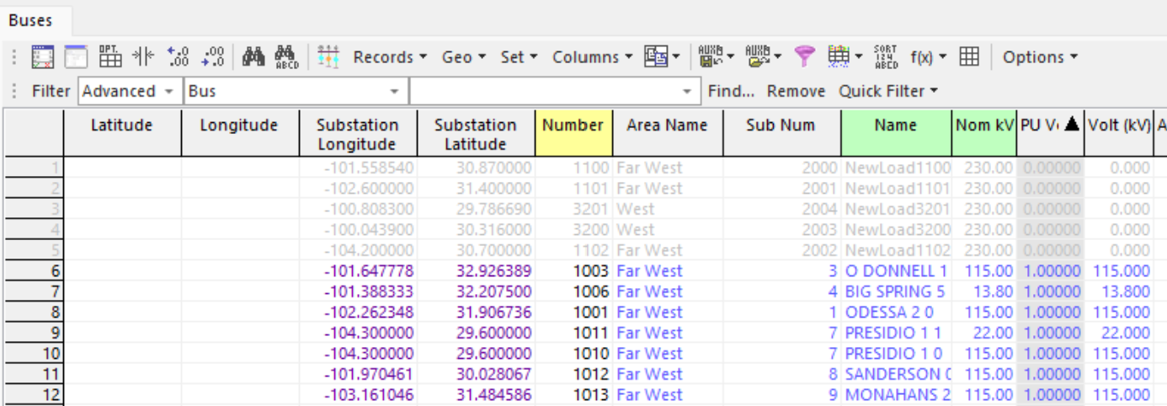
Adding latitude and longitude info for buses
Substation have geography associated with them.
Buses belong to substations.
Thus, in these cases, buses don’t have their own Lat, Lon. They usually are found under ‘Substation Latitude’ and ‘Substation Longitude’
You can find these under ‘Geography’ in the Fields tab.

Slide 11
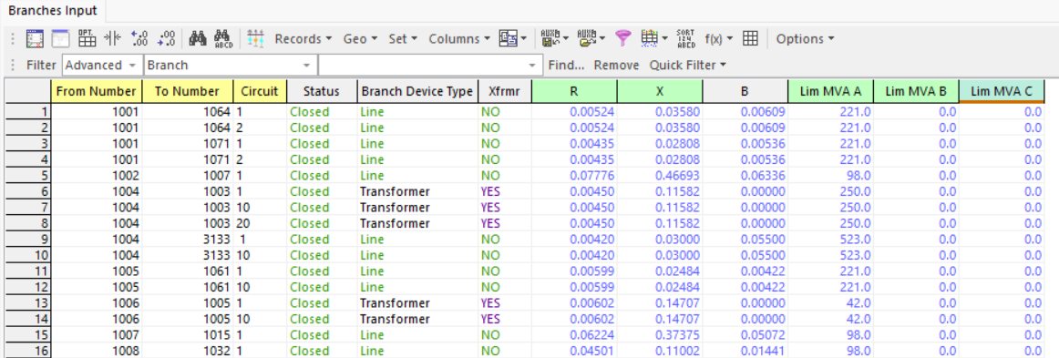
Branches
Lim MVA A is the only one you need. No need to add values in Lim MVA B and Lim MVA C.
Circuit indicates another line between two same buses. There can be multiple circuits between two buses.
Branches has two objects. Branches Input and Branches Status.
Input (as in the name) is used to add/delete lines or change information like R,X,B,Limits.
Status is where you can observe results after a simple power flow, like flows, % of MVA used etc.
This is where you will be adding transformers and lines.

Slide 12
Exporting and Importing from Powerworld
Click on object of choice.
Click on any cell here
Right click -> Click on Copy/Paste/
Send.
Send All to Excel.

Slide 13
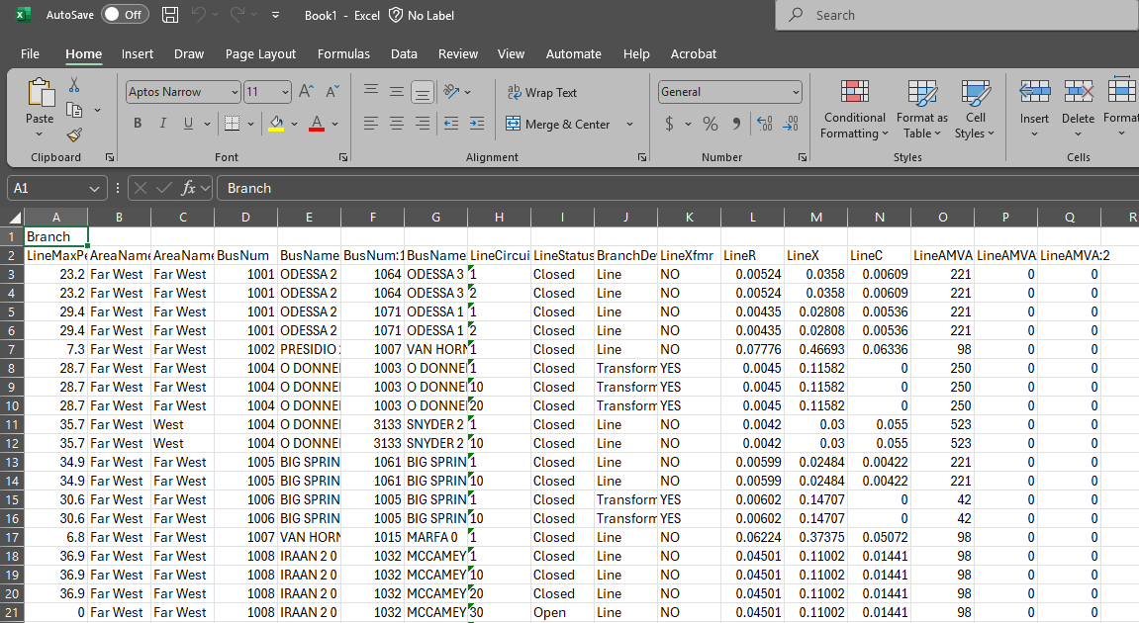
Exporting and Importing from Powerworld
Excel file will open automatically.
Object name.
This is REQUIRED when importing the file into Powerworld.
Column headers are variable names or “fields”
There are three types:
Key Fields
Required Fields
Secondary Key Fields
If your CSV file is missing the Object name in A1 OR missing any KEY/REQUIRED fields the CSV file will not load into Powerworld when importing.

Slide 14
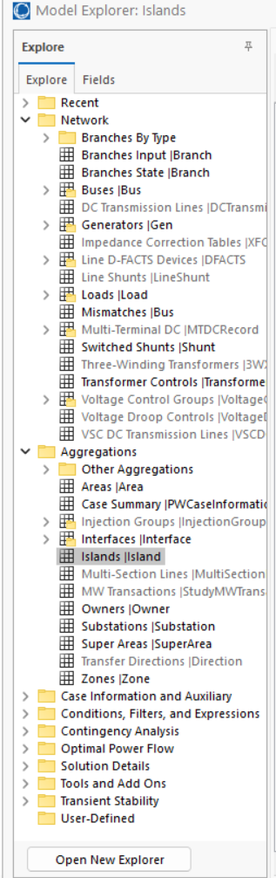
Things to note when importing/exporting
Before creating a new Branch you must add the new Buses if they do not exist.
Log is your best friend in telling you what happened. If there is an issue in the CSV file you are importing, the log will tell you whether the file was imported or not. OR it will tell you how many objects were imported versus how many were not loaded.
Quick way to check object name is to look at the ‘Explore’ window in Model explorer.
Make sure you are in ‘Edit Mode’
To get this go to Options -> Headings -> Switch from Normal to Variable Names.

Slide 15
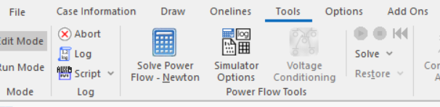
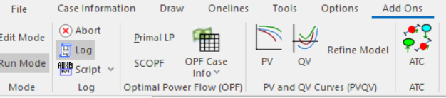
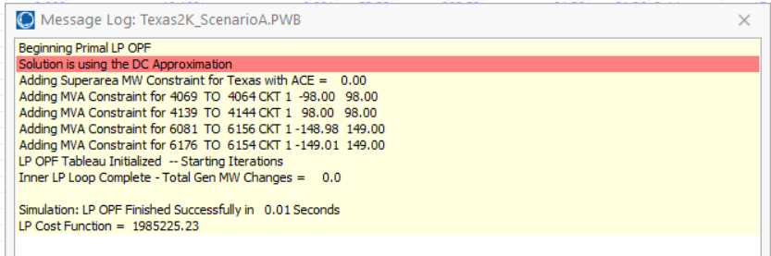
Power Flow – Simulator Options
Make sure the simulator is in ‘Run Mode’
Click on Solve → Choose any power flow approach.
Mostly you will be using Power Flow – Newton or DC power flow.
Optimal Power Flow – Add Ons
Click on Primal LP to run OPF
OPF Case Info → OPF Options → Solve LP
Good to have the log open to check what happened.

Slide 16
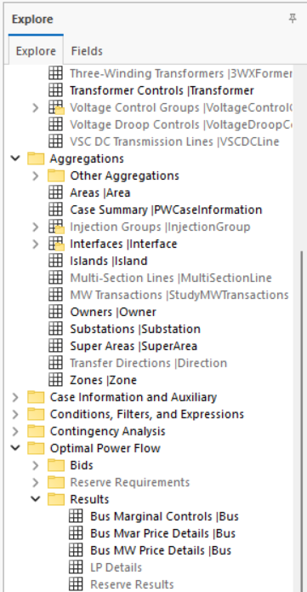
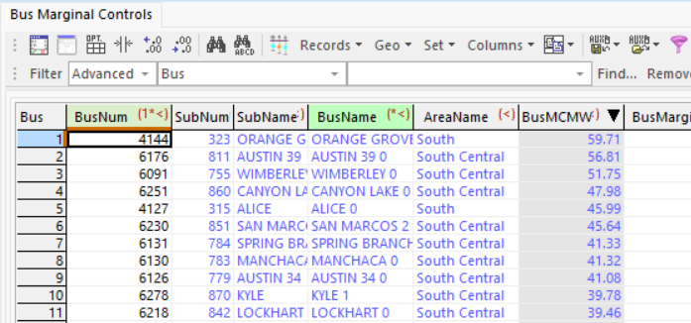
OPF Results
This is in Model Explorer, under Optimal Power Flow → Results.
LMP is the MW Marg. Cost column or also called BusMCMW

Slide 17
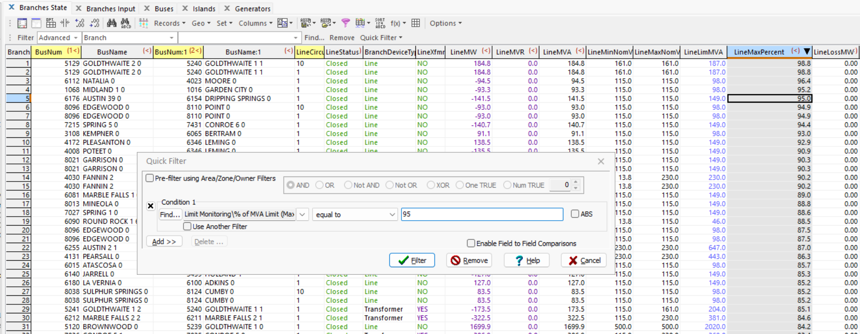
Filter
PW Model explorer has a nice feature to filter the information.
Right click anywhere in the open object window in model explorer.
Use Quick Filter.
If you have multiple conditions, you can use these logic combinations.
You can pick any field to apply the filter to here.

Slide 18
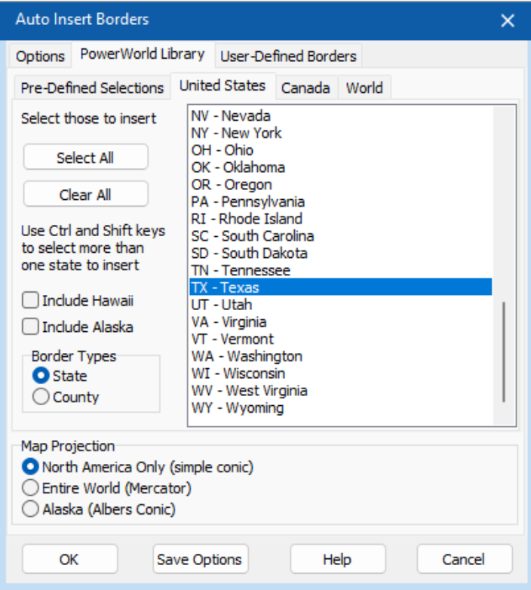
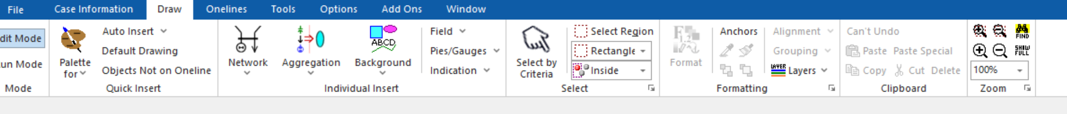
How to make a one line diagram?
Open case “.pwb”
File → New Oneline
PW auto switches to Edit mode.
Auto insert → Borders
Use this to quickly auto-insert multiple objects on the .pwd file.
In case you add multiple objects to the oneline and cannot see it, click this.

Slide 19
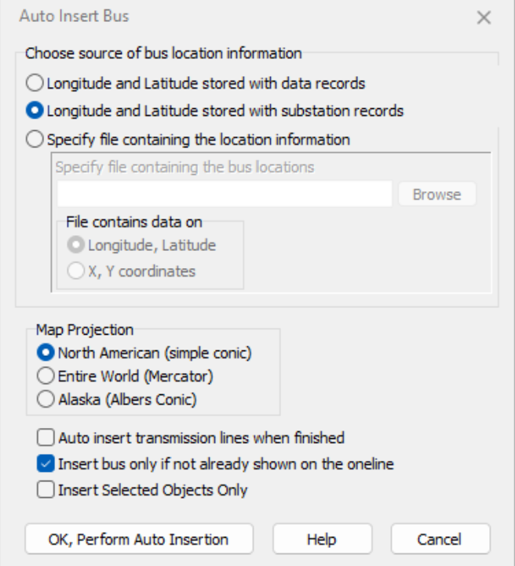
How to make a one line diagram?
When inserting buses choose ‘Longitude and Latitude stored with substation records.
Adding buses.
Any other object can be added in a similar way.
Don’t forget to save the new oneline file as a .pwd file.
Choose this if you want to also add transmission lines.

Slide 20
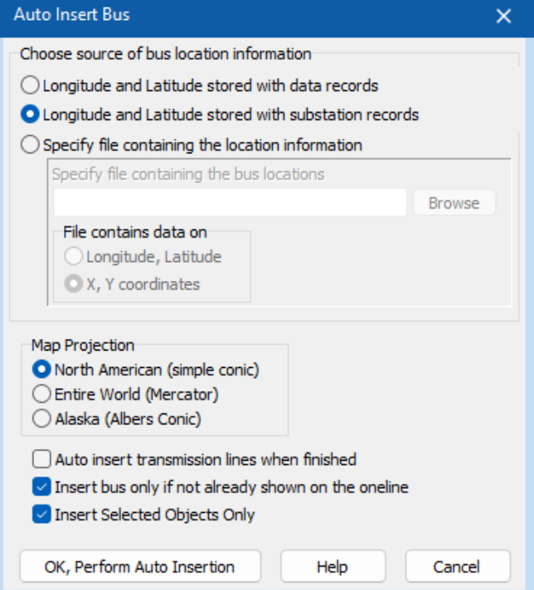
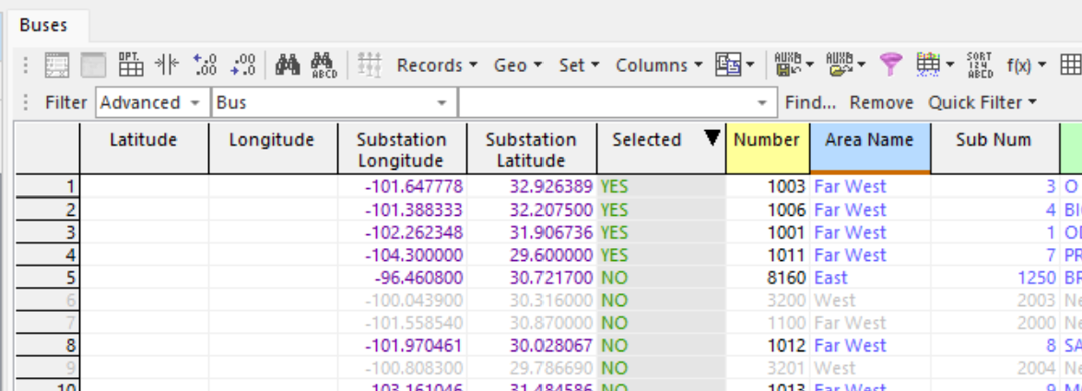
If you don’t want to bulk add objects to one line diagram
In the model explorer, for an object (either a bus or a substation), find the variable ‘Selected’ under Custom variables in the Fields tab.
Add that to the Object variables. By default, it is toggled as ‘No’.
Toggle it to ‘Yes’.

Slide 21
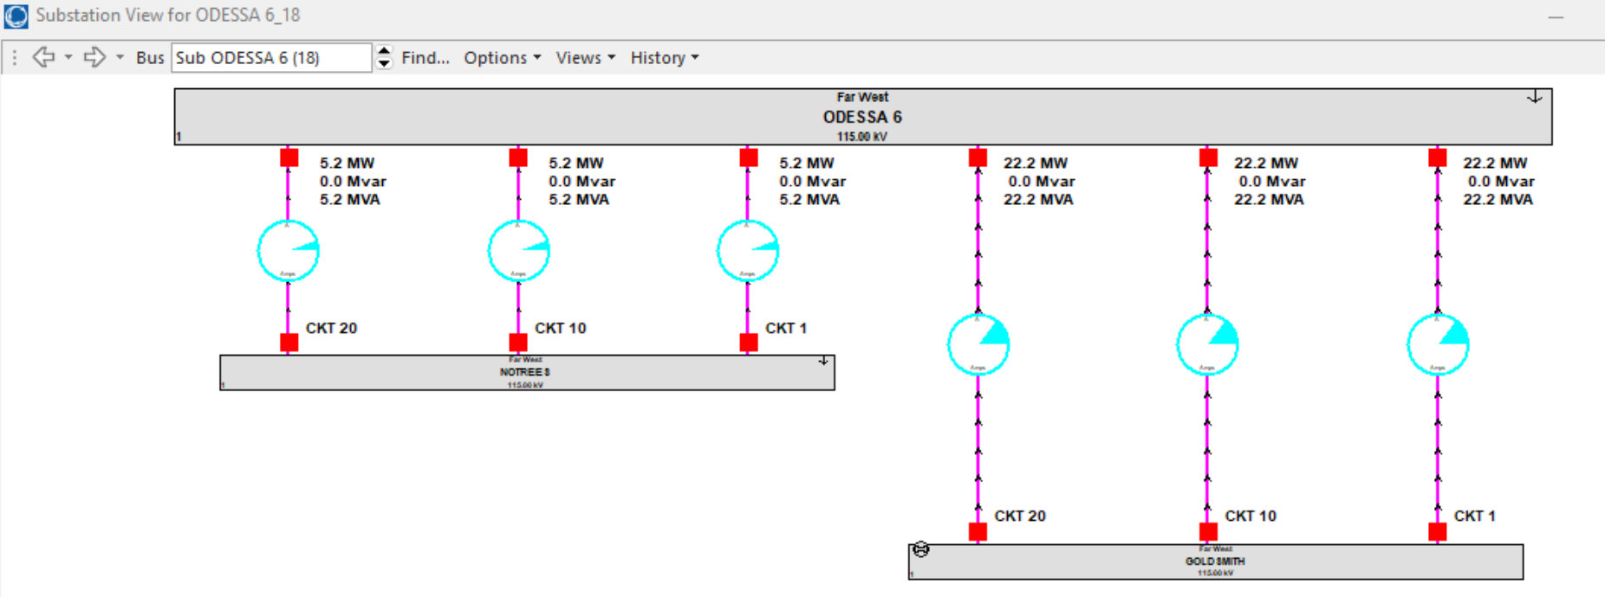
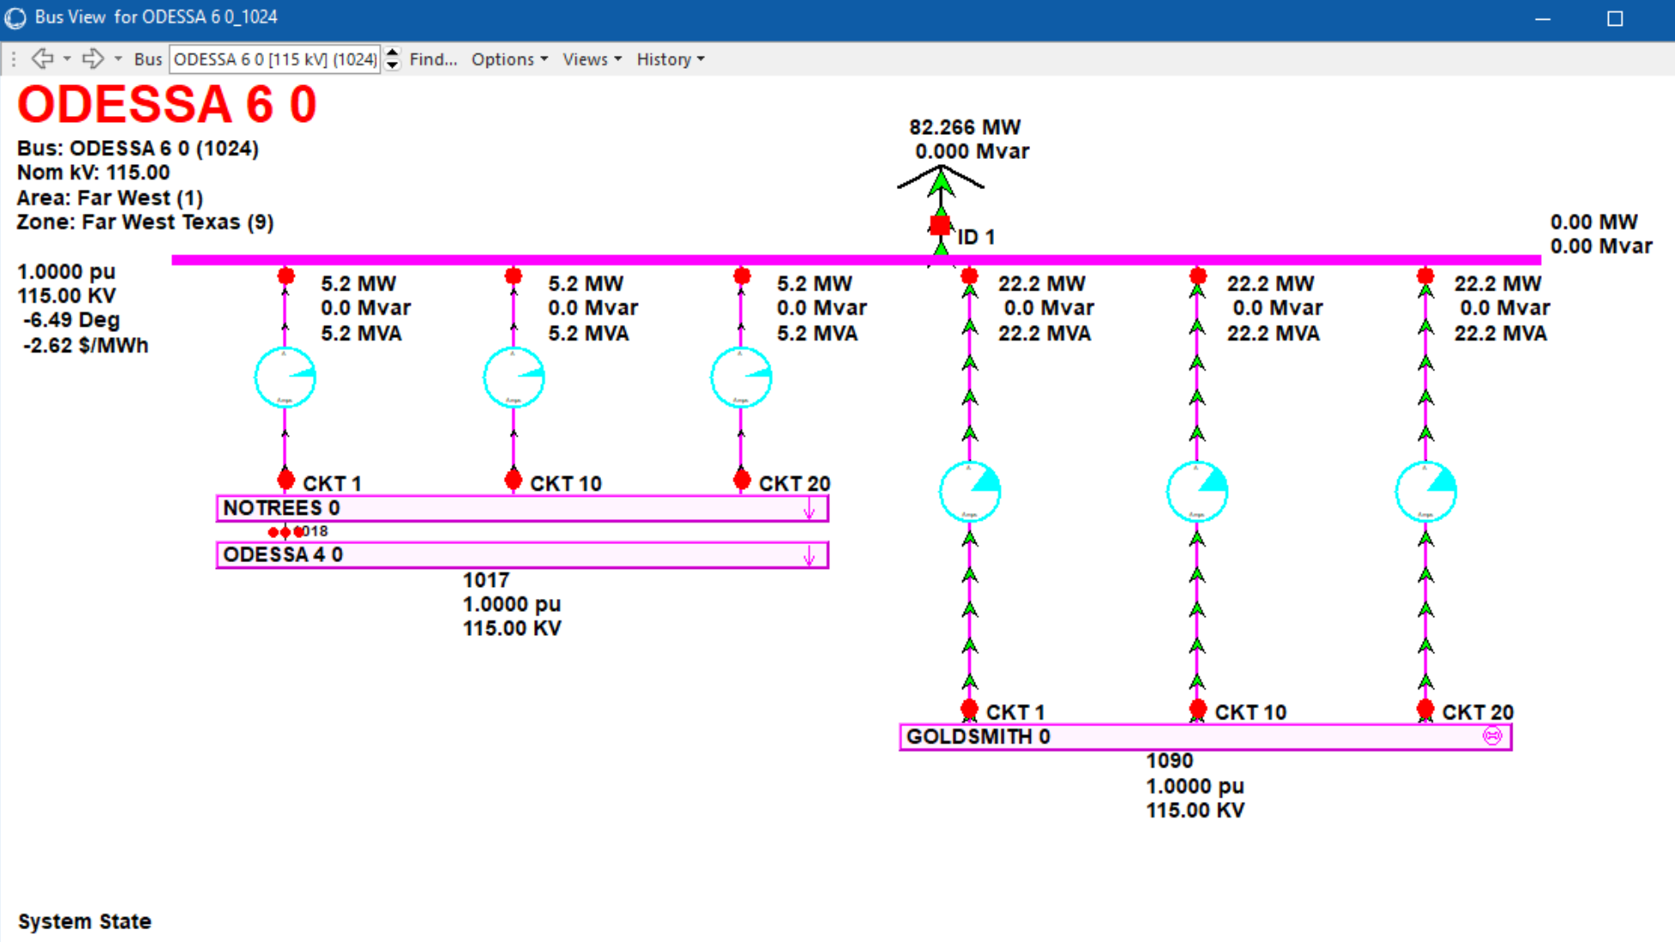
Substation/Bus Oneline View
Go to any Bus object → right click → Bus records → Substation View Oneline.
OR to view inside one substation, instead of Substation view oneline, click on Bus View Oneline.

Slide 22
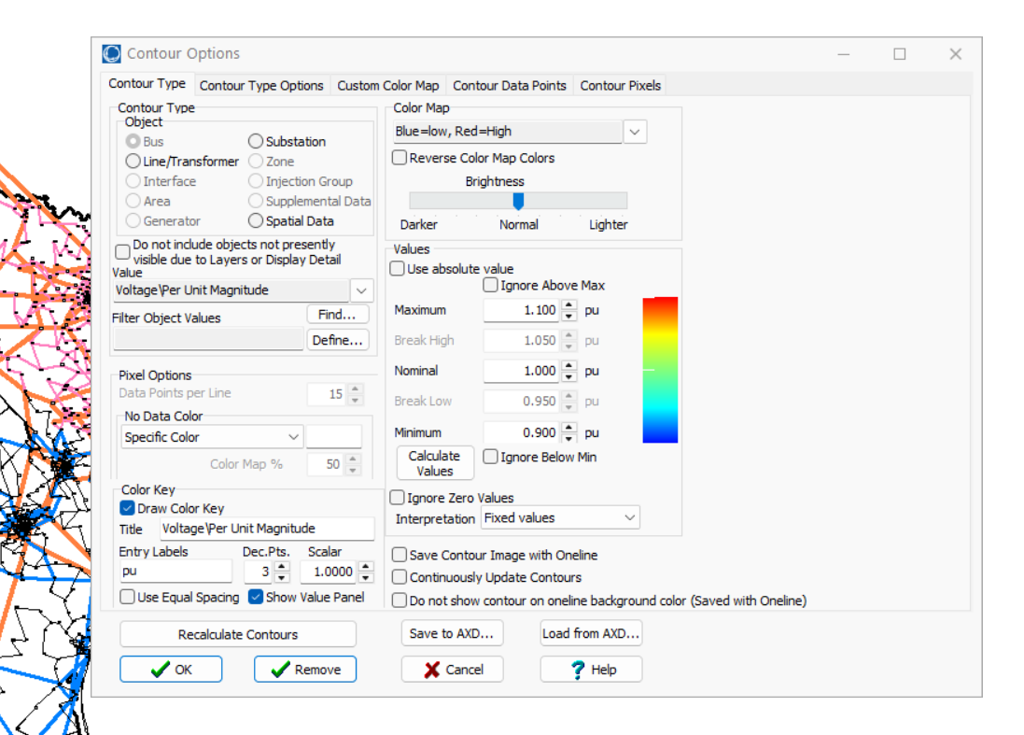
Contouring
Object type which is already on the oneline. Any value of the fields associated with these objects can be used to contour the oneline.
Helps to get a visual intuition of what is happening in the system. For example, looking at LMPs.
Right click anywhere on the oneline diagram
Click on Contouring
This is used to set the range of the contour.
It is nice to have this checked if you don’t want to manually update the contour when making changes in the case.

Slide 23
(advanced) PW cases can be saved as .m files
File → Save case as → Under ‘Save as type’ pick Matpower (*.m)
This can be used with the python interface for matpower or directly in matlab.
Before using need to convert to .mat using matlab.

Slide 24
(advanced) Sim Auto
Sim Auto is a COM automation server so outside applications (matlab, python) can be used to automate tasks.
“Auxilliary file format” is the format/syntax used.
Resources:
Tutorials: https://www.powerworld.com/training/courses/automation-with-python
Auxilliary file format: https://www.powerworld.com/WebHelp/Content/Other_Documents/Auxiliary-File-Format.pdf

Slide 25
(advanced) Aux file format
Can contain entire case information or just a particular object.
Format of the auc file depends on the object.
Can be used to import/export information to powerworld.
Can contain more information than CSV files.
Can be opened in a notepad editor to view/edit.
Great to automate editing/importing/exporting of a case.
Key fields and required fields are needed for loading into powerworld just like the CSV files.
Aux file format information:

